Slide 10
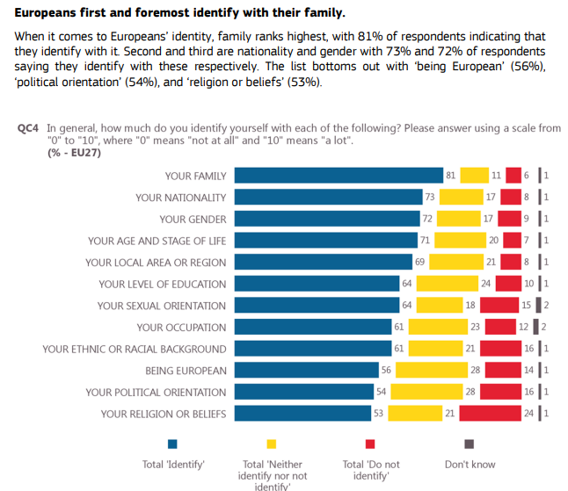

Slide 11
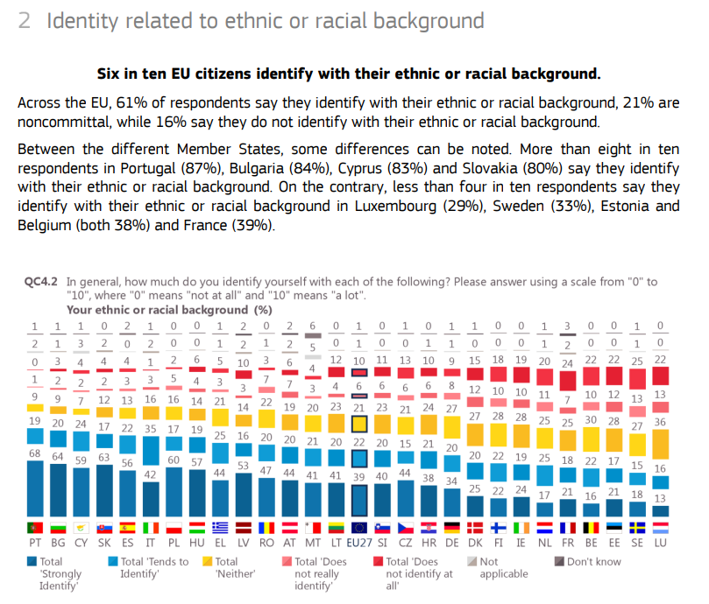

Slide 12
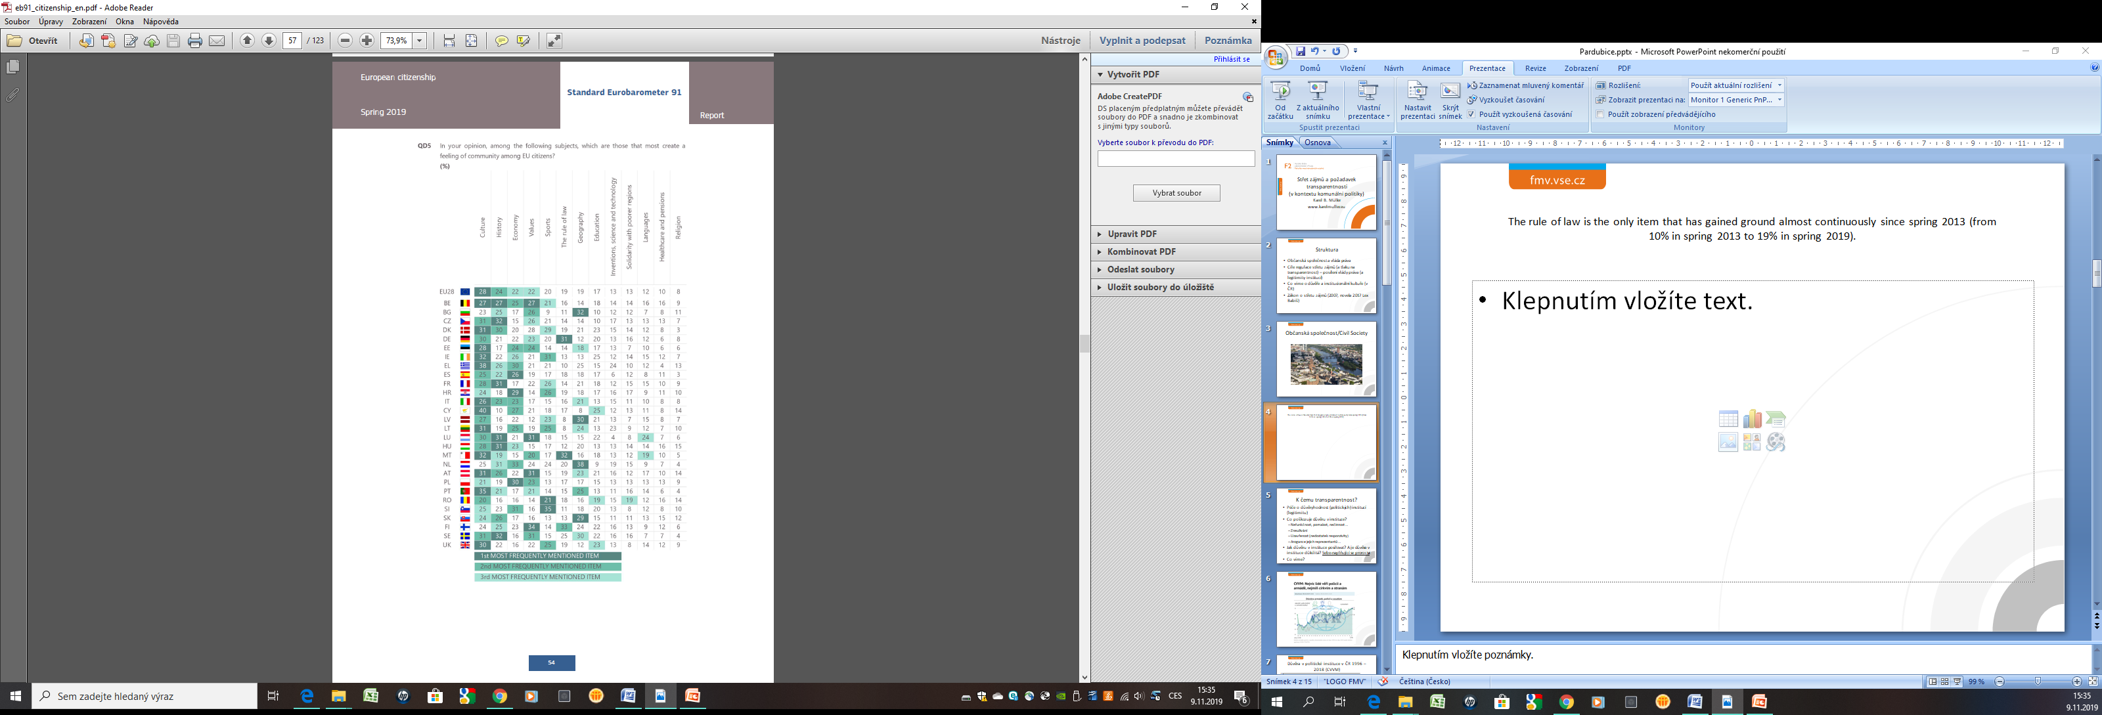
Source: EB, Spring 2019

Slide 13
TO REMEMBER …
EU – union of nation states, and European citizens (two sources of legitimacy)
What is NATION/VOLK/THE PEOPLE?
Nationalism; National Interests, welfare; National Enemies etc. (?)
Collective (national) X Individual (personal) Identity
Variety of meanings, multicultural competence
Primordial, Sacred (ethnic/cultural), Civil (political) (Edward SHILS)
Border Perspective: Im/Permeability
Various Integrational/Absorption Capacity
Case of Immigrants Quota (?)

Slide 14
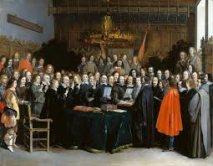
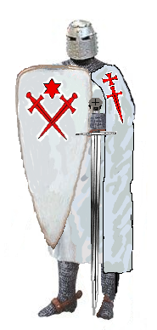
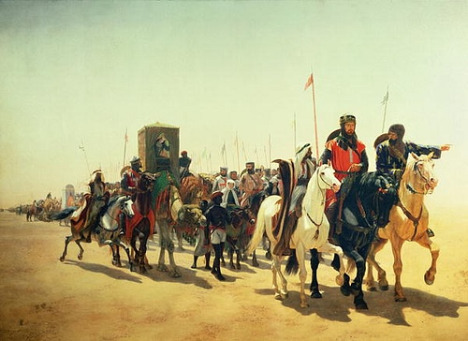
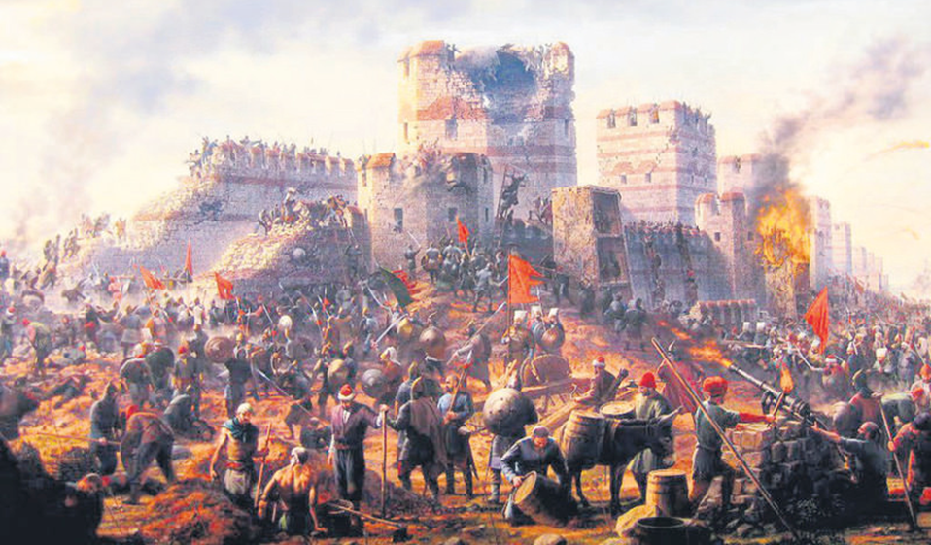
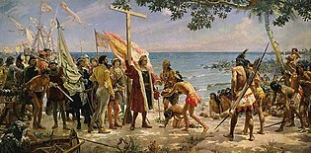

Slide 15
European identity (DELAnty)
Historical perspective
Europeanness as (Western) Christendom
Constitutive others/outside - role of Islam & Orthodoxy
Significance of Crusades/Crusaders, Constantinople seized (1453)
1492 (New World) – colonization & the end of Reconquista
Double schism (Roman x Orthodoxy; Catholics x Protestants)
Religious war, Victory of Protestantism
Peace of Westphalia (1648)
European identity as set of values (cultures)

Slide 16
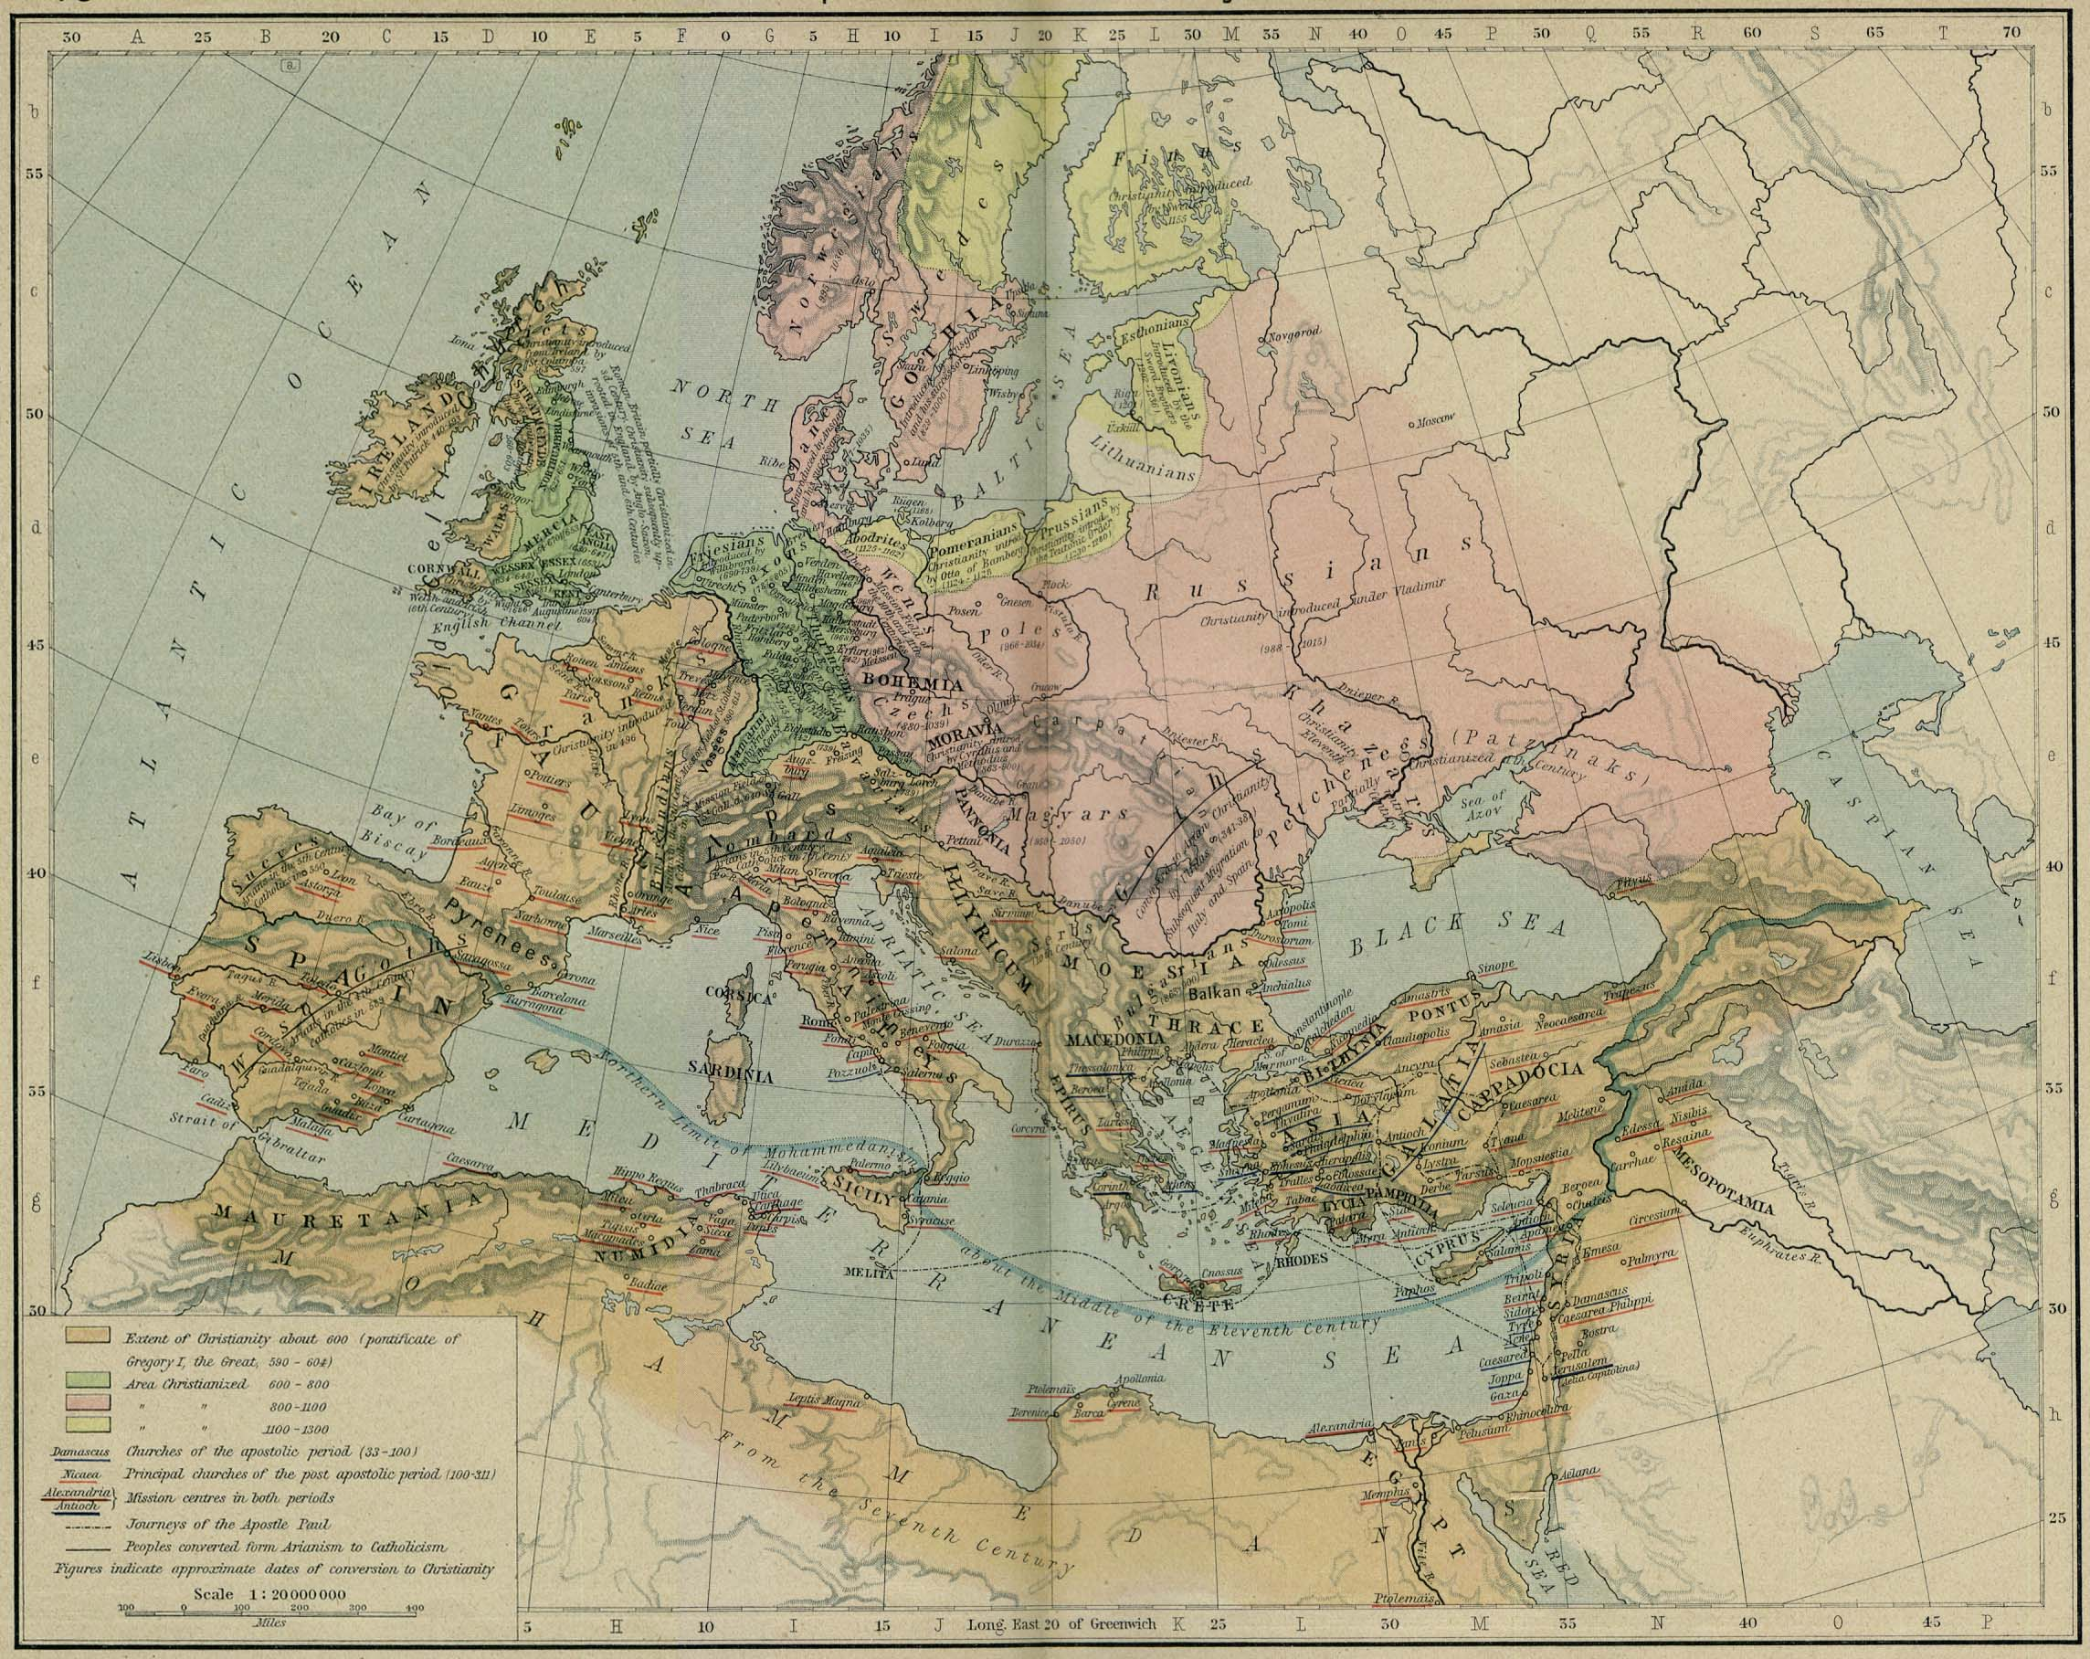
Christianization waves

Slide 17
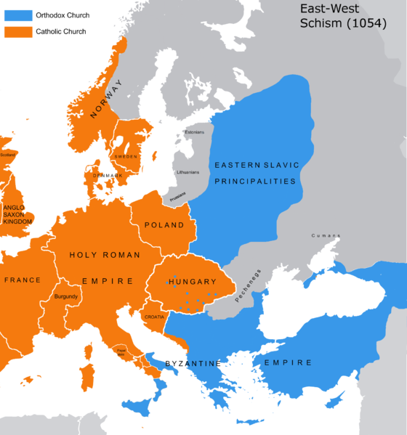

Slide 18
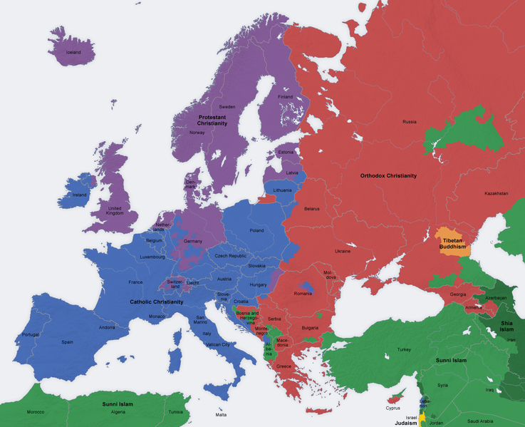
Religions in europe

Slide 19
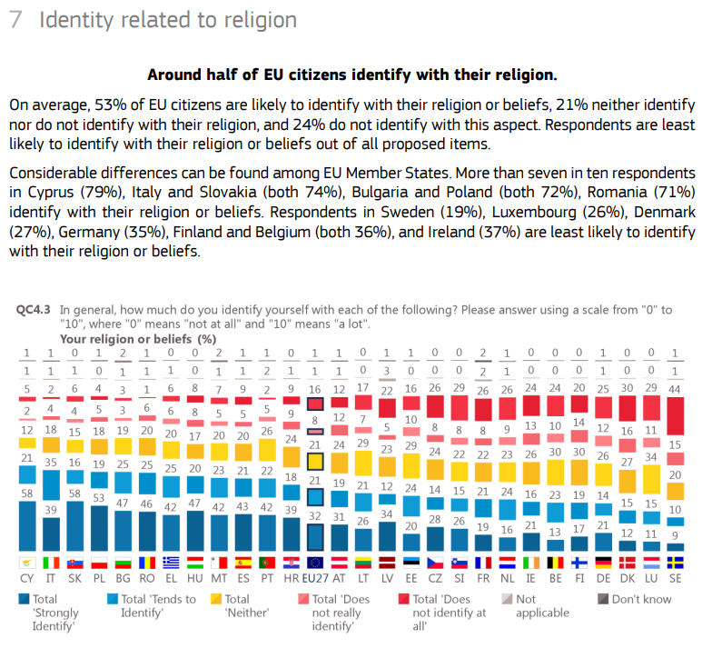

Slide 20
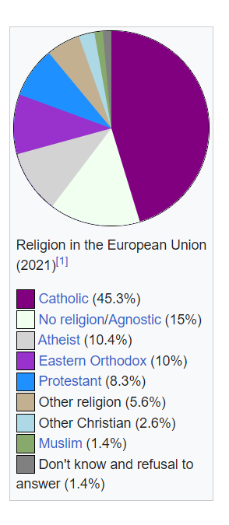

Slide 21
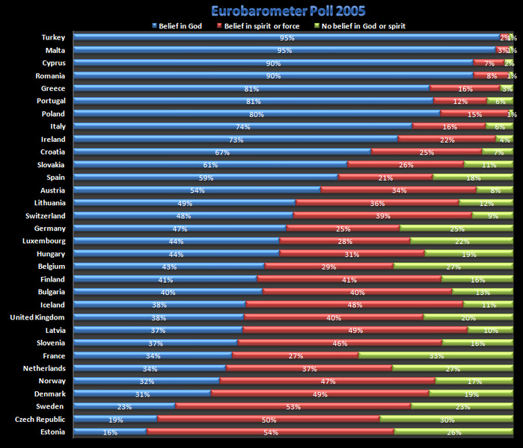

Slide 22
