Slide 1
Fiscal policy as macroeconomic tool
Ing. Vít Bárta, CSc.
9|12 | 2025

Slide 2

Fiscal policy: main mission
Fiscal policy is the use of:
government purchases (G)
Taxes (T)
transfer payments (TP)
to influence a country's economy (business cycle, growth, allocation of resources, etc.)
GDP = C + I + G + NX
This equation shows that governments affect economic activity (GDP) by controlling G directly and influencing C, I, and NX indirectly, through changes in taxes, transfers, spending, and borrowing
Use of government revenue expenditures to influence macroeconomic variables developed in reaction to the Great Depression of the 1930s, when the previous laissez-faire approach to economic management became unworkable
Fiscal policy is based on the theories of J. M. Keynes, whose Keynesian economics theorised that government changes in the levels of taxation and government spending influence aggregate demand (= level of economic activity and price level)
John Maynard Keynes (1883 – 1946), English economist whose ideas fundamentally changed the theory and practice of macroeconomics and the economic policies of governments

Slide 3
Fiscal policy: varying focus
Fiscal policy objectives vary over time
In the short term, governments may focus on macroeconomic stabilization—for example, spending more or cutting taxes to stimulate an ailing economy or slashing spending or raising taxes to rein in inflation or reduce external vulnerabilities
The longer-term aim may be sustainable growth or less poverty through supply-side actions to improve infrastructure or education
These objectives may be shared broadly across countries, but their relative importance differs with country circumstances:
Short-term priorities may reflect business cycle or response to a natural disaster or global food or fuel price spikes
Longer-term drivers may be development, demographics, or natural resource endowments.
Low-income countries might tilt spending toward primary health care in an effort to reduce poverty
Advanced economies might favor pension reform to target looming long-term costs related to an aging population
In an oil-producing country, policymakers might gear fiscal policy toward broader macroeconomic developments by moderating procyclical spending—both by limiting bursts of spending when oil prices rise and by refraining from painful cuts when they drop

Slide 4
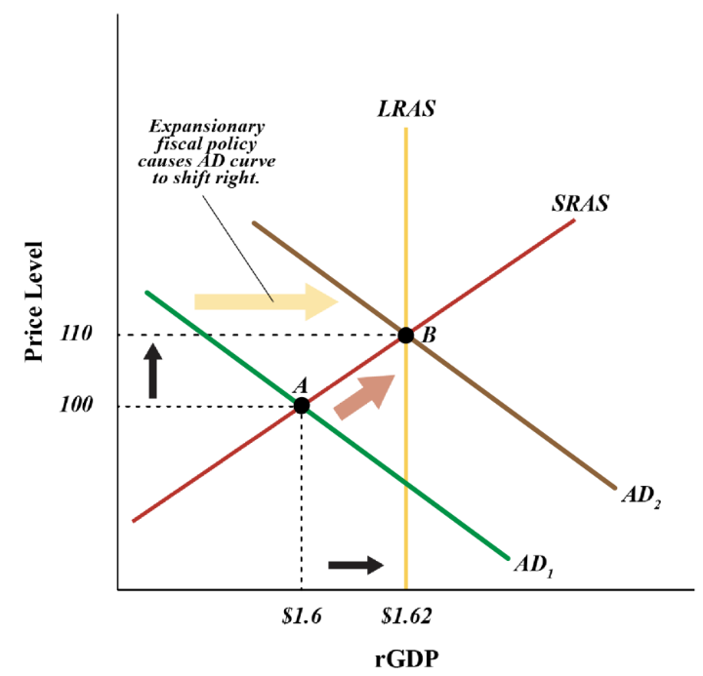
Expansionary fiscal policy
If the economy is experiencing recession and the government wants to stimulate the economy by increasing aggregate demand (and real GDP), it would:
Increase government purchases (G)
Decrease taxes (T)
Increase transfer payments (TR)
Transmission mechanism of fiscal expansion:
↑G → ↑AD → ↑GDP
↓T → ↑DI → ↑C → ↑GDP
→ ↑I → ↑GDP
↑TR → ↑DI → ↑C → ↑GDP
Expansionary policies help in eliminating recessionary gaps but might result in inflation
Also, an increase in government expenditure could widen a budget deficit or reduce a budget surplus

Slide 5
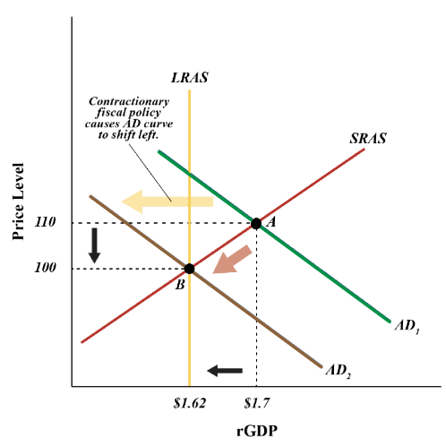
contractionary fiscal policy
If the economy is experiencing inflation and the government wants to bring down prices, it would:
Decrease government purchases (G)
Increase taxes (T)
Decrease transfer payments (TR)
Transmission mechanism of fiscal contraction:
↓G → ↓AD → ↓GDP → ↓inflation
↑T → ↓DI → ↓C → ↓GDP → ↓inflation
→ ↓I → ↓GDP → ↓inflation
↓TR → ↓DI → ↓C → ↓GDP → ↓inflation
Contractionary fiscal policy tends to decrease economic growth to lower inflation
Decreasing government expenditure could also help reduce a budget deficit
Sometimes, if government is facing huge public debt, they might take contractionary policies called “austerity” measures to reduce budget gaps, as we saw in Greece in 2010

Slide 6
Automatic fiscal stabilizers
Built-in features of tax and transfer systems that automatically adjust government revenues and spending to counteract business cycle fluctuations, cushioning booms and softening recessions without new legislation
How they work:
During a recession: Incomes fall, so people pay less in income/sales taxes, while government spending on unemployment benefits and welfare automatically rises, injecting money into the economy
During a boom: Incomes rise, so people pay more in taxes (especially with progressive systems), and government spending on benefits falls as fewer people need help, slowing down overheating demand
Advantages:
Timely: They act instantly, unlike discretionary policies that require legislative approval
Automatic: They do not rely on policymakers accurately timing interventions
Temporary: They naturally phase out as the economy recovers
Automatic stabilizers do not just help families facing financial difficulties, they also help the overall economy by stimulating aggregate demand when times are bad and when the economy is most in need of a boost; when times are better, automatic stabilizers generally phase down or turn off

Slide 7
Automatic fiscal stabilizers: examples
Progressive income taxes
In a progressive system, tax rates rise with income; when economic activity slows, individuals earn less, falling into lower tax brackets or paying less overall tax, which leaves them with more disposable income to spend
Unemployment benefits
When unemployment rises during a downturn, more people become eligible for benefits, providing them with a steady stream of income that they can use for consumption, thus supporting aggregate demand
Welfare programs
Programs like food stamps and other forms of social assistance see increased enrollment during economic hardship, providing a safety net that boosts spending power among vulnerable populations
Most automatic stabilizers are federal (in US cirmustatnces); states and localities are generally required to balance their budgets, so they cannot run big deficits during downturns

Slide 8
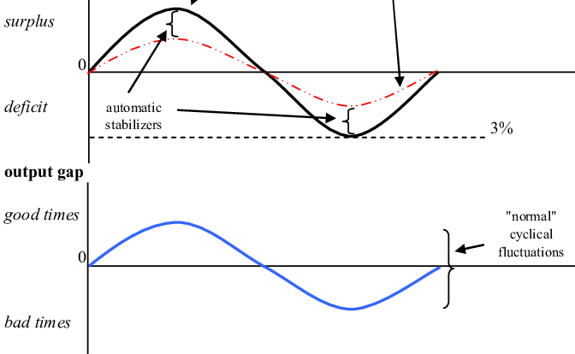
Automatic fiscal stabilizers: how they work

Slide 9
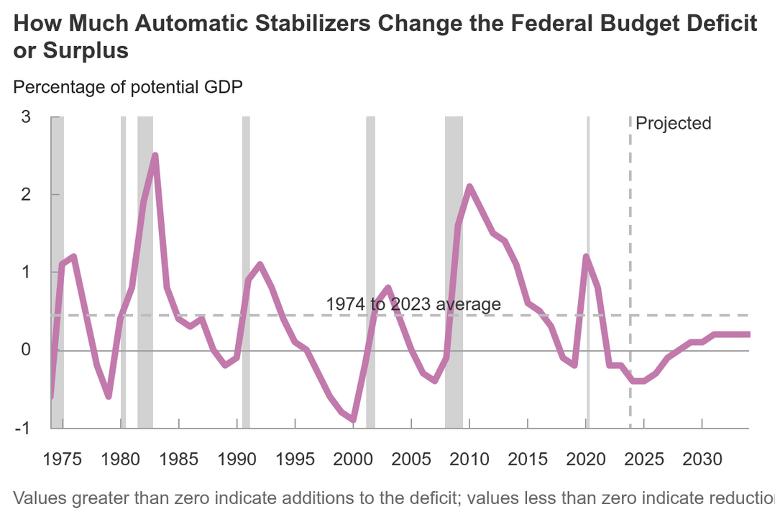
The bulk of the value of automatic stabilizers comes from changes in tax revenues, rather than from spending on programs; according to the Congressional Budget Office (CBO), revenues have accounted for about three-quarters, on average, of the effect of automatic stabilizers on the budget over the past 50 years (CBO 2015)

Slide 10
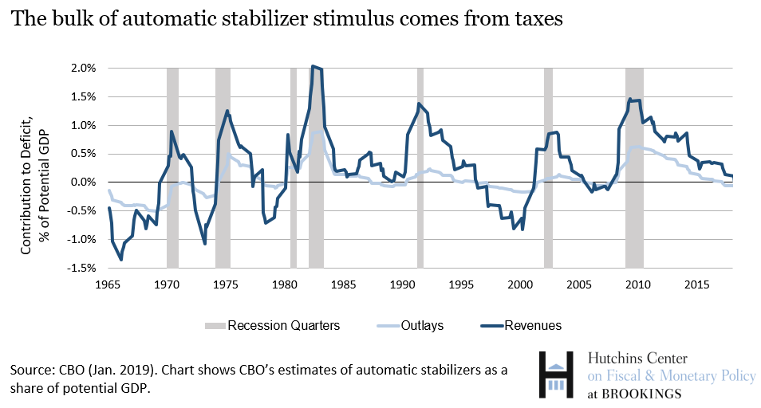
Bulk of automatic stabilizer stimulus comes from taxes
The bulk of the value of automatic stabilizers comes from changes in tax revenues, rather than from spending on programs; according to the Congressional Budget Office (CBO), revenues have accounted for about three-quarters, on average, of the effect of automatic stabilizers on the budget over the past 50 years (CBO 2015)

Slide 11
How are Automatic stabilizers different from changes in discretionary fiscal policy?
One of the benefits of automatic stabilizers is that they do not require legislative action and respond quickly to economic downturns. Discretionary fiscal policy requires action from Congress, so there may be considerable time lags due to debates on the appropriate response, steps in the rulemaking process, and the administrative actions for funds to reach the pockets of consumers.
During the Great Recession, Congress responded relatively quickly: the first fiscal action was the Bush Economic Stimulus Act, which was signed on February 13, 2008, which turned out to be only two months after the recession was later determined to have begun (Furman 2018).
Largest stimulus package, the American Recovery and Reinvestment Act (ARRA) of 2009, was authorized five quarters after the start of the recession. By this time, spending on automatic stabilizers had already grown to 2 percent of potential GDP—the maximum sustainable output of the economy (Schanzenbach 2016).
Examining economic stabilization policy from 1980 to 2018, Sheiner and Ng (2019) find that automatic stabilizers provide about half of the total fiscal stabilization, with the other half provided by discretionary fiscal policy.

Slide 12
How have automatic stabilizers changed over time?
The responsiveness of automatic stabilizers to economic conditions has been fairly stable over time.
According to CBO, automatic stabilizers averaged about 0.4 percent of potential GDP for each percentage point difference between GDP and potential GDP (“output gap”) from 1965 to 2016.
Likewise, Auerbach and Feenberg (2010) find that the federal tax system’s impact as an automatic stabilizer has changed relatively little.
Sheiner and Ng find that although the degree of cyclicality of overall fiscal policy has been somewhat stronger in the past 20 years than the previous 20 before that, the contribution to GDP growth of automatic stabilizers in response to a percentage point gap between the unemployment rate and the natural rate has been relatively steady, fluctuating between 0.3 and 0.5 between 1980 and 2008.

Slide 13
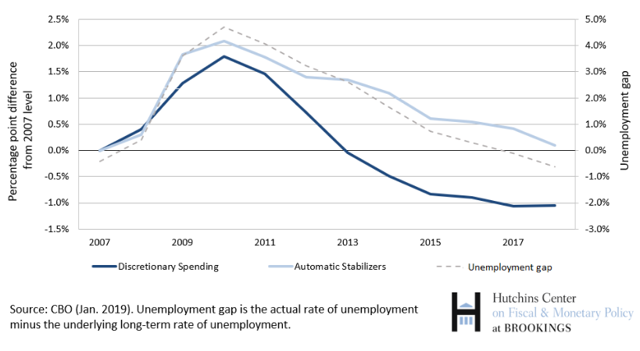
How did automatic stabilizers function during the Great Recession?
From 2009 to 2012, automatic stabilizers lowered revenues by 1.2 percent of potential GDP, and increased spending by 0.6 percent — a combined effect of 1.8 percent of potential GDP. Increase in discretionary spending stemming from legislative action contributed on average about 1.3 percent of potential GDP over this period. Stimulus from discretionary spending was cut off abruptly in 2013, even though the unemployment rate was still high. Automatic stabilizers provided stimulus for much longer.

Slide 14
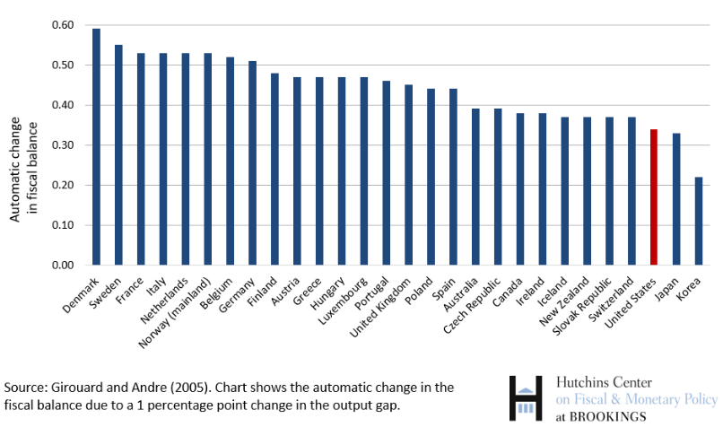
automatic stabilizers in developed countries
Automatic stabilizers—the automatic change in the fiscal balance due to a one percentage point change in the output gap—for each country
Automatic stabilizers are linked to the size of the government, and tend to be larger in advanced economies
Among the advanced economies, the U.S. has relatively weaker automatic stabilizers

Slide 15
Cyclically adjusted deficit (CAD)
Cyclically adjusted deficit (= structural deficit or full employment deficit) is the government budget deficit after removing the effects of the busines cycle
It measures how much the government would be borrowing if the economy were operating at its normal (potential) level, neither in recession nor boom
It isolates the structural part of the deficit, indicating underlying imbalances from fiscal policies (spending/tax rules) rather than just economic ups and downs, helping policymakers assess long-term fiscal health and policy impacts
Normal economy: During a typical economic state, tax revenues are stable, and spending on things like unemployment benefits is lower
During a recession (Actual Deficit Grows): Tax revenues fall (fewer people working/earning), and spending on social programs rises, making the actual deficit larger. The cyclically adjusted figure would show a smaller deficit (or even a surplus) for this period.
During a boom (Actual Deficit Shrinks): Tax revenues increase, and spending falls, making the actual deficit smaller. The cyclically adjusted figure might reveal a larger structural deficit than the actual number suggests.

Slide 16
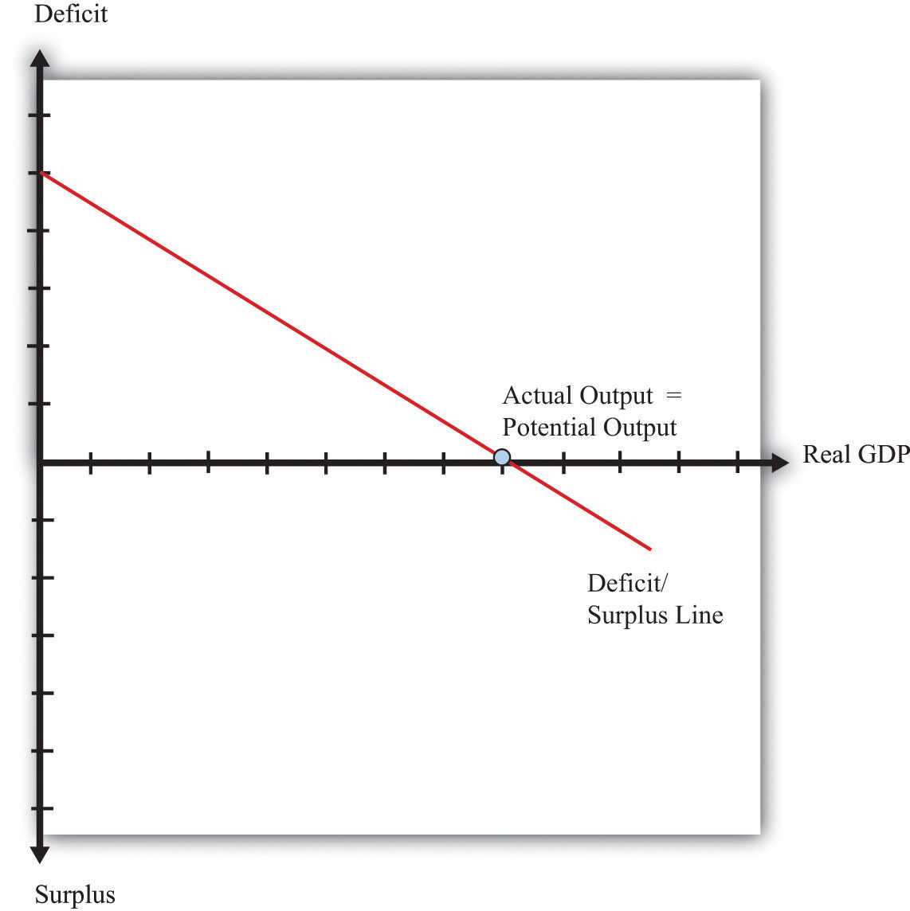
Cyclically adjusted deficit (CAD)
Movement along deficit/surplus line reflects the effects of the busines cycle
Movement of the whole deficit/surplus line reflets the impact of discretionary fiscal policy

Slide 17
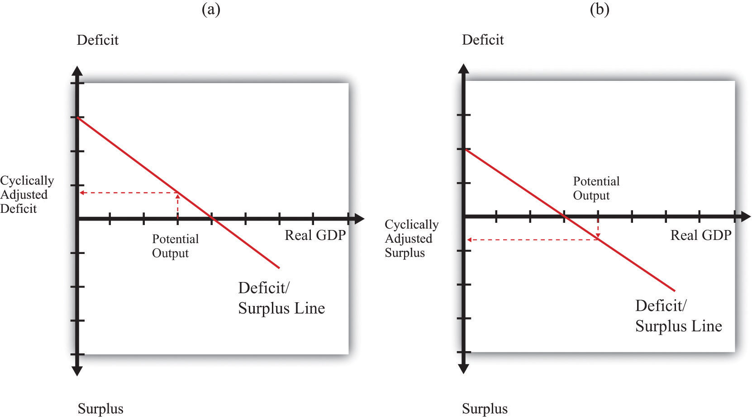
Cyclically adjusted deficit and surplus

Slide 18
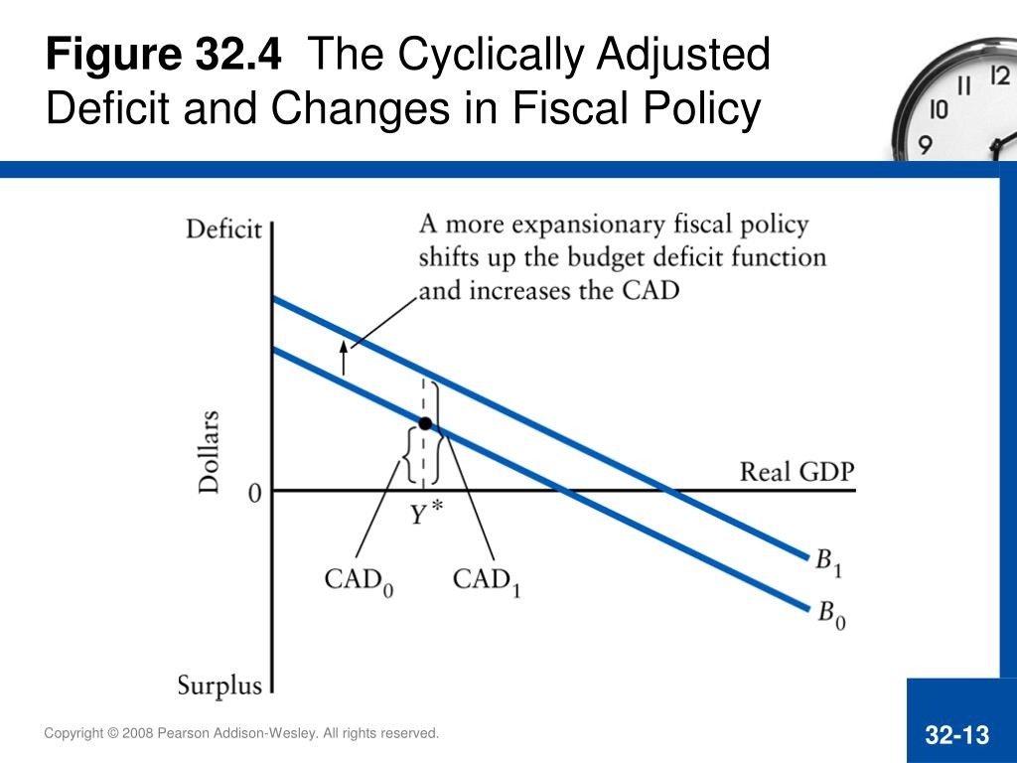

Slide 19
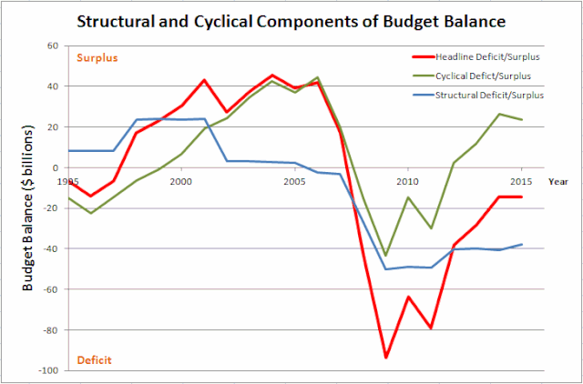

Slide 20
Primary balance
The primary fiscal balance is the government's budget balance excluding interest payments on its debt, showing its core fiscal effort by comparing revenues to non-interest spending (like services, infrastructure).
Primary Balance = Total Government Revenues - Total Non-Interest Expenditures
Positive primary balance (surplus) means revenues exceed core spending, allowing for debt reduction, while a negative balance (deficit) shows core spending outstrips income, requiring new borrowing or drawing on reserves.
It's a key indicator for assessing fiscal sustainability and debt dynamics.
By removing interest payments (which are determined by past deficits), it shows the immediate fiscal stance, similar to a household's budget after excluding mortgage payments.
Why It Matters?
It helps policymakers and analysts understand if current policies are sustainable or if debt levels will spiral, providing "breathing room" for fiscal management.

Slide 21
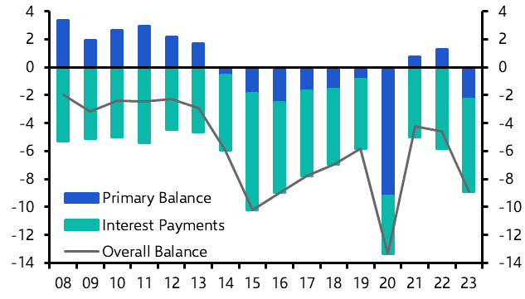
Brazil: return to fiscal malaise

Slide 22
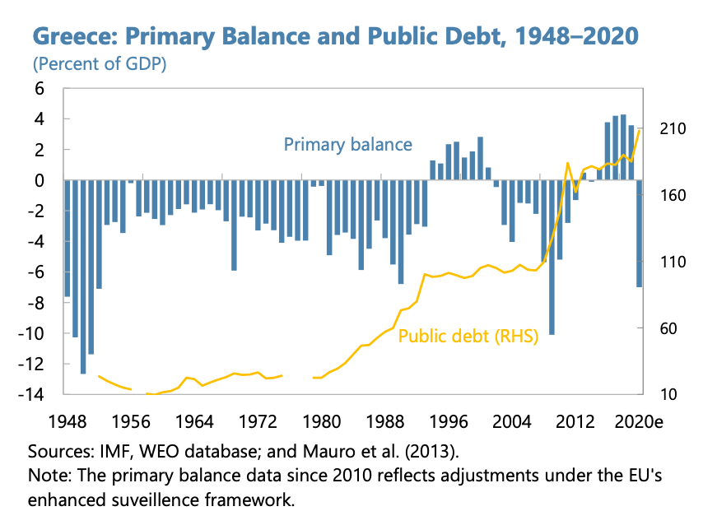

Slide 23
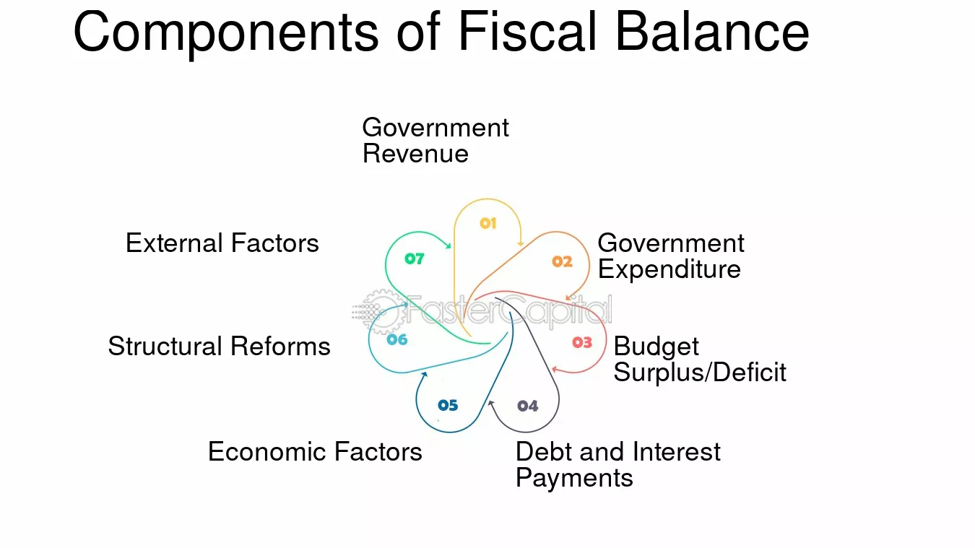
Brazil: return to fiscal malaise

Slide 24
fiscal impulse
Fiscal impulse is a variable which reflects the effect of fiscal policy in the given year on economic activity over the business cycle. It is calculated using the volume of fiscal discretion and the fiscal multiplier.
Fiscal discretion refers to year-on-year changes in government revenue and expenditure (made by the government and/or due to legislative amendments) that are derived from specific fiscal measures and affect government finances beyond the impacts of the business cycle (i.e. beyond automatic fiscal stabilisers).
Fiscal multiplier measures the degree to which fiscal discretion affects real GDP.
The bottom-up fiscal impulse method is based on the sum of the budgetary impacts of the government’s individual discretionary fiscal measures.
The top-down fiscal impulse method uses aggregated data – the structural government budget balance, i.e. the budget balance adjusted for the effects of the business cycle and extraordinary one-off measures.

Slide 25
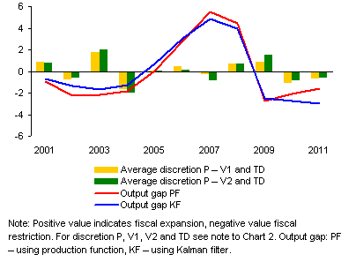
fiscal impulse in Czech republic (2001-2011)
(% of real GDP)
Assessment of stabilisation effect of fiscal discretion on business cycle is performed by comparing the impacts of fiscal discretion on GDP with the output gap estimates
Fiscal measures stabilise the economy if the contribution of fiscal discretion is negatively correlated with the output gap
Periods of desirable counter-cyclical fiscal policy are relatively short (only 2001, 2003, 2007 and 2009), while the periods of pro-cyclical fiscal policy are dominant and longer-lasting (2002, 2004–2006, 2008, 2010–2011)
Miroslav Kalousek byl ministrem financí dvakrát:
První období: Leden 2007 – květen 2009 (Topolánkova vláda)
Druhé období: 13. července 2010 – 10. července 2013 (Nečasova vláda, do června 2013 v plné funkci, poté v demisi)
Kalousek: 2007,2009, 2008, 2010, 2011

Slide 26
Composition matters: Fiscal Consolidation and Economic Growth in the Czech Republic (2010-2013)
Between 2010 and 2013, the Czech Republic undertook a significant fiscal consolidation that cut the headline government deficit by about 4.5 pps., bringing it well below the reference value in the Treaty
This consolidation was largely achieved by discretionary fiscal measures in two areas: public investment and indirect taxes
Composition of the Czech consolidation package had a larger negative impact on economic activity than the counterfactual packages. This is due to the large and persistent negative impact that reductions in public investment have on GDP in our model
While discretionary measures in other areas also have a negative impact on GDP in the short term in our model, the impact generally dissipates in the years following the consolidation
Having achieved a balanced budget (in structural terms) by the end of the consolidation period, the Czech Republic had scope to increase public investment and, indeed, such an increase occurred in 2014 and 2015
Kalousek: 2007,2009, 2008, 2010, 2011

Slide 27
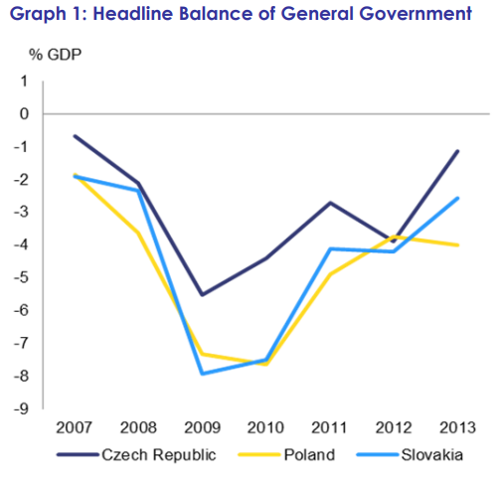
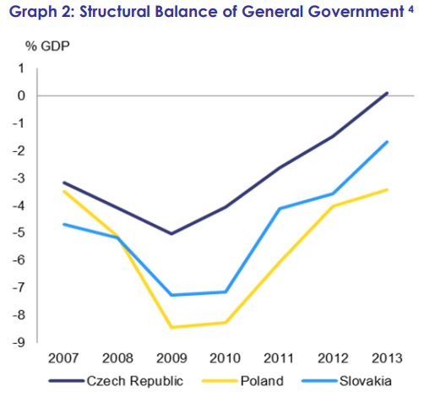
Composition matters: Fiscal Consolidation and Economic Growth in the Czech Republic (2010-2013)
Czech authorities undertook a substantial fiscal adjustment (in the context of the excessive deficit procedure) with the headline government deficit falling from 5.5% of GDP in 2009 to 1.2% in 2013 …
… and the structural deficit falling from 5.0% of GDP to a surplus of 0.1%
Kalousek: 2007,2009, 2008, 2010, 2011

Slide 28
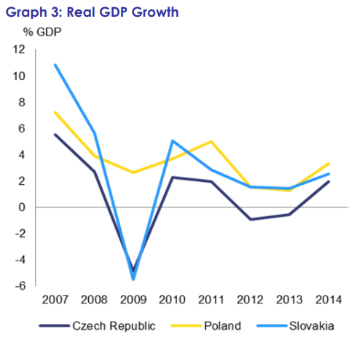
Composition matters: Fiscal Consolidation and Economic Growth in the Czech Republic (2010-2013)
Polish economy: the only country with positive growth in 2009
Czech economy: „W“ shape pattern of recession
Kalousek: 2007,2009, 2008, 2010, 2011 …. 2012 and 2013

Slide 29
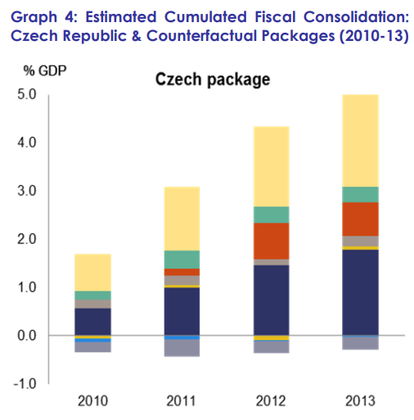
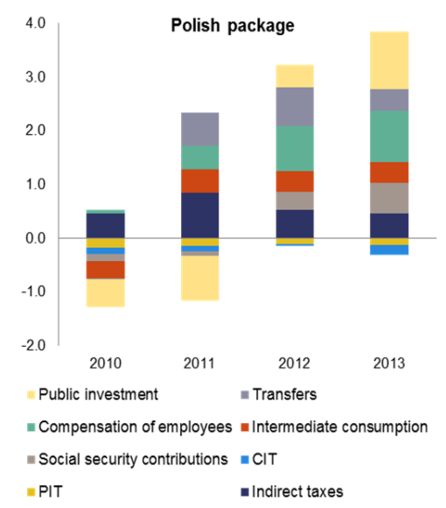
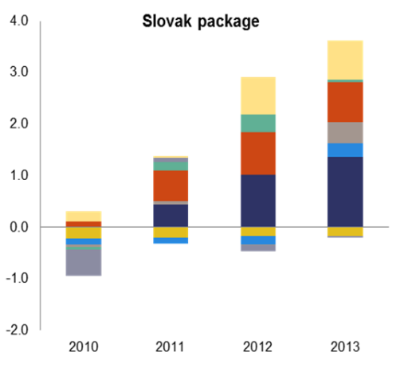
Estimated Cumulated Fiscal Consolidation: Czech Republic & Counterfactual Packages (2010-13)

Slide 30
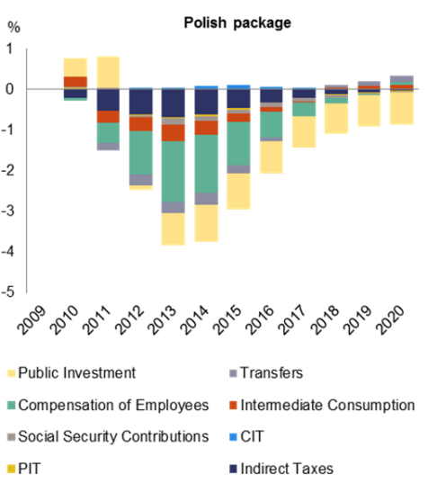
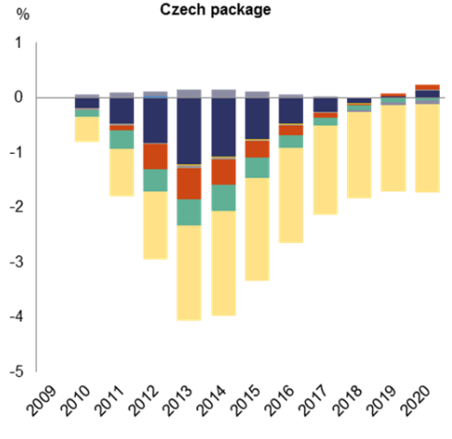
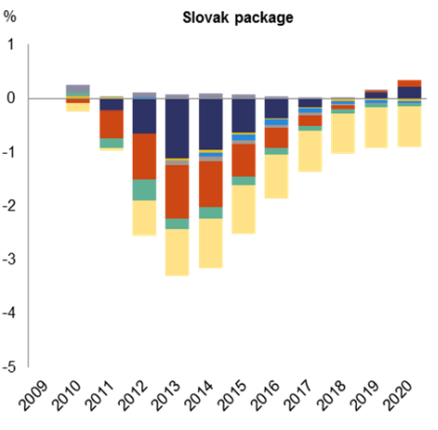
Simulated Impact of Individual Discretionary Measures on Czech GDP (2009-2020)
Czech focus on investments: higher negative impact on GDP and longer lasting decline than in Slovakia and Poland

Slide 31
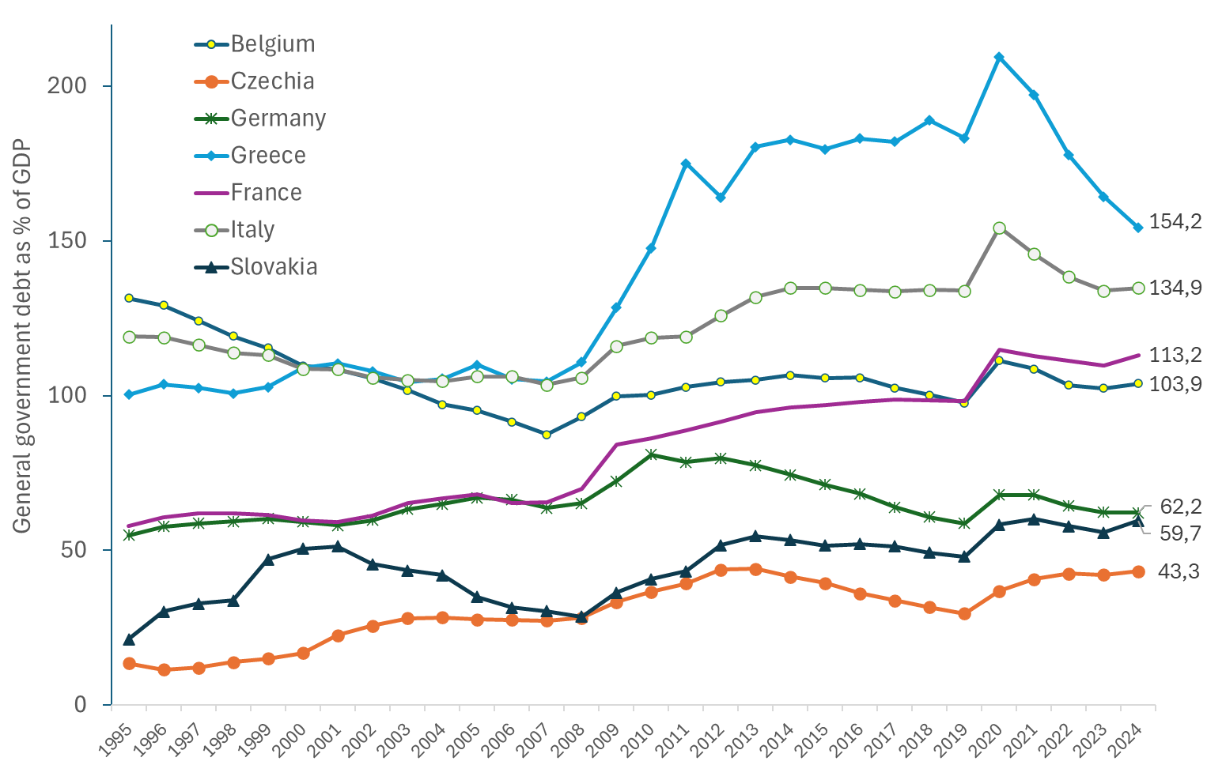
General government debt in selected countries EU, 1996 – 2024 (as % of GDP)
Source: Eurostat

Slide 32
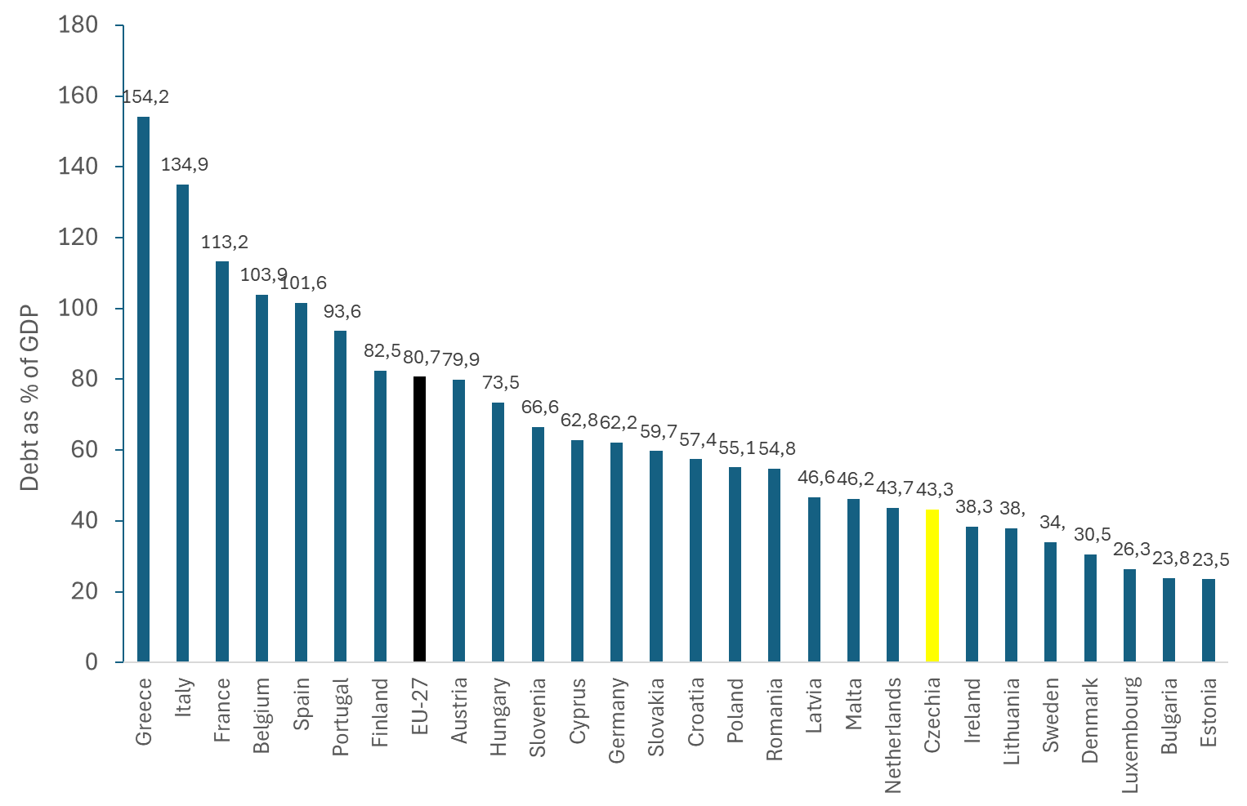
General government debt in EU in 2024 (as % of GDP)
Source: Eurostat

Slide 33
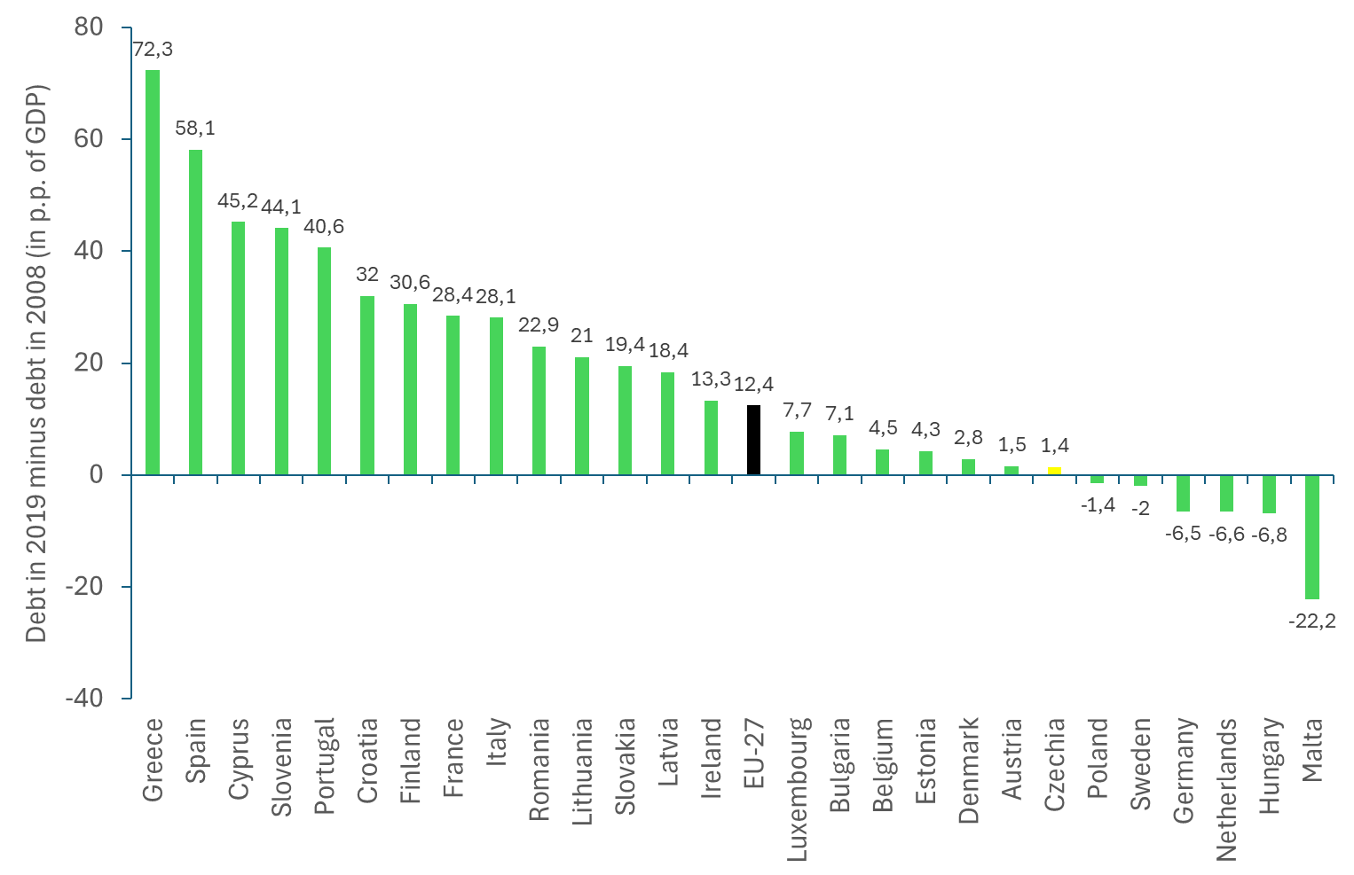
General government debt in 2019 minus 2008 (as % of GDP)
Source: Eurostat

Slide 34
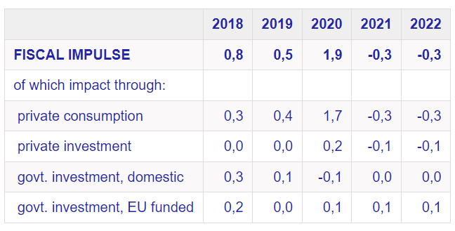
contribution of discretionary fiscal measures to GDP growth is divided into the individual components of domestic demand (contributions to gdp gowth in p.p.)
Source: CNB

Slide 35
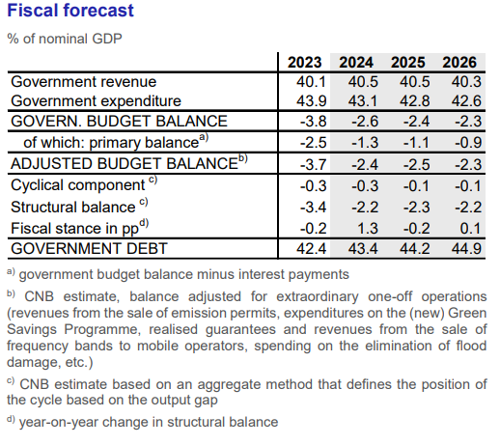
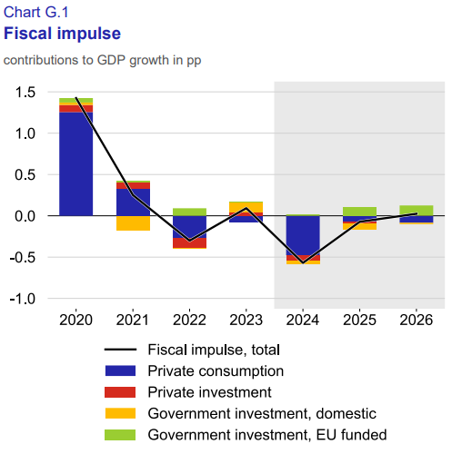
Source: CNB

Slide 36
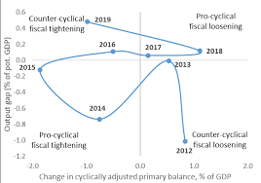
fiscal policy: pro-cyclical and counter-cyclical

Slide 37
Why the „law on balanced budget“ would be detrimental?
Worsens recessions: forces cuts or tax hikes when the economy needs stimulus, deepening recessions.
Removes automatic stabilizers: prevents the natural increase in deficits (from lower tax revenue/higher benefits) that cushions economic slumps.
Creates harmful spirals: a weak economy leads to higher deficits, forcing more cuts, which further weakens the economy.
Over-stimulates booms: requires spending cuts or tax increases during good times, unnecessarily slowing down a growing economy.
Hinders investment: prevents crucial public investments in areas like education, infrastructure, and research, which are vital for long-term growth.
Threatens social programs: can interfere with trust funds (like social security) by preventing use of accumulated savings, potentially cutting benefits or raising taxes.
Reduces flexibility: makes it harder to respond to unforeseen crises, like pandemics or natural disasters, that require deficit spending.

Slide 38
THANK YOU FOR YOUR ATTENTION
Jungmannova 17 | 110 00 Praha 1 | Česká republika
cevro.cz

