Slide 1
Elements and principles of taxation and government revenue
Ing. Vít Bárta, CSc.
14 |10 | 2025

Slide 2
Lecture Overview
Elements and principles of taxation
Overview of government revenue

Slide 3
Taxation
  Effectiveness of government depends on how well it can provide public goods that will meet the demand of citizens; thus, it must be able to collect necessary revenue, in particular tax revenue
  Tax = mandatory financial charge or levy imposed on an individual or legal entity by a governmental organization to support government spending and public expenditures collectively or to regulate and reduce negative externalities
  Old saying: „Two things are certain in life: death and taxes“
  Government needs to use its legal power and at times its coercive authority
  Tax is not a choice but rather an involuntary payment to government by a taxpayer for which there may not be a quid pro quo return or benefit (= taxpayer may not receive a good or service that is equal in value of the tax contribution)
  Conventional wisdom is far from being a cliché: if a government can find a way to tax, it will
  Central issue: in not how much revenue a tax system generates but who ultimately bears tax burden
  Tax incidence (tax burden): the effect of a particular tax on the distribution of economic welfare
  Tax compliance: policy actions and individual behaviour aimed at ensuring that taxpayers are paying the right amount of tax at the right time and securing the correct tax allowances and tax relief

Slide 4

Desirable characteristics of a tax system
  All tax decisions have a direct bearing on the economic wellbeing of taxpayers as well as society at large
  Already Adam Smith (1776) recognised 4 cannons of taxation that serve to this day
  Below, we will discuss in more detail 5 „desirable characteristics“:
    Efficiency
    Equity
    Flexibility
    Simplicity
    Feasibility
    Stability
    Transparency
    Security
  Adam Smith (1723 – 1790), „Wealth of Nations“,1776, pioneer in field of political economy

Slide 5
1. efficiency
  Tax system is efficient when it does not distort or affect as little as possible the working of free-market system yet produce maximum revenue for a government without producing an excess burden for taxpayers called deadweight loss
  If tax system is inefficient it will produce an welfare loss not only to the individual tax payer but also to society at large
  Welfare loss occurs when the tax policy of government causes a consumer vis-a-vis a taxpayer to change his behaviour by consuming less than what is socially desirable and a firm produces less to avoid the tax burden
  Efficiency-loss ratio (ELR) = Excess Burden/Tax Revenue
  Example: ELR = 0,25 ⇒ for each $ of tax revenue an excess burden will be 25 cents
  Estimation the efficiency-loss ratios from various tax measures can produce useful information for government to help achieve that tax decisions do not create excess burden or produce excess burden as little as possible without lowering the tax revenue

Slide 6
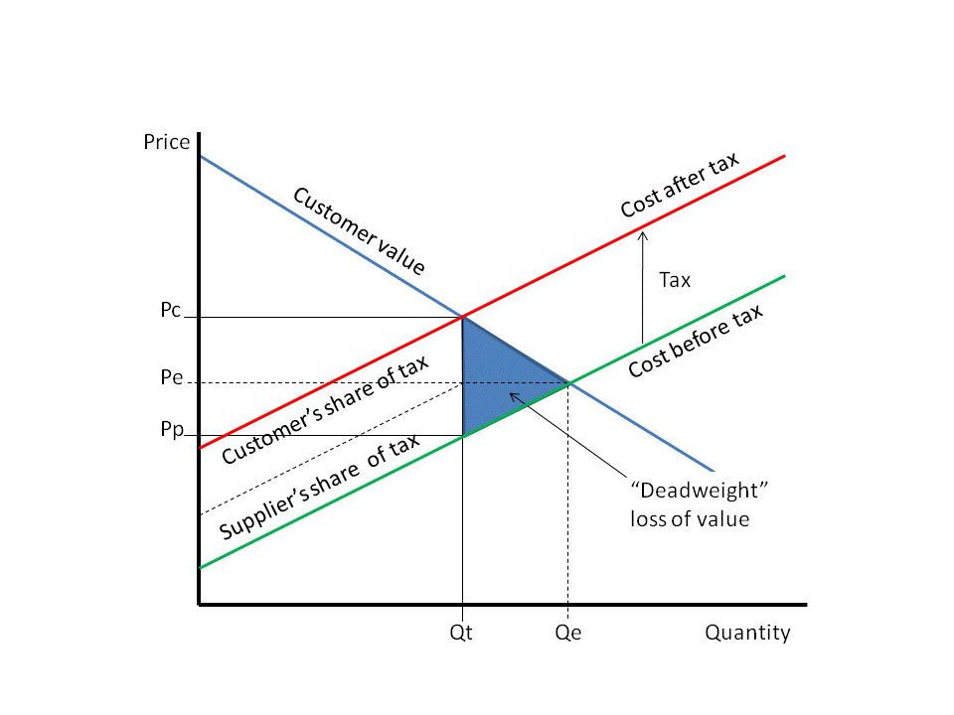
Deadweight loss of tax
  Introduction of taxes into a market reduces economic efficiency by causing deadweight loss
  Introduction of a tax causes the price received by the seller to be less than the cost to the buyer by the amount of the tax
  This causes fewer transactions to occur, which reduces economic welfare; the individuals or businesses involved are less well off than before the tax
  Tax burden and the amount of deadweight cost is dependent on the elasticity of supply and demand for the good taxed

Slide 7
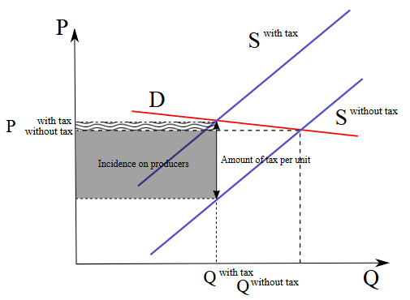
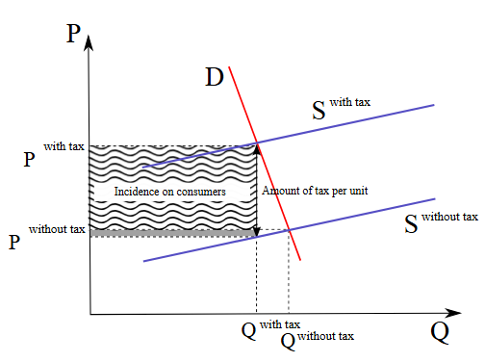
Effects of relative elasticity on Tax incidence
  Inelastic supply and elastic demand …
  Elastic supply and inelastic demand …
  … burden is on producers
  … burden is on consumers
  Example: if a 10% tax is imposed on sellers of butter, but the market price rises 8% as a result, most of the tax burden is on buyers, not sellers

Slide 8
Effets of tax decisions
  Effects a tax decisions produces are often complex and numerous
  A) Behavioral effects – taxes directly affect an individual‘s ability to consume, save and invest (the more and individual pays in taxes the less will be the portion of his after –tax income that will be available for consumption, saving and investment)
  B) Financial effects – e.g. it makes very little difference whether an employer contributes to an employee‘s retirement plan or pays an equivalent amount directly to the employee (as employer is concerned); but it makes a real difference on the employee‘s overall income situation (if it goes directly to employee, then it will add to his aggregate income increasing his overall tax liability)
  C) Organisational effects – how business organisations make financial decisions that involve risk; decisions depend on tax structure ⇒ higher tax burden discourage firms from taking risks
  D) Distortionary versus non-distortionary effects – if an individual can do nothing to alter his tax liability it is a non-distortionary tax = lump-sum tax (e.g. head tax or poll tax); if an individual can alter his tax liability in some way, it is a distortionary tax
  E) Partial versus general equilibrium effects – if tax decision affects only one market or more markets which are interdependent; tax decisions have effects on all other sectors of economy

Slide 9
2. Equity
  Also called fairness is concerned with relative distribution of resources among individuals and groups according to some established notions of fairness and justice
  Horizontal equity – tax system is considered horizontally equitable if if treats individuals with equal income equally (if two individuals with identical incomes pay same amount of taxes)
  Horizontal equity is not a serious issue because it does not deal with real distributional concerns of society
  B) Vertical equity – tax system is considered vertically equitable if it treats individuals with unequal incomes differently
  Dealing with vertical equity is much more complex because it requires the use of some scales by which to measure the wellbeing of individuals with different incomes
  Two constructs are typically used: ability to pay principle and the benefit principle

Slide 10
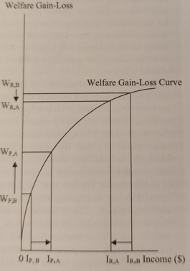
Ability to pay principle
  According to this principle taxes should be levied in accordance with the tax-payer‘s ability to pay and often serves as the basic criterion of fairness in taxation – those who have grater ability should pay more than those who do not (a real issue: by how much more?)
  Consider a society with a rich man and a poor man
  Rich man decides or is asked to sacrifice a small fraction of his income through tax transfer for the welfare of poor man
  Little sacrifice by rich man will have far greater effect on poor man than on the rich
  Marginal utility of a dollar to a rich man is much lower than the marginal utility to a poor man
  Since the welfare gain of the poor man from a marginal dollar is considerably higher than the welfare loss of the rich man, in the aggregate both will be better off by the income transfer ⇒ will increase aggregate welfare of society
  HOWEVER, MANY QUESTIONS AND OPEN ISSUES!

Slide 11
Benefit principle
  Usually, individuals do not receive the same amount of benefits they receive for their taxes
  Therefore it is unfair to use income as the sole basis for taxation
  According to benefit principle individuals should pay in proportion to the benefits they receive from the consumption of a good and not on their ability to pay
  Problems:
  a) it is not always possible to asign precise value of to the benefits which individuals receive (especially if the good is intangible such as education and health care)
  b) for public goods where there is free-rider problem it is difficult to determine exact quantity individuals will consume
  Benefit principle makes perfect sense for goods that are provided in business-like manner (such as water, sewer, electricity, toll roads, etc.)
  c) it is unfair if not difficult (especially on moral ground) to ask individuals at the lower rung of income strata to pay full value (price) of the benefit they receive
  d) by itself, the benefit principle may not be sufficient to generate needed revenue
  Both principles (ability to pay and benefit principle) are necessary to provide „enough“ resources

Slide 12
Efficiency-equity tradeoff
  Equitable tax system – easy in theory, difficult in reality:
  1. Decision makers need to have full information on individual preferences for goods and quantities they want to consume
  2. Individuals are unlikely to reveal voluntarily that information to reduce their tax burden
  3. When government imposes a tax (in particular progressive tax) to improve vertical equity it will invariably impinge on their ability to consume, save and invest, causing the deadweight loss not only to individual but also to society at large (inefficiency)
  Tradeoff between progressive taxation (that would ensure vertical equity) and deadweight loss to society (that would result from the excess burden of taxation)
  Ramsey rule – taxes should be placed in inverse proportion to the elasticity of demand for goods:
  the more inelastic the demand for good, the higher should be the tax on the good (this may partly explain why taxes are high on goods such as alcohol and tobacco: inelastic demand and)
  Summary: to distribute the liability among multiple income groups and sources as much as possible to minimise the excess burden although it may increase the cost of administration

Slide 13
3. Flexibility
  Flexibility in taxation allows governments to adapt to changing economic conditions and societal needs
  A rigid tax system may struggle to respond to economic fluctuations, demographic changes, or unexpected events
  3 measures:
  1. Expansion of existing tax base
  Example: property tax – expansion of full value of taxable property
  2. Increase in tax rates
  either raising of tax rate on existing source or intruducing the tax on source which was not previously taxed
  3. Finding a new source of revenue
  Nontax revenues can provide an effective tool for raising higher revenue without creating excess burden for taxpayers (user fees, fines, licenses and permits, etc.)

Slide 14
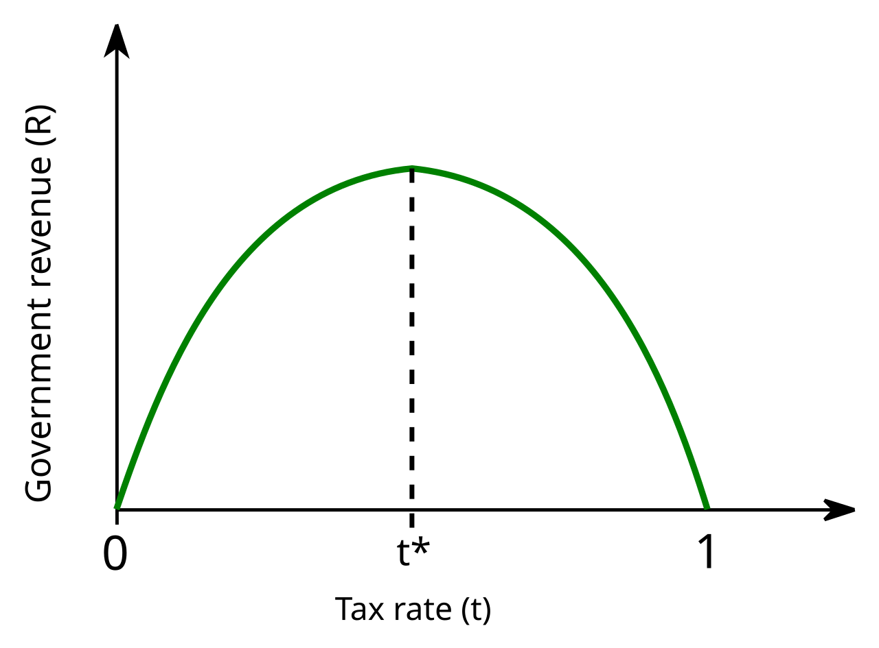

Laffer curve
  Laffer curve illustrates a theoretical relationship between rates of taxation and the resulting levels of the government's tax revenue
  It assumes that no tax revenue is raised at the extreme tax rates of 0% and 100%, meaning that there is a tax rate between 0% and 100% that maximizes government tax revenue
  Implication: increasing tax rates beyond a certain point is counter-productive for raising further tax revenue
  In United States, conservatives have used the Laffer curve to argue that lower taxes may increase tax revenue
  However, the hypothetical maximum revenue point of the Laffer curve for any given market cannot be observed directly and can only be estimated
  Arthur Laffer (1940 - ) American economist; member of Reagan's Economic Policy Advisory Board

Slide 15
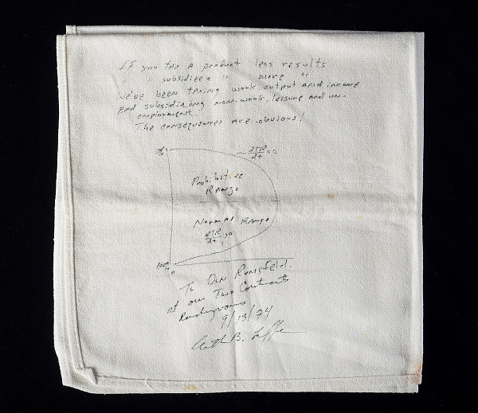
Laffer curve napkin
  In 1974 economist Art Laffer sketched a new direction for the Republican Party on this napkin
  Displeased with President Gerald Ford’s decision to raise taxes to control inflation, four men got together at a Washington, DC restaurant to think about alternatives
  Laffer was joined by journalist Jude Wanniski and politicians Dick Cheney and Don Rumsfeld. Laffer argued that lowering taxes would increase economic activity; Wanniski popularized the theory, and politicians Don Rumsfeld and Dick Cheney carried it out
  The cloth napkin was taken as a souvenir by Jude Wanniski
  The napkin reads “If you tax a product less results/If you subsidize a product more results./We've been taxing work, output and income and subsidizing non-work, leisure and un-/employment./The consequences are obvious!” with an image of the Laffer curve in the middle
  The bottom of the napkin reads To Don Rumsfeld/at our Two Continents/Rendezvous/ 9/13/74/Art B. Laffer

Slide 16
4. simplicity
Simplicity is very important principle
Tax system should be easy to understand
Complexity in tax laws can lead to confusion, errors, and increased compliance costs for taxpayers and administrative costs for the government
When tax laws are straightforward, it becomes easier for individuals and businesses to fulfil their tax obligations
Simple tax system also reduces the need for extensive tax advice and decreases disputes with tax authorities
Complexity often has an economic costs that increase overtime
US tax system:
    is extremely complex; it consists of a myriad of laws and regulations built over time that is not easy grasp by an average taxpayer
    Tax reform in 1986 – robust simplification: extension of tax base, reduction of marginal tax rates, elimination of numerous exceptions and loopholes

Slide 17
5. feasibility
In a democratic system public support is necessary for a government to pass legislation on major tax decisions
If a government wants to introduce a new tax it has to have the approval of the voting public
Role of public referendum on taxes:
    It gives the public an opportunity to carefully evaluate the proposed policy before voting on it
    It allows the decision makers to recognise the choices made by the public and to ensure that the policy reflects those choices
  OTHER CRITERIA OF THE TAX SYSTEM
  6. Stability – stable sources of government revenue
  7. Transparency – taxpayers should understand what they pay
  8. Security – taxpayer must be protected from unlawful disclosures

Slide 18
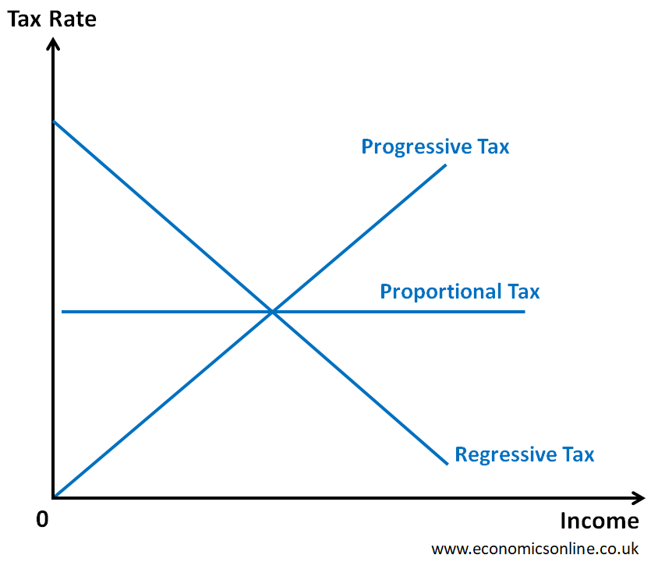
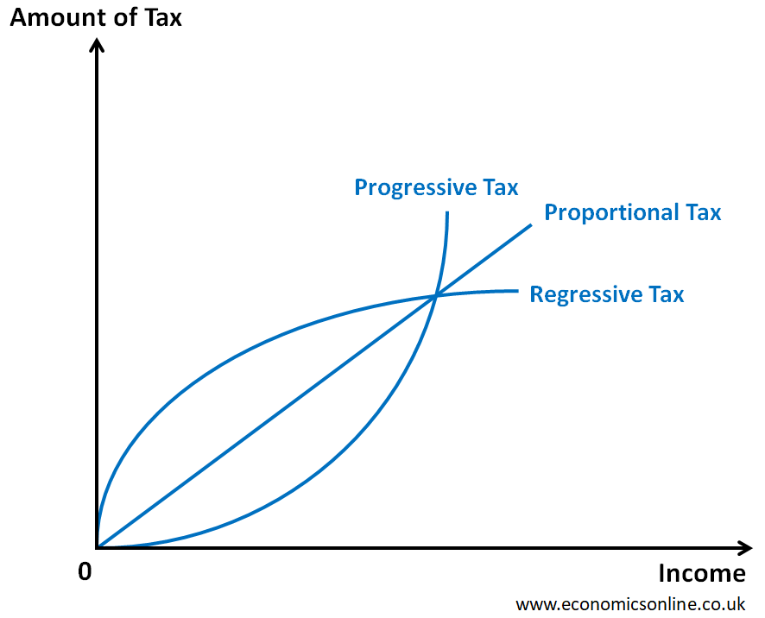
Tax rate progression

Slide 19
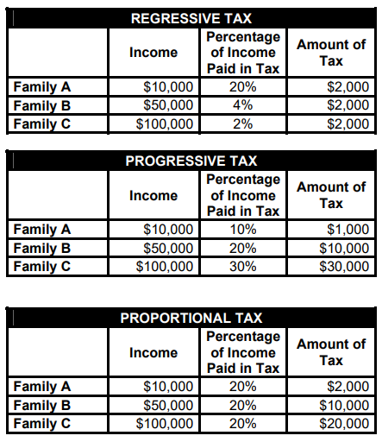
Tax rate progression: numerical example

Slide 20
Overview of Government revenues

Slide 21
Types of revenues - 1
Taxes on income, profits and capital gains
  Income tax
    Personal income – tax levied on the wages, salaries, investments, or other forms of income an individual or household earns
    Corporate income tax – tax levied on the income or capital of corporations and other similar legal entities
    (Negative income tax – is a progressive income tax system where people earning below a certain amount receive supplemental payment from the government instead of paying taxes to the government)
  Payroll tax – mandatory payments calculated on employee salaries and wages, paid by either employers, employees, or both, to fund government programs such as Social Security and Medicare
  Social security contributions – payments made by both employees and employers, or by self-employed individuals, to fund social welfare programs like pensions, sickness benefits, and healthcare
  Capital gains – capital gain is generally a gain on sale of capital assets—that is, those assets not held for sale in the ordinary course of business (antiquities, shares, precious metals, second homes, etc.)
Taxes on goods and services
  Value added tax (VAT) - equivalent of a sales tax to every operation that creates value
  Sales tax - are levied when a commodity is sold to its final consumer
  Excise taxes - an indirect tax imposed upon goods during the process of their manufacture, production or distribution
  Tariffs - is a charge for the movement of goods through a political border

Slide 22
Types of revenues - 2
Taxes on property and wealth
  Property tax – ad valorem tax levy on the value of a property that the owner of the property is required to pay to a government in which the property is situated
  Land value tax – levy on the value of land without regard to buildings
  Inheritance tax – taxes that arise for inheritance or inherited income
  Expatriation tax – tax on individuals who renounce their citizenship or residence
  Remittance tax – an excise tax levied on international money transfers, typically paid by a sender to a recipient in a foreign country
Other sources of revenue
  Licence fees - payment made for permission to use a right, such as operating a business or accessing a service
  User fees and charges – (highway tolls)
  Poll tax - per capita tax, or capitation tax, is a tax that levies a set amount per individual
  Intergovernmental revenue – from higher to lower level of government
  Franchise tax – a priviledge tax because of the rights given to them to operate in the state
  Lottery revenue -

Slide 23
Taxes and law
  Tax avoidance is a legal practice where taxpayers use provisions in the tax code, such as deductions and credits, to minimize their tax bills
  Tax evasion is illegal and involves underreporting income or falsifying information to reduce tax liabilities
  Tax avoidance: example
  Most popular scheme - operated by companies where directors receive their income as directors' loans and then either do not repay such loans to the company or write them off at the year-end
  Tax evasion: under-reporting business income to ministry of treasury

Slide 24
THANK YOU FOR
YOUR ATTENTION
Jungmannova 17 | 110 00 Praha 1 | Česká republika
cevro.cz

