Slide 1
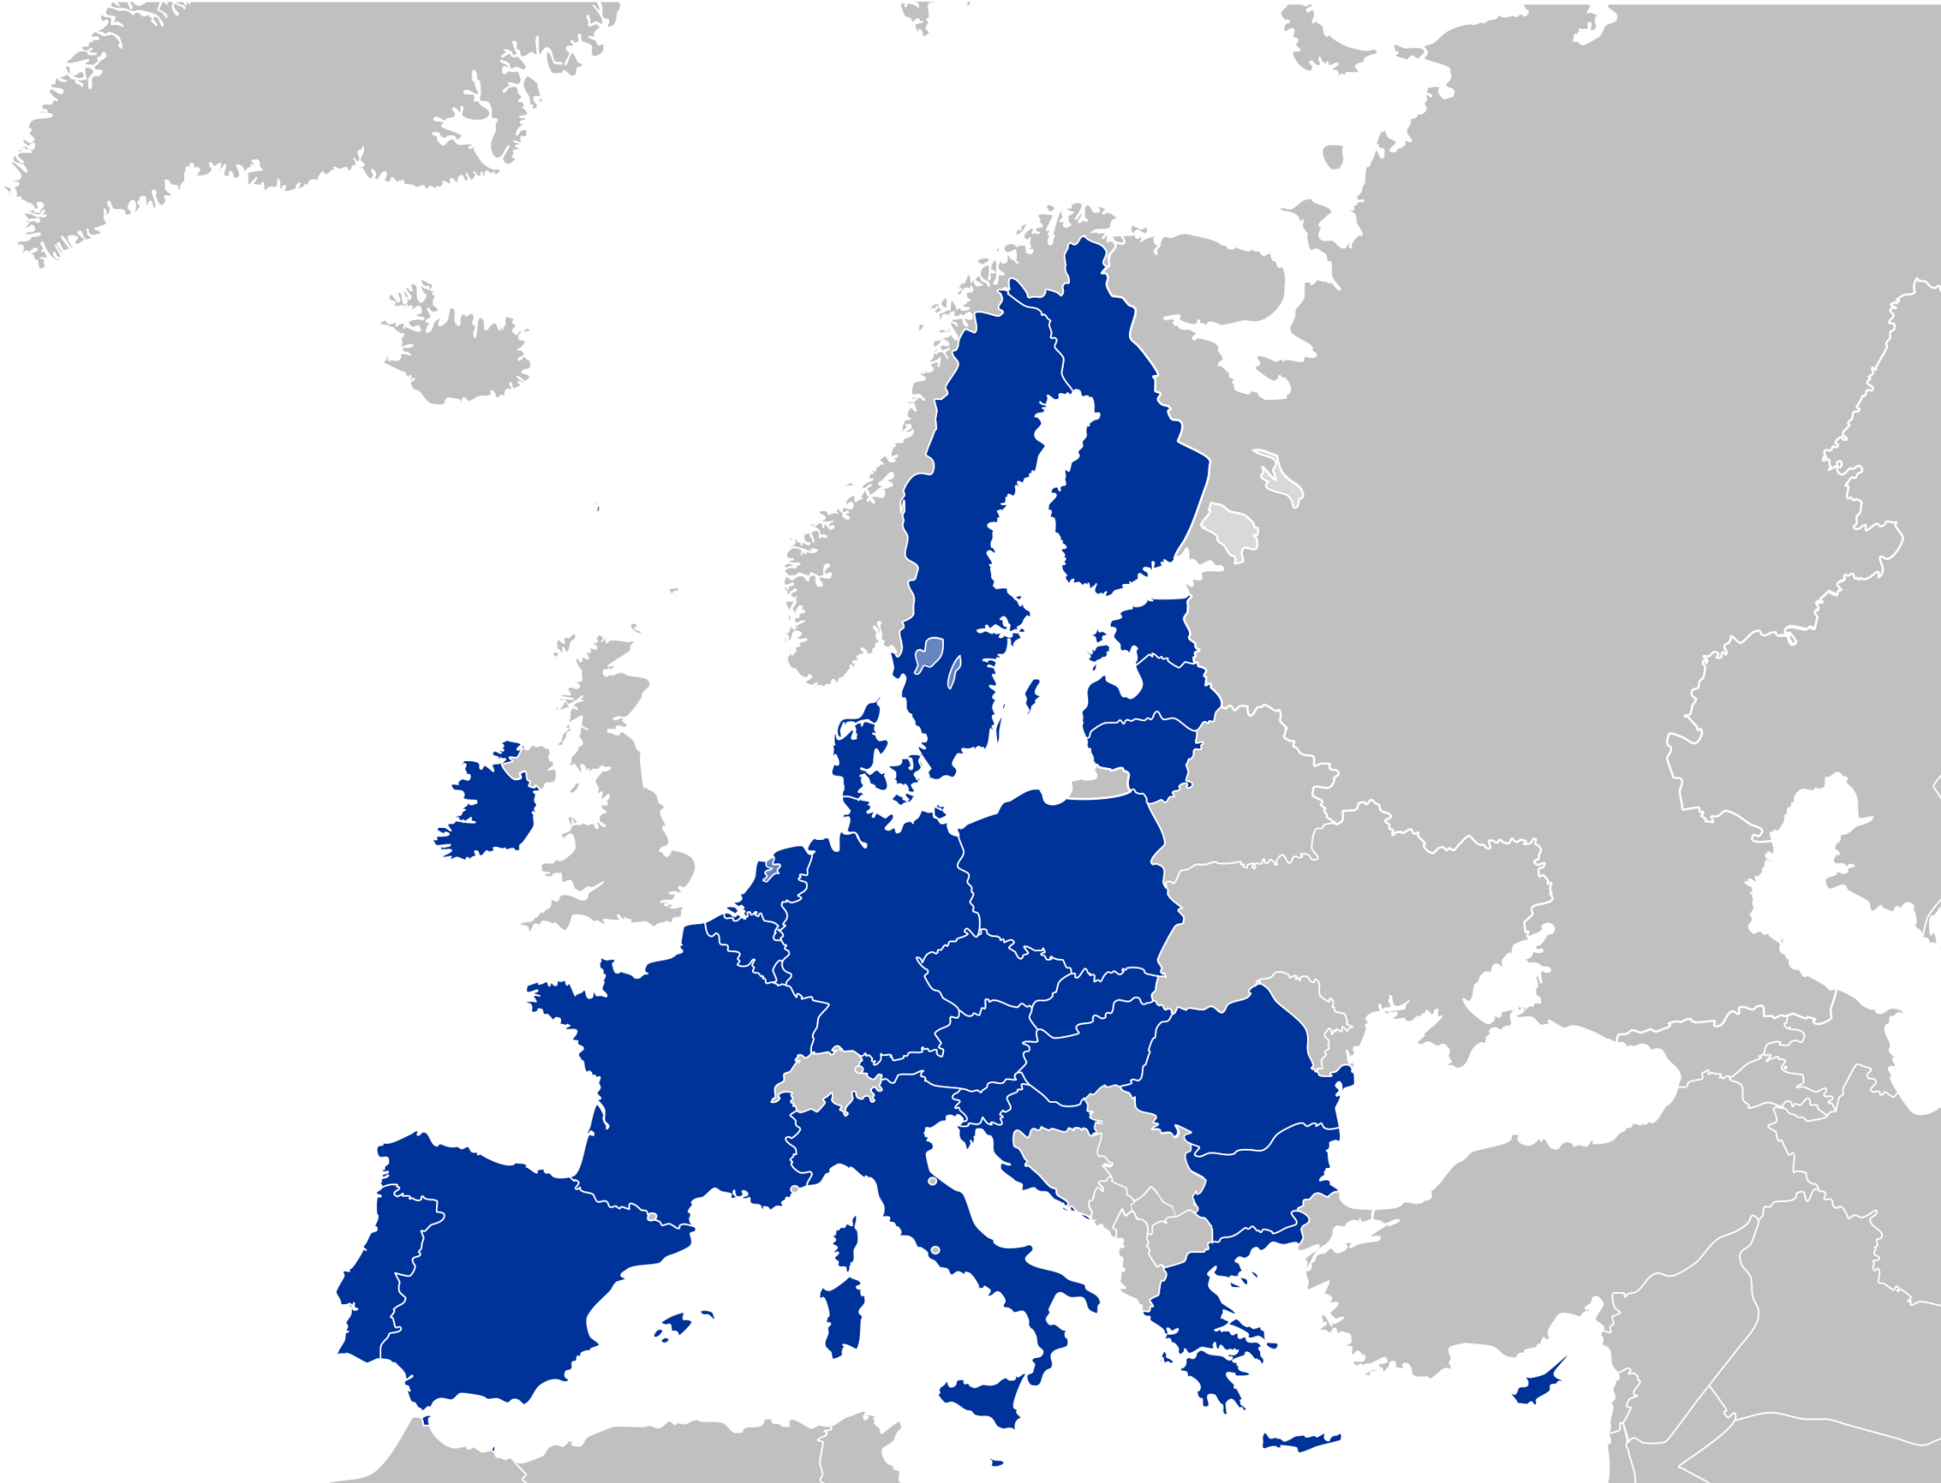

Slide 2
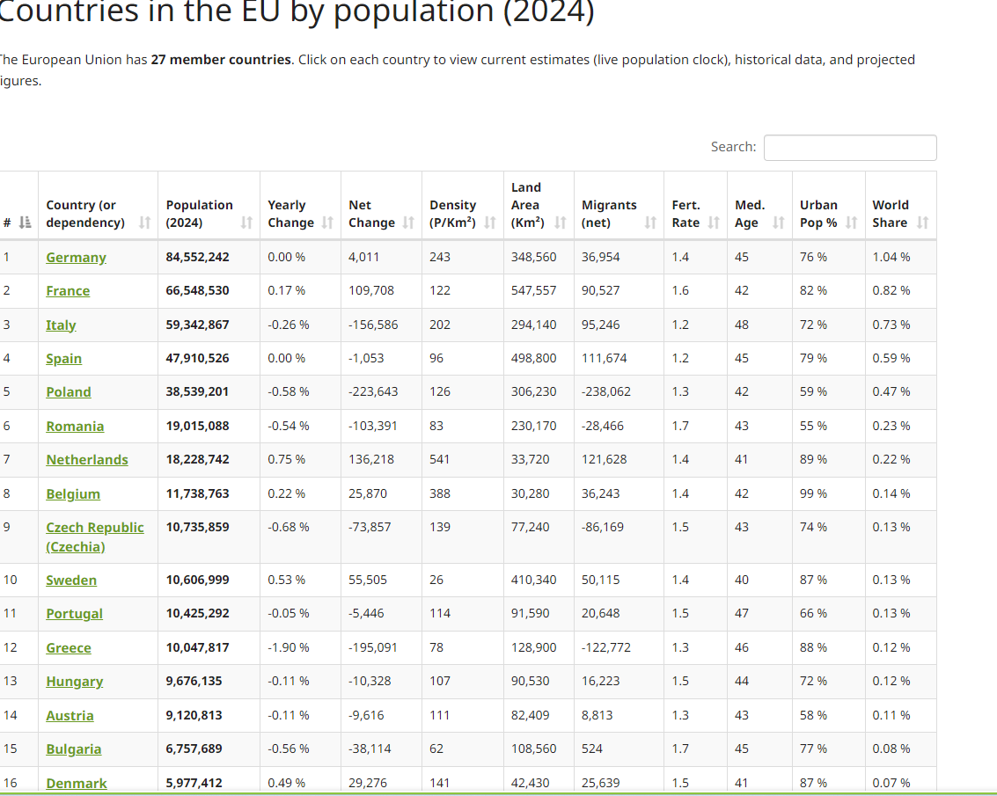
Countries in the EU by population (2024)

Slide 3
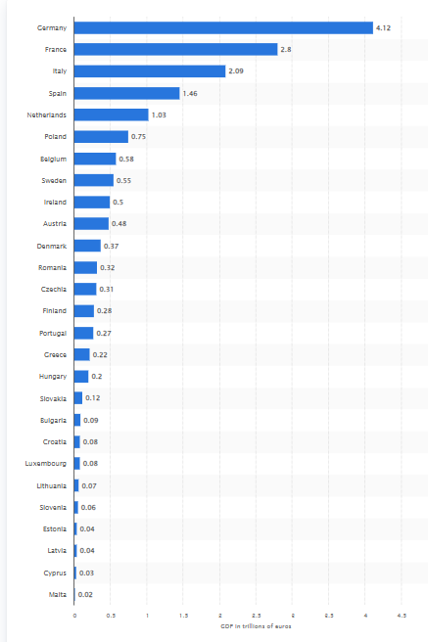
Gross Domestic Product (GDP) of European Union member states in 2023 (in trillions of Euros), EU/27, CZ/13th

Slide 4
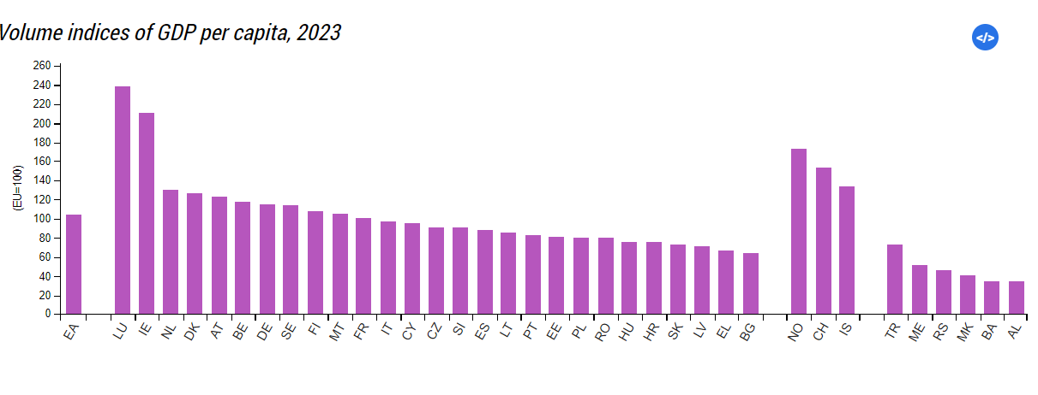
GDP per capita, 2023
EU=100%, CZ=91%
EU/27, CZ/14th

Slide 5
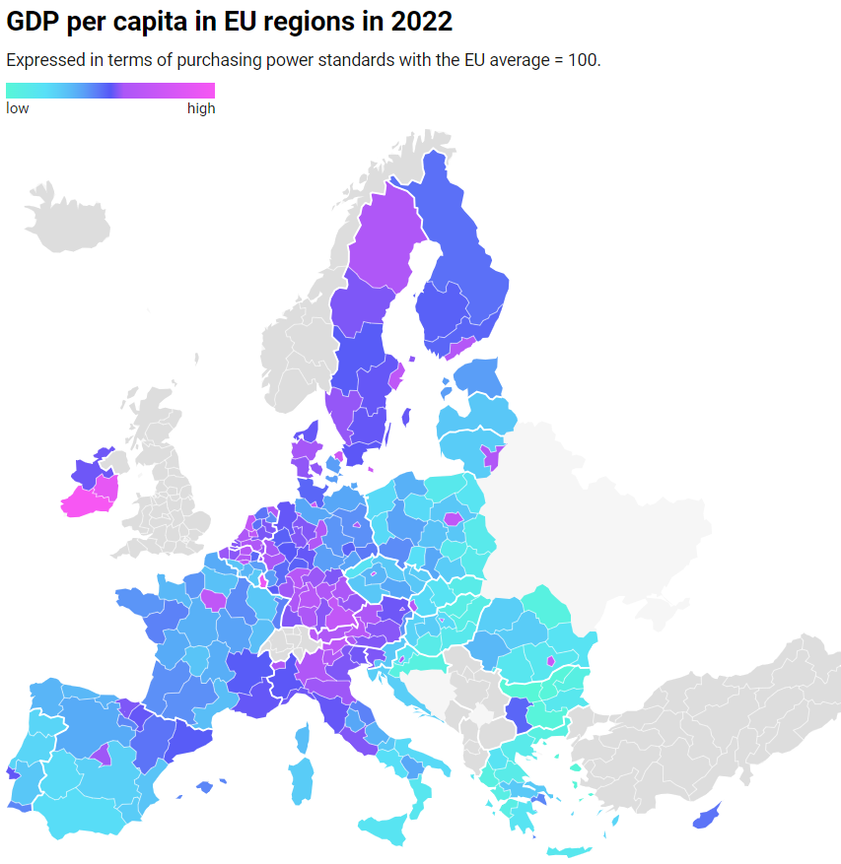

Slide 6
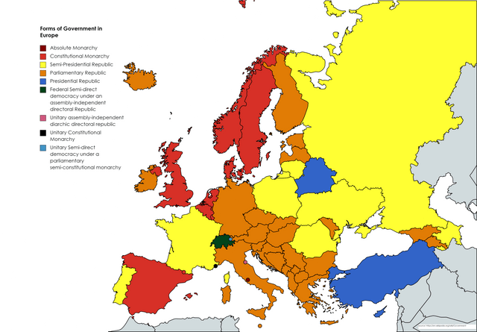

Slide 7


Slide 8
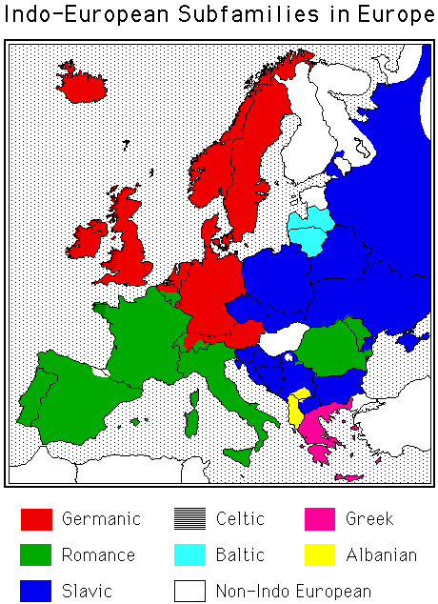

Slide 9
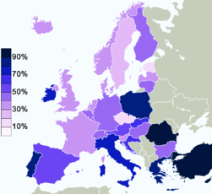
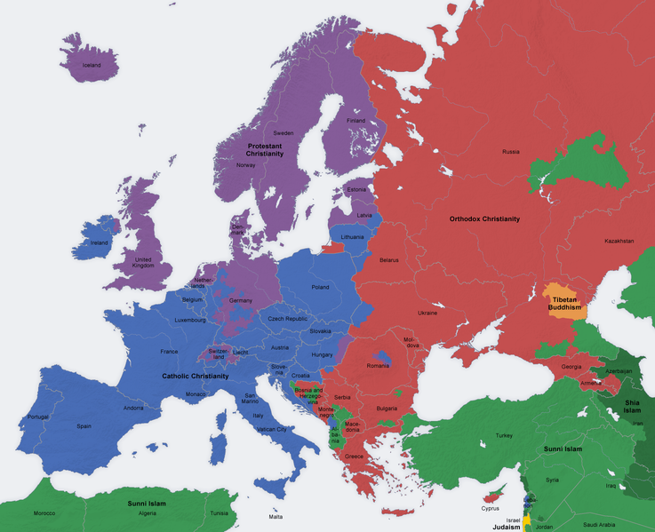
Belief in God in the EU/Religious in Europe

Slide 10
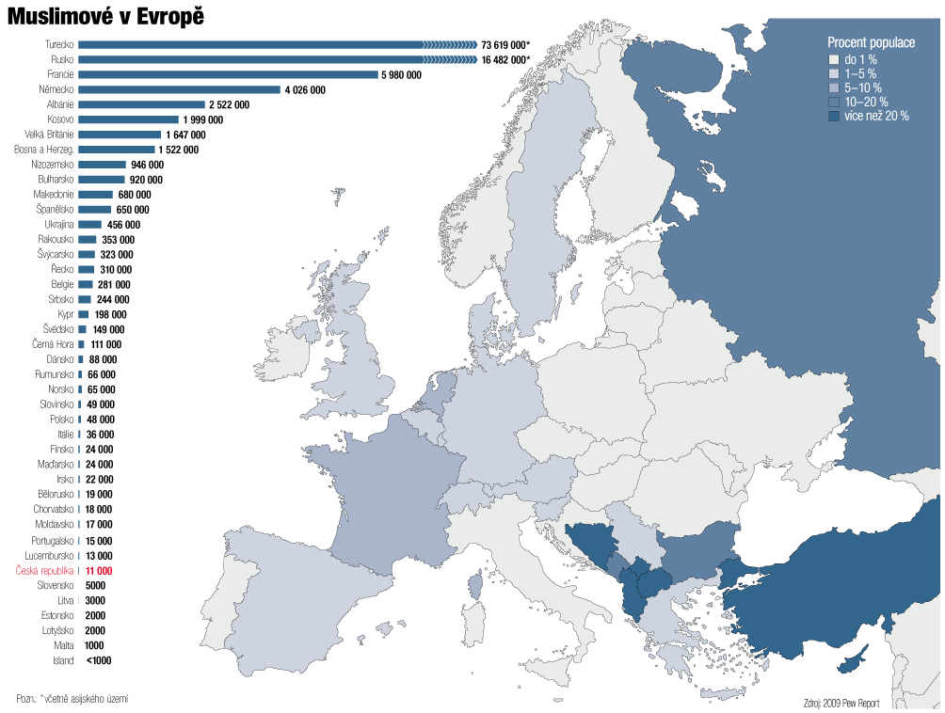

Slide 11
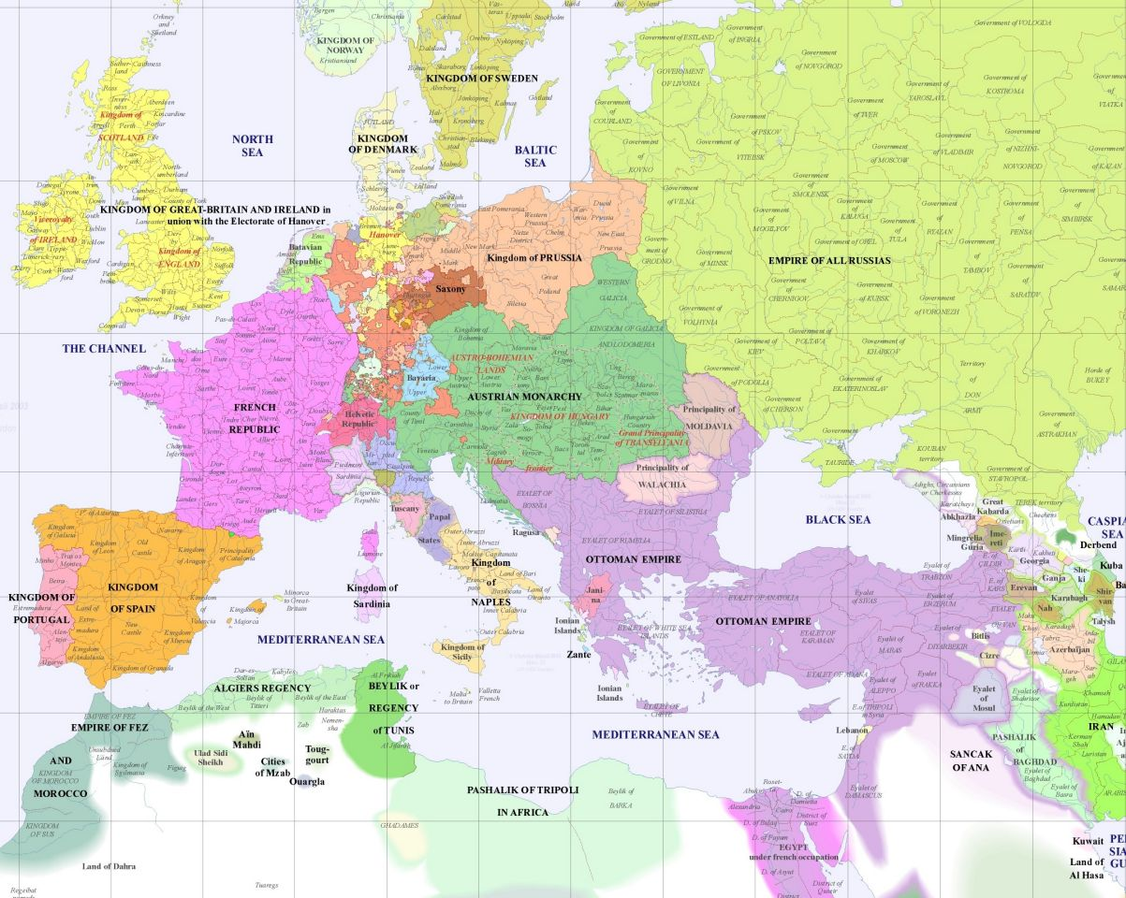
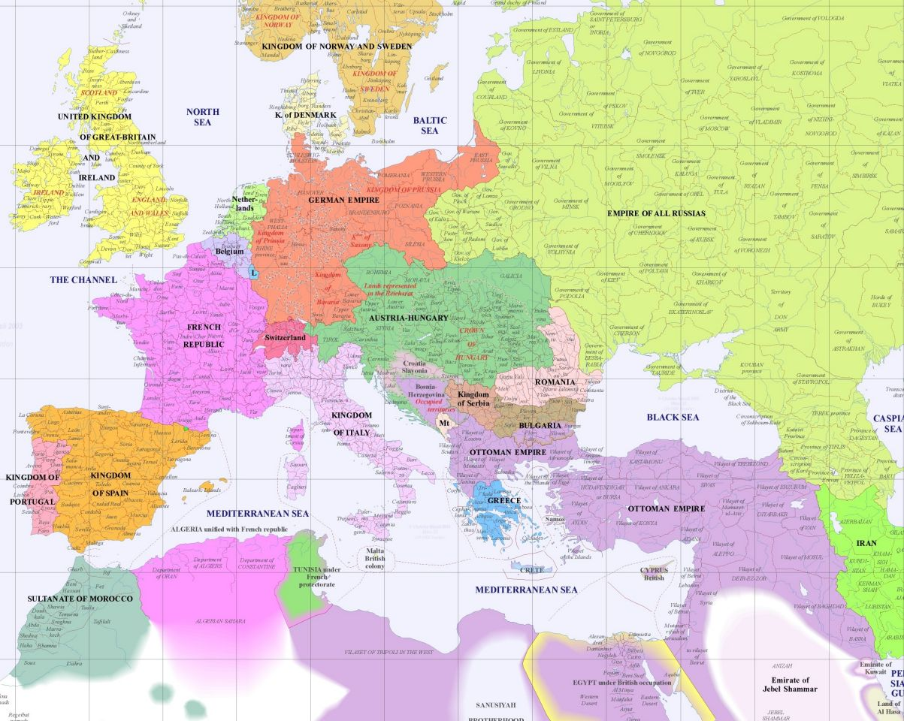
EUROPE in 1800 and 1900

Slide 12
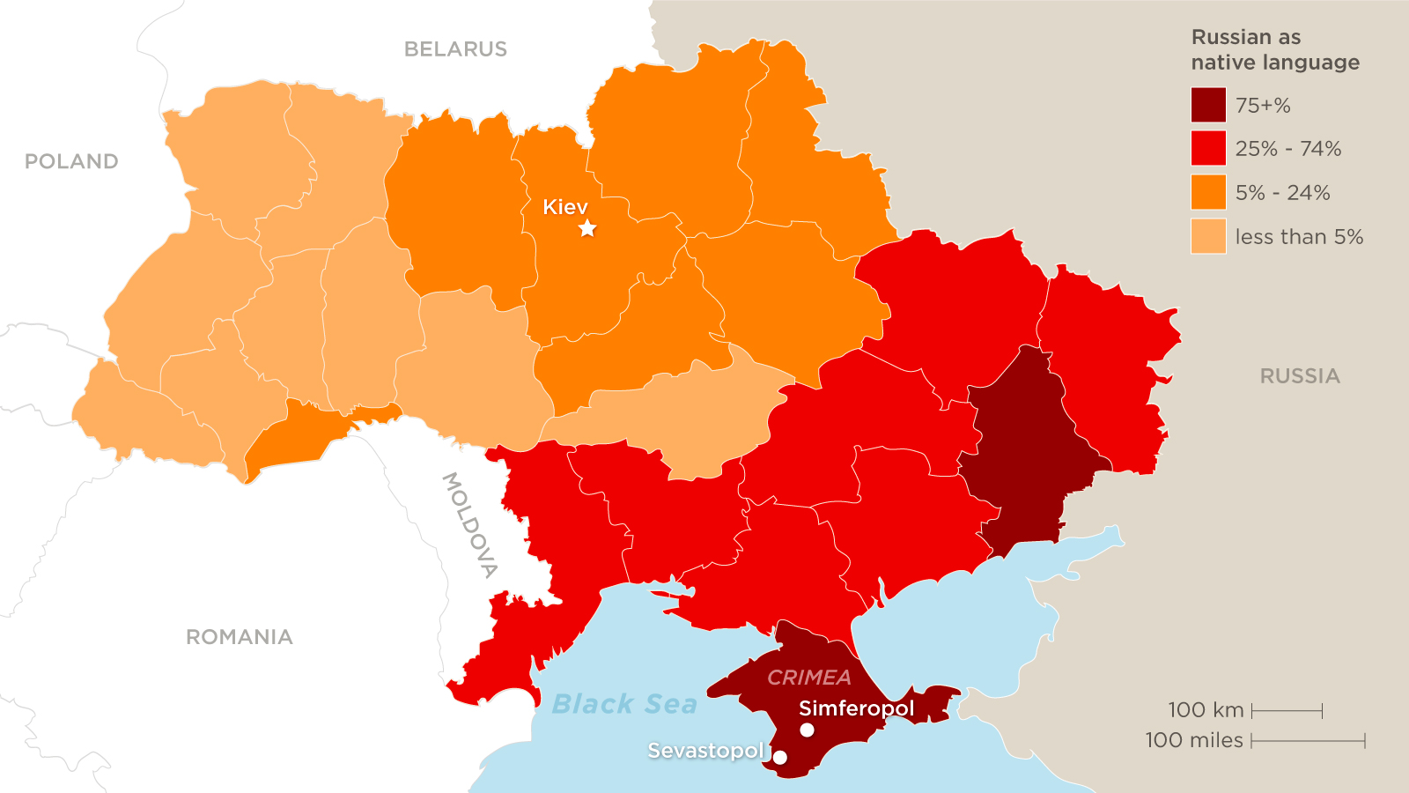
Ukraine Census 2001

Slide 13


