Slide 1
Official Languages in Süd Tyrol:
A Study of Multilingualism and Cultural Coexistence

Slide 2
Historical Context
Sociolinguistic Dynamics
Challenges and Controversies
South Tyrol as a Model

Slide 3
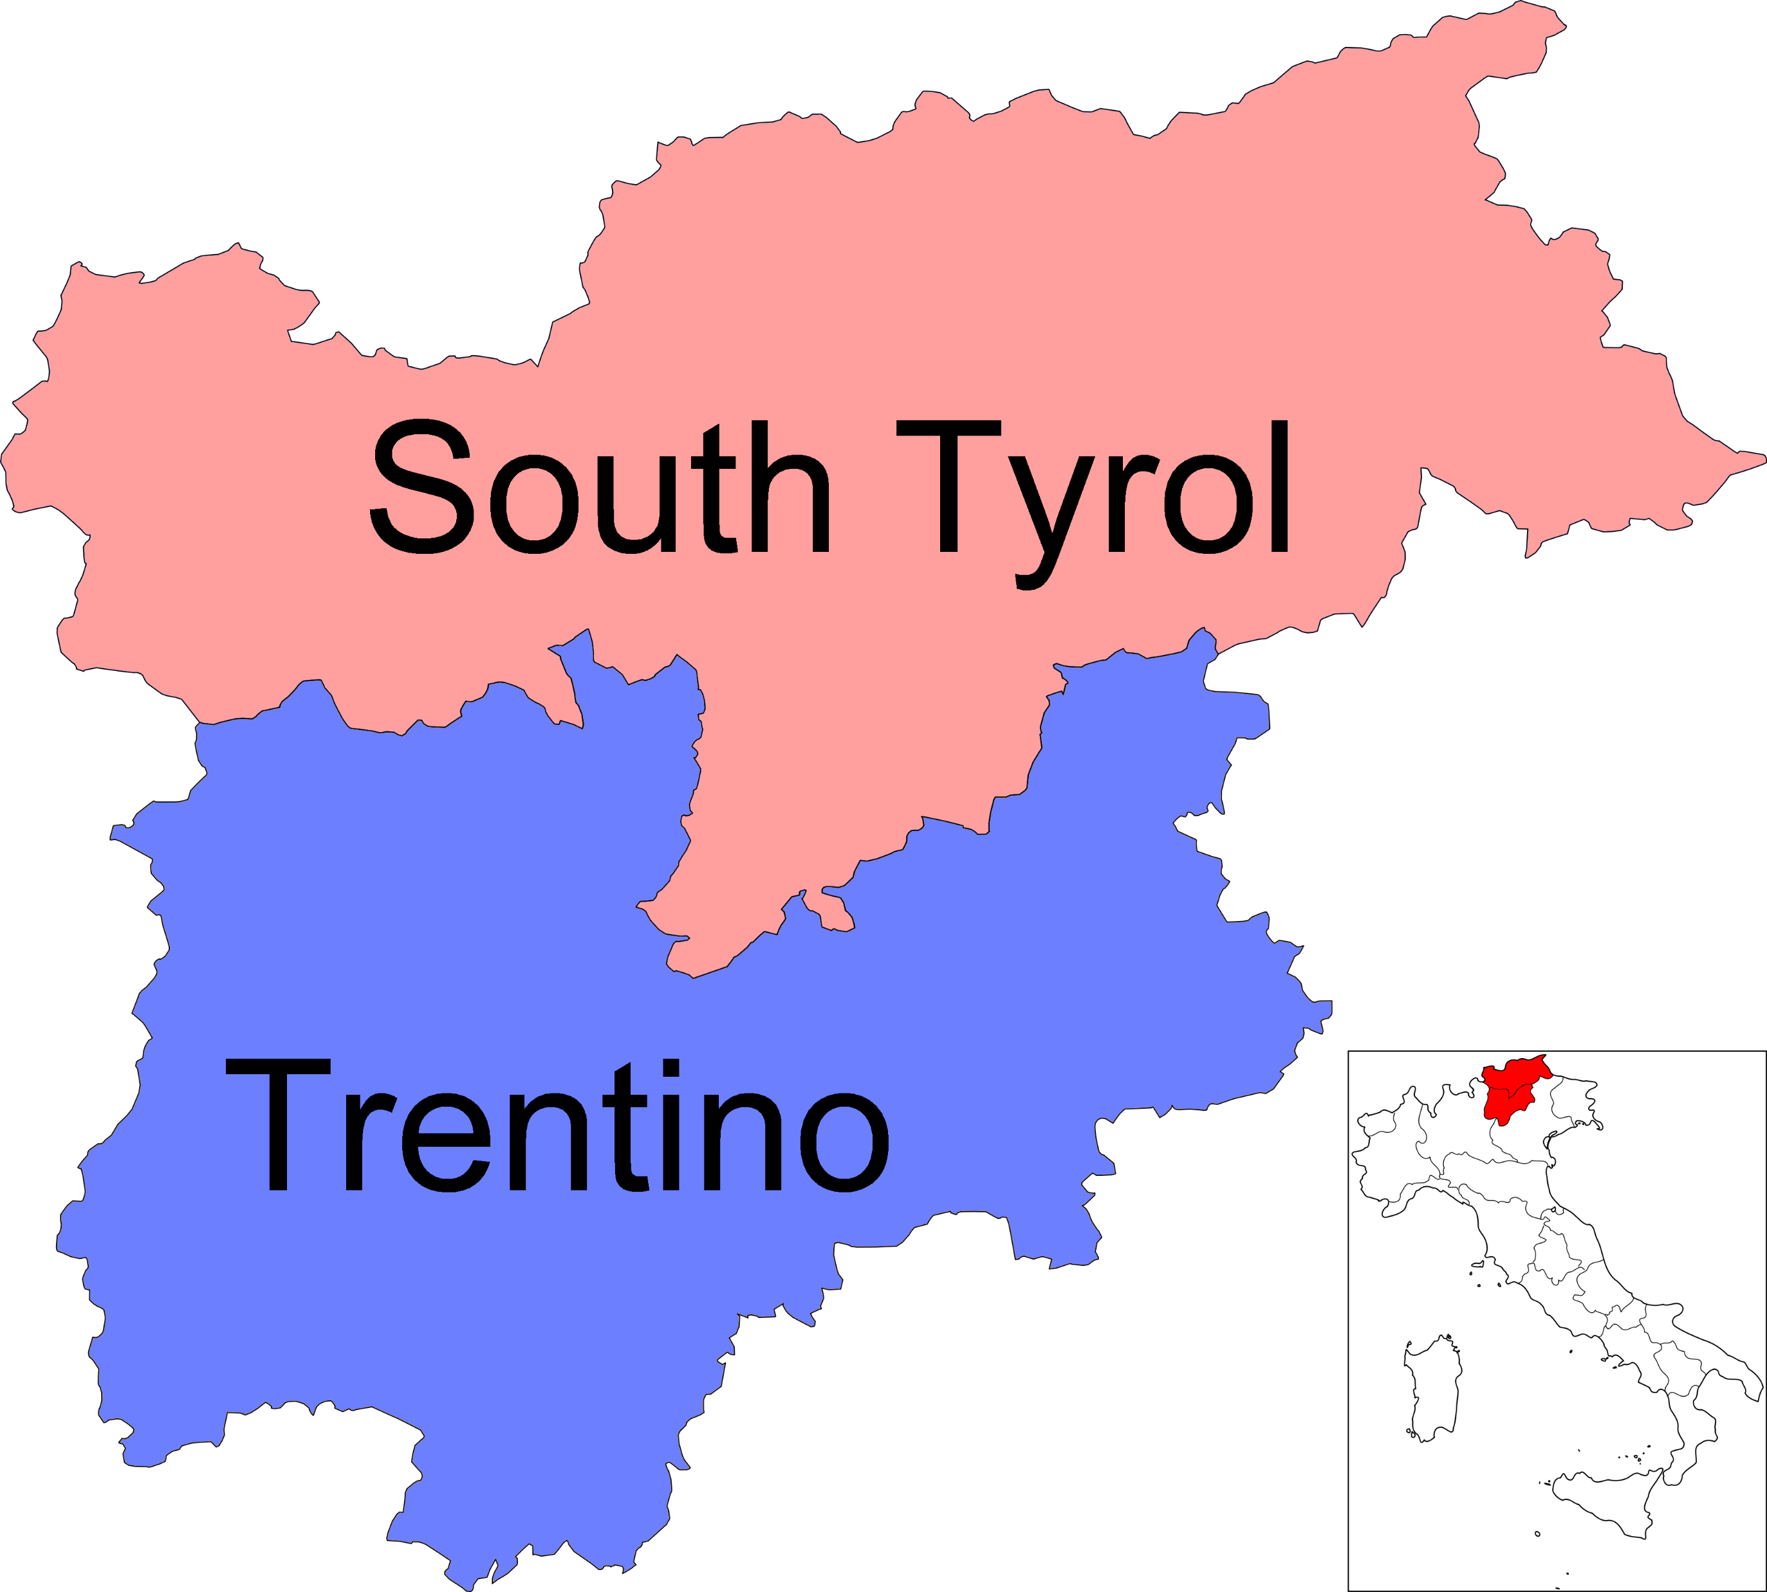
German, spoken by approximately 70% of the population
Italian spoken by 25%
Ladin spoken by 5%

Slide 4
Historical Context
Austrian Heritage (1363–1919): For centuries, South Tyrol was part of the Habsburg Empire, where German and Ladin were predominant.
Annexation to Italy (1919): After World War I, the Treaty of Saint-Germain transferred South Tyrol to Italy, initiating a period of Italianization under Fascist rule. German and Ladin speakers faced severe.
Autonomy Agreements (Post-World War II): Following World War II, international pressure, particularly from Austria, led to the 1946 Gruber-De Gasperi Agreement. This agreement laid the foundation for autonomy, ensuring the protection of linguistic minorities.

Slide 5
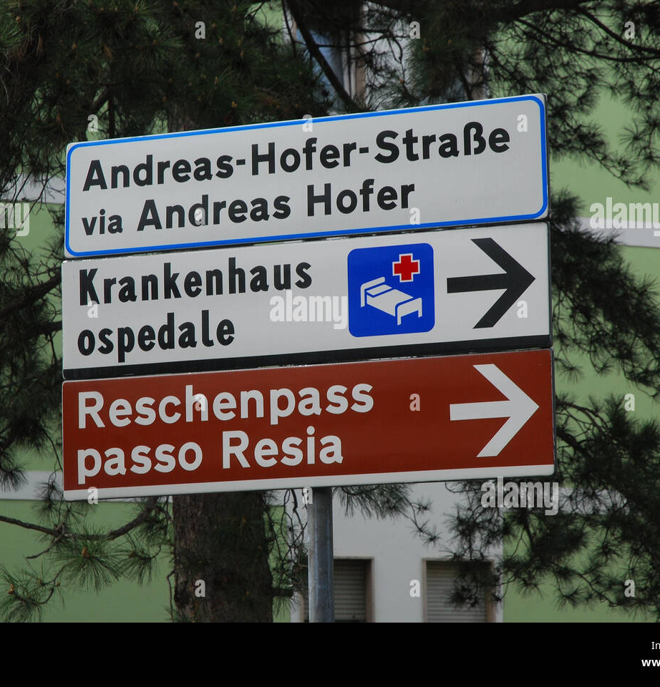
Sociolinguistic Dynamics
All public institutions must operate in both German and Italian, with Ladin included in specific areas.
Schools are divided by linguistic group, allowing children to be educated in their mother tongue.
Language in South Tyrol is not merely a means of communication; it is a core element of individual and group identity.
European Charter for Regional or Minority Languages

Slide 6
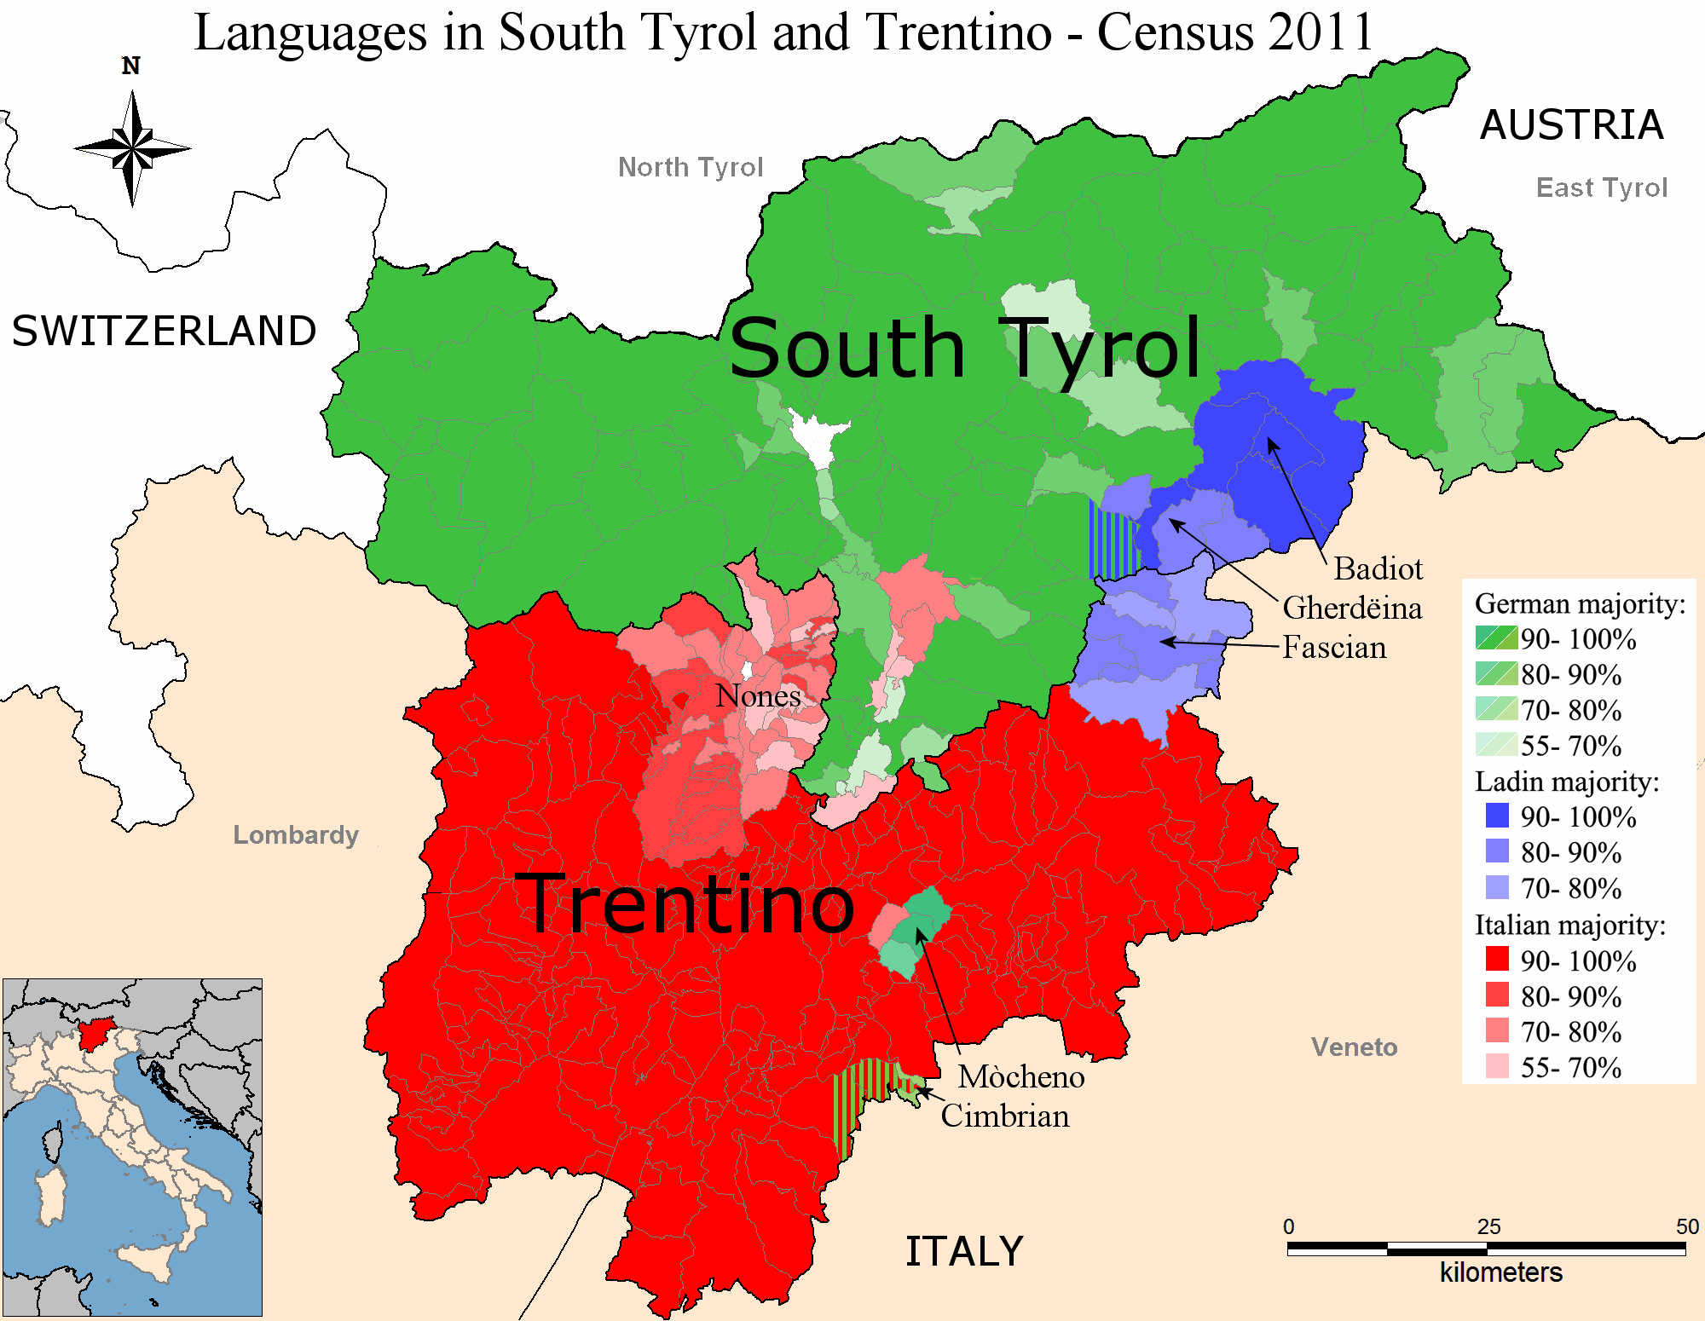

Slide 7
Challenges and Controversies
Segregation can perpetuate stereotypes and prevent the development of a shared regional identity.
There are ongoing debates over whether South Tyrol should push for greater autonomy, independence, or even reunification with Austria.
Ladin speakers, the small minority, often feel sidelined despite official recognition.

Slide 8
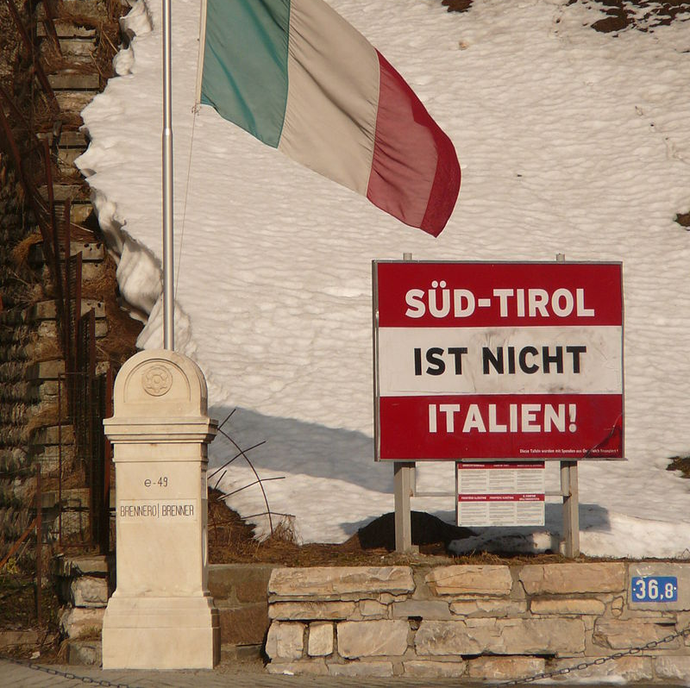
South Tyrolean independence movement
The poster is located on the Austrian side of the border.

Slide 9
South Tyrol as a model
South Tyrol is often studied as a successful case of conflict resolution and linguistic coexistence.
Key success factors:
-Strong legal protections
-Recognition of minority rights
-Focus on multilingual competence
-Cultural empowerment

Slide 10
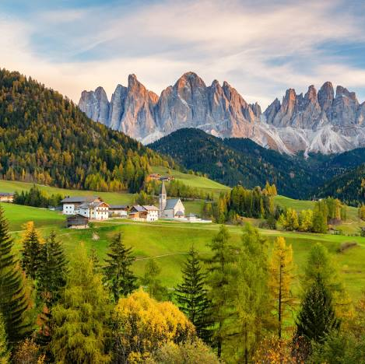
Conclusion
South Tyrol demonstrates that linguistic coexistence is possible when minority rights are protected, multilingualism is encouraged, and cultural diversity is celebrated.

Slide 11
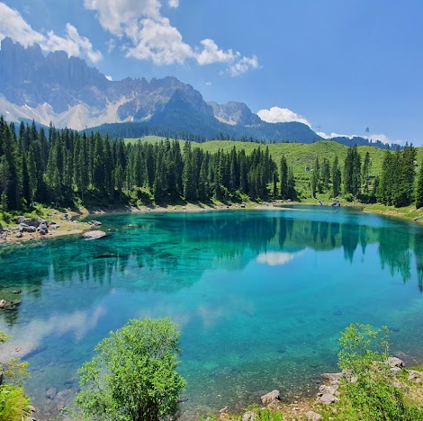
Thanks for your attention
Alessi Irene

