Slide 1
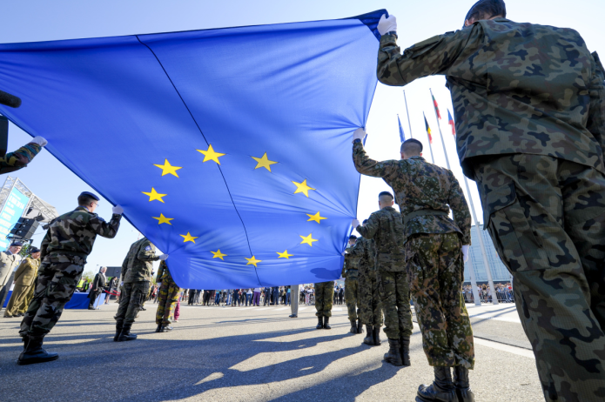
European common army

Slide 2
1/ History of the common army
Cold war
1990s
21st century
2/ The European common defense today
3/ Difficulties of a common European defense nowadays
The European Union and the NATO
The problem of the nuclear weapon

Slide 3
History of the common army
Cold War
21st century
Creation of Eurocorps
Need of protection against the Soviet Union
Europe facing difficulties
1990s

Slide 4
The European common army today
2009 Treaty of Libon Update of the Common Foreign and Security Policy | June 2017 European Defense Fund (EDF) | December 2017 Permanent structured cooperation (PESCO)

Slide 5
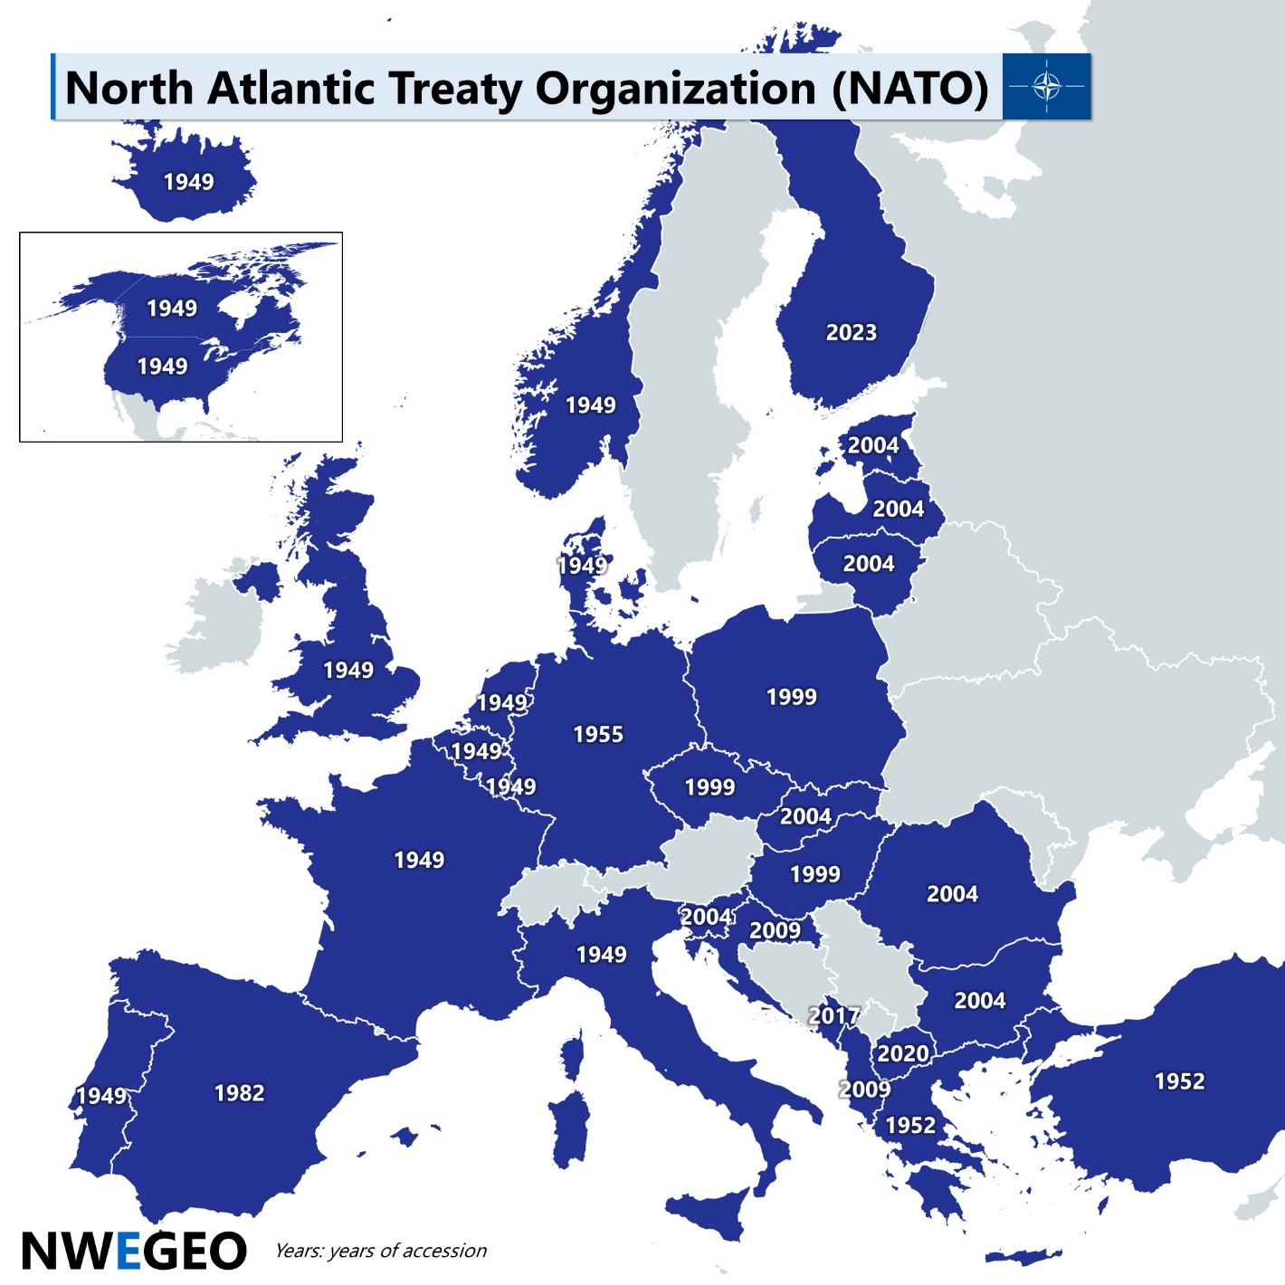
Difficulties of a common European army nowadays
The EU and the NATO
The problem of the nuclear weapon
23 out of 32 NATO Member States also in EU Member

Slide 6
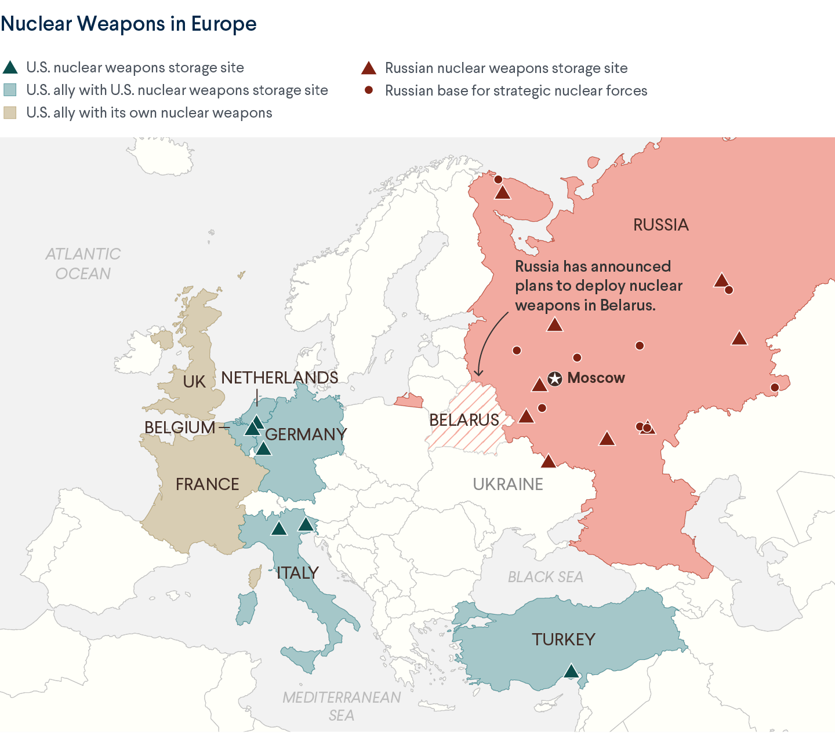
Difficulties of a common European defense nowadays
The EU and the NATO
The problem of the nuclear weapon

Slide 7
“Defence is a member state competence. The point is not about having an EU army but rather to work better together among the 27 armies”
Josep Borrell, the EU’s top foreign policy diplomat,
March 2024

