Slide 1
Collective identity (Shils)
EU – union of nation states, and European citizens (two sources of legitimacy)
What is NATION/VOLK/THE PEOPLE?
Collective (national) X Individual (personal) Identity
Nationalism; National Interests, welfare; National Enemies etc. (?)
Variety of meanings, multicultural competence
Primordial, Sacred (ethnic/cultural), Civil (political)
Border Perspective: Im/Permeability
Various Integrational/Absorption Capacity
Case of Immigrants Quota (?)

Slide 2
European identity (DELAnty)
Historical perspective
Europeanness as (Western) Christendom
Constitutive others/outside - role of Islam & Orthodoxy
Significance of Crusades/Crusaders, Constantinople seized (1453)
1492 (New World) – colonization & the end of Reconquista
Double schism (Roman x Orthodoxy; Catholics x Protestants)
Religious war, Victory of Protestantism
Peace of Westphalia (1648)
European identity as set of values (cultures)

Slide 3
Christianization waves

Slide 5
Religions in europe

Slide 6
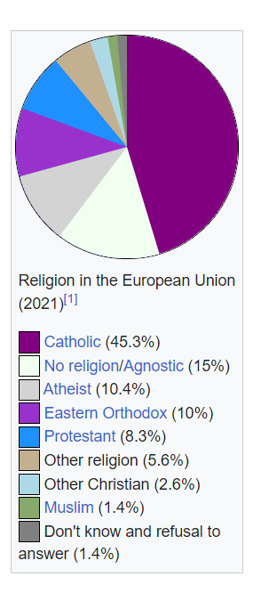

Slide 7
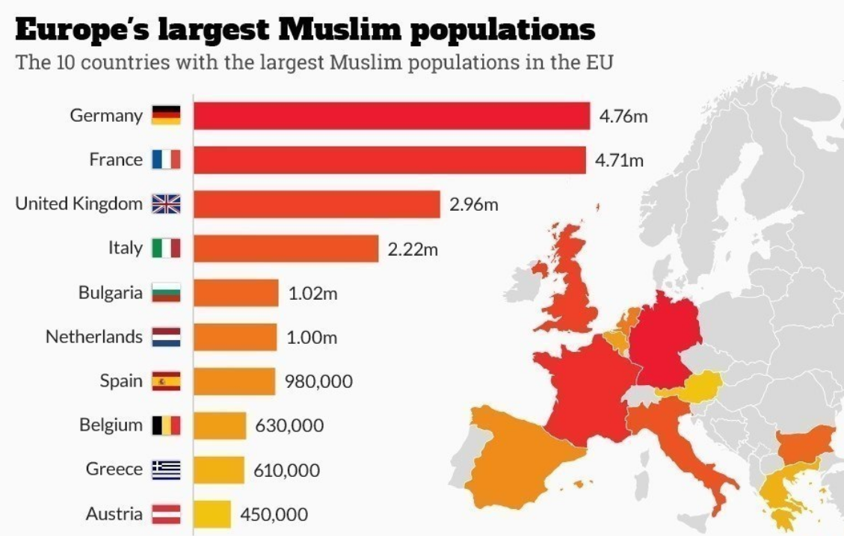

Slide 8
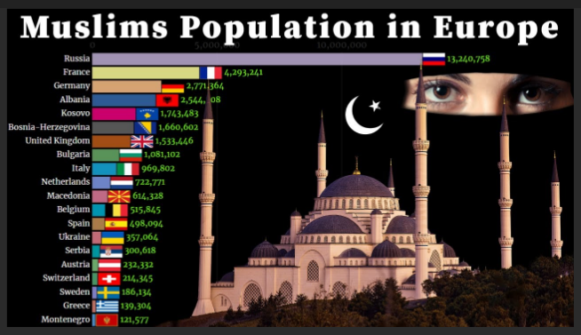

Slide 9
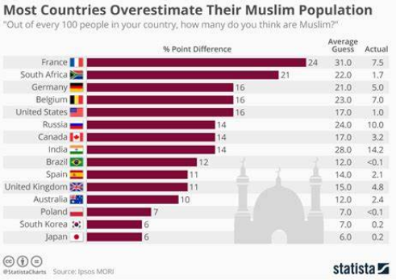

Slide 11
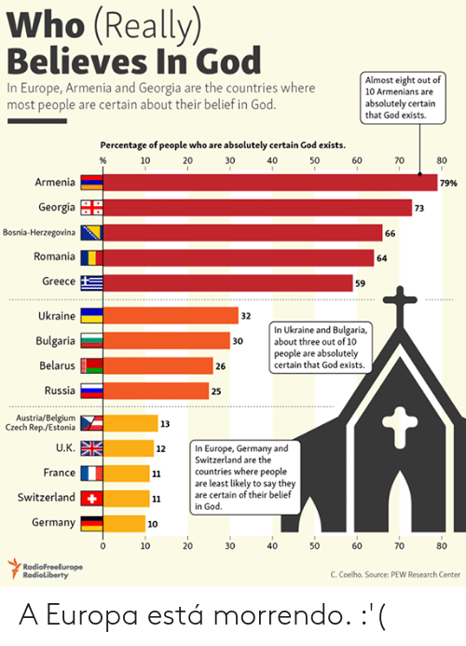

Slide 12
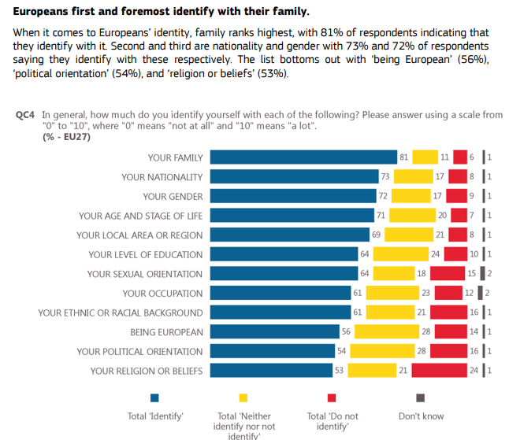

Slide 13
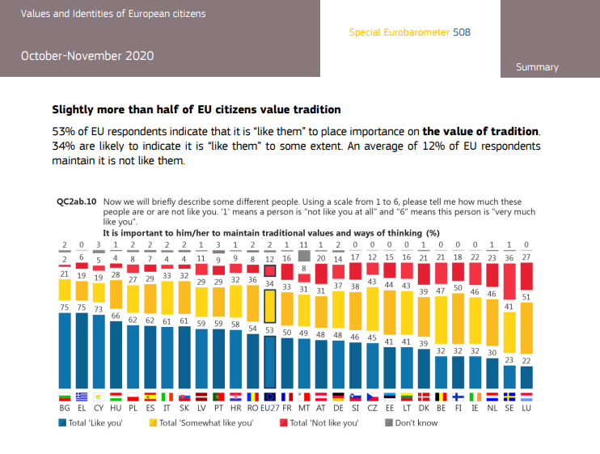

Slide 14
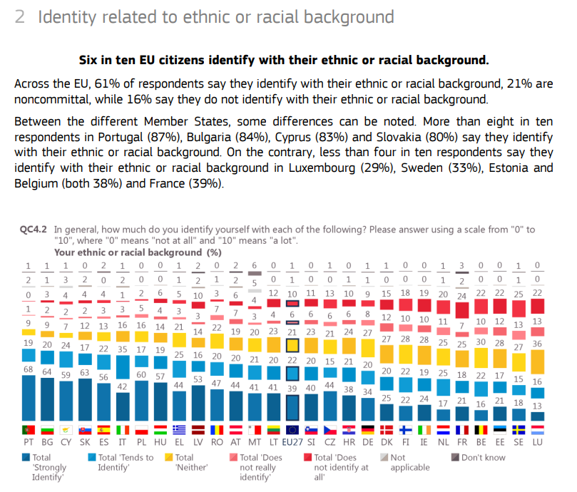

Slide 15
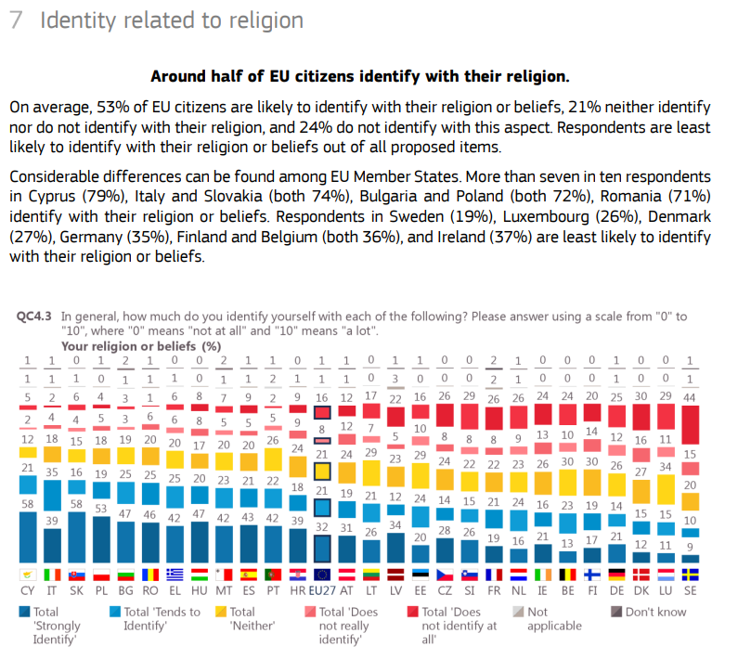

Slide 16
Source: EB, Spring 2019

