Slide 1



The advance of extreme right-wing parties in Poland,
Austria and Hungary
Andrea Hidalgo Camargo
Radan Šíbl

Slide 2
What is an extreme right-wing party?
European far-right parties share an anti-immigration political program reflecting their ultra-nationalist ideology; they consider that only natives should be inhabitants of the state and that non-native elements threaten the homogeneity of the nation-state (Mudde, 2007)

Slide 3
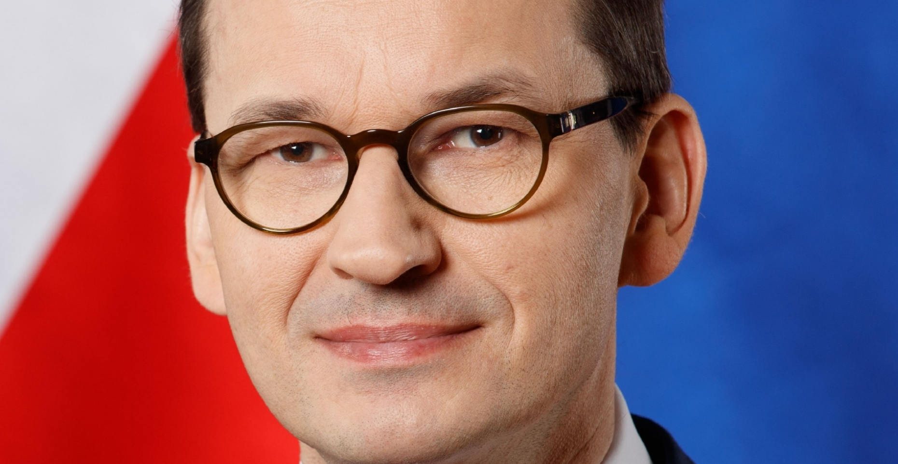
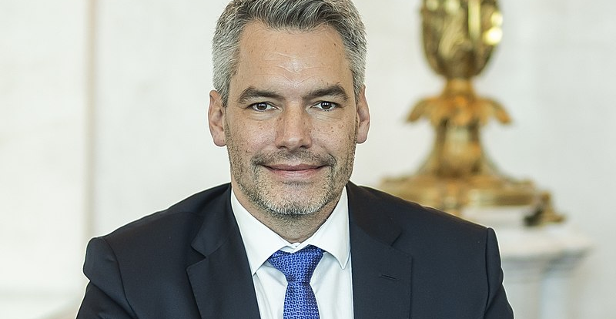
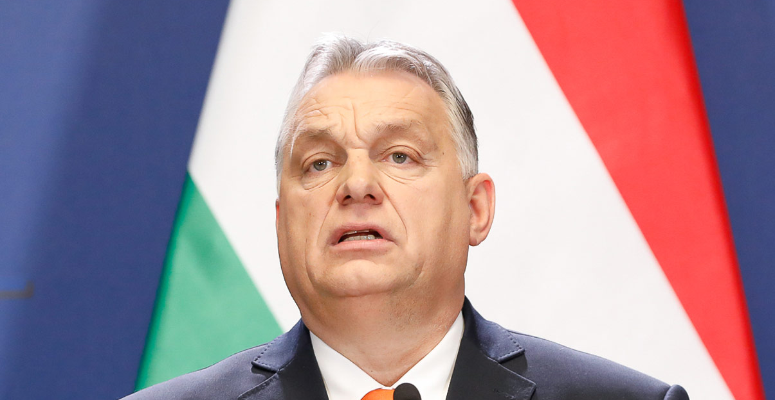
Actual Government
Poland
Mateusz Morawiecki – Prime Minister (Law and Justice Party)
Austria
Karl Nehammer - Chancellor of Austria (ÖVP, Austrian People's Party )
Hungary
Viktor Orban – Prime Minister (Fidesz – Hungarian Civic Alliance)

Slide 4
Post-Communist Transition
In the late 20th century
  Influenced political landscape
  Challenges of transitioning:
    Market economy.
    Stability and national identity.
    Traditional values
    Rise of populist movements
Religious Conservatism
Religious influence: Catholic Church
Social Conservatism.
Cultural preservation.

Slide 5
National Identity and Historical Memory
Struggle against communism.
Historical grievances, Treaty of Trianon.
The framing of national pride.
Post-Imperial Legacies
Austria-Hungarian Empire
World War I: territorial loses and border changes

Slide 6
Historical Right-Wing Movements
Austria | Hungary | Poland
- After World War II: conservative Austrian People's Party (ÖVP) played a crucial role in rebuilding the country. -Freedom Party of Austria was founded in 1945 but became popular with leader Jörg Haider in 1990s who combined liberal economics with nationalism, euroscepticism and antisemitism. It is unofficial successor of Christian Social Party that focused on keeping catholic Austria out of protestant state of Germany - NEOS – liberal right-wing party. | - Fidesz: Right-wing to far right Viktor Orbán continuously winning from 2010 with 40% or more. - Jobbik: Before extreme right now more center, nationalism, agrarism, antiglobalization. - Our homeland movement: Hungarian nationalism, euroscepticism, antisionism, antiglobalization. | - PiS: Jarosław Kaczyński. - Civic Platform: Donald Tusk, liberal conservatism, christian democracy, pro european - Sovereign Poland: Zbigniew Ziobro, national conservatism, social conservatism.

Slide 7

Economic Disparities
Economic uncertainty (Covid, Inflation, War)
Globalization – concerns about the job loss
Regional differences – some regions are left behind economically compared to others
Isolated elites from ordinary citizen

Slide 8

Immigration and Nationalism
Strict border control and limitation on immigration
Border fences – Fidesz
Opposition to EU policis on migration
Protection of cultural and religious identity
Against any external interference

