Slide 1
Modernisation – Birth of nation stateS
1455 1774 Literacy
1517 1648 1781 Secularization
1759 1765 1884 Industrialization
1784 1833 1859 1868/9 Commodification
1781 1848 Urbanization
1893 1906 1918 Democratization

Slide 2
Time-Space Distanciation
SEPARATION
EMPTY TIME END SPACE
DISENBEDDING MECHANISM
  EXPERT SYSTEMS (Railways to Internet)
  SYMBOLIC TOKEN (Money, Language)

Slide 3
The Institutional Dimensions of Modernity
Anthony Giddens
Surveillance
Military power
Industria-lisation
Capitalism

Slide 4
Social differentiation & Media of might/power
Niklas Luhmann
State Government
Family and Intimacy
Public Sphere
Market
Love, Solidarity
Money
Knowledge (Communication)
Reputation (Trust)

Slide 5
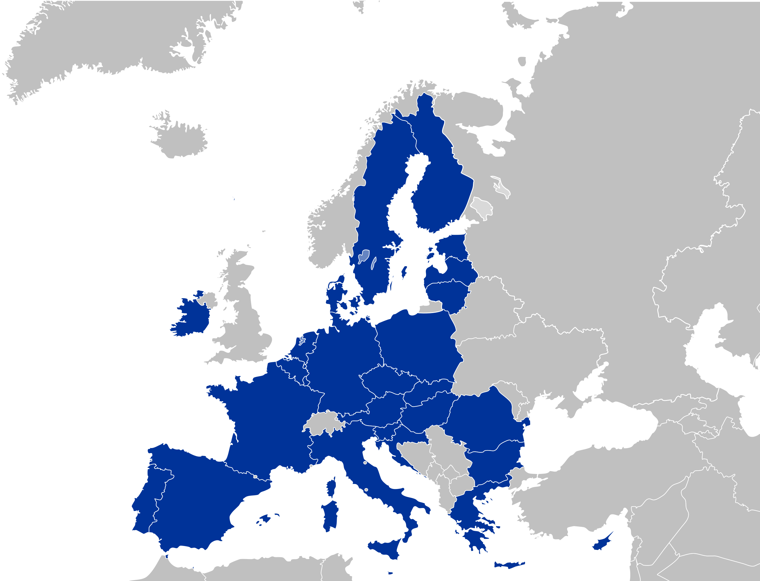
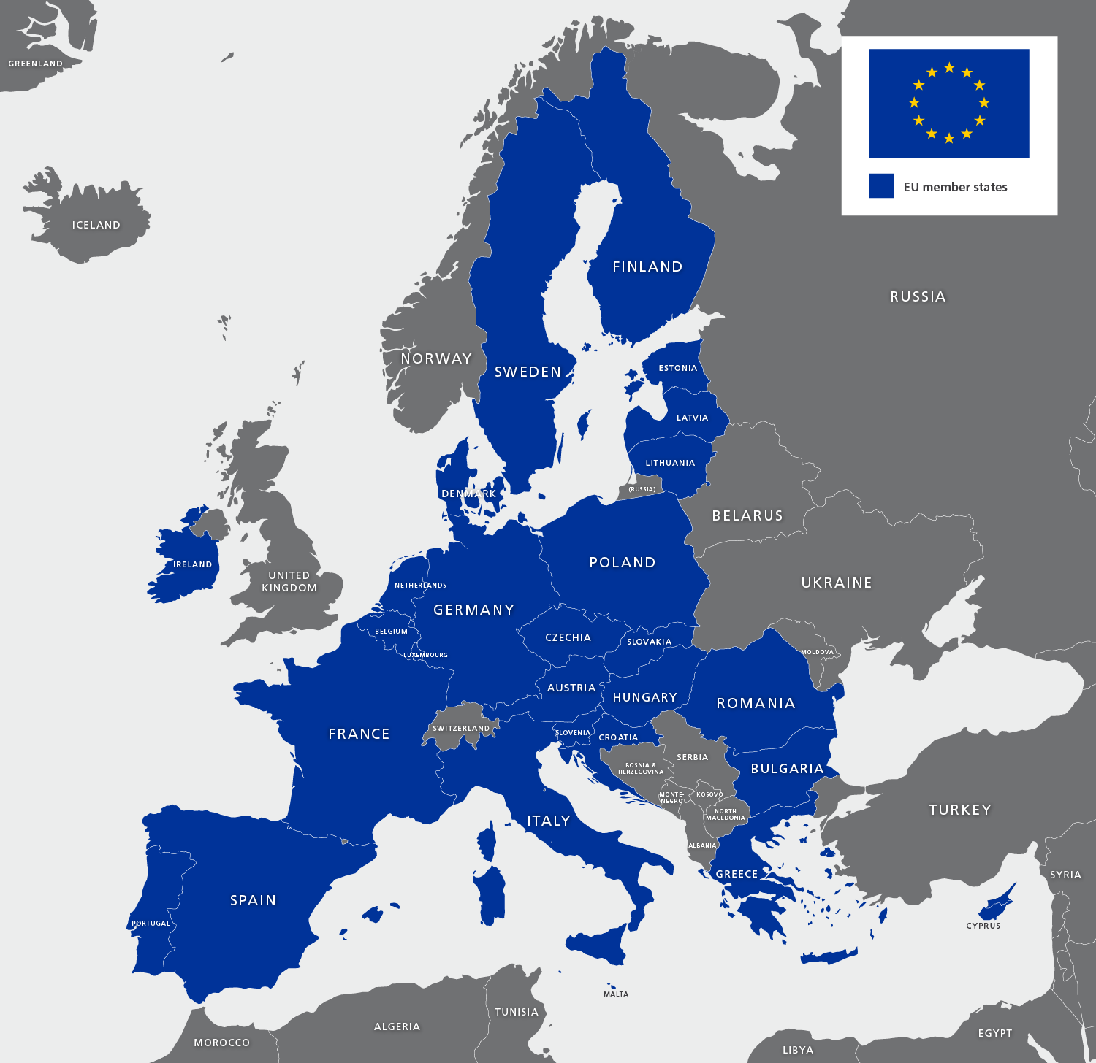
EuropeAn
Union
2023

Slide 6
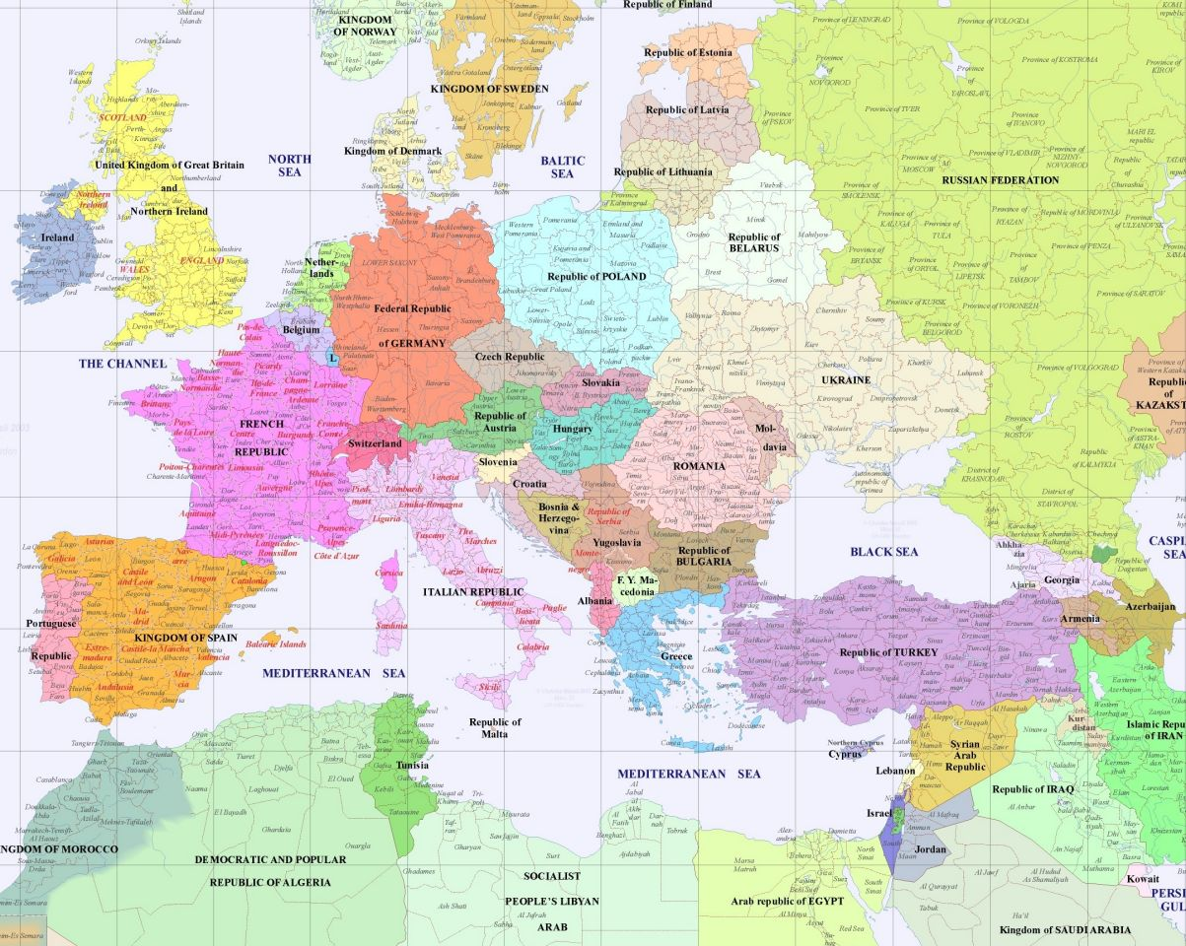
Europe
2000

Slide 7
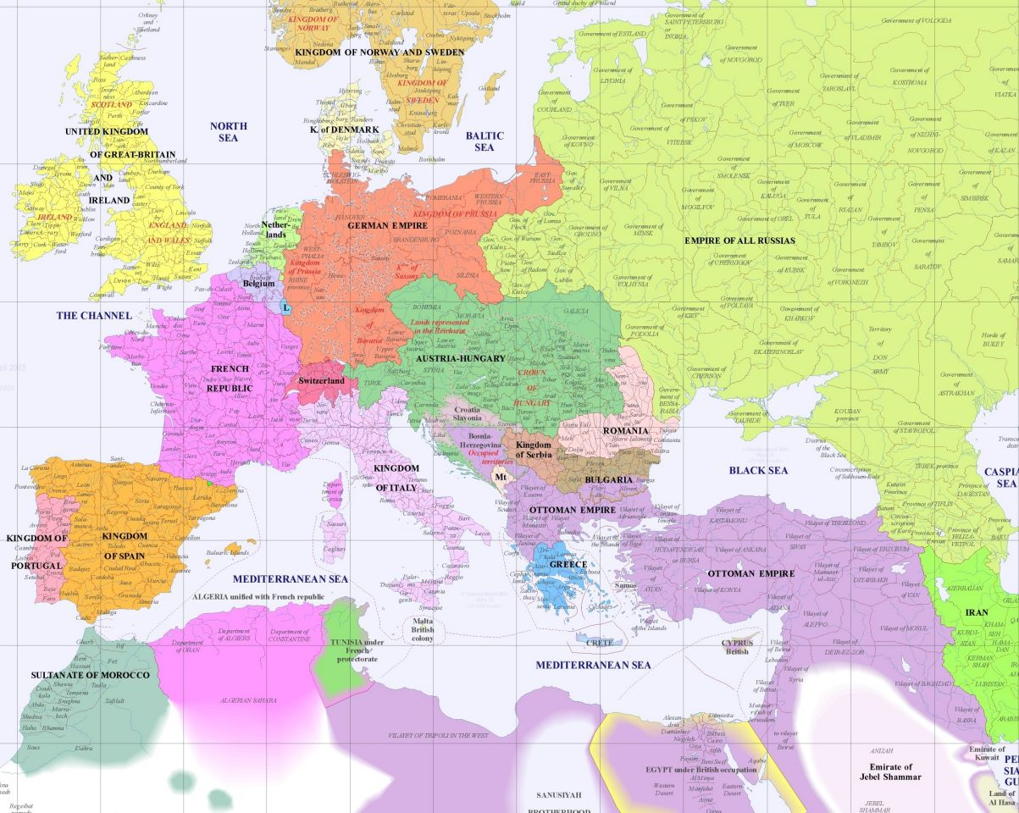
Europe
1900

Slide 8
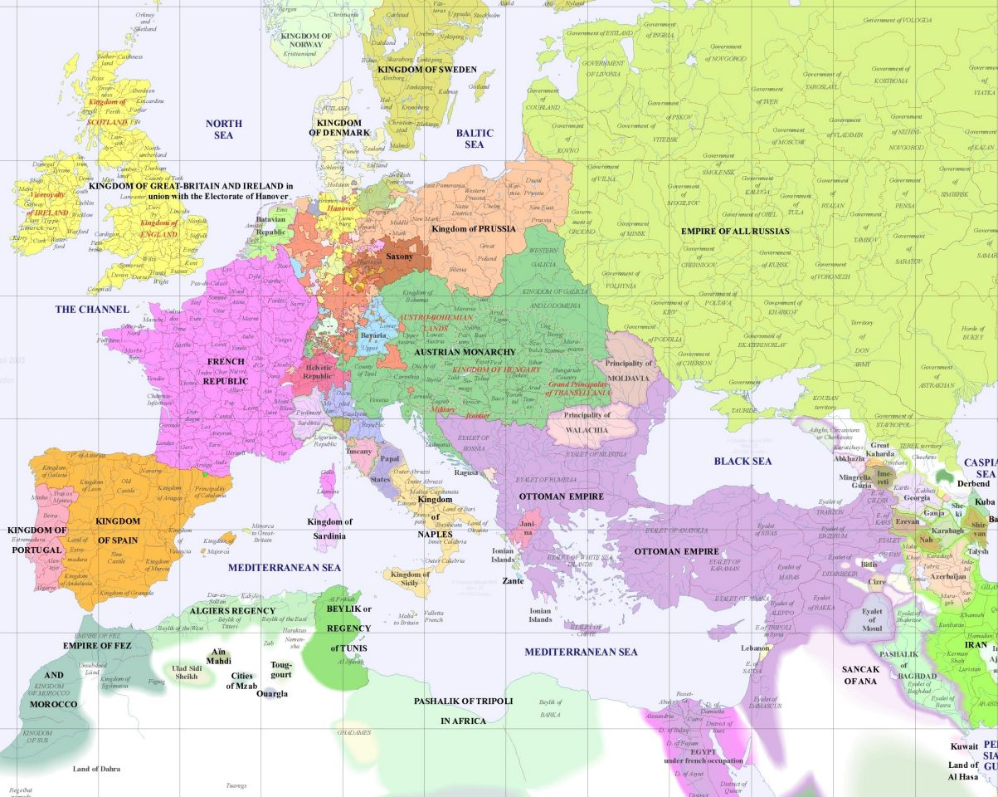
Europe
1800

Slide 9
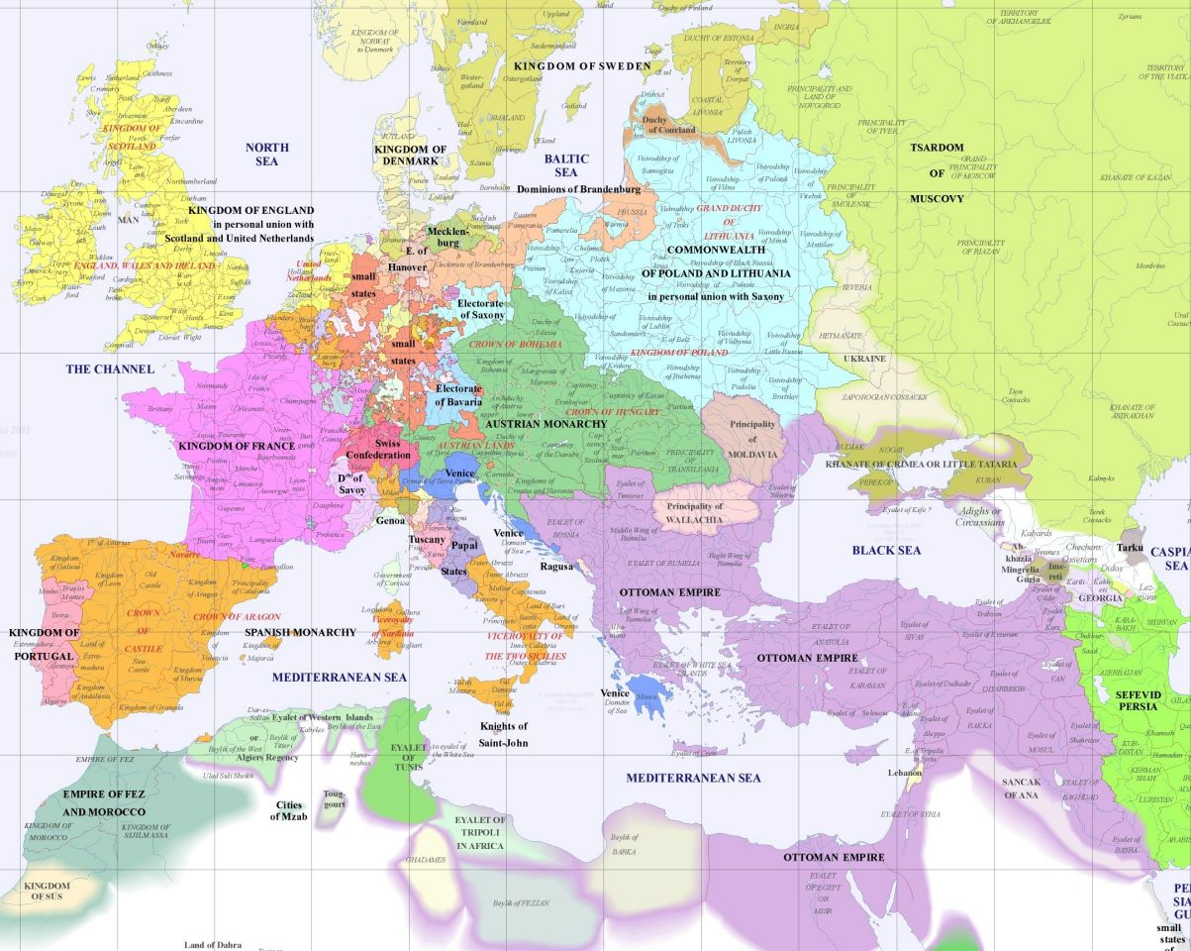
Europe
1700

Slide 10
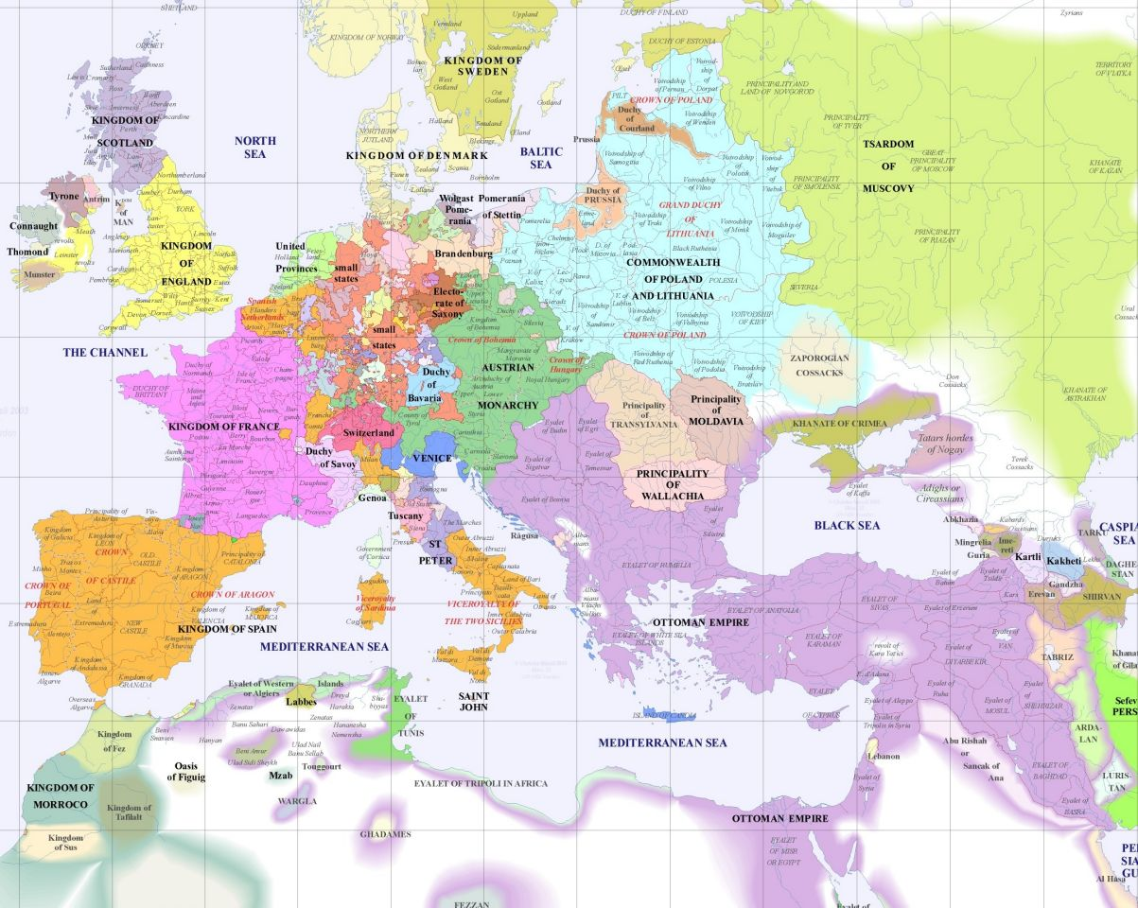
Europe
1600

Slide 11
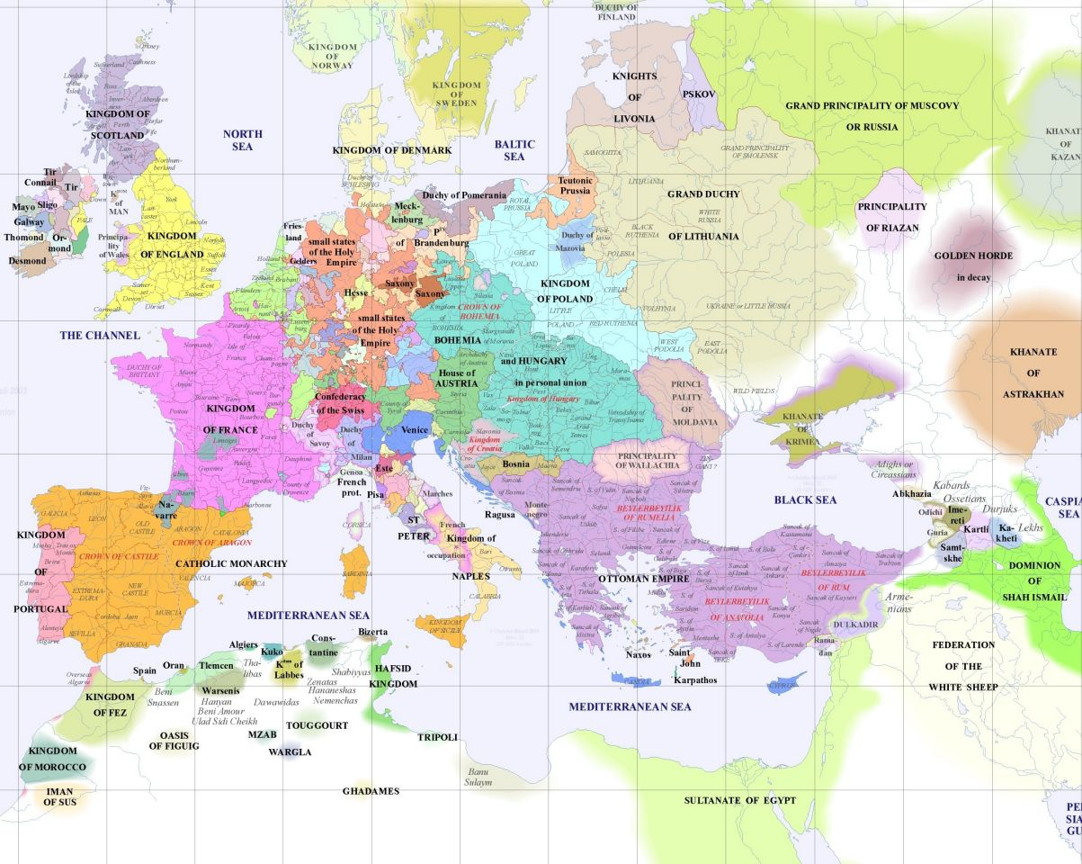
Europe
1500

Slide 12
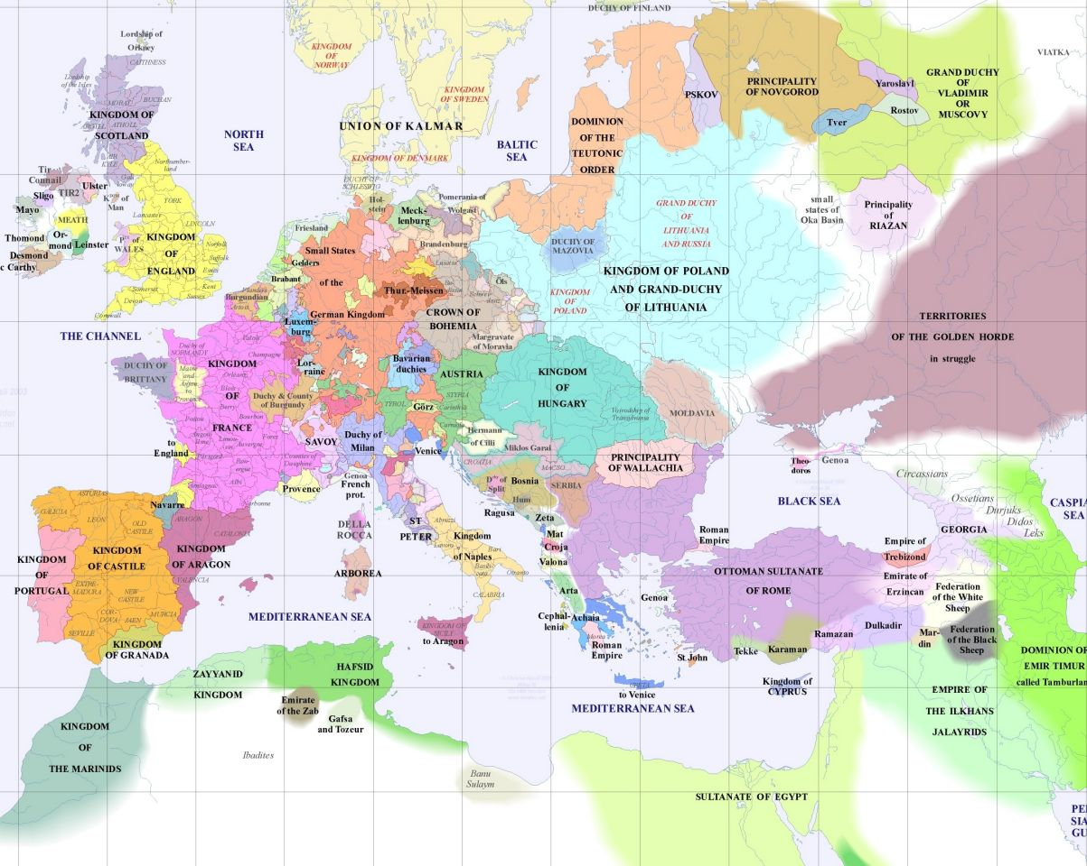
EUROPE
1400

Slide 13
