Slide 1
https://europa.eu/eurobarometer/surveys/detail/3052
https://citizens.ec.europa.eu/index_en

Slide 2
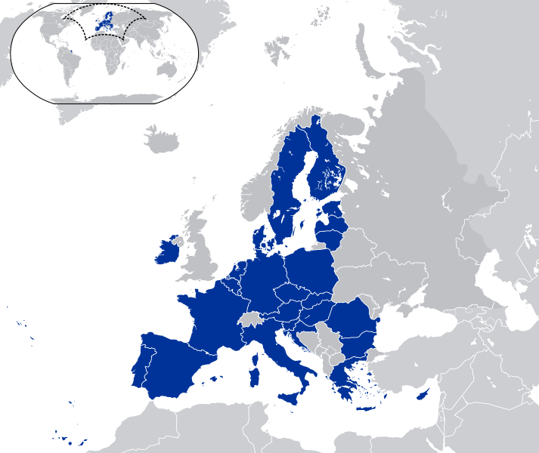

Building the European Union
Stronger !!!
6. 12. 2022
www.karelmuller.eu

Slide 3
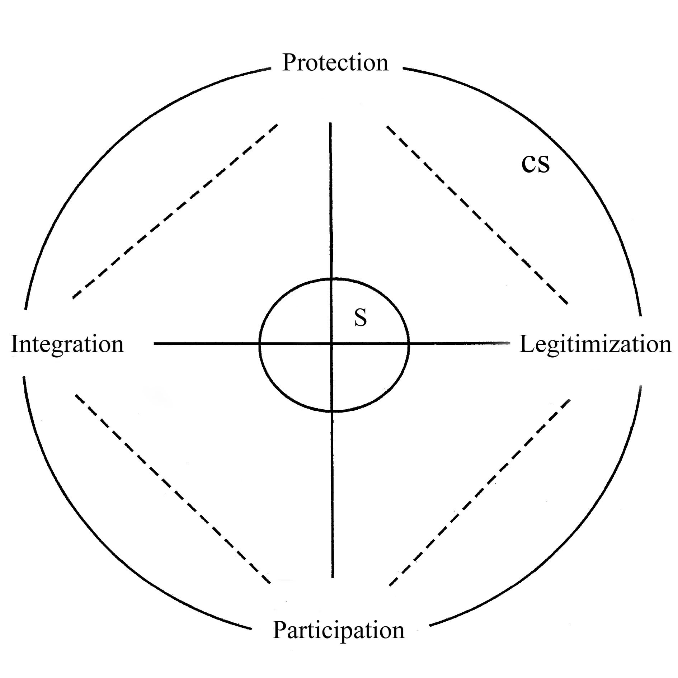
The Concept of Civil Society
Complementary Giddens Perspective of Tocqueville
Müller KB (2006), The Civil Society-State Relationship in Contemporary Discourse: A Complementary Account from Giddens Perspective. The British Journal of Politics and International Relations, 8 (2), 311-330.
Passivity, apathy
Abuses of power
Crisis of legitimacy, low trust to institutions
Anomy, low trust to others

Slide 4
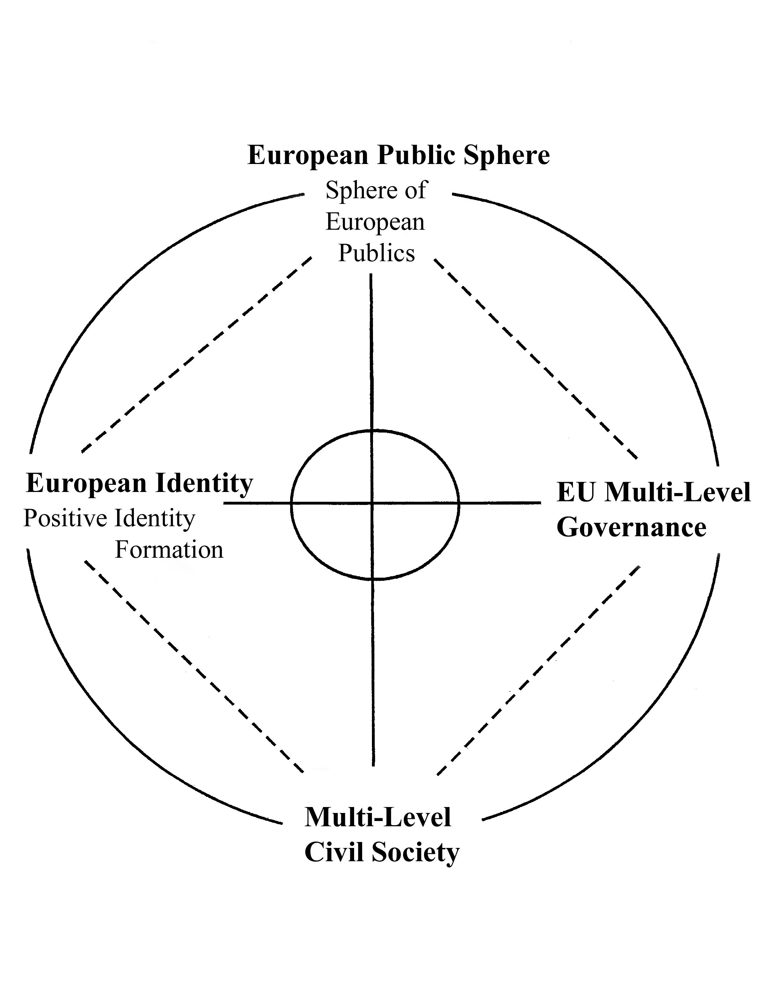
Predicaments of a European Civil Society
Weak spots
Complacency
Lack of Politics (just Policy)
Legitimacy/democratic deficit
Weak European public sphere
Weak European identity
Weak European narrative

Slide 6
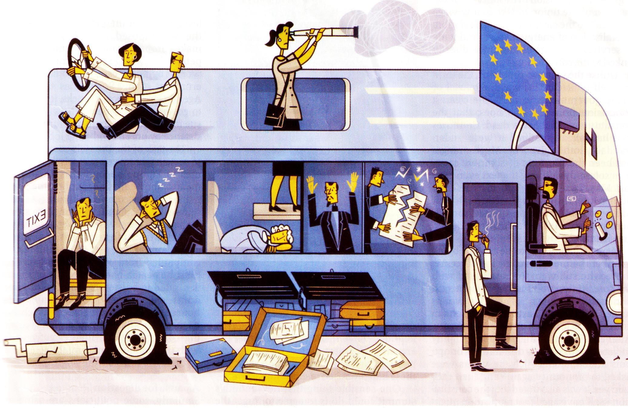

Slide 7
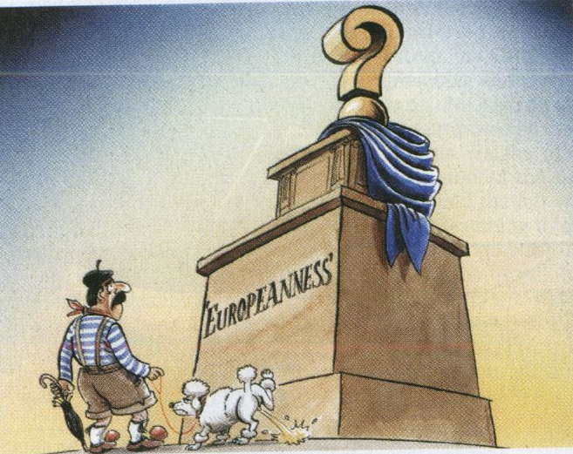
European Identity
Aspiration for complementary and multiple positive identities

Slide 8
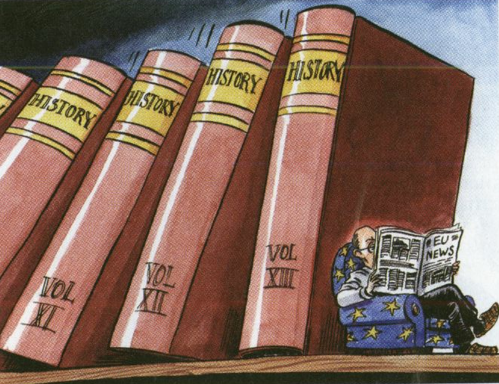
Make history history

Slide 9
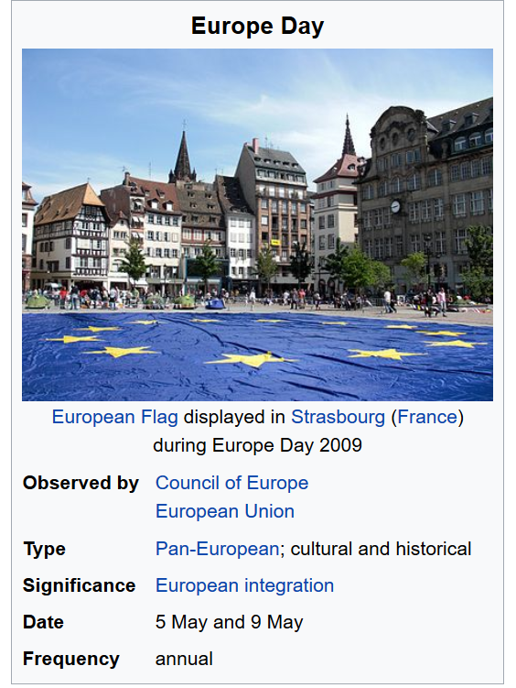

Slide 10
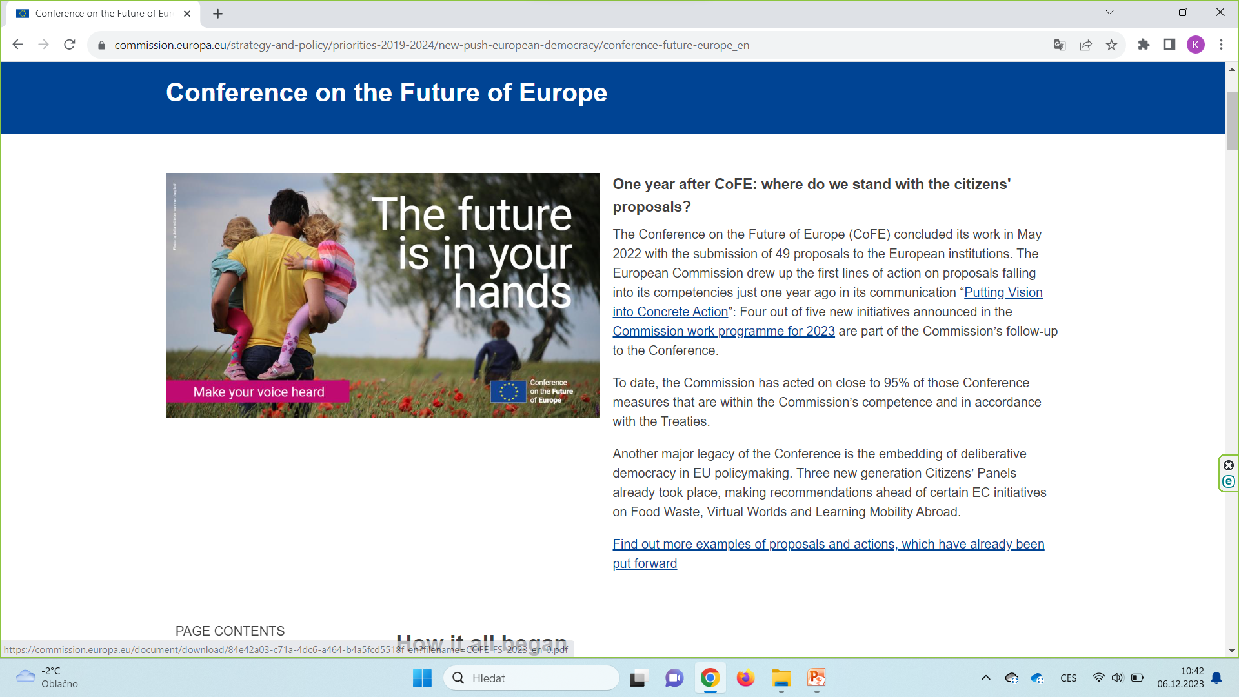
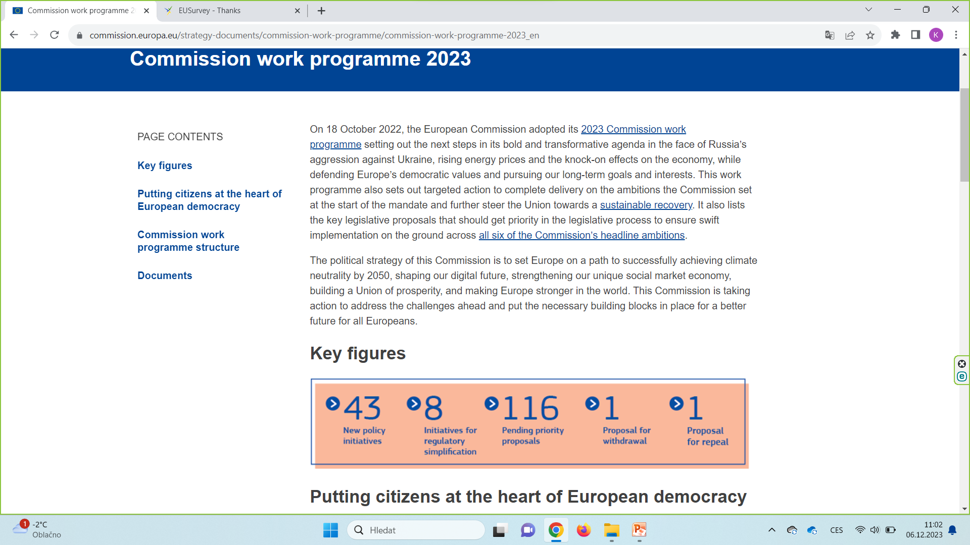

Slide 11
POLITICISATION of the European Union
Policy without Politics (EU) x Politics without Policy
Weak Public Sphere, Weak Collective Identity, Weak Narrative
Absence of Opposition (Alternatives) – Unanimity principle
Voting system in the Council of the EU
EU Commission or High Representative Proposals: Double (Qualified) Majority (55% of MS – 15 out of 27, and 65% of Citizens)
Member state proposal: Reinforced Qualified Majority (72% of MS and 65% of Citizens
The blocking minority must include at least four MS representing more than 35% of the EU population
Lisbon Treaty (2009) Citizens´ Initiative (2012)

Slide 12
