Slide 1
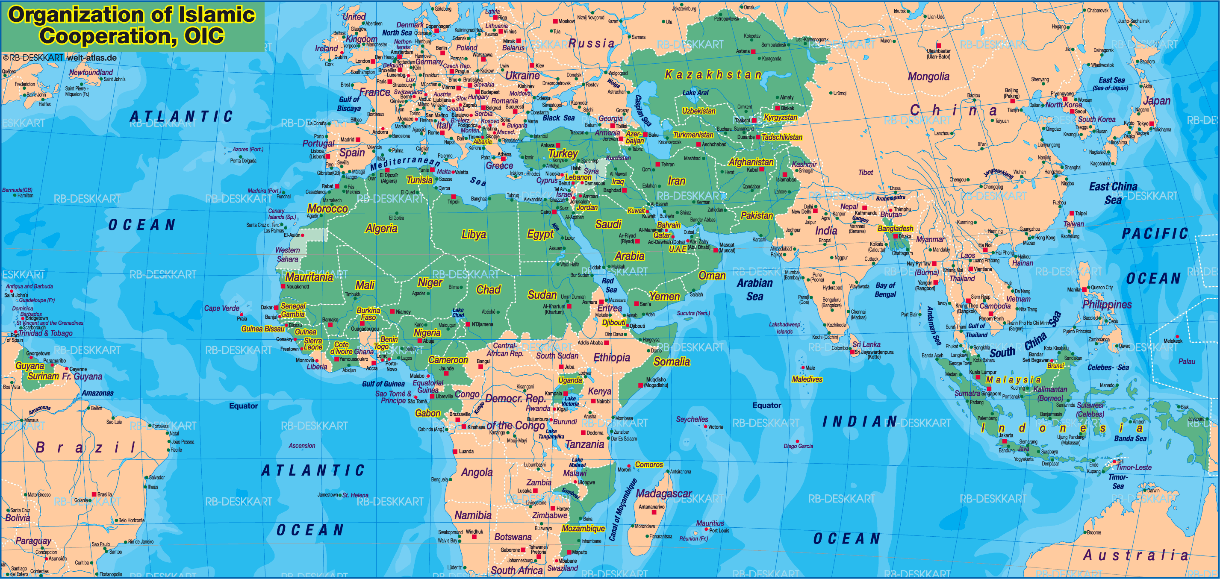
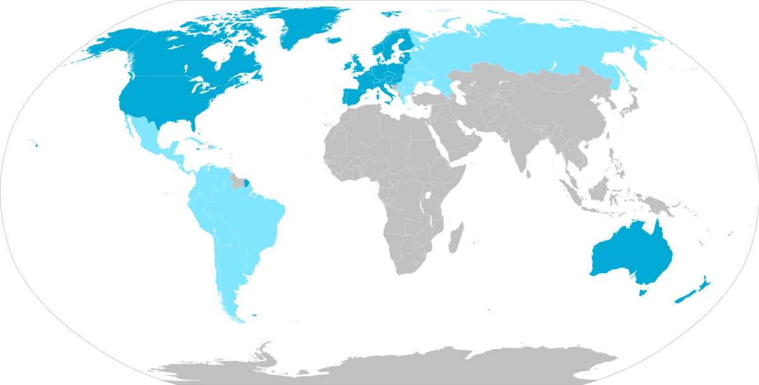
Samuel Huntington
“Clash of Civilizations”
The West vs. Islam
Miguel Inácio

Slide 2
Clash of Civilizations
Huntington defends conflict is not to become less prevalent between states just as Fukuyama believed. Instead believes humanity is following a new pattern of conflict, the latest phase of conflict;
States are still the protagonists of International Relations, just inserted in different civilizations;
This new pattern of conflict will no longer be ideological like it was in the Cold War, instead it will be cultural - predominantly between nations and groups of nations of different civs;
But what is a civilization?
«A civilization is thus the highest cultural grouping of people and the broadest level of cultural identity»
Defined by Objective elements common to all nations and subjective self-identification

Slide 3
Eight Major Civilizations
Western
African
Sinic
Hindu
Orthodox
Japanese
Latin American
Islamic

Slide 4
Inevitability of conflict
Conflict doesn’t necessarily mean armed violence, but conflict in a sense of competition for consumer markets. Even though armed conflict is a possibility.
«The most important conflicts of the future will occur along the cultural fault lines separating these civilizations from one another.»
The nations located on these fault lines of civilizations are called Torn-Countries
Every different civilization has a new way of interpreting and responding to international developments, each with different instruments, means and goals.
Reasons of conflict
Differences between civilizations are real and profound;
Globalization intensifies civilization consciousness and awareness of differences and commonalities;
Processes of globalization separate people from their permanent identities;
Dual role of the West. The West a model to follow and a model to rebel against;
Cultural elements of civilizations are less flexible and susceptible to compromise;
Economic regionalism.

Slide 5
The West Vs. Islam
The conflict between Western civilization and Islam has roots stretching back for over one thousand years.
732 marked the turning point of Islamic conquest in Europe and the West united under the banner of Christianity started pushing back.
11th – 13th century: Crusades
14th – 17th century: Ottoman power in Europe and close
19th – 20th century: European colonialism
1991 marks a new point of conflict between the West and Islam
1991 is the end of the First Gulf War (1990-1991) and since then the West, headed by the United States of America, becomes the big bad boogeyman of the Middle East.
Conflict between West and Islam has been ongoing now for 2 decades.

Slide 6
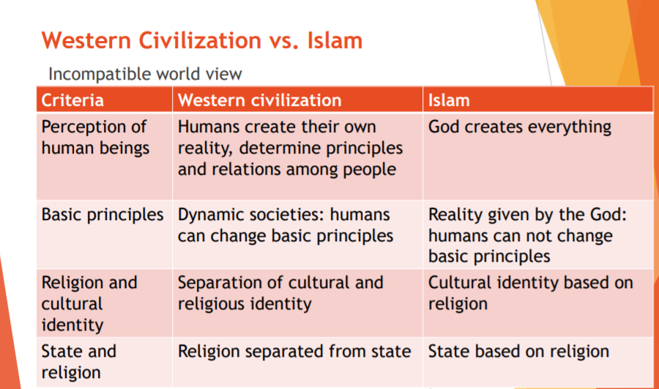

Slide 7
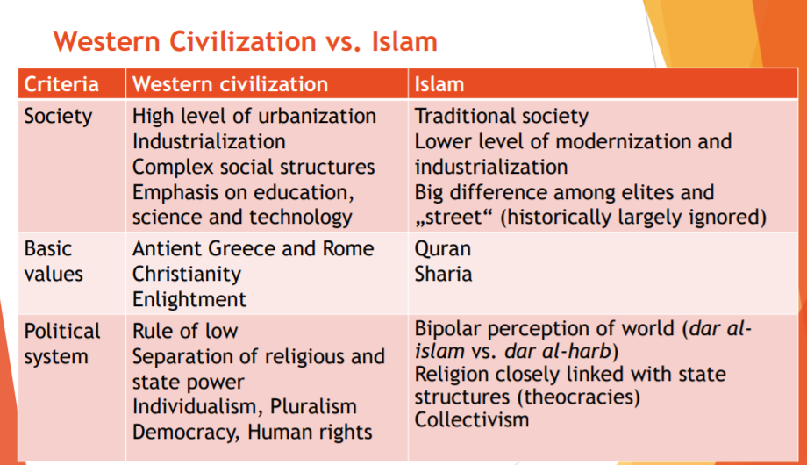

Slide 8
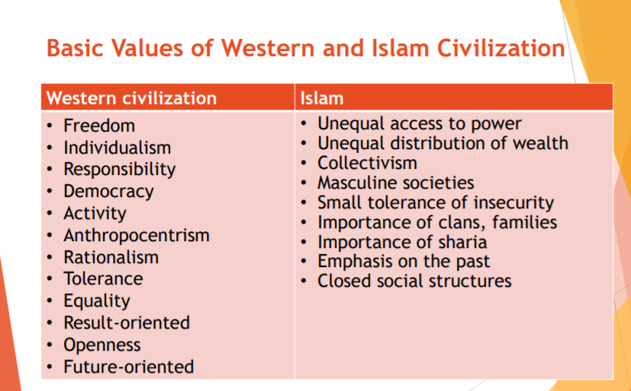

Slide 9
Comparison with other authors
Kissinger in his book “World Order” presents a series of rivel conceptions of World Order followed by different civilizations:
  The Western Civilization, albeit divided between European and American points of view and conceptions;
  The Islamic Civilization;
  And the Sinic Civilization.
This came as a consequence of the acknowledgement that the world is living without a World Order, since there is not a single common system to follow.
The Liberal Order (Western Order as a whole) has wained in the years after 2001. This was an artificial Order, according to Robert Kagan, only sustained due to the effort of the United States.
The Liberal Order only worked if the Western World preserved it and the U.S.A. has stepped back on its role as protector of the world, as such disorder and anarchy in the field of International Relations grew.
The consequence of the attempt to maintain a world order, is that it carries heavy costs supported mostly by the US. These costs are not only measured in terms of finance and economy, but also in lives lost and moral ones.
It is because of this role that the World revolted against the Western World, most notably the Islamic Civilization.

Slide 10
Western vs. Islamic World Order
Islamic Order:
. Dismantling States and Societies in pursuit of a global revolution based on a fundamentalist interpretation of religion – The World Caliphate.
. Carried out by fringe religious groups on both sides of the Sunni- Shia split, some of which are more powerful than governments propped up by Western countries.
. One Empire, One Faith, One Sovereignty.
European Order:
. Based upon the Westphalian Peace’s realistic and practical compromise.
. Multiplicity of political unities and none of them is to be powerful enough to defeat others.
. Neutral and fair common rules of coexistence capable of regulating conduct on the world stage and mitigating conflict.
American Order:
. Peace and equilibrium between nations to occur naturally and old animosities to be set aside as other nations participated in this concert of nations headed by the United States.
. Not based upon the european power sharing model, but on the expansion of democratic principles, on which peace would prevail.

