Slide 1

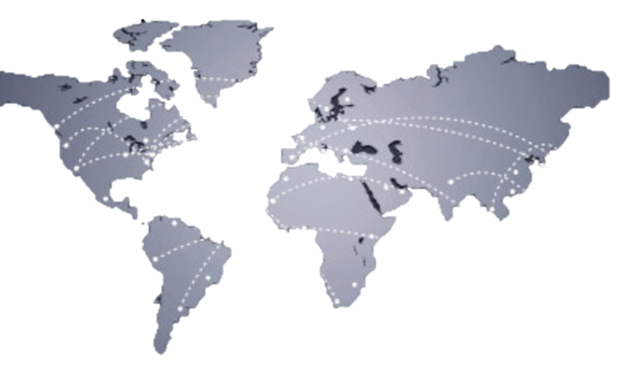
Importance of transnational socials movements at the age of globalization
Wandrille Neviaski

Slide 2
CONTENT
1) WHAT ARE THE TRANSNATIONAL SOCIALS MOVEMENTS?
2) WHAT IS THE GENESIS OF TRANSNATIONAL SOCIALS MOVEMENTS?
3) WHAT ARE THE EXAMPLE OF FAMOUS TRANSNATIONAL SOCIALS MOVEMENTS?
4) WHATS IS THE LINK BETWEEN GLOBALIZATION AND TRANSNATIONAL SOCIALS MOVEMENTS?

Slide 3

1) WHAT ARE THE TRANSNATIONAL SOCIALS MOVEMENTS?
Actors engaged together in two different countries
Against one of this two states from or against an international organization

Slide 4

2) WHAT IS THE GENESIS OF TRANSNATIONAL SOCIALS MOVEMENTS?
XIXth century
First TSM
XX century
Spread of TSM
XXI century
Rapid growth of TSM
Spread of liberals democracies
and Fall of USSR

Slide 5





3) WHAT ARE THE EXAMPLE OF FAMOUS TRANSNATIONAL SOCIALS MOVEMENTS?
NGO transnational social movement
transnational social movement

Slide 6


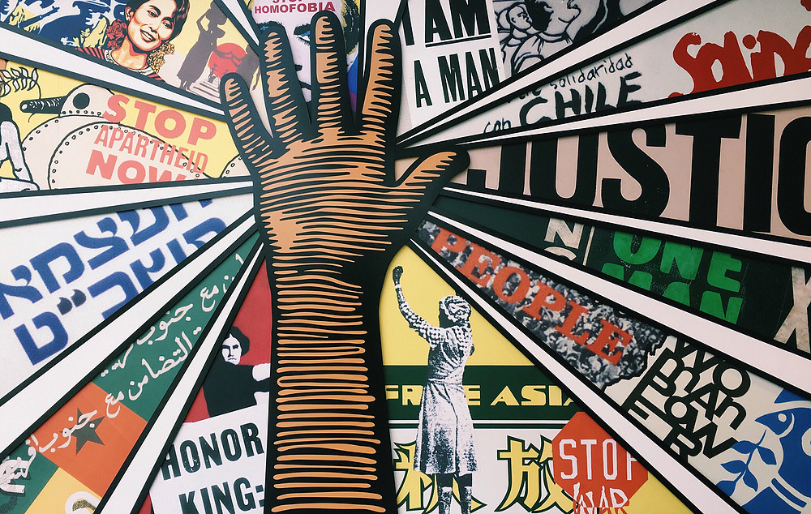

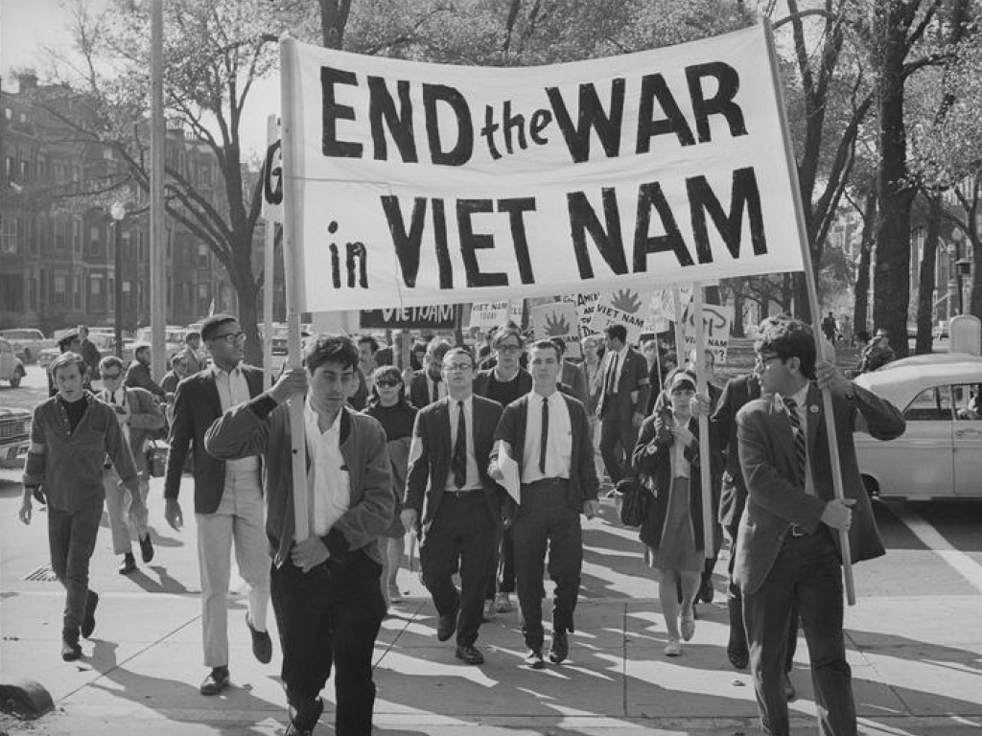
4) WHATS IS THE LINK BETWEEN GLOBALIZATION AND TRANSNATIONAL SOCIALS MOVEMENT?
FREE CIRCULATION OF INFORMATION AND FACILITY CIRCULATION OF PERSONS CREATE TRANSNATIONAL SOCIAL MOVEMENT
FACILITY OF MOVEMENT
FREE FLOW OF INFORMATION
TRANSNATIONALS SOCIALS
MOVEMENTS
E.G : THE VIETNAM WAR

Slide 7
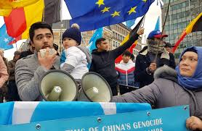
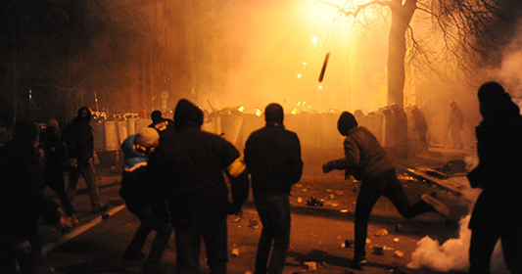
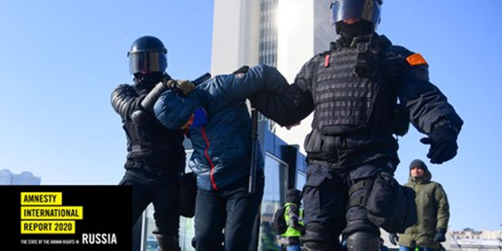
4) WHATS IS THE LINK BETWEEN GLOBALIZATION AND TRANSNATIONAL SOCIALS MOVEMENTS?
GLOBALIZATION OF PROBLEMS ( E.G UIGHUR)
TRANSNATIONAL MOVEMENT CAN BE INSTRUMENTALIZED BY STATES (E.G :ORANGE REVOLUTION IN UKRAINE & SOROS FOUNDATION)
SUSPICION OF STATES (E.G RUSSIA)

Slide 8
TO CONCLUDE
THE APPEARANCE OF THIS TYPE OF MOVEMENT IS LINKED TO THE APPEARANCE OF DEMOCRATIC SYSTEMS
TRANSNATIONAL SOCIALS MOVEMENT CAN BE USED BY A STATE TO EXTEND ITS INFLUENCE
TRANSNATIONAL SOCIALS MOVEMENTS ARE PART OF SOFT POWER OF STATES
THE GROWTH OF TRANSNATIONAL SOCIALS MOVEMENTS IS IN LIKED WITH GLOBALISATION

Slide 9
SOURCES
https://www.britannica.com/topic/transnational-social-movement
https://www.cambridge.org/core/books/abs/social-movements-and-organization-theory/globalization-and-transnational-social-movement-organizations/A9C975B7AB8ACAFCA47BA2F6CF6E0CF1
https://oxfordre.com/internationalstudies/view/10.1093/acrefore/9780190846626.001.0001/acrefore-9780190846626-e-491
https://www.jstor.org/stable/45037992
https://www.oxfordbibliographies.com/view/document/obo-9780199743292/obo-9780199743292-0164.xml
https://www.degruyter.com/document/doi/10.14361/9783839451830-006/pdf
https://etd.ohiolink.edu/apexprod/rws_etd/send_file/send?accession=osu1437519854&disposition=inline
https://www.lefigaro.fr/international/en-russie-une-acceleration-des-mesures-contre-le-droit-a-manifester-20210812
https://www.lexpress.fr/informations/les-dessous-de-la-revolution-orange_666653.html

