Slide 1
Social problems in China
Nikita Umnov
Notes:
Hello, my name is Nikita and I have prepared for you some information about social problems in China.Usually, when we talk about social problems in a country, we think we have to rely solely on sociological data. However, it is much more important to understand and interpret social realities in a certain context. So I will try to present a whole picture of the social situation in China through three major sociological theories.

Slide 2
Sociological theories
Conflict theory
Sociological theories
Functionalism theory
Symbolic interactionism theory
Notes:
Social theories explain not only known facts, but also help us understand not only the political, social, but also cultural nature of social problems in different societies. For example Symbolic interactionism theory describes society as an ongoing process of many social interactions, which based on symbolic context in which they occur. On the other hand, the conflict theory focuses on the economic dimension of the problem, while the functionalist theory tries to find a balance in the social structure of society.On the other hand, the conflict theory focuses on the economic denomination of the problem, while the functionalist theory tries to find a balance in the social structure of society. Therefore, through these theories, we can explore all three major dimensions of Chinese social space: the economic, political, and cultural dimensions

Slide 3
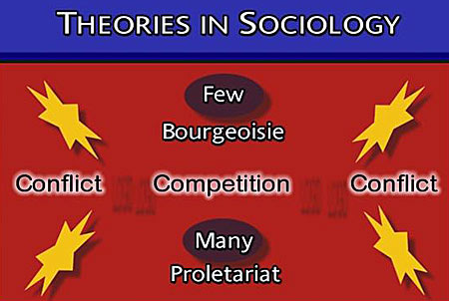
Conflict theory
Class conflict- Bourgeoisie x Proletariat
Competition for limited resources
War is natural
Wealthy elite (Bourgeoisie) have the most power
Notes:
As I have already said one of the main sociological theories, which interprets social conflicts as a result of economic unevenness , is the conflict theory. It is clear from the name of this theory,that the basis of this theory are certain conflict situations in society. According to the conflict theory the main reason of any social conflict is the unfair distribution of resources among different segments of the population. One of the first apologists of this theory Karl Marx used the term class to refer to a particular social group with or without access to resources. The group of people with access to most resources Marx called the bourgeoisie. The second more quantitative group is the proletariat, which has almost no access to resources. The most interesting point of this theory is the innovative interpretation of conflict as the main driving mechanism of the process of social change. Despite the generally accepted notion of a Marxist solution to social problems, proponents of conflict theory do not focus on the problem of a completely equal distribution of resources. Rather, it is a question of acquiring resources by the larger group, which would result in a more equitable distribution of wealth in society.

Slide 4
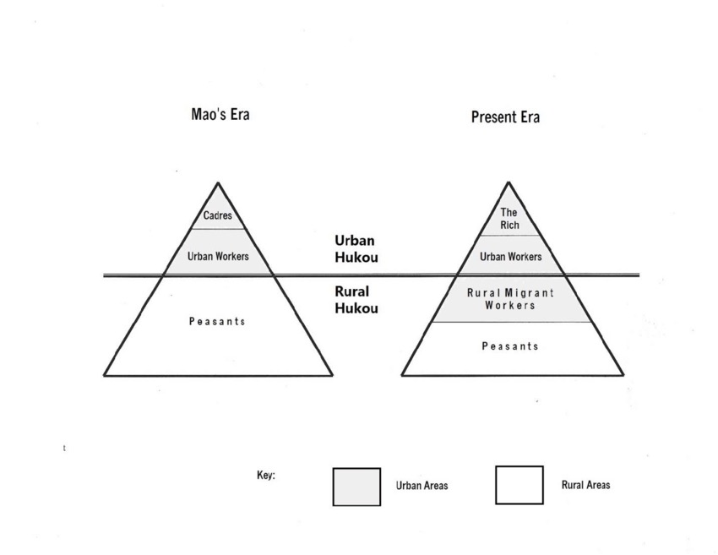
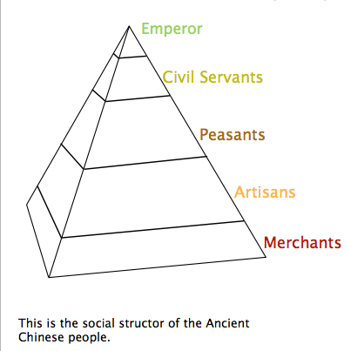
Changes in social structure
Notes:
If we look closely at the historical development of China's social structure, we are surprised to find that it has not changed much. Certainly in the course of historical events, new classes have always appeared and old ones have disappeared. But the principle of ruling the rich minority over the poor majority remained the same, even after Mao's communist revolution.This argument is a key one for critics of the conflict theory.

Slide 5
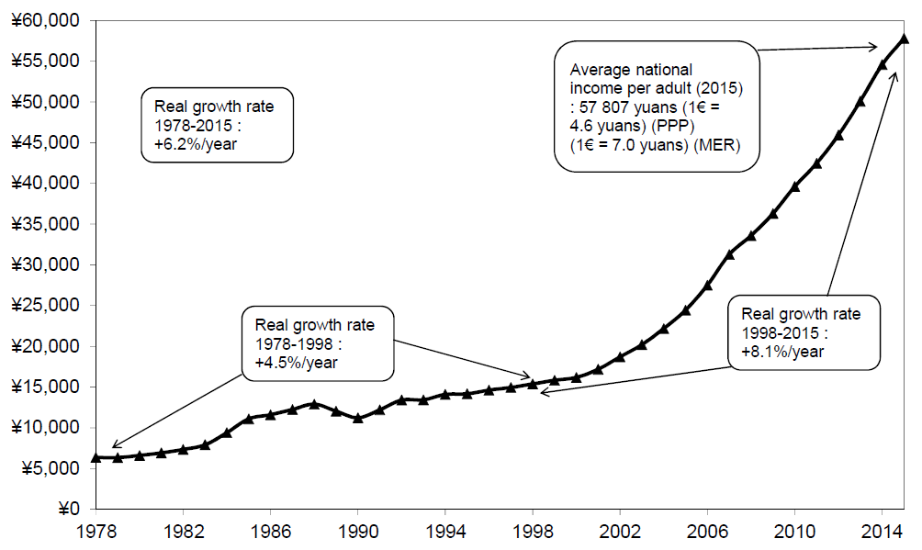
Income inequality
Notes:
On the other hand, it should also be emphasized that during the process of economic liberalization in China, income inequality was constantly growing.

Slide 6
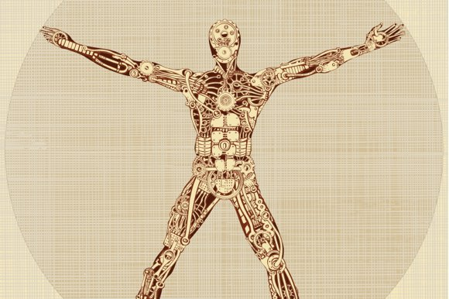
Functionalism
Biological model of society
Society has interrelated parts
Functions x dysfunctions of parts
Equilibrium- society adjusts to maintain balance
Manifest and latent functions
Notes:
The second fundamental theory is the functionalist theory.
The main difference of this theory from all other theories is its optimistic interpretation of social processes. Unlike conflict theorists, functionalists believe that any negative or destructive impact of certain social processes can be stopped by transformation or adaptation of society to new realities.This raises the question of the specific way of carrying out this transformation. Therefore, supporters of functionalism turned to biology for help and constructed their biological model of society. This model is especially interesting by its idea of functioning of society as a living organism, which can be affected by different diseases or dysfunctions. In order to cure the organism or stabilize society, it is necessary first to identify the sick or dysfunctional part in time, and then to proceed to the establishment of an adequate result or achieving balancebalance. This goal can be achieved through visible or manifest actions (treatment) or actions that are not sufficiently clear and visible, of course I am talking about latent actions.

Slide 7
Functionalism - practical dimension
Social inequality in China
The Chinese government's solution- state interventions in different spheres of life
Manifest function of government intervention - reducing economic inequality
Latent function- Increasing solidarity , stable situation in society
Manifest dysfunctions - lower economic growth, more state control
Latent dysfunctions - lowering public pluralism, limiting the protest potential of society
Notes:
Now we look at the application of these principles in practice. For example, if we talk about the problem of social inequality, China has tried to solve this problem with the help ofstate intervention in the economy. Among the manifest functions of this action is the reduction of economic inequality in society. The latent or invisible functions include the growth of social solidarity and a stable situation in society. On the other side, manifest dysfunctions include reduced economic growth and increased government control.Or if we are talking about latent dysfunctions, these include limiting social pluralism or reducing the protest potential of society

Slide 8
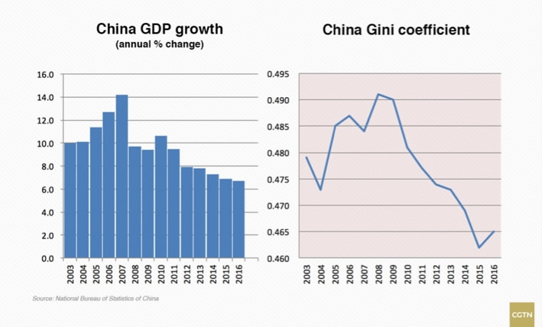
Functionalism - practical dimension
Notes:
On this slide, we can see a direct correlation between increased government control of the economy and China's declining economic growth. The Gino coefficient shows the measure of economic inequality. This graph also shows that the ideal state for the state is a balance between economic openness and policies aimed at restoring evenness in society

Slide 9
Functionalism - practical dimension
China's overpopulation problem
The Chinese government's solution- overpopulation laws (one-child limit)
Manifest function- declining birth rate, sufficient resources
Latent function- less spending on child care
Manifest dysfunction - decreasing the number of workers
Latent dysfunction - restriction of people's freedom
Notes:
The next social problem we will analyze is the problem of overpopulation in China. The solution was the implementation of the one-child policy in 1980, which allowed only one child per family. The manifest functions of this solution include fertility reduction and resource abundance. The latent functions include the lower cost of childcare for parents. As for the dysfunctions of this solution, the manifest dysfunctions include a reduction in the number of workers, and the latent ones include restrictions on people's right to family planning.

Slide 10
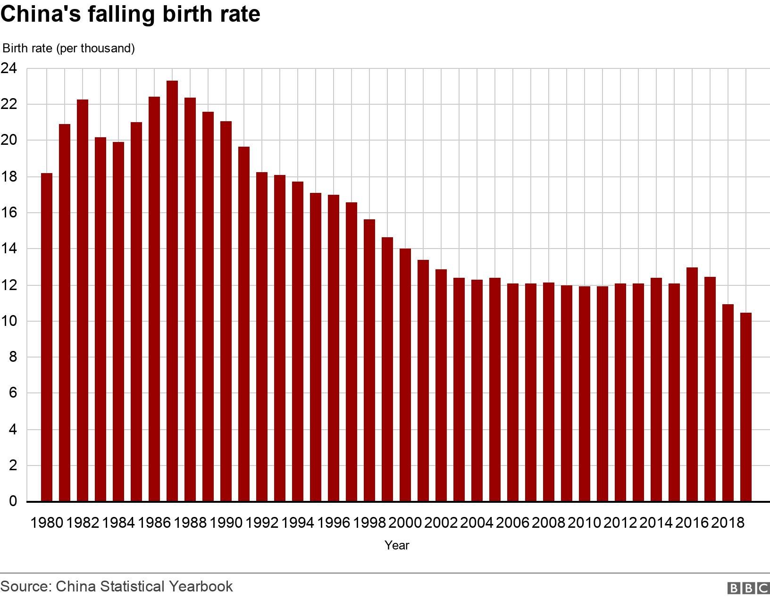
Functionalism - practical dimension
Notes:
As we can see, China's one-child policy has fulfilled its eye-opening goal of reducing the birth rate. On the other hand, China is currently experiencing some difficulties in renewing population growth due to the abolition of these laws in 2015.

Slide 11
Symbolic interactionism
Society is an ongoing process of many social interactions
Symbolic context of interactions
Subjective interpretation of symbols
Communications
Roles
Notes:
Finally, the last theory presented is the theory of social interactionism. This theory differs from the others in its interpretation of social problems as communicative problems. According to some theorists, our social reality is constructed of relationships between people who can subjectively interpret certain events with the help of symbols. This process is key to the creation of social programs that could change the social thinking of people in society.

Slide 12
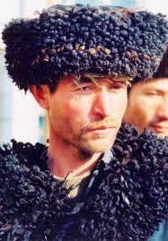
Religious and cultural discrimination
The influence of Confucianism - secularized culture
Homogeneous and closed society
Discrimination against Uyghurs
Rejection of Muslim culture
State propaganda
Notes:
One of the main cultural problems of Chinese society is discrimination against the Muslim Uighur people, who do not fit into the generally accepted cultural context. The main reason is the historical closed nature of this society, which is also skeptical of different religious beliefs due to the influence of Confucianism and Communism. A negative influence is also exerted by state propaganda, which presents Islam as a societal threat

Slide 13
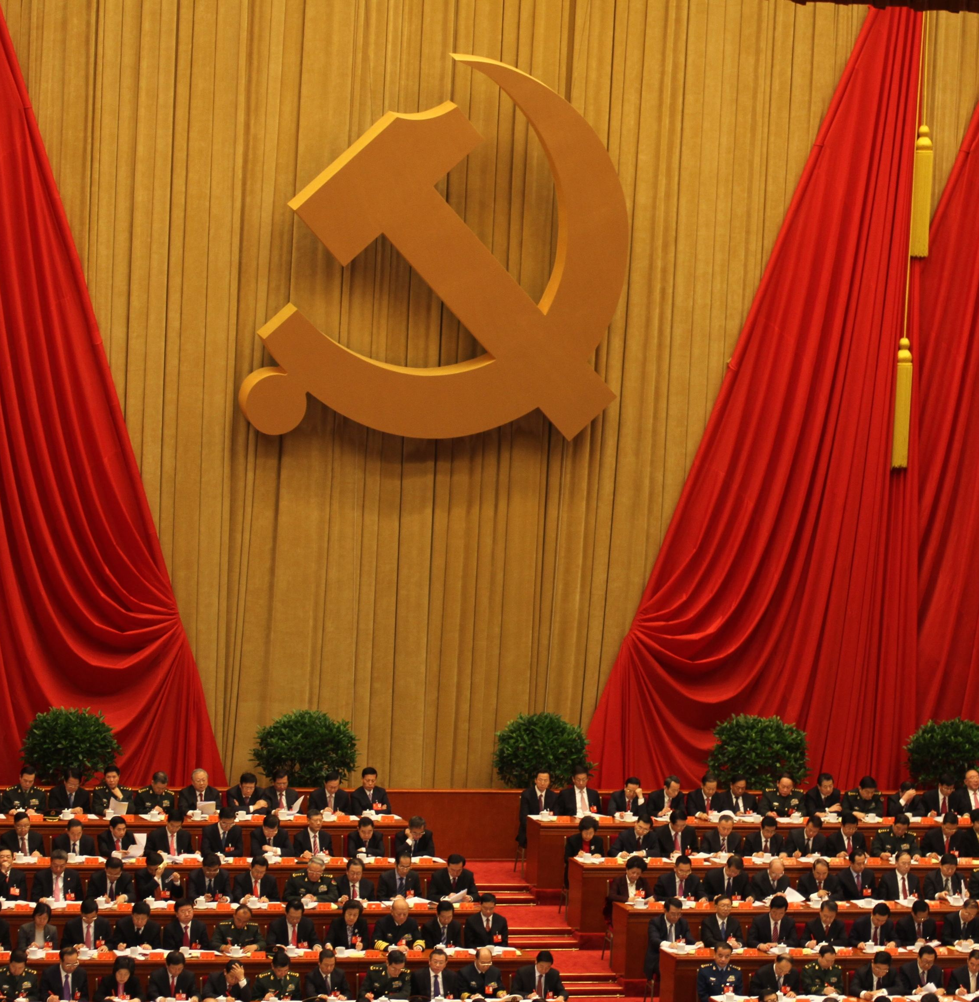
Inequality and the Communist Party
Communist Party Membership-Successful Life
Suppression of the business sphere
Party authority - resignation to a lack of civil liberties
Notes:
As for the cultural discourse on the influence of communism, it should be divided into two parts. First, the ideological influence of the Communist Party, which is not too great today, is compensated by the authoritative role of the party, which is based on repressive power and the suppression of civil liberties. In addition, more and more young people are joining the party for the purpose of enrichment and career advancement, resulting in a massive state apparatus where corruption is rampant.

Slide 14
Gender inequality
Patriarchal culture- symbol of a man as a leader
Discrimination in politics - fewer women in public office
Pregnancy related discrimination
Domestic violence
Covid 19 - higher unemployment among women
Notes:
The next big problem is gender discrimination, which has its roots in the ancient medieval view of the man as the master and head of the family. The most urgent problems in this area are the smaller number of women in public functions or problems related to domestic violence and limited access to jobs for women due to pregnancy.

Slide 15
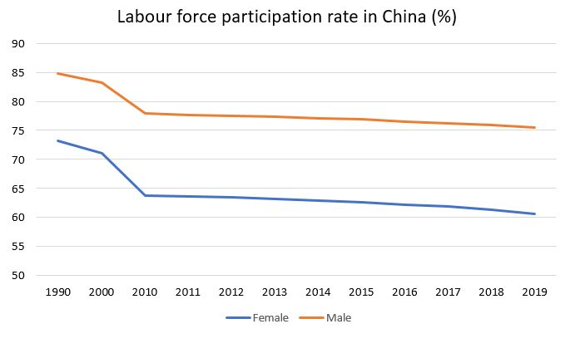
Gender inequality
Notes:
This graph shows us a constant decrease in the number of working women compared to working men. The government is trying to solve this problem through various social programs and the introduction of gender quotas in the workplace.

Slide 16

Digital surveillance
MyChat
Sharp eyes
Social credit system
DNA database
Notes:
I would also like to end with a few facts about digital surveillance in China. The Chinese state uses different technologies to collect information about Chinese citizens. For example, the social network wechat collects information about people's correspondence. Sharp eyes technology also collects data from video cameras across the country. The Chinese government is also recently trying to create a DNA database. But the most interesting is the social credit system which rewards or punishes citizens with limited access to social services.

Slide 17
Cryptocurrencies and wealth inequality
How cryptocurrencies can help end wealth inequality in China?
People can no longer be trampled by “monetary policy”
The government will no longer be able to interfere ineffectively in the economy.
The growth of crypto and decentralized finance will ease wealth transfer
Simplification or elimination of the rules of the formal financial system
2021- China has declared all cryptocurrency transactions illegal

Slide 18
Sources
STRASSER, Hermann; RANDALL, Susan C. introduction to theories of social change. 1974.
https://www.hrw.org/news/2020/04/29/china-gender-discrimination-hiring-persists
Rosenberg BG, Jing Q. A revolution in family life: The political and social structural impact of China's one child policy. Journal of Social Issues. 1996 Oct;52(3):51-69.
Bian Y. Chinese social stratification and social mobility. Annual review of sociology. 2002 Aug;28(1):91-116.
https://cryptonews.com/exclusives/how-bitcoin-crypto-might-help-ease-wealth-inequality-without-miracles.html
Li, S., Sato, H. and Sicular, T. eds., 2013. Rising inequality in China: Challenges to a harmonious society. Cambridge University Press.
Knight J. Inequality in China: an overview. The World Bank Research Observer. 2014 Feb 1;29(1):1-9.

