Slide 1
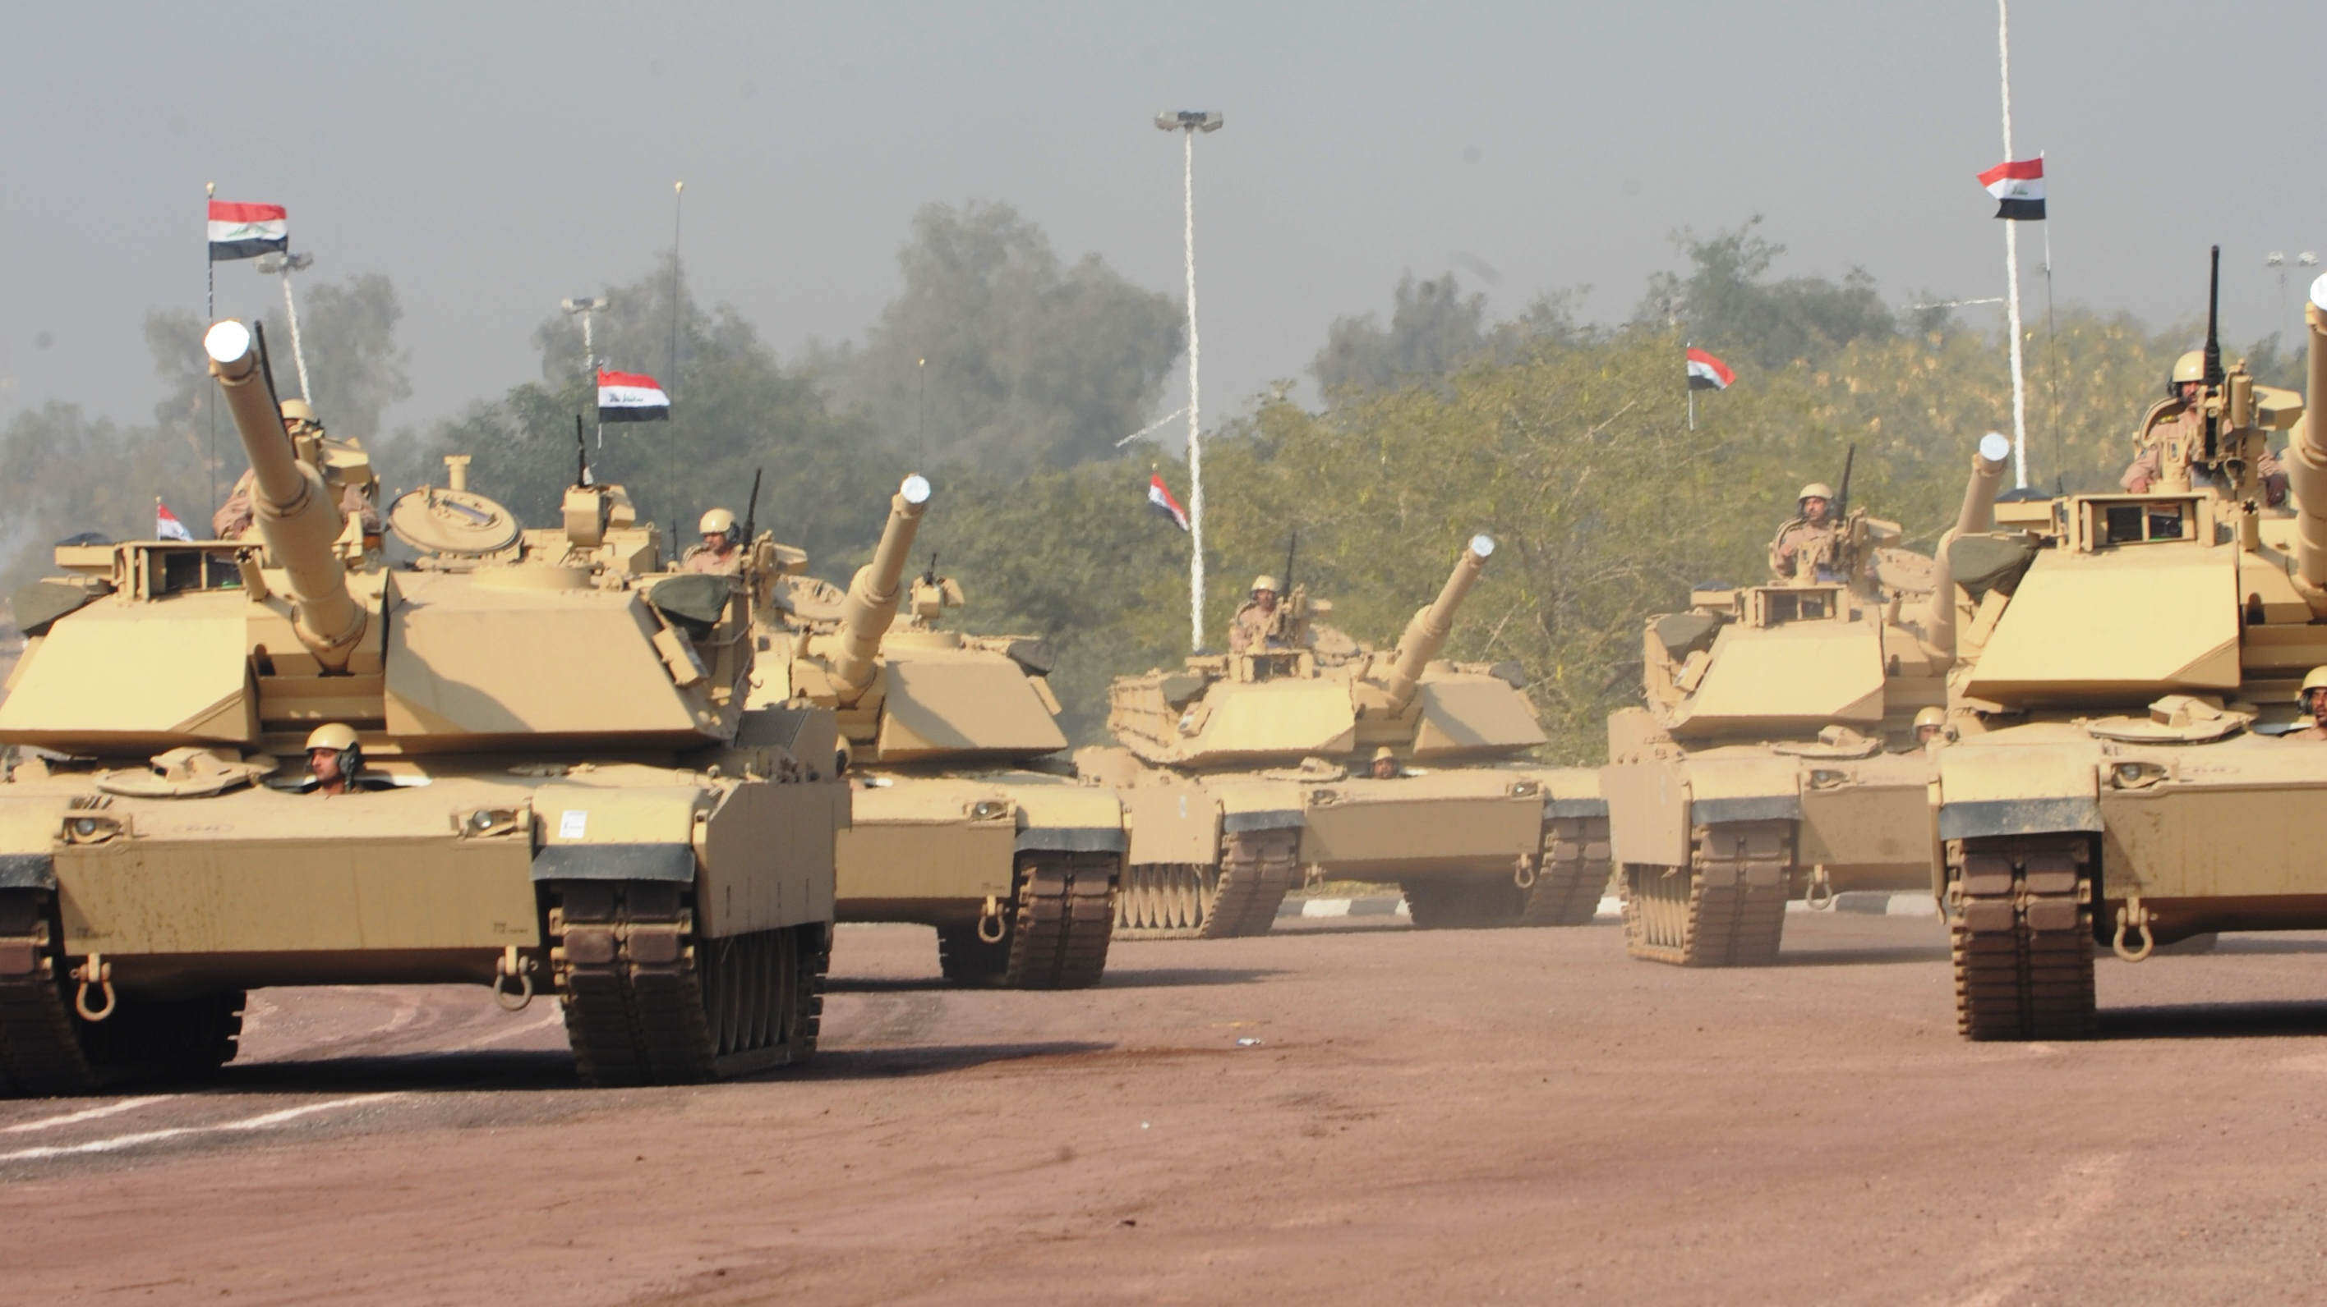
Role of armies in countries of the Global South
Arab Armies
Based on Florence Gaub’s «Arab Armies: Agents of Change?»

Slide 2
Function of armies
The core function and tasks of armies is the protection and defense of the state.
But how do Arab armies differ??
Many people may consider Arab Armies as rigid institutions which defend the state and the political regime to its dying breath, as well as stamp out opposition with an iron fist.
The Arab Spring Revolution showed Arab Armies as “agents or at least facilitators of change”.
It also showed Arab armies as having an important political function in the workings of the country.
Arab armies are an important element in uniting cultural, ethnic and religiously diverse societies; reforming autocratic systems and bringing about innovation.
Furthermore, they are the “make or brake” element of political regimes in Arab countries.
Faced with the Arab Uprisings of 2011, only the Syrian army behaved as expected, i.e., standing by the regime and suppressing the uprisings. As for other Arab Armies, such as the Egyptian Army, they facilitated regime change.

Slide 3
A Matter of allegiances
To whom do the armed forces owe allegiance???
There are two options:
State
Regime
In the case an armed force identifies its loyalty as belonging to the state, it will dissociate itself from the ruling government for the good of the people.
It will not act against its own civilian population;
It may change the regime for the good of the nation if society grants it the social and political maneuvering necessary for such action.
Will recruit equally from different segments of society.
On the other hand, if a military force identifies its loyalty as belonging to the regime, it will act as if its own survival depends on the continuance of the regime, because it ultimately does.
It will target civilians, as everyone is a possible threat.
Most likely will recruit more people of the same segment of society as the one in power, compared to others.

Slide 4
Are Arab armies any good??
Armed forces internal functioning efficiency is professionalism
What is professionalism? (according to Florence Gaub)
Expertise (management of violence)
Clientship (responsibility to its client – state or regime)
Corporateness (group consciousness)
Ideology (military mindset)
The one element which “makes or brakes” armies is cohesion so it’s the criteria by which army professionalism may be judged.
When an army is cohesive it fights more effectively as it is a disciplined fighting force. When not it will disintegrate (suffer from mass desertion) and show a lack of discipline which prevents it from following orders and act effectively.
The main problem of Arab Armies is that a regime may wish to weaken the armed forces in order to not be ousted by a coup d’etat and, therefore, remain in power.
This may happen in 2 ways:
«Portraying the armed forces as a pro-regime militia rather than a national institution»
Limiting its resources and internal capabilities in order to reduce its threat potential»
Of course, the problem is that the weaking of a military force will render it ineffective and it will not be able to perform in accordance with its duties.

Slide 5
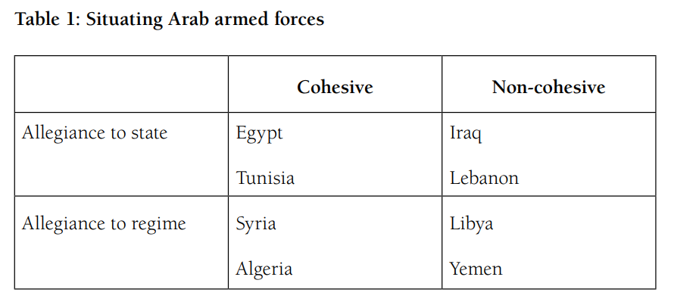
Types of Arab Armies
Arab Armies may be divided into 4 categories:
Cohesive and loyal to the state
Not cohesive but equally loyal
Cohesive but loyal to the regime
Not cohesive but loyal to the regime

Slide 6
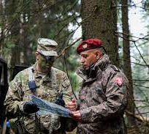
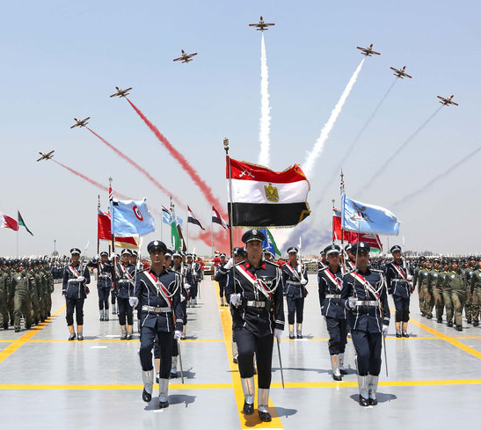
1) The Western Standard
Armies obedient to the will of the people and not that of the regime in power, such as western style armed forces when it comes to professionalism and cohesion in the military.
A neutral armed force when it comes to politics, seeing as it does not play a role in the political life of the country, and is capable militarily.
This neutrality from the regime is evidenced in situations of societal and political unrest, as is the case of the Arab Spring, when armies of this standard backed away from the regime in power.
Egyptian and Tunisian armed forces are regarded as following the Western Standard as they protected the revolution and ensured their countries would have free elections afterwards.
This action by these countries’ armies reinforced the confidence the people had and continue to have in their armed forces as they did not seek to gain any kind of power in the unrest and acted in the best interest of the nation as a whole.

Slide 7
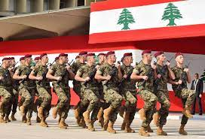
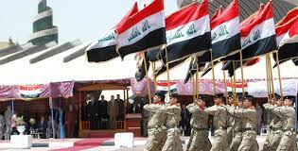
2) The Symbolic Institution
Armed forces in this category do not really deliver in military terms but they play an important role in society.
These armed forces are seen as prestigious by the population of the country they serve and are regarded as important because they «either played a role in the process of state formation, or serves a projection screen for societal desires, e.g., for unity.
They rate consistently high in approval ratings in their countries, even though they perform poorly.
Armed forces in countries such as Lebanon and Iraq fall under this category.

Slide 8
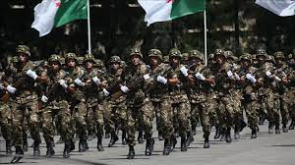
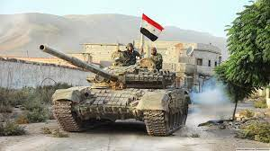
3) The Arab Classic
This is the category of army most people have in mind when considering Arab militaries.
Closely attached to the regime and conflating regime and state in its self-perception.
Army institutions in this category protect the regime in order to protect themselves and conserve the benefits they possess. As such, they are so connected to the regime they do not differ state from regime.
It is because of this conflating of allegiances that armed forces in this category respond with violence against their country’s civilian population when it demonstrates against the regime.
Arab armies in this category are the Syrian and the Algerian armed forces.
The Syrian army is the most pressing example of a cohesive and highly capable fighting force which serves the regime in power instead of the state.

Slide 9
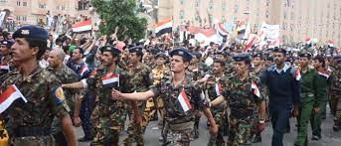
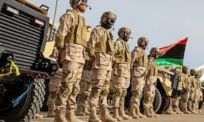
4) The Failed force
Armies in this category are in internal disarray, connected to the regime and do not possess public approval.
These armies are connected to the regime and act more like regime militias than national armed forces, therefore not boasting a good public image.
Furthermore, Arab militaries under this category are weakened forces in order to coup-proof the regimes. This means that these militaries will not be militarily capable as their cohesion is depleted.
This lack of military capabilities creates a big problem:
These forces do not possess leadership support because they have been weakened by the regime, which still expects them to perform like they have not been weakened.
Nor do they possess societal backing because they serve the regime and not the state.
It is these factors that make them failed forces because in times of crisis they will simply disintegrate and have no effective political role.
Arab armies in this category are those of Libya and Yemen.

Slide 10
Opinion
Agree that Arab Armies are agents of change
Western Standard armies are much more reliable in combat
Arab countries use the military as a stable career opportunity
Way to bring people under the governmental umbrella
Fails from having a rigid top-down command structure
Weapons importing as diplomatic instrument

