Slide 1
Economic inequality in the global south
Bonawentura Lach

Slide 2
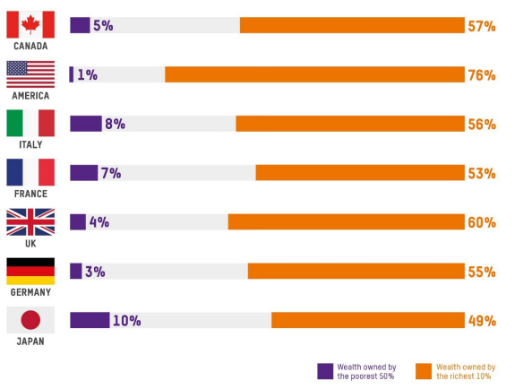
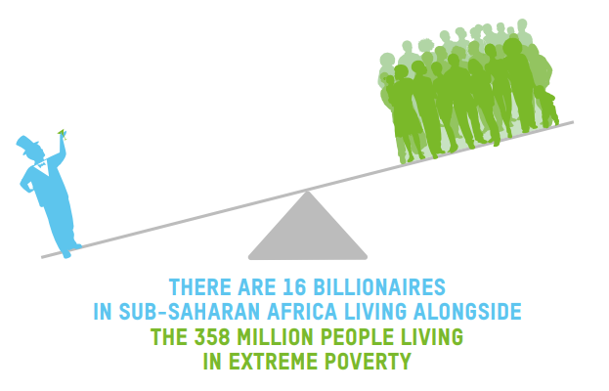
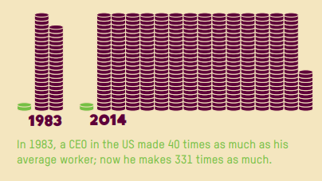

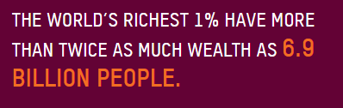
Annual ofxfam’s report

Slide 3
The problems with Oxfam
Ignoring the purchasing power of money
Not taking into account „human capital”
„Poorest” 10% are just debtors
Calculating debt as a negative wealth
Ignoring long-term trends
Focusing on short-term changes
Data only from 49 countries (47 of them are developed)
Fabricating data for the Global South

Slide 4
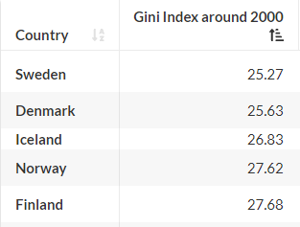
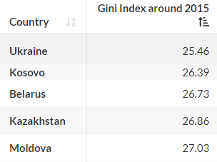
Gini index

Slide 5
The benefits of Inequalities
Division of labor – poor people (with no experience, nor qualifications) are good workers in lower-paid jobs
Motivation – seeing wealth motivates you to work harder and improve your skills
Innovation – the possibility of producing some goods, even though they are still very expencive
94% of „1%” is on the list for one year – „the rich” are not safe with their wealth, they have to be enterprising to maintain it
50% of Americans is in the „1%” at least once – each and every one of us can be in the „1%”
We must not focus on the inequalities, but on poverty

Slide 6
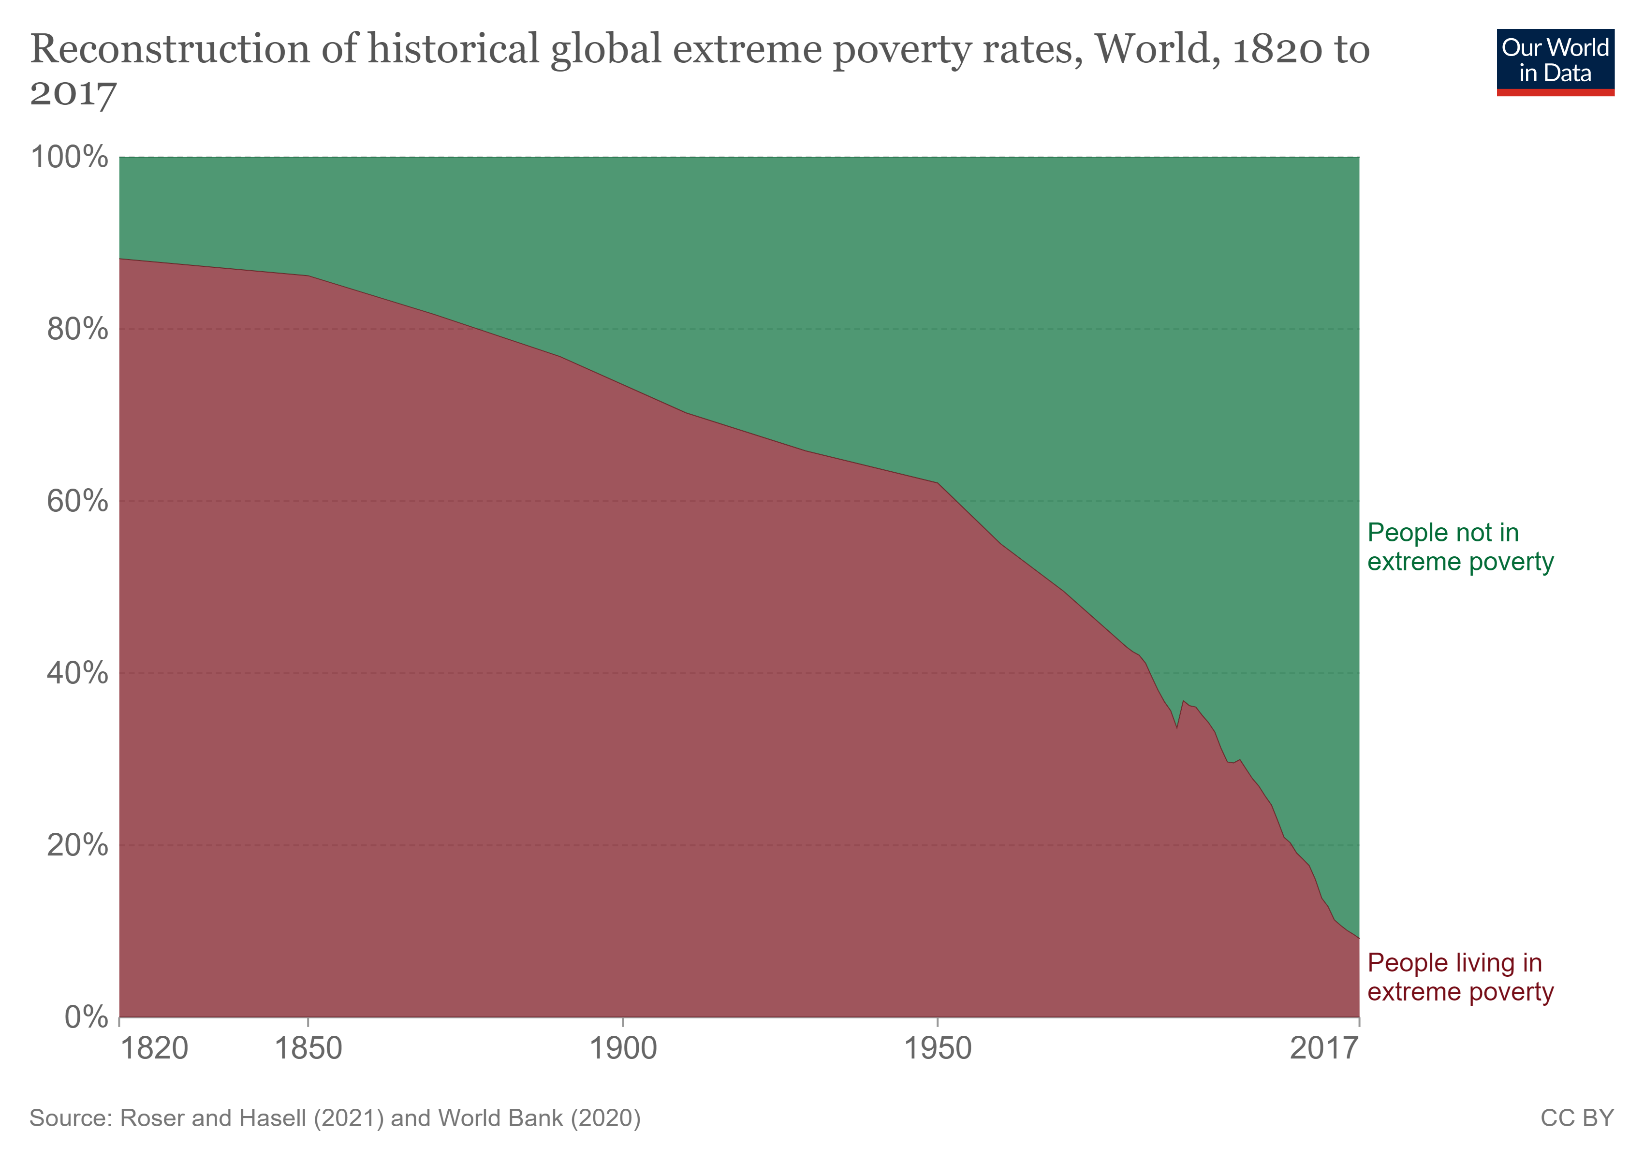
Causes of poverty
The question of the causes of poverty is fundamentally wrong. Rather, we should ask why we no longer starve. Poverty is the initial state of humanity.
Since the dawn of mankind, we were miserable, because the amount of natural recources is limited, so we cannot be richer, until we find out how to be more productive.
That (increase in productivity) happened in XVII century, and we call it The Industrial Revolution

Slide 7
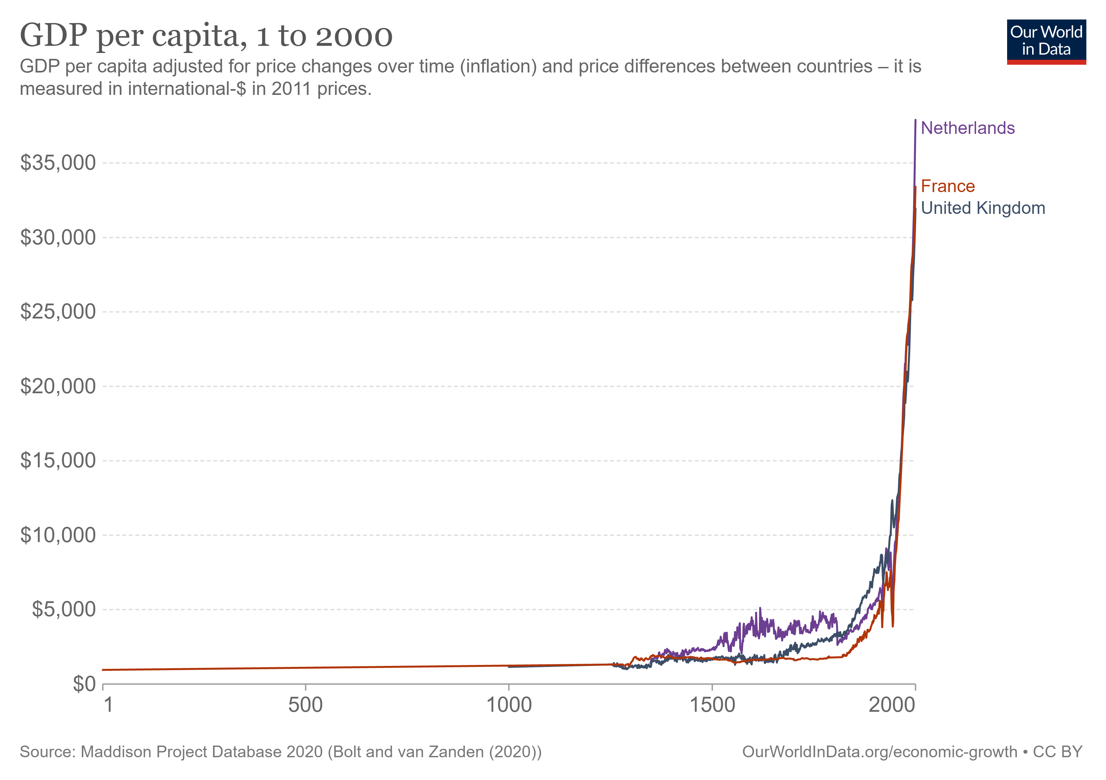

Slide 8
Putative Causes of the enrichment
Exploatation – can only explain distribution, but not the increase in the amount of wealth
Peace – always, until the 20th century, Europe was very militant continent
Science – development in science, as long as it remains only in science, does not inluance the real economy. Moreover, the Middle East and China also developed science, even earlier than Europe. Furthermore, the Global South has access to science from the Developed Countries
Genetic predispositions – the peoples of England do not seem to display any intelligence that is unusual in the world. Moreover, there are many wiser nations, for example Asians. Furthermore, genetic changes could explain the industrial evolution, but they cannot explain the industrial revolution. Flynn effect
Trade – The largest trading companies in history (East India Company, Dutch West India Company, Dutch East India Company) were established long before the industrial revolution. Trade also included Asia, but there was no revolution there. Also today the countries of the Global South are often in trade unions, but this does not translate into a dramatic increase in wealth.
Capital accumulation – it was also before the industrial revolution. In medieval Europe, the savings rate often reached over 20%. South American Indians were also famous for their huge savings, hence the legend of El Dorado
Innovations – it is a correct answer, but incomplete. We need to explain why there has been an increase in innovation in England, despite the fact that inventions were also made in other parts of the world. Moreover, it is necessary to answer the question why the countries of the Global South, despite having access to modern inventions, do not become developed

Slide 9
Institutional evironment
Of course, all the aforementioned elements were important for the enrichment of the Western countries.
They can be compared to strategies telling you what to do to succeed in the game. However, in order to achieve this success, it is also necessary to follow the "rules of the game". We call these rules "institutions" when they relate to social life.
Even knowing winning strategies, we cannot win if other players do not follow the rules

Slide 10
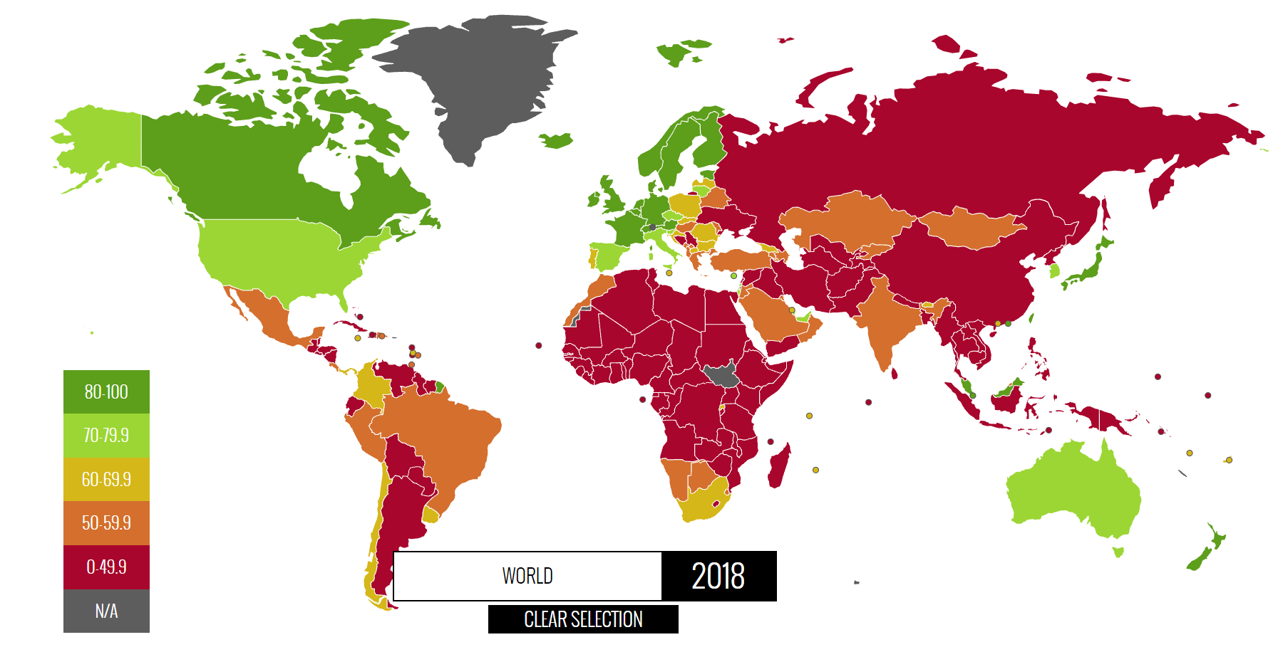
Property rights

Slide 11
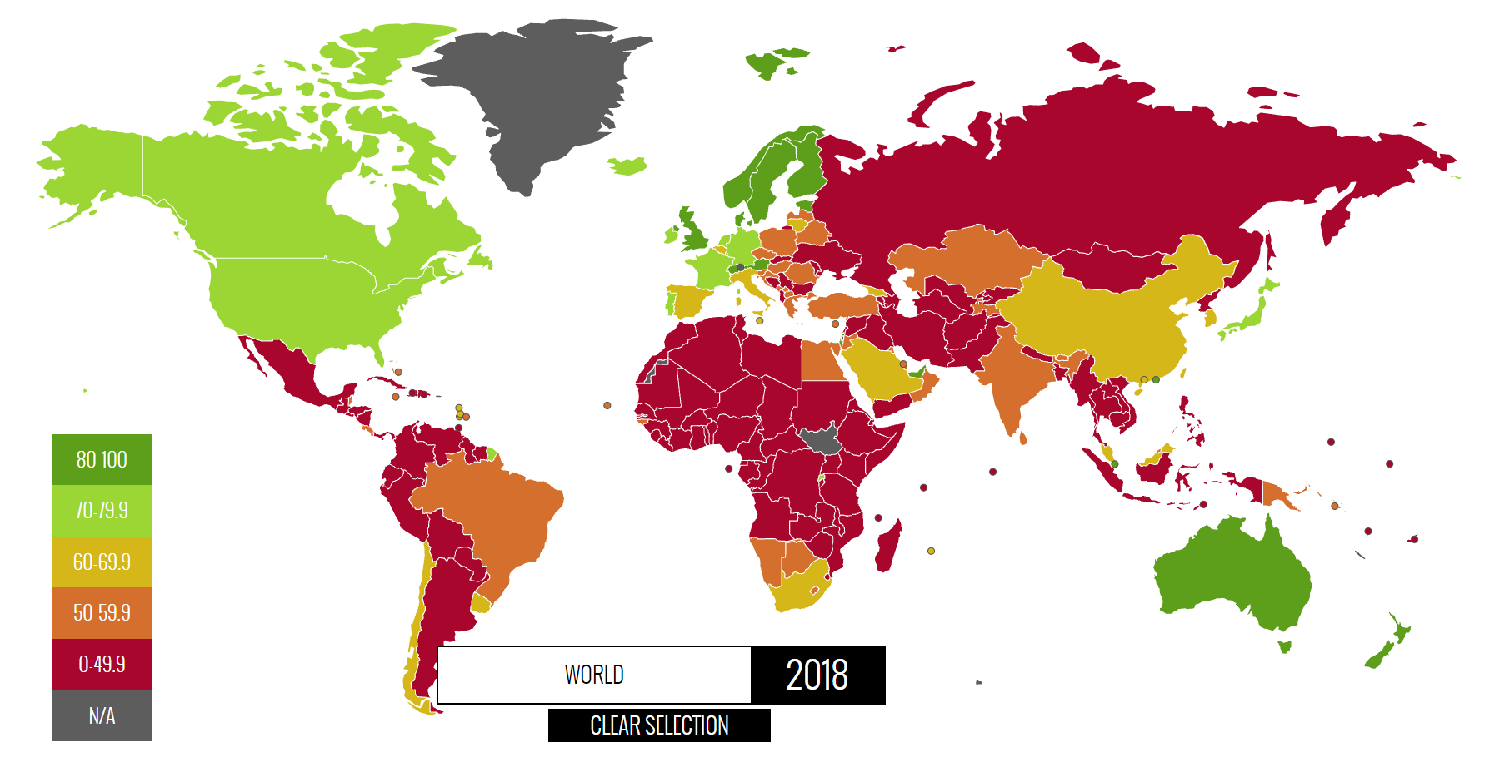
JUDICIAL EFFECTIVENESS

Slide 12
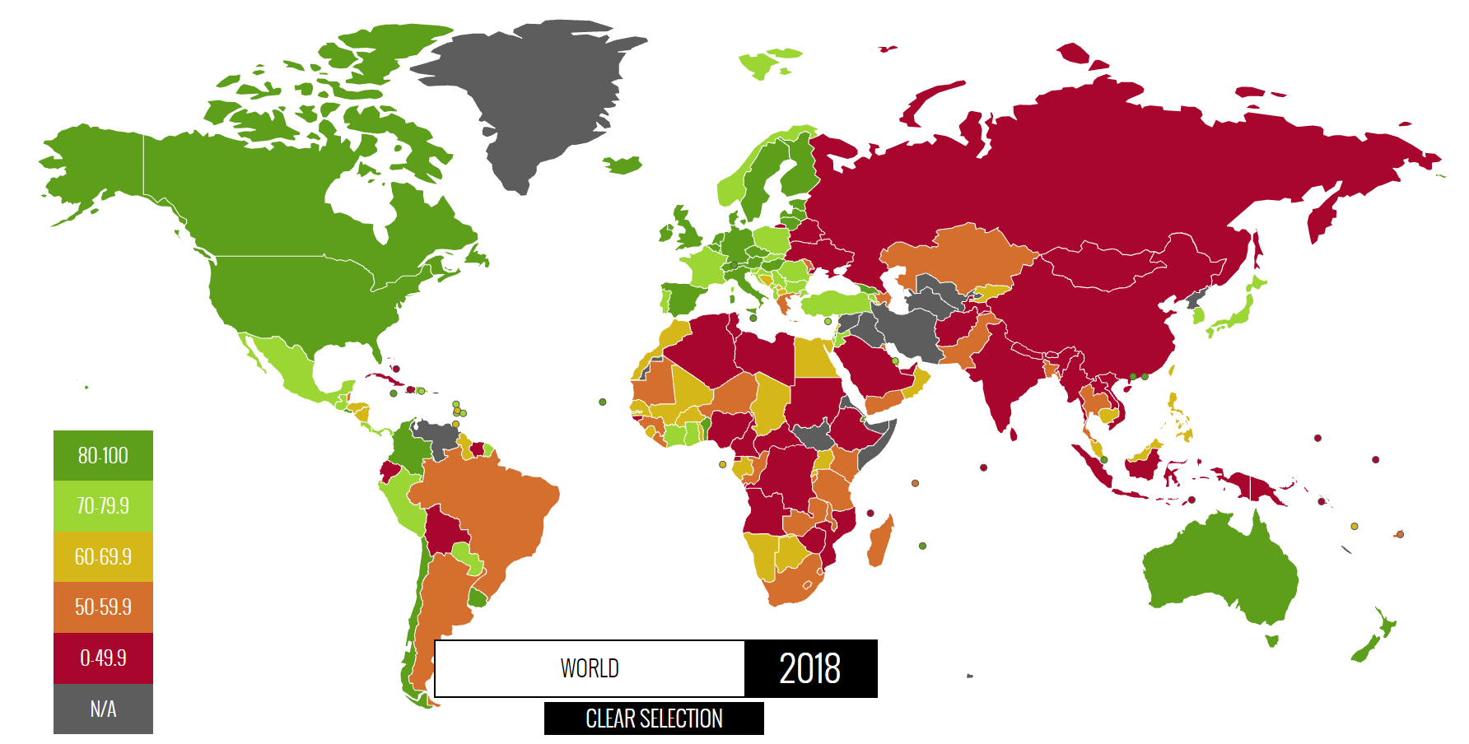
Investment freedom

Slide 13
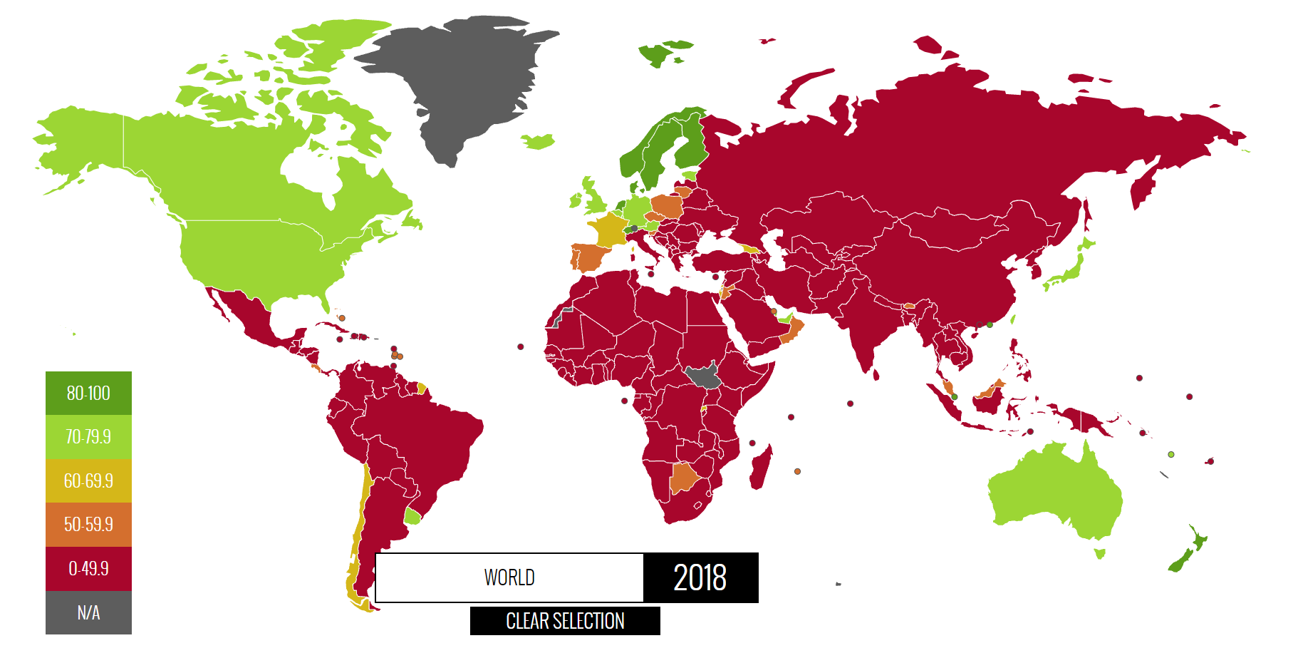
Government Integrity

Slide 14
Institutional evironment
Formal Institutions They are definitely better for measuring. The state of some of them in the countries of the Global South is presented above. However, we must ask why these institutions are not working properly? After all, the Developing Countries see the patterns working in the Northern Countries, and the benefits that flow from them. Moreover, Developed Countries often intervene by writing laws for developing countries and helping them with military missions
A potential reason why helping these countries does not bring results may be poorly functioning „social/informal institutions” i.e. a way of thinking that is ingrained in people's minds
Social Institutions They are very difficult to measure, so the conclusions made here remain speculative. Nevertheless, it can be said that the development of the country and society requires such institutions as those that began to develop in Europe in the 17th and 18th centuries:
Economic Harmonies – understanding that my neighbor's profit is not my loss, but a profit for everyone
Bourgeois Dignity – accepting that some people are doing much better in the economy, and showing them respect rather than envy
Creative Destruction – understanding the fact that development requires the collapse of certain elements of social and economic life as a step towards change for the better

Slide 15
Conclusions
It is not worth reading the Oxfam reports, because they are deceptive and unscientific
Economic inequality is not necessarily a bad thing, as long as even the poorest profit from it
Not all problems of the Global South can be solved through outside intervention
If the Global South is to become developed, it must follow the same path as the Western countries in improving their institutions
The countries of the Global South are in a much better situation than Europe in the 18th century, because they can start peaceful cooperation with already rich countries

Slide 16
de Soto, Hernando The Mystery of Capital: Why Capitalism Triumphs in the West and Fails Everywhere Else 2003
de Soto, Hernando The Other Path 1986
Bastiat, Frederic What is Seen and What is Not Seen 1850
McClockey, Deirdre Bourgeois Dignity: Why Economics Can't Explain the Modern World 2011
Schumpeter, Joseph Capitalism, Socialism, and Democracy 1942
Wiśniewski, Jakub Bożydar Rozwój gospodarczy https://www.youtube.com/watch?v=2yA2yJ0-yUY
Machaj, Mateusz Najważniejsze wydarzenie w historii świata https://www.youtube.com/watch?v=RgRxPggwtMU&t=1137s
Mateusz Benedyk - Bogactwo świata własnością niewielu. Nierówności a raport Oxfamu https://www.youtube.com/watch?v=xq9p0RXajvA&t=5s
Sieroń, Arkadiusz Misesowskie spojrzenie na nierówności ekonomiczne https://www.youtube.com/watch?v=AYUUbvR9pJU&t=2s
McClockey, Deirdre Dlaczego ekonomiście nie rozumieją rewolucji przemysłowej? https://www.youtube.com/watch?v=mxUsupDtrk0&t=251s
https://data.worldbank.org/indicator/SI.POV.GINI?most_recent_value_desc=false&view=chart
https://ourworldindata.org/grapher/maddison-data-gdp-per-capita-in-2011us-single-benchmark
https://www.heritage.org/index/heatmap
https://www.heritage.org/index/ranking
https://www.oxfamamerica.org/

