Slide 1
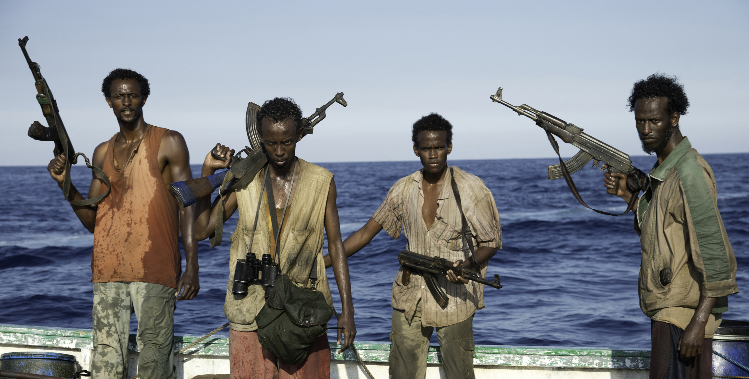
Terrorist organizations in selected region of Global South
Somalia
Al-Shabaab

Slide 2
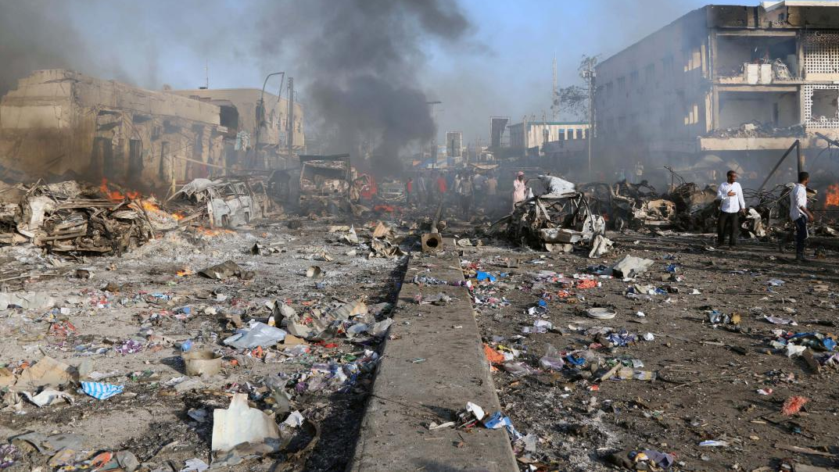
Failed state
Phenomenon – from 90s
The consequence of the disintegration of the bipolar world and the escalation of long-terming conflicts
Interior armed conflicts – state vs. non-state units
  Aspiration to take power
Religious, Cultural and Ethnic fighs
Central government is weak – unabale control state‘s territory
Able to keep order only in Capital city
  Rest of the country in chaos
The state leaves the citizens to their destiny
Armed forces works as personal security for the rulers in capital

Slide 3
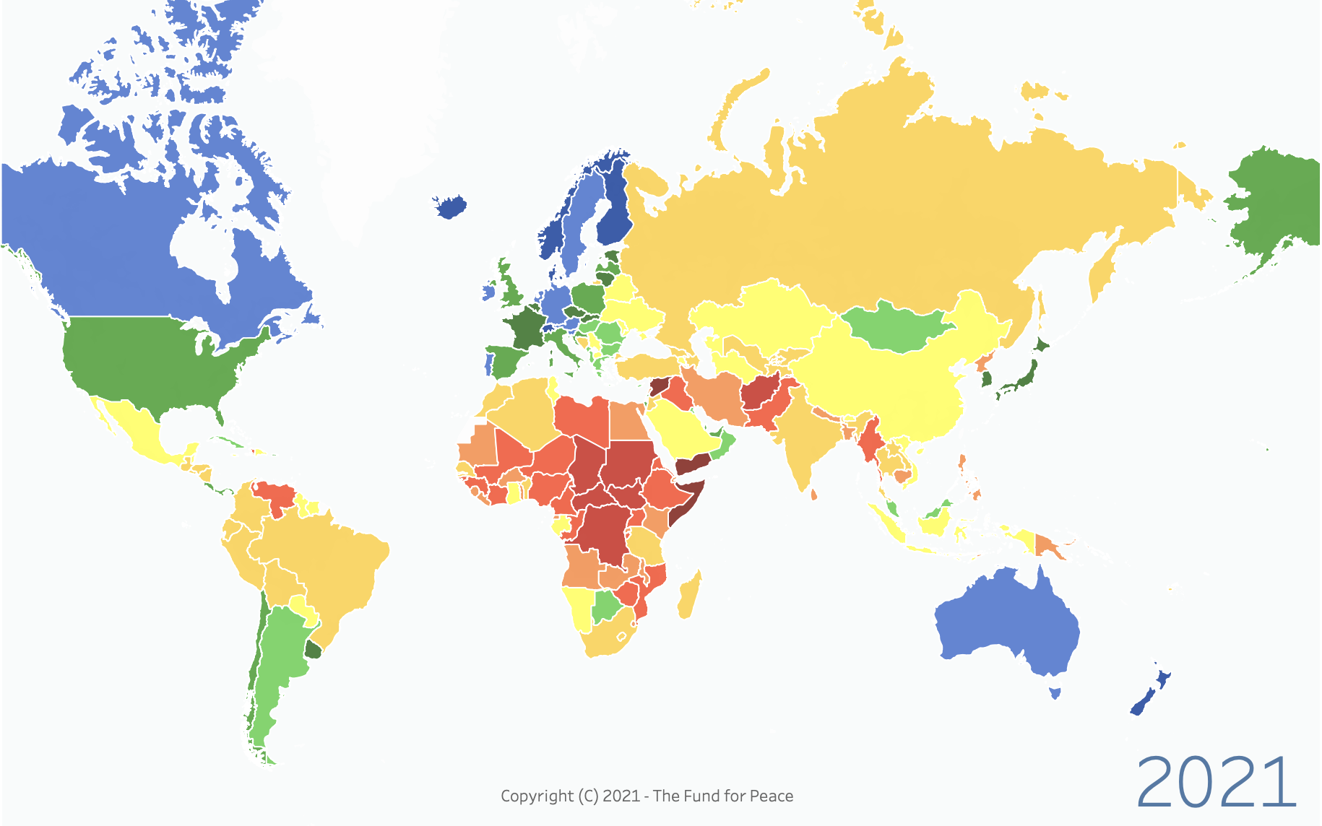

Slide 4
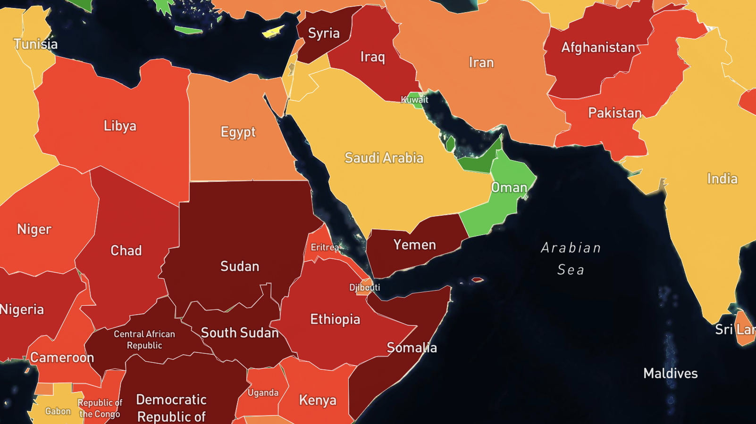

Slide 5
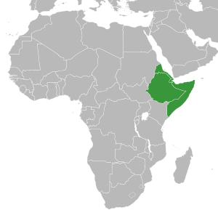
African corner
East part of Africa
Somalia , Ethiopia, Eritrea a Djibouti
Only the Ethiopia without acces to the sea
Strait Bab al-Mandab – škrtící bod světa
"neighbouring" with Yemen
  (other unstable states)
Consequences of decolonisation
  artificial borders
  Ethnic and civil wars
Notes:
Během jednoho roku zde projede více jak 30 000 obchodních lodí . Jedná se o kratší plavbu ze Středozemního moře přes Suezský průplav, Rudé moře, průliv Bab al-Mandab, Adenský záliv a Arabské moře do Indického oceánu.
Pirátství a rozpadlý jemen značně snižuje možnost těžby ropy a zemního plynu v této oblasti

Slide 6

Somalia
Fishing – main source for economy
Unstable government, minimal control sovereign waters – foreing ships fishing here
  Aftermath - falling of Somalia‘s economy
  Many former fishermans now as a pirates
Strategic location near Gulf of Aden
  Frequent, a lot of world trade passes through here
Piracy = Involvement IOs, NATO and EU
Notes:
Connetcs Suez, Rudé a Arabské moře (Bab al-mandab)

Slide 7
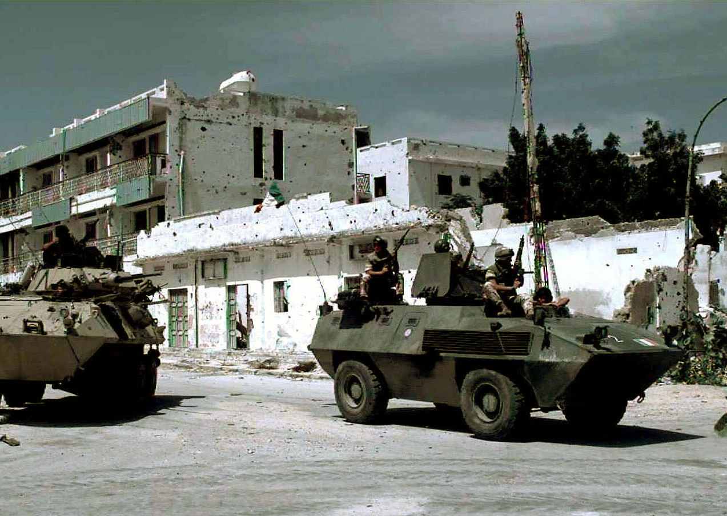
Somalia - History
Regions of interest during Cold War
Assassination presidet Shirmarke –> military coup in 1969
New part of Somalia‘s gov are communist
  nationalization of private property
Empathy towards the USSR
Teritorial disputes with Ethiopia
Somalia – homogeneous – many clans, hard negotiations
1991 civil war - inability of the government to establish order (Dictator Baare)
Ethiopian invasion to Somalia in 2006
Notes:
Pak prohoz – USA a Somálsko, Rusko a Etiopie - po převratech

Slide 8
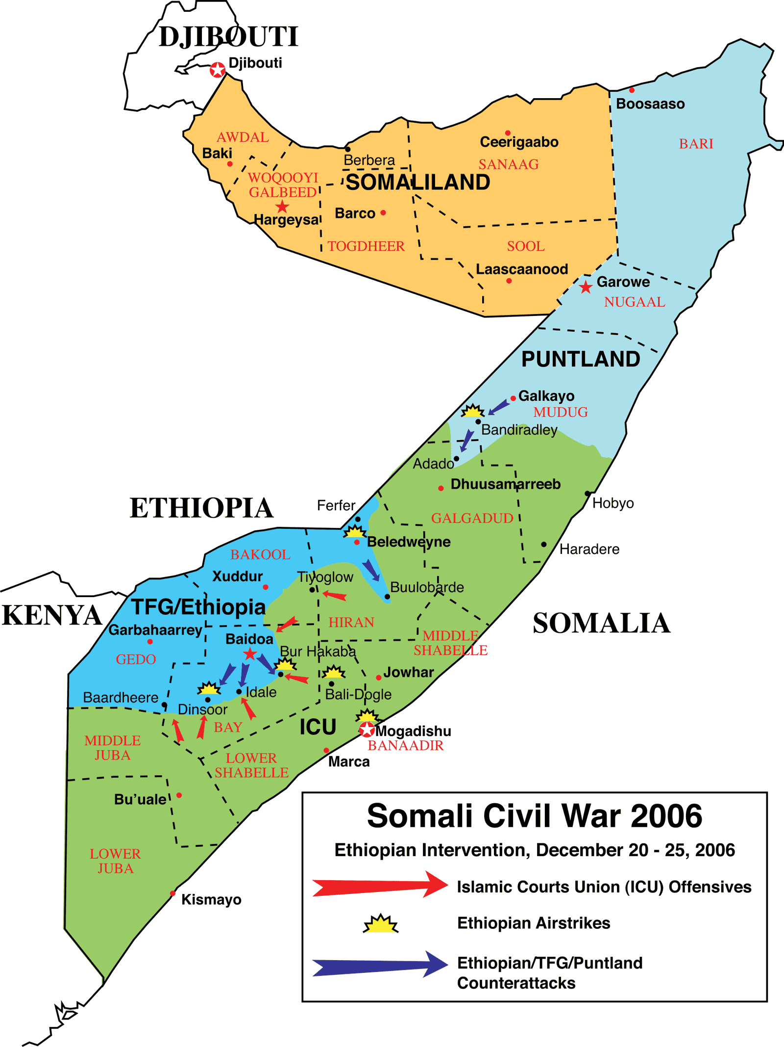
Secession of territory
  creation of Somaliland (Hergeysa)
Secession of other par of Somalia
  Puntland (Garoowe)
  Operations of Daesh – Terrorism
Teritorial disputes
Settlement efforts - UN mission

Slide 9
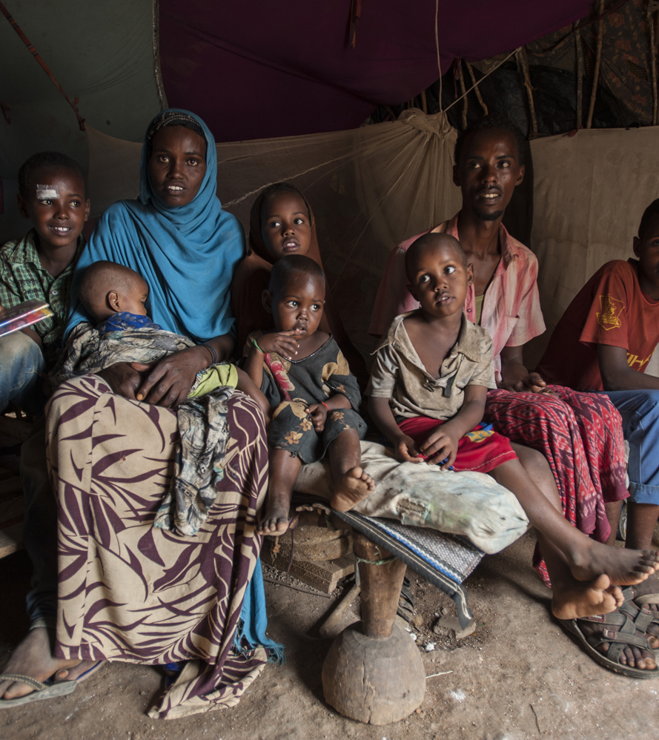
Somalia in the 21st century
The extreme form of a Failed state
Pirate attacks after the fall of a stable government in 2004
2005 – Massive growth of piracy in the area
2006 – Decline of piracy with Islamists coming to power
  Strict religious rules
2007 – The new government unable to
maintains the safe place for the population
Aid from Ethiopia's armed forces, government collapse,
clashes with rebels
  civilians being held as a hostages (abuse by both sides)
Failure to guarantee sovereignty in territorial waters
The coast of Somalia is polluted by waste
Rising influence of Islamist
  Al-Shabaab
  Daesh
Fear of terrorist attacks - Islamists attack soft targets
  Operates from Puntland

Slide 10
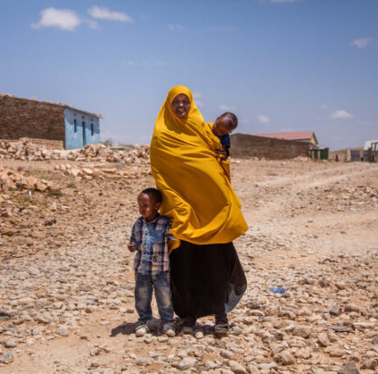
Somalia in the 21st century
Bad conditions of enviroment
Raids by foreign fishermen
  Somalis are losing resources at the same time
Lack of rain
Extensive drought - impact on agriculture + grasshoppers
Residents migrated closer to the sea – fishing
Tsunami
Once a stable exporter of salt, bananas and other commodities

Slide 11
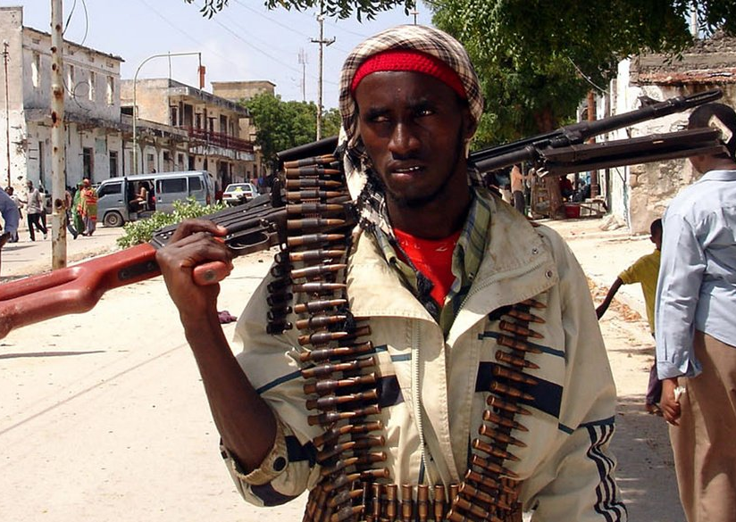
Al-Shabaab
In Somali: YOUTH
Fully : Ḥarakat al-Shabāb al-Mujāhidīn
Islamist militant group based in Somalia
Links to Al-Qaeda
Beginning in 2006
  Against Transitional Federal Government
Incubator for Al-Shabaab, was Al-Ittihad al-Islami (AIAI)
  “Unity of Islam”,militant Salafi group
Threath for Christian Ethiopia

Slide 12
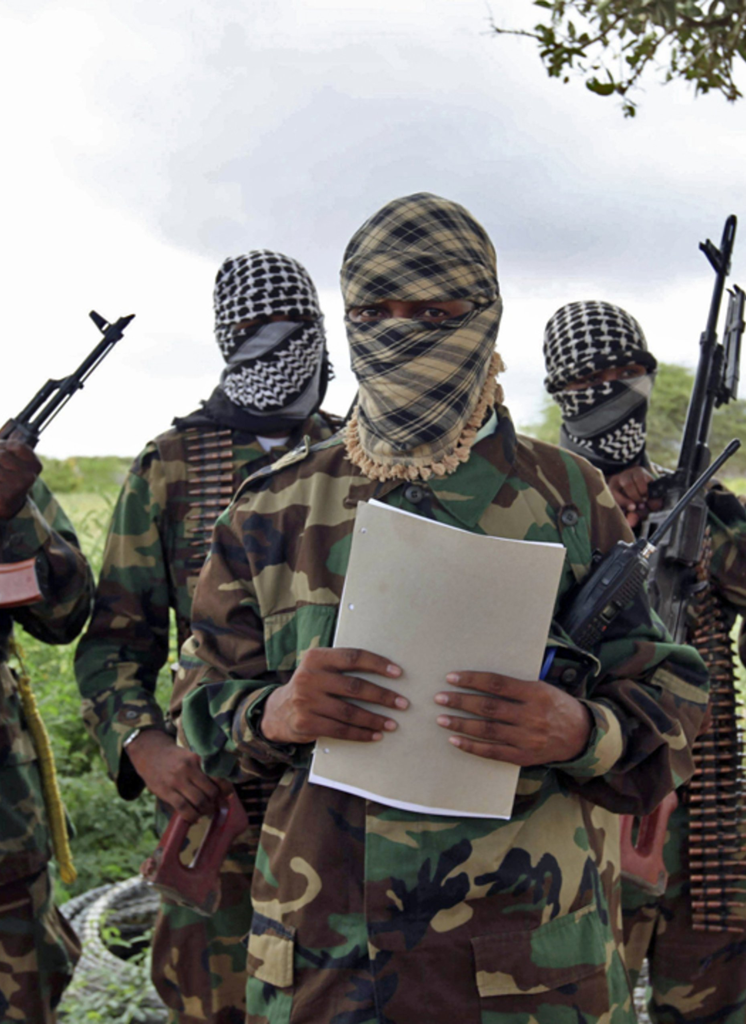
Al-Shabaab
Militia affiliated with the Islamic Courts Union (ICU)
  Federations of local and clan-based Islamic courts
  Founded in 2004 (Southern Somalia)
    Fighting with the lawlessness and banditry (Piracy) since collapse of the government
  Al-Shabaab work as armed wing of ICU
Leading by Aden Hashi Farah Ayro
  Operative trained by Al-Qaeda in Afghanistan
Extreme ideology
Al-Shabaab played key role in ICU combat against central government, 2006
  Central gov supported by US (prevent for the spread of islamism)

Slide 13
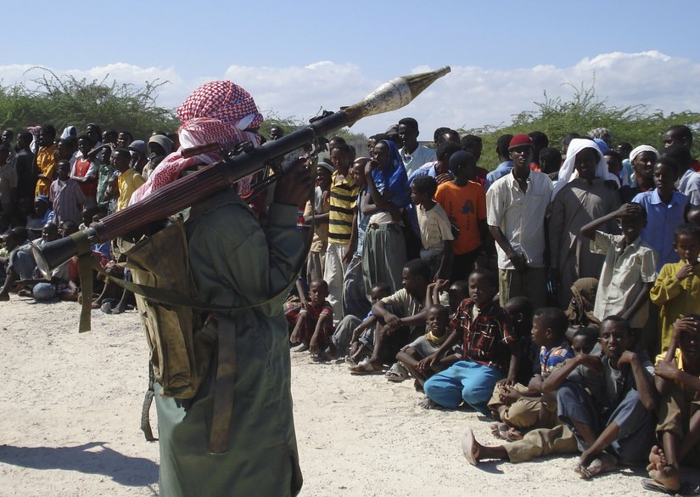
Al-Shabaab
2006 – intervetion lead by US + Ethiopia and Somalia federal government
  ICU was quickly defeaded, but Al-Shabaab start against intervention forces
    Also attacks civilians, journalist and international aid (AMISOM)
2008 – US air strike kill Al-Shabbab leader Ayro
2009 – Extend area under control
  Banning non islamic behavior – punishments (amputations, stoning)
2010 – Suicide bombers major attack outside Somalia in Uganda
  75 kill were citizens

Slide 14
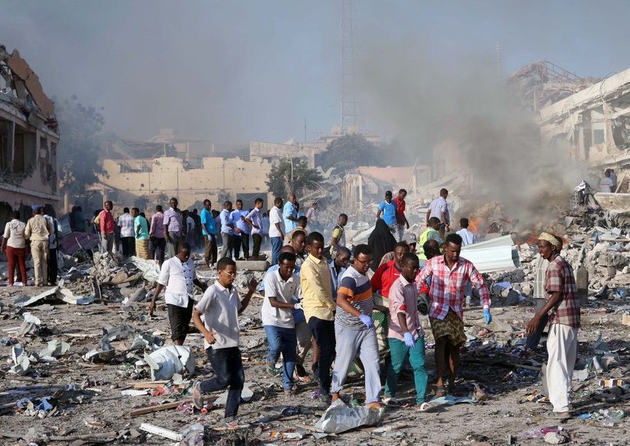
Al-Shabaab
2012 – Al-Shabaab sworn loyalty to Al-Qaeda
21st September – attack in Nairobi
  Islamist stormed a shopping mall, 65 killed
2015 – massacre at Kenya's Garissa University
2017 – bombing in Mogadishu, >500 killed
2018 – kidnapping an Italian non-governmental organisation aid worker in Kilifi, Kenya, and held her captive for 18 months. She was released in May 2020 after a ransom of 1.5 million Euros was reportedly paid.
2021 – suicide car bomb blast near to security checkpoint at presidental palace

Slide 15
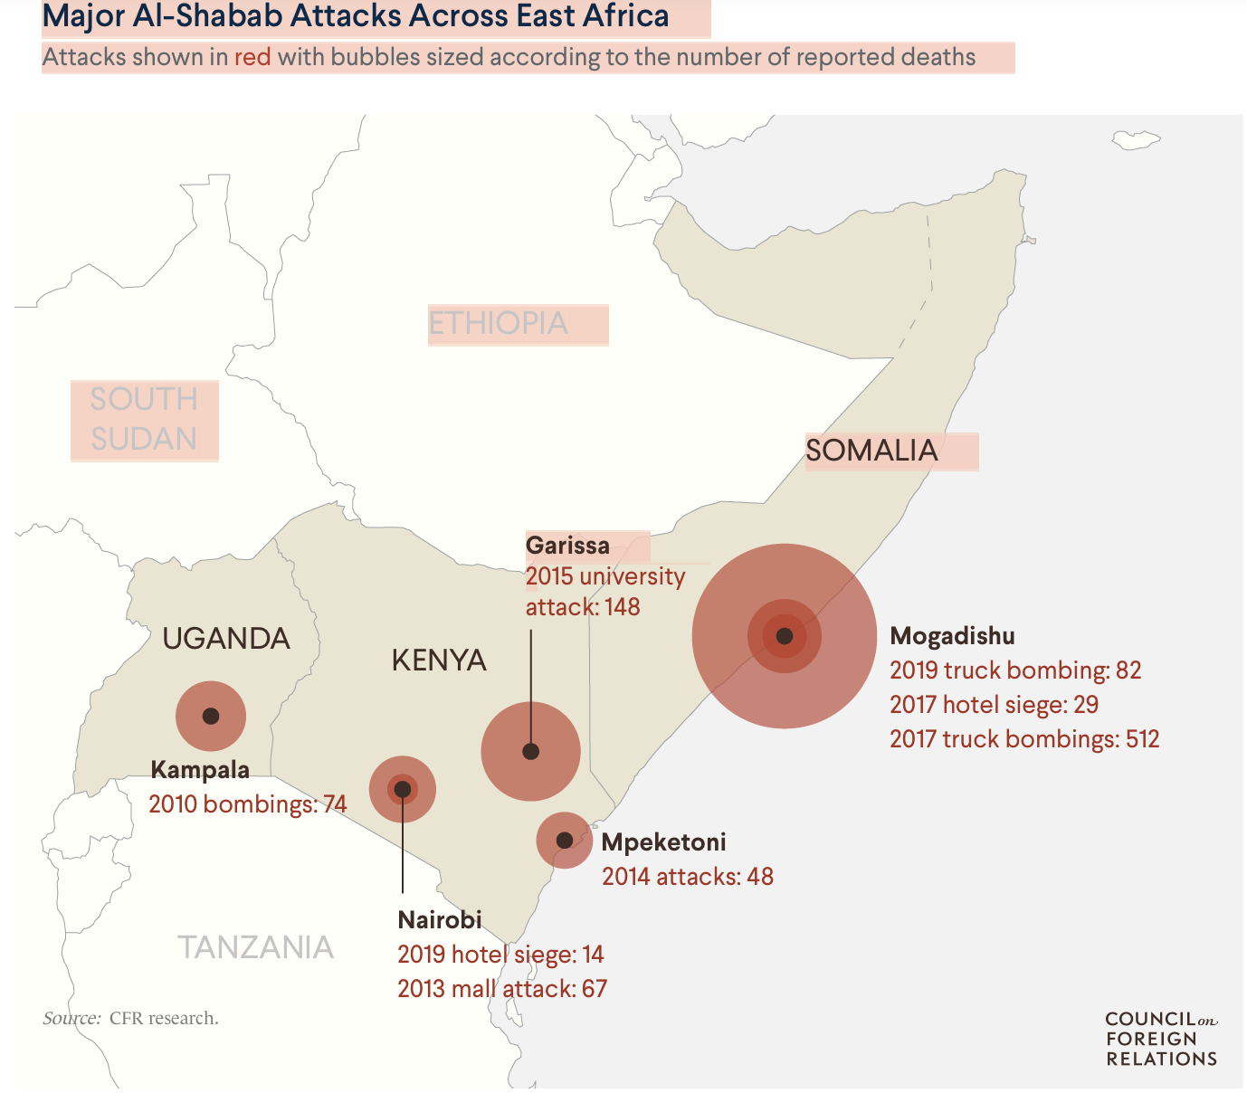
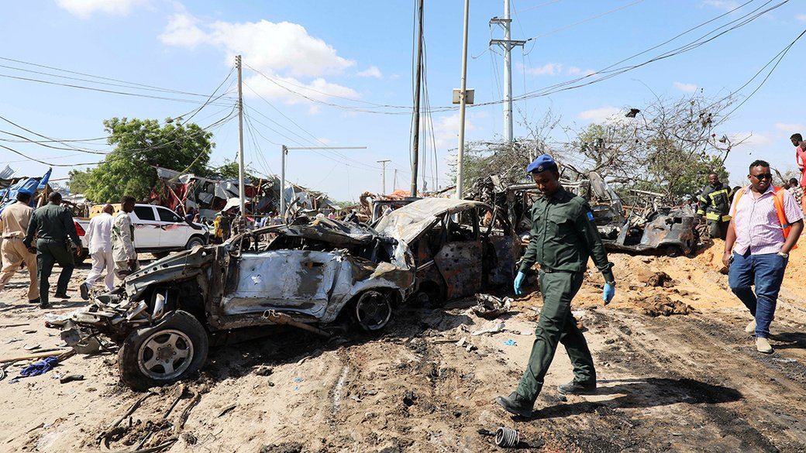

Slide 16
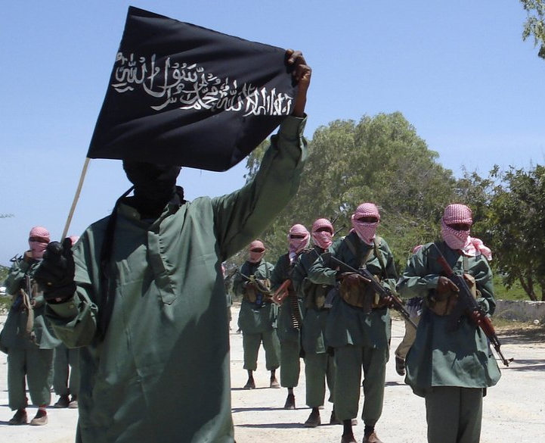
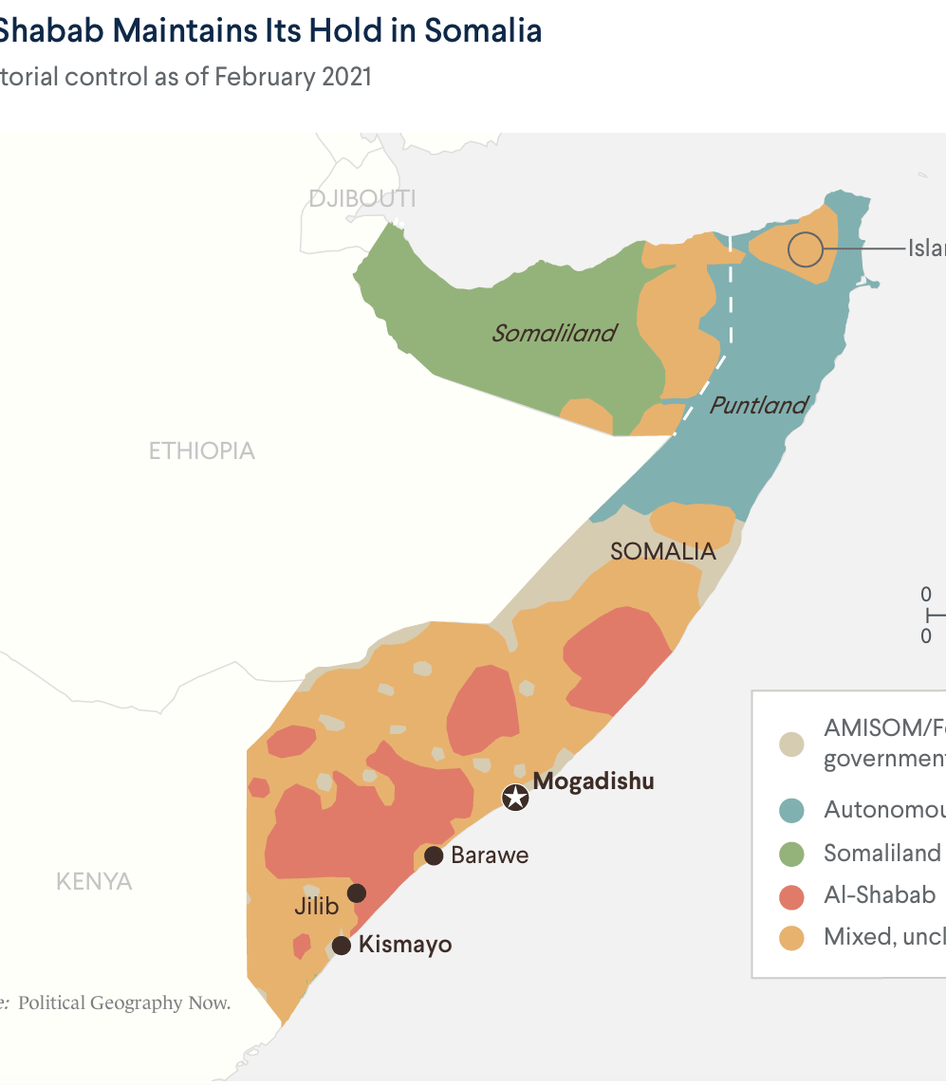
Al-shabaab Goal : Islamic state
Areas under contorol: Hard interpretation of sharia
  Prohibition of entertainment – movies, music
Founding: sources of income from other terrorist groups, piracy, kidnapping, blackmailling, smuggling, Eritrea ?

Slide 17
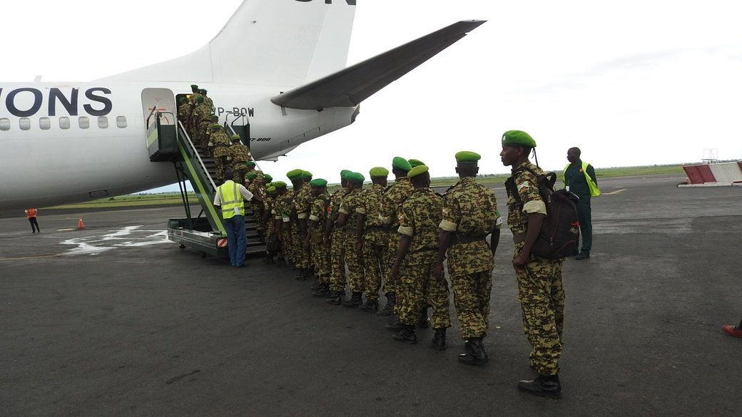
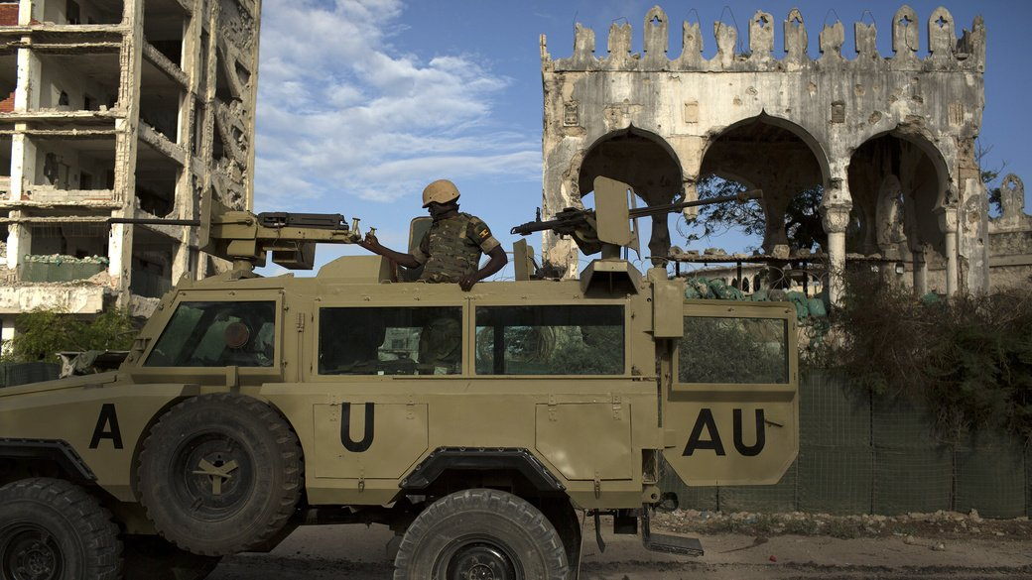
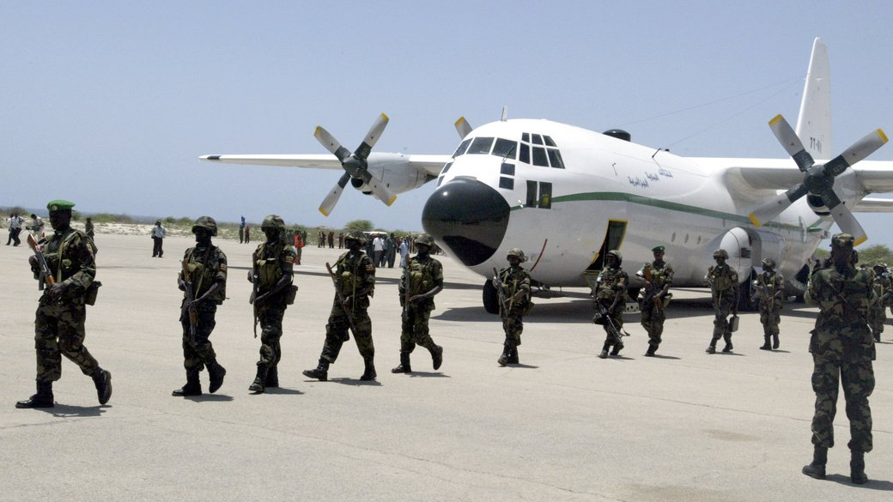
AMISOM
UN mission leading by African Union
  Peacekeeping forces in Somalia from 2007
Mandate – protect the country’s transitional government
  Uganda – Largest contingent >6000 troopers
  Burundi, Ethiopia, Kenya, Djibouti.
  AMISOM in total = 20 000 troops.
“We are sending a message to every country who is willing to send troops to Somalia that they will face attacks on their territory,”

Slide 18
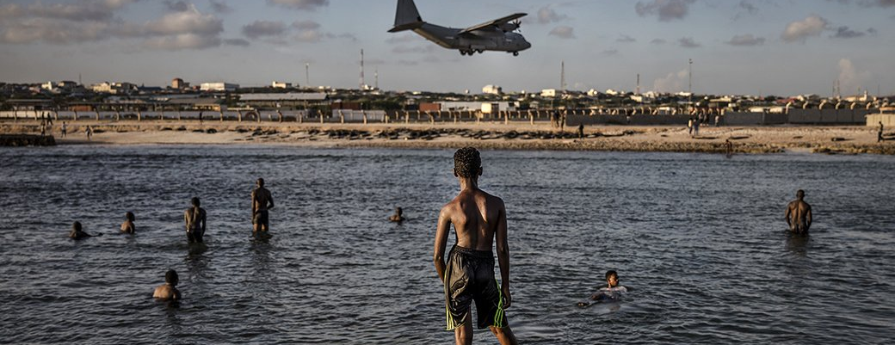
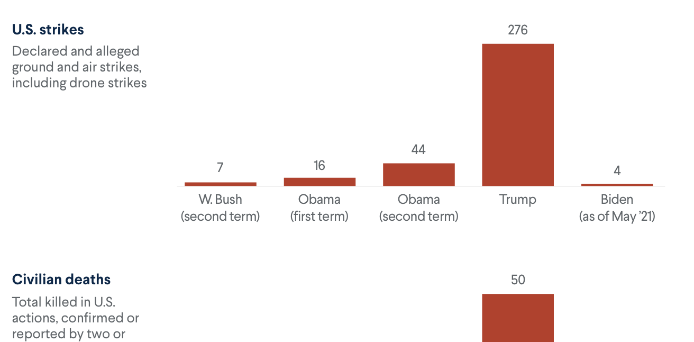
United States
Interest
  preventing the country from becoming a refuge for terrorist groups to plot attacks on the United States and destabilize the Horn of Africa, where long-standing disputes among Eritrea, Ethiopia, and Somalia
  Worries about collaboration between Islamist organisations in region
    Al-Shabaab, Boko Haram, al-Qaeda in the Islamic Maghreb, and al-Qaeda in the Arabian Peninsula
  Somali diaspora in US = radicalization
US train and equip AMISOM forces

Slide 19
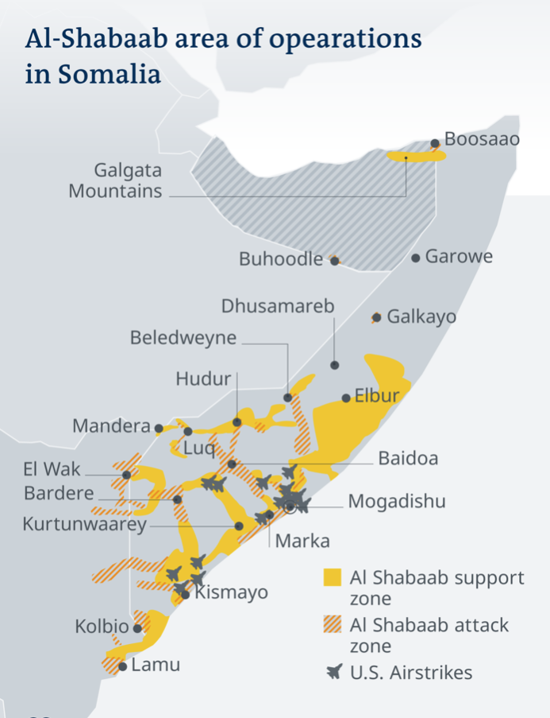

Slide 20
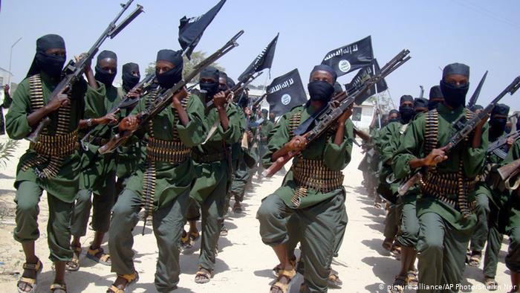
Thank you for your attention
Roman Liška
Security policy
CEVRO Institut

Slide 21
Melicharová, Fighting with piracy in Horn of Africa – Role of NATO and EU, https://dspace5.zcu.cz/bitstream/11025/37895/1/Boj%20s%20piratstvim_Melicharova.pdf
Fragile states index, data of Failed states, https://fragilestatesindex.org ; https://fragilestatesindex.org/analytics/fsi-heat-map/
Aljazeera ,Suicide bomber kills at least eight in Somali capital, https://www.aljazeera.com/news/2021/9/25/suicide-bomber-kills-at-least-eight-in-somali-capital
Claire Felter, Jonathan Masters, and Mohammed Aly Sergie, Council on foreign relations, Al-Shabbab, https://www.cfr.org/backgrounder/al-shabab
Institute for security studies, AMISOM should provide more than security in Somalia, https://issafrica.org/iss-today/amisom-should-provide-more-than-security-in-somalia
BBC, Who are Somalia's al-Shabab?, https://www.bbc.com/news/world-africa-15336689
Center for strategic and international studies, Examining Extremism: Harakat al Shabaab al Mujahideen (al Shabaab), https://www.csis.org/blogs/examining-extremism/examining-extremism-harakat-al-shabaab-al-mujahideen-al-shabaab
Australian national security, Al-Shabab, https://www.nationalsecurity.gov.au/Listedterroristorganisations/Pages/Al-Shabaab.aspx
Britannica, Al-Shabaab, Somali-based militant group, https://www.britannica.com/topic/al-Shabaab
DW, Al-Shabab, https://www.dw.com/en/al-shabab/t-18172913
United States institute for peace, Fragile States Fail Their Citizens and Threaten Global Security, https://www.usip.org/blog/2018/09/fragile-states-fail-their-citizens-and-threaten-global-security
European Union Naval forces (EUNAVFOR), COUNTERING PIRACY OFF THE COAST OF SOMALIA, https://eunavfor.eu
Aljazeera, Al Shabab claims Somalia plane bomb attack, https://www.aljazeera.com/news/2016/2/13/al-shabab-claims-somalia-plane-bomb-attack

