Slide 1

European Banking Union
The Implications of the Membership in the European Banking Union on
the Legal and Institutional Framework in the EU Member States
Dominik Králik, LL.M.EUR. (LMU Munich)
University of Salzburg
Department of Public, International and European Law
Section European Law
June 7th, 2023, Salzburg, Austria
Notes:
1

Slide 2

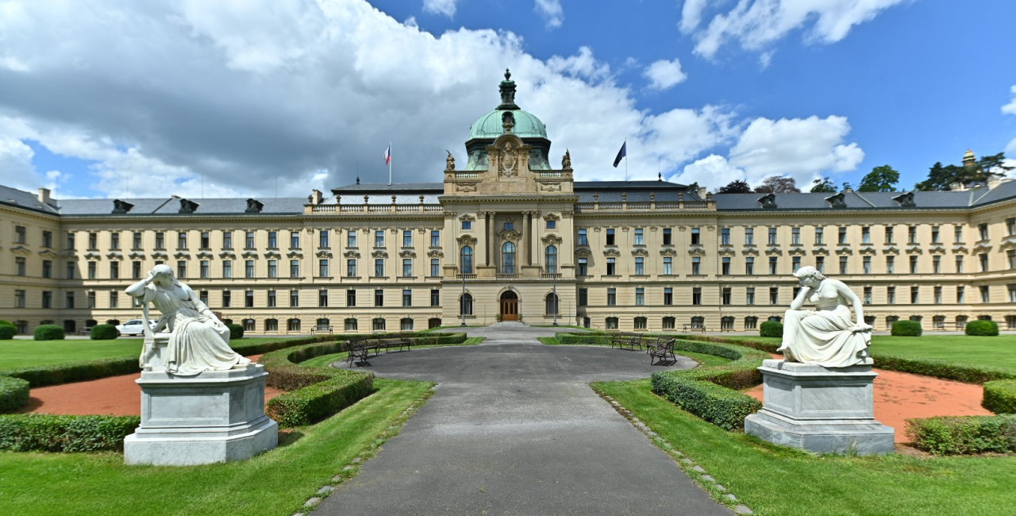
THE OFFICE OF THE CZECH GOVERNMENT
EU Law Department
Proving the correct implementation of EU Financial Law into Czech legal order
2.

Slide 3
Title and Main Research Question
Title: European Banking Union
Subtitle: The Implications of the Membership in the European Banking Union on the Legal and Institutional Framework in the EU Member States
Main Research Question: How can we assess the current legal and institutional framework for the banking supervision and resolution in the Czech Republic and in Slovakia in relation to their (non-)membership in the European Banking union?
3.

Slide 4
Subquestion 1:
Does the current set-up of the European banking law system motivate non-members to join the Banking union?
How far goes prudential regulation under Single Rule Book? Is this zero Pillar of Banking Union so strong and, that there is no need from perspective of Czech Republic to access the Banking Union?
Is it true that the correct setting of prudential rules at the EU level and leaving the supervision and resolution of the crisis to national authorities better corresponds to the principle of subsidiarity under the founding treaties of the EU and makes joining the banking union unnecessary from the point of view of the Czech Republic?
Can we see in the resolution competence the problem of national sovereignty? Why is it appropriate to think that this second pillar is a major barrier of the Czech Republic's entry into the Banking Union? Is it because of the resolution history that the ECB has gone through?
4.

Slide 5
To Subquestion 1:
Why do we have Single Supervisory Mechanism?
LONG STORY SHORT: The EU law was not implemented correctly.
The financial crisis revealed flagrant weaknesses in decentralized supervisory system in the EU. Coordination between the competent national authorities did not work as hoped.
The problem with the Single Rule Book was that supposedly common rules were sometimes interpreted and enforced very differently in practice. So there was non-uniform application of supervisory law.
The creation of SSM should further eliminate this problem.
5.

Slide 6
To Subquestion 1:
THE PRINCIPLE OF SUBSIDIARITY?
The ECB exercises supervision in conjunction with the national supervisory authorities.
The differentiation between significant and less significant institutions affects the division of competences between the ECB and national authorities.
The differentiation criteria are the size of the credit institution, its relevance for the economy of the Union or a participating Member State, and the significance of the cross-border activity. In addition, under certain circumstances, the ECB is empowered to draw competence to itself. This applies, for example, to institutions that have subsidiary banks in several Member States.
The ECJ in the case of Landeskreditbank Baden-Wüttenberg v. Commission assumes that the ECB has exclusive competence with respect to all institutions, both significant and less significant. Rs. C-450/17 P.
According to the ECJ's conception, the SSM Regulation thus transfers banking supervision entirely to the ECB. The national authorities merely support the ECB in the form of decentralized implementation. This view corresponds to a transfer of competences back from the European to the national level.
6.

Slide 7
To Subquestion 1:
Why do we have Single Resolution Mechanism?
LONG STORY SHORT: The EU law was not implemented correctly.
Like the SSM Regulation, the SRM Regulation aims to shift decision-making competencies from the national to the European level in order to ensure the uniform application of substantive bank resolution law in the euro area member states.
The dividing of competencies between ECB and national (resolution) authorities is the very same as in SSM.
SRM obliges and forces the national resolution authorities to take the measures required for implementation.
National resolution authorities are supervised by the Committee and are subject to its instructions.
7.

Slide 8
To Subquestion 1:
  Entry of the Czech Republic into First Pillar of the Banking Union
IT IS ABOUT SUPERVISION, BUT: MONEY. MONEY FIRST
The ECB has obligation to take into account the implications for financial stability not only of the EU, but of each individual participating state. But how to interpret it? - Legal interpretation' takes place in a field of pain and death.
As part of the single supervisory exercise, the ECB will be responsible for setting and supervising compliance with prudential requirements (i.e. capital requirements, liquidity, large exposures, leverage ratio, etc.) by the institutions it directly supervises and it give it the right to include banks in the Czech Republic in liquidity subgroups, thus facilitating the transfer of liquidity and liquid assets within the group.
If the Czech Republic were to join the banking union, the CNB would have no control over the liquidity management within the cross-border liquidity subgroups.
LONG STORY SHORT: It will be possible to drain money from Czech banks abroad.
8.

Slide 9
To Subquestion 1:
  Entry of the Czech Republic into Second Pillar of the Banking Union IT IS ABOUT RESOLUTION, BUT: MONEY FIRST
For the Czech Republic, where mainly subsidiaries of European groups operate, the question of the choice of a crisis resolution strategy is of fundamental importance.
One aspect of the transfer of resolution powers from the national resolution authority to the SRB is the setting of (part of) MREL.
As long as the Czech Republic remains outside the banking union, the CNB will decide for individual institutions located in the Czech Republic whether they are resolution entities or not. The European public interest is not the Czech public interest. - Legal interpretation' takes place in a field of pain and death.
Contributions paid into the Single Resolution Fund could be used to finance the resolution of any institution across the banking union.
The possible entry of the Czech Republic into the banking union also brings the negative risk of the Czech Republic's performance under the backstop. THE PROBLEM OF NATIONAL SOUVEREIGNTY?
9.

Slide 10
To Subquestion 1:
    The Banking Sector in the Czech Republic
    These characteristics point to the high number of subsidiary banks operating in the Czech banking sector
Bank | Number of clients | Mother Company | Probably significant bank
Česká spořitelna | 4,548 Mio. | Erste Bank, Austria | YES
ČSOB | 4,34 Mio. | KBC Bank, Belgium | YES
Komerční banka | 2,24 Mio. | Société Générale, France | YES
Raiffeisenbank | 1,8 Mio. | Raiffeisen CEE, Austria | YES
UniCredit | 1,5 Mio. | UniCredit, Italy | YES
PPF Banka | 850 000 | - | NO
10.

Slide 11
To Subquestion 1:
    The Banking Sector in the Slovak Republic
    These characteristics point to the high number of subsidiary banks operating in the Czech banking sector
Bank | Number of clients | Mother Company | Significant bank
Slovenská sporiteľňa, a.s. | 2 329 480 | Erste Bank, Austria | YES
VUB Banka (Intesa) | 1 202 615 | Italy | YES
Tatra banka, a.s. | 811 379 | Raiffeisen CEE, Austria | YES
Československá obchodná banka, a.s. | 393 939 | KBC Bank, Belgium | YES
UniCredit Bank Czech Republic and Slovakia | 234 229 | UniCredit, Italy | YES
Poštová banka, a.s. | 134000 | - | NO
11.

Slide 12
To Subquestion 1:
    The Banking Sector in the Czech Republic
    These characteristics point to the higher resilience and stability of the banking sector in the Czech Republic compared to many other EU Member States and members of the banking union.
relatively high capitalisation and profitability of the banking sector | low share of household debt in foreign currency
marginal importance of central bank financing | the lower size of the banking sector's balance sheet relative to GDP
high share of financing of banks' balance sheets by customer deposits | the higher concentration of the banking sector acting as a factor potentially exacerbating the negative consequences of a possible resolution of the crisis
low level of household and non-financial corporation debt, low share of household debt in foreign currency | the quite dominant role of banking entities owned by euro area parent entities
low level of household and non-financial corporation debt | the relatively significant role of the banking sector as an owner of domestic government bonds
12.

Slide 13
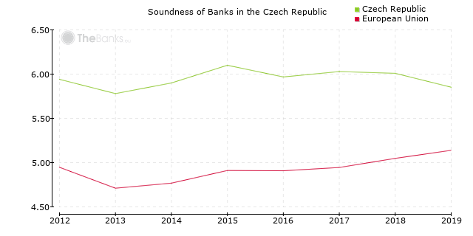
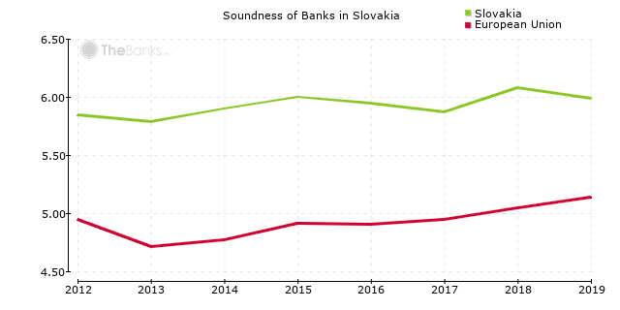
To Subquestion 1:
    The Soundness of the Banking Sector in the Czech Republic and in Slovakia
    These characteristics point to the higher resilience and stability of the banking sector in the Czech Republic but also in Slovakia compared to many other EU Member States
13.

Slide 14
To Subquestion 1:
The Question of joining the European Banking Union is based on the POWER OF MOMENT.
Why is the Slovakia member of the Banking Union?
The structure of the Slovak Banking Sector is more-less the same as in Czech Republic.
However, the following chart gives us the answer.
14.

Slide 15
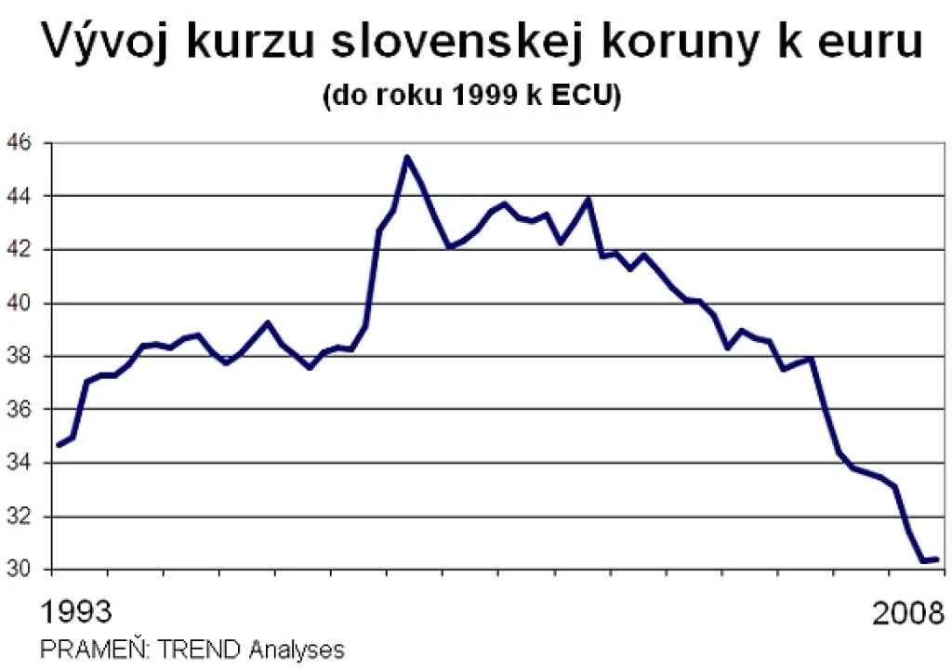
To Subquestion 1:
15.

Slide 16
To Subquestion 1:
Czech Republic:
Czech Republic as the Member of Banking Union: The question of the Power of the sword
According to the Czech government, joining the banking union is associated with cross-border sharing of risks and losses and may therefore be more beneficial in this respect for those Member States whose banking sector is relatively less stable.
It is not appropriate to argue from Czech populism. People simply do not see any economic advantage; on the contrary, there are risks. NO NEED NO ACTION
We have to ask what can joining the Banking Union and the eurozone bring for the Czech Republic?
Slovakia:
Entry into the eurozone (and only as a consequence) has brought economic stabilisation to Slovakia.
This is clearly a big plus for the Slovak economy.
16.

Slide 17
To Subquestion 1:
Conclusions:
1. SSM and SRM were created to ensure the proper implementation of EU law. In fact, the most problematic points for Czech Republic are conferral from national to European level of legislative and/or decision-making competencies about how the money placed or collected in Czech Republic should be ALLOCATED (used or trasnfered(. In fact – substantial rules will be changed, not only institutional framework.
2. I am of the opinion that the functioning of the banking union is in conformity with the principle of subsidiarity and also does not interfere with national sovereignty.
3. The decision to join is not problematic from a legal point of view, but the actual economic aspect that determines the political decision may be problematic.
17.

Slide 18
Subquestion 2:
What are the differences in the legal framework for banking prudential regulation, supervision and resolution in the Czech Republic and Slovakia?
What is the difference between the regulation of bank supervision in Slovakia and the Czech Republic and which legislative framework has proved to be more progressive since Slovakia joined the Banking Union?
What are the differences between Slovak and Czech legislation in the way EU law is implemented in these countries and where is the greatest confidence that the implementation process will not lead to incorrect transposition of the directive?
18.

Slide 19
To Subquestion 2:
The Czech National Bank as macroprudential and microprudential authority
The Czech National Bank (Financial Markets Supervision Department I) is the organ in charge of banking prudential supervision.
The Czech National Bank is the only resolution authority for banks, credit unions and certain investment firms in the Czech Republic.
The CNB implements and enforces the rules under the Single Rule Book.
19.

Slide 20
To Subquestion 2:
National Bank of Slovakia as macroprudential authority
The organ in charge of banking prudential supervision, supervisory authority, is the National bank of Slovakia.
The stability of the European financial stability is also supported by the European Systemic Risk Board (ESRB), which issues recommendations and warnings on current risks as appropriate.
The Resolution Council as microprudential authority
There is only one national resolution authority in Slovakia and it is the Resolution Council.
The Single Resolution Board (SRB) is the common resolution authority for all EU Member States participating in the Single Resolution Mechanism (SRM), i.e. the euro area countries and those EU Member States that have opted to participate in the SRM.
The Resolution Council cooperates closely with the SRB, mainly with regard to financial institutions incorporated in Slovakia.
20.

Slide 21
To Subquestion 2:
The ECB carries out the single supervisory exercise and acts through instructions, guidelines and requests to national supervisors, as it has no direct competence over institutions outside the euro area.
In relation to Slovakia and other the countries of the Banking Union, the ECB has both the possibility of directly supervising the exercise of powers and the possibility of taking over the supervision of an institution directly. Motivation for non obeying the soft law measures is on lower level than in Czech Republic.
Some Czech laws therefore adopt the rule set out in the founding regulations, namely that the CNB, as a national supervisory authority, has the option to opt-out and justify it in relation to specific EU soft law acts. Otherwise, however, the CNB has a legal obligation to rely on such acts. A situation where the CNB explicitly enforces the implementation of EU soft law is not unusual in practice.
21.

Slide 22
Subquestion 3:
How does the transfer of competencies in the field of banking law from the national to the European level and the subsequent reverse transfer of the exercise of these competencies work effectively?
How do European banking regulators communicate with each other?
What is the communication between the Council, EC, ECB, ESAs and national authorities? How far do national authorities accept the soft law issued by the European institutions and what impact does this have on the degree of integration of Member States in the EU and in the Banking Union?
What is the communication between the CJEU and the European banking regulators and how is the communication between the CJEU and the national authorities? Where do problems arise and at what level are they resolved?
22.

Slide 23
To Subquestion 3:
State Aid Issue
The same legal framework for Slovakia and Czech Republic
Under Recital 29 SRMR it is essential for the good functioning of the internal market that the same rules apply to all resolution actions, regardless of whether they are taken by the resolution authorities under Directive 2014/59/EU or within the framework of the SRM. The Commission should assess those measures under Article 107 TFEU.
23.

Slide 24
To Subquestion 3:
The communication between ECB, Commission and Banking Union member states
If the resolution plan provides for use of the fund or state aid, its adoption is conditional on a prior decision by the Commission on its compatibility with the criteria of European state aid law pursuant to Art. 19 SRM Regulation.
To date, the ECB has determined a default or probable default of an institution in four cases, thus giving rise to a decision of exclusion on their resolution. In three cases, it decided that resolution was not in the public interest. Only Banco Popular was resolved. The cases of Italian bank rescues with the help of state aid (based on Article 18 (4) (d) of the SRM Regulation) have repeatedly caused a public debate.
24.

Slide 25
To Subquestion 3:
The communication between ECJ, ECB, Commission and Banking Union member states
The Commission communicated its position on whether the granting of Deposit Guarantee Fund resources constitutes State aid in the 2013 Banking Communication, where, referring to case C-460/07 Puffer, it points out that the mere use of deposit protection fund resources to pay depositors for unavailable deposits does not constitute State aid.
Any other allocation of funds to the deposit protection fund may constitute State aid, despite the fact that the FOV is privately financed. This is because these funds are under the control of the state and the decision to use them can be attributed to the state.
25.

Slide 26
Subquestion 4:
How does legal protection in banking law work in the Czech Republic and Slovakia?
What are the legal options for a private bank to defend itself against a breach of soft law and hard law provisions of European law in the context of Slovak law and in the context of Czech law? Which legal system provide better legal protection to a private entity?
26.

Slide 27
Subquestion 5:
To what extent does the non-unification of public banking law constitute an obstacle to the EU's freedom of establishment?
The strongest banks with the largest market share in the Czech and Slovak markets are subsidiaries of Austrian banks. What legislative acts should the Czech Republic revise to ensure that the European freedom of establishment is restricted as little as possible? We take the postulate that a certain restriction of a fundamental freedom can be justified at the time of the adoption of a law, but that this justification must be corrected over time in the light of changing social circumstances.
27.

Slide 28
THANK YOU VERY MUCH
MERCI BEAUCOUP
VIELEN DANK
28.

