Slide 1
Business Economics
Ondrej Bednar

Slide 2
Lesson 1: Introduction to the course and to the business economics
Student should be able to explain what business does economics studies
Key Concepts
Structure

Slide 3
Business Economics
What is business?
What types of business do we know?
Types of economic societies
Fundamental questions of society
What is economics
Economics, economy, economic….
Scarcity

Slide 4
Key Concepts
Scarcity
Opportunity costs
Rationality
Marginal changes
Unintended consequences
“There is no such thing as a free lunch”
Examples, examples

Slide 5
Ideas
Efficient allocation of resources and markets
Trade can be mutually beneficial
Market outcomes can often be improved by governments
Externalities
Market power
The ability to produce goods and services determine standard of living

Slide 6
Microeconomics vs Macroeconomics
Microeconomics
Single markets
Business Optimisation
Macroeconomics
All markets within economy aggregated
GDP, Inflation, Balance of Payment, Unemplyoment …

Slide 7
MicroEconomics for business: Where we are
Money Flows
Demand
Households (HH)
Supply
Goods and Services Market
Factor Market
Firms (F)
Demand
Supply

Slide 8
Firms
Maximize profits Π
Π(Q) = TotalRevenue-TotalCosts= p(Q)⋅Q+C(Q)
Maximizing Π with respect to quantity …0 =p(Q)+Qp′(Q)+C′(Q) ->
p(Q)+Qp′(Q)=C′(Q).... MR=MC Marginal Revenue= Marginal Cost

Slide 9
Revenue Function
Depends on market structure where the firm operates: prefect or imperfect competition
Total Revenue, Average Revenue, Marginal Revenue Graphs

Slide 10
Cost function
Fixed vs variable costs distinction
Production function: Total product TP, Average Product AP, Marginal Product MP
Factors of production L, K, A
Total Costs, Average Costs, Marginal Costs Graphs

Slide 11
Households optimisation
Total Utility, Marginal Utility, Budget

Slide 12
Elasticities
εd​=%ΔQ/%ΔP​
How big a change causes in Quantity demanded causes price change
What makes demand more elastic

Slide 13
Market interactions graphs

Slide 14
Market Structures
Monopoly, Oligopoly, Monopolistic competition, Perfect competition

Slide 15
Repetition
Profit-optimizing company in imperfect market
Break-even analysis
Price elasticity of demand and supply and what affects the elasticities

Slide 16
Elasticities continued
Income Elasticity
Cross Elasticity
Example:
D1:P=20-5Q
D2:Q=5-0.25P

Slide 17
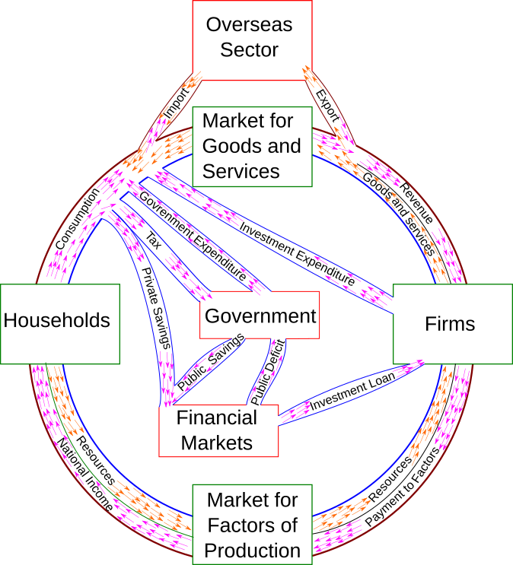
Macroeconomics

Slide 18
Main macroeconomic variables
Product
Inflation
BoP
Unemployment rate
Interest Rate
Exchange Rate

Slide 19
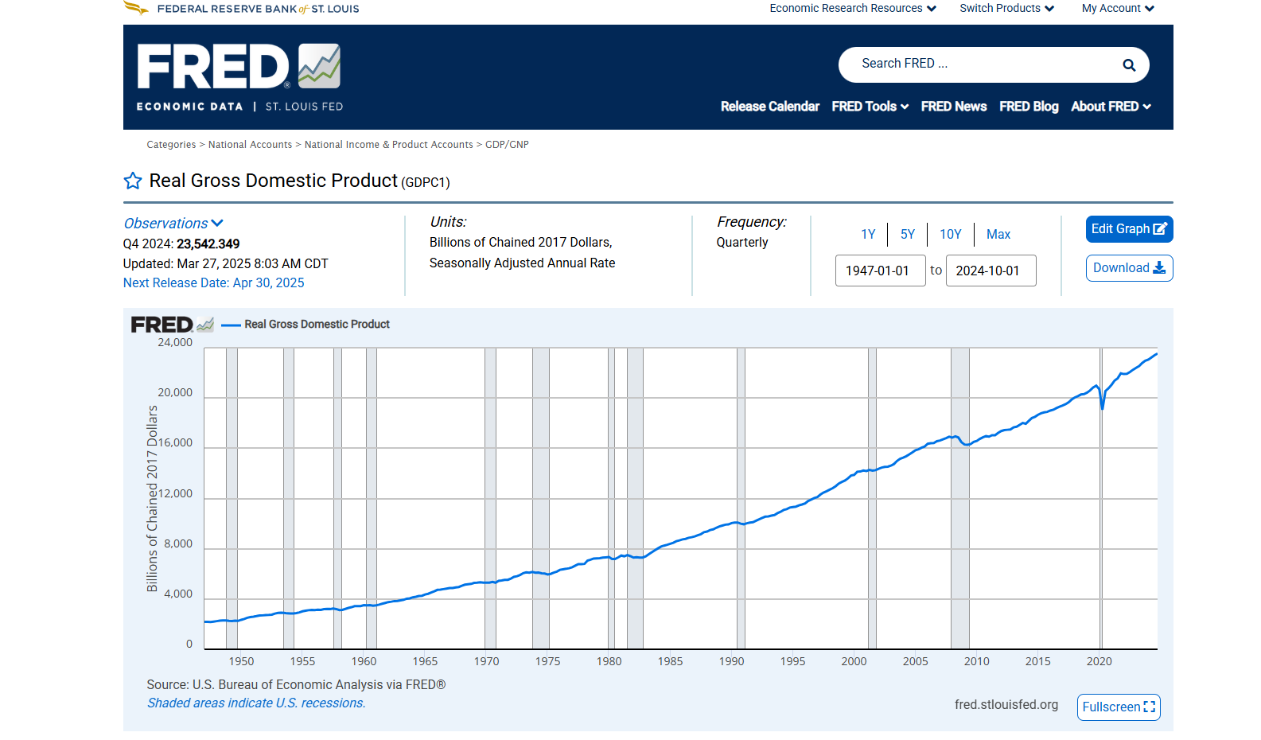
PRODUCT

Slide 20
Growth Economics
Cycle/wave name Period (years)
Kitchin cycle (inventory, e.g. pork cycle) 3–5
Juglar cycle (fixed investment) 7–11
Kuznets swing (infrastructural investment, demographics) 15–25
Kondratiev wave (technological basis) 45–60

Slide 21
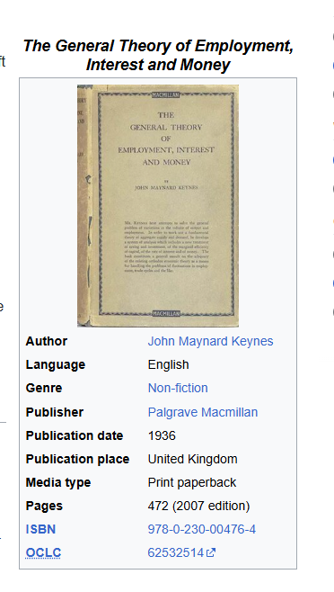
Fiscal Policy
Fiscal policy refers to how the government uses spending and taxation to influence the economy.
  Spending: On infrastructure, public services, social benefits, etc.
  Taxation: Income tax, corporate tax, VAT, etc.
Goal: Promote economic stability, reduce unemployment, and support growth.
Contrast with Monetary Policy:
Fiscal = government (Ministry of Finance/Treasury)
Monetary = central bank (interest rates, money supply)

Slide 22
Types
🟢 Expansionary Fiscal Policy
Used during a recession
Involves increasing spending or cutting taxes
Goal: Stimulate demand, reduce unemployment
Example: 2009 U.S. stimulus package during the Great Recession
🔴 Contractionary Fiscal Policy
Used when economy is overheating (high inflation)
Involves cutting spending or raising taxes
Goal: Slow down inflation, reduce deficits
Example: Austerity measures in Europe post-2010 debt crisis

Slide 23
Main schools
Keynesian View
Pro-fiscal intervention
Believes demand drives the economy
Advocates government spending during downturns to offset weak private sector
“The boom, not the slump, is the right time for austerity.” — Keynes
Classical / Monetarist View (e.g., Milton Friedman)
Skeptical of government intervention
Believes markets self-correct
Advocates limited fiscal policy, prefers monetary policy
“The use of fiscal policy to offset the business cycle has not been a success.” — Friedman

Slide 24
Monetary Policy- lesson goals
Explain what a central bank can control and what it influences indirectly.
Trace the transmission mechanism from policy rate → financial conditions → spending → inflation → hiring.
Predict which kinds of firms benefit/hurt when rates rise/fall (and why).
Turn a rate/inflation scenario into a pricing, investment, and financing decision.

Slide 25
Interest Rate
If rates jump 2 percentage points, what changes tomorrow morning for a business?

Slide 26
Interest rates impact
Financing Costs
Customer demand
FX / international sales
Hiring & inventory

Slide 27
Central Bank and monetary policies
CB is an institution that manages the monetary policy of a country or monetary union
Monetary policy affects monetary and financial conditions to accomplish its objectives, most often price stability and low unemployment

Slide 28
Monetary Policy Tools
Interest Rates
Forward Guidance
Reserve Requirements

Slide 29
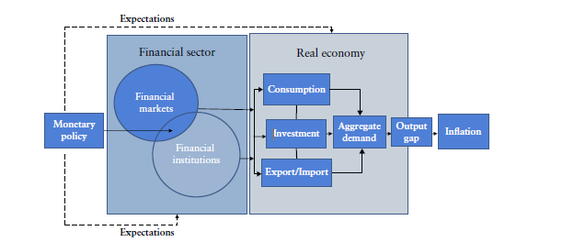
Transmission mechanism

Slide 30
Monetary policy impact on busines
Market rates → WACC goes up/down, capex hurdle rates shift.
Credit availability → banks tighten lending standards, covenants matter.
Asset prices → wealth effect (consumer), valuation/financing (firms).
FX channel → rate differentials move currency, hits exporters/importers.
Expectations → pricing power and wage negotiations change.

Slide 31
Terms and concepts
Yield Curve
Quantitative Theory of Money

Slide 32
Game Theory
Statistics primer
Finance- company valuation
Finance derivatives and accounting
Behavioral economics

