Slide 1
Meaning of European Integration
Lecture presentation CEVRO University

Slide 2
Lecture Overview
Historical models of European unity
From imperial domination to institutional integration
Key figures and turning points
Notes:
Speaker notes: Explain the significance of 'Lecture Overview' in the broader history of European attempts at unity. Connect the topic to the transition from imperial domination to institutional integration.

Slide 3
Europe: A Continent of States
Europe consists of about 48 sovereign states
Large differences in population, territory and power
Political fragmentation shaped European history

Slide 4
Linguistic Diversity
Europe is the most linguistically diverse continent
EU alone recognizes 24 official languages
Cultural differences complicate political unity

Slide 5
Three Models of European Unity
Imperial
Military
Institutional
Notes:
Speaker notes: Explain the significance of 'Three Models of European Unity' in the broader history of European attempts at unity. Connect the topic to the transition from imperial domination to institutional integration.

Slide 6
Integrations
European history shows three different models of unity:
Empire — Roman Empire
Christian empire — Charlemagne
Institutional integration — European Union
The EU represents the first attempt to organize Europe without military domination.

Slide 7
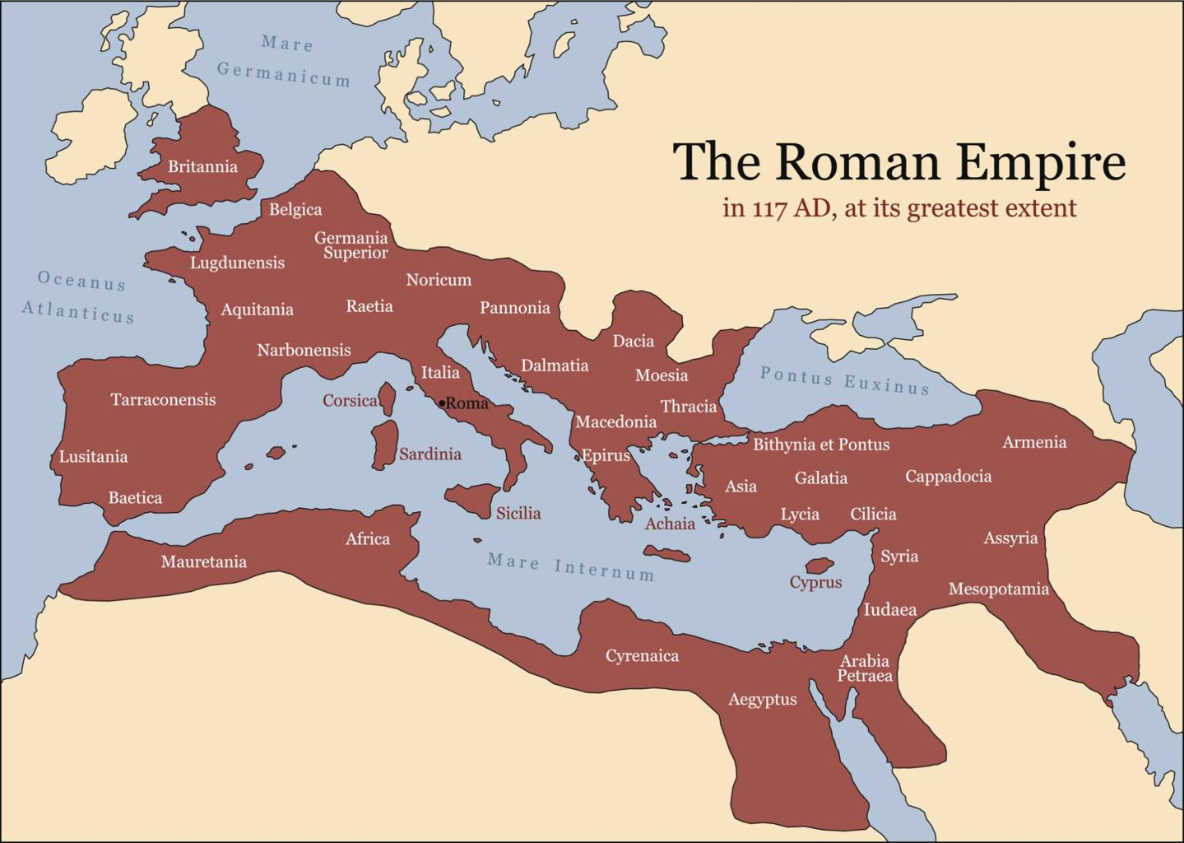
The Roman Empire

Slide 8
Roman Empire
Characteristics
first large political unification of Europe
centralized imperial administration
Roman law and infrastructure
imperial authority of the emperor

Slide 9
Timeline of European Unification Attempts
476 Fall of Western Roman Empire
800 Charlemagne crowned Emperor
962 Holy Roman Empire
1815 Fall of Napoleon
1945 End of WWII
1951 ECSC
1993 Maastricht Treaty
Notes:
Speaker notes: Explain the significance of 'Timeline of European Unification Attempts' in the broader history of European attempts at unity. Connect the topic to the transition from imperial domination to institutional integration.

Slide 10
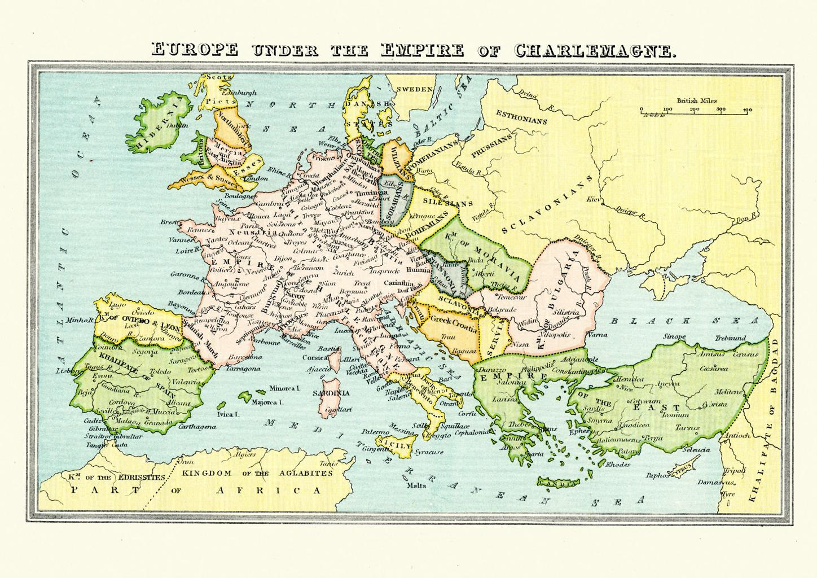
Charlemagne

Slide 11
Charlemagne
Characteristics
revival of Western Roman imperial idea
Christian political order
alliance between emperor and papacy
administrative reforms

Slide 12
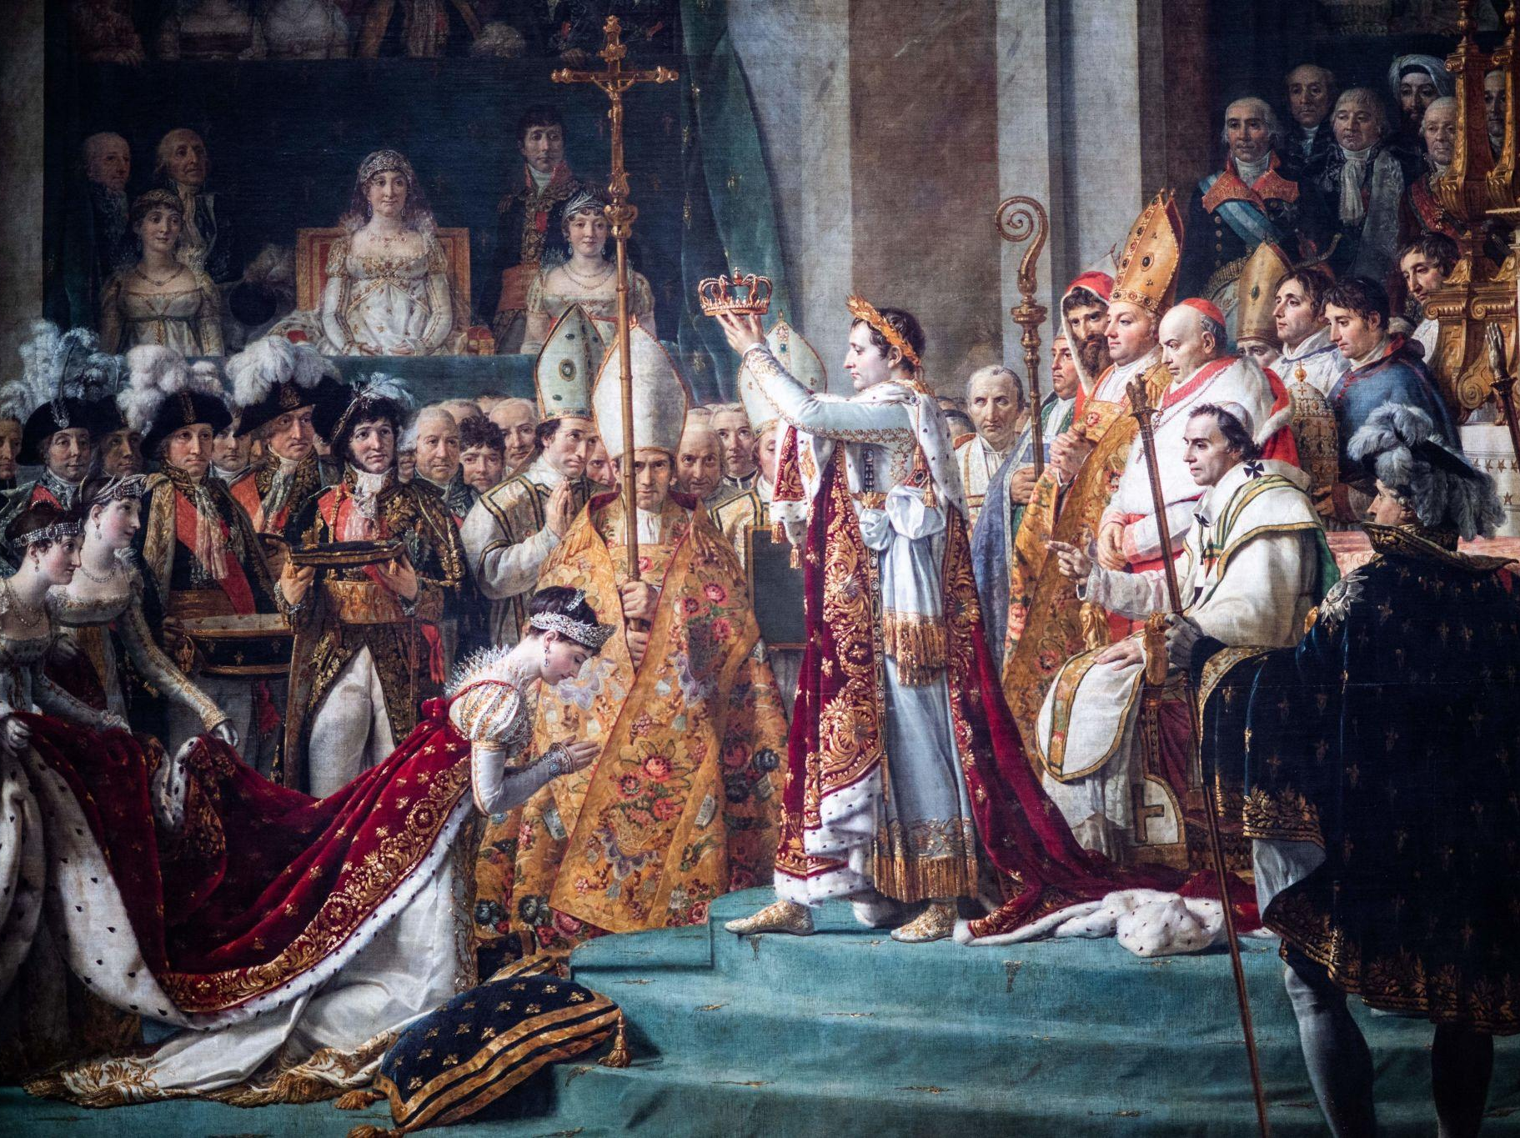
Napolen

Slide 13
Roman Empire: Political Unity
First large-scale European political order
Roman law and administration
Infrastructure integration
Notes:
Speaker notes: Explain the significance of 'Roman Empire: Political Unity' in the broader history of European attempts at unity. Connect the topic to the transition from imperial domination to institutional integration.

Slide 14
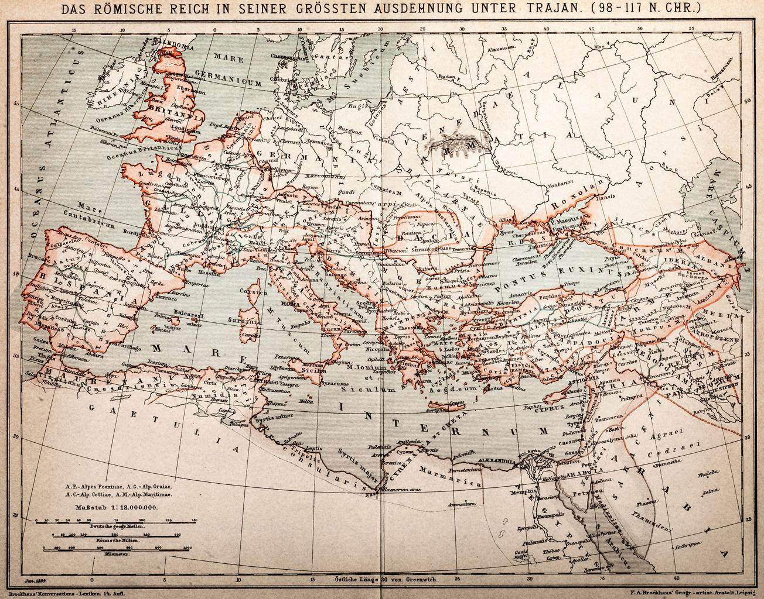
Charlemagne’s Empire

Slide 15
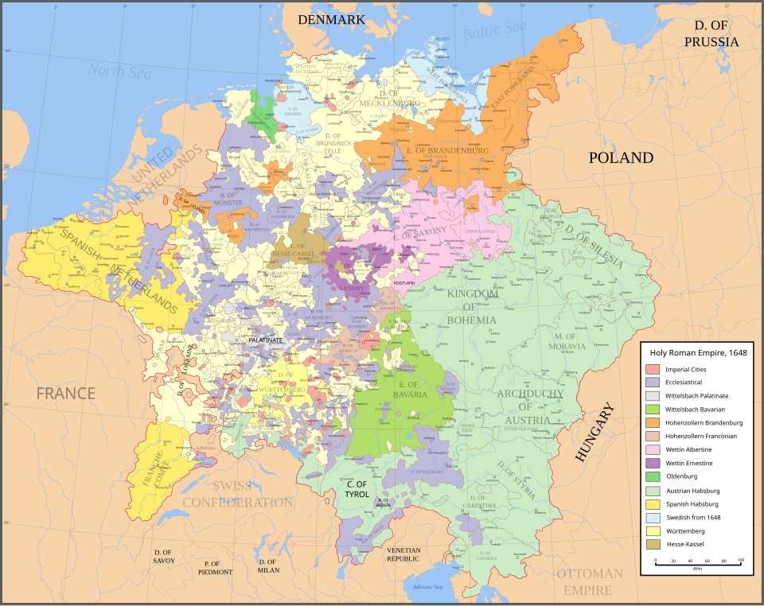
Holy Roman Empire

Slide 16
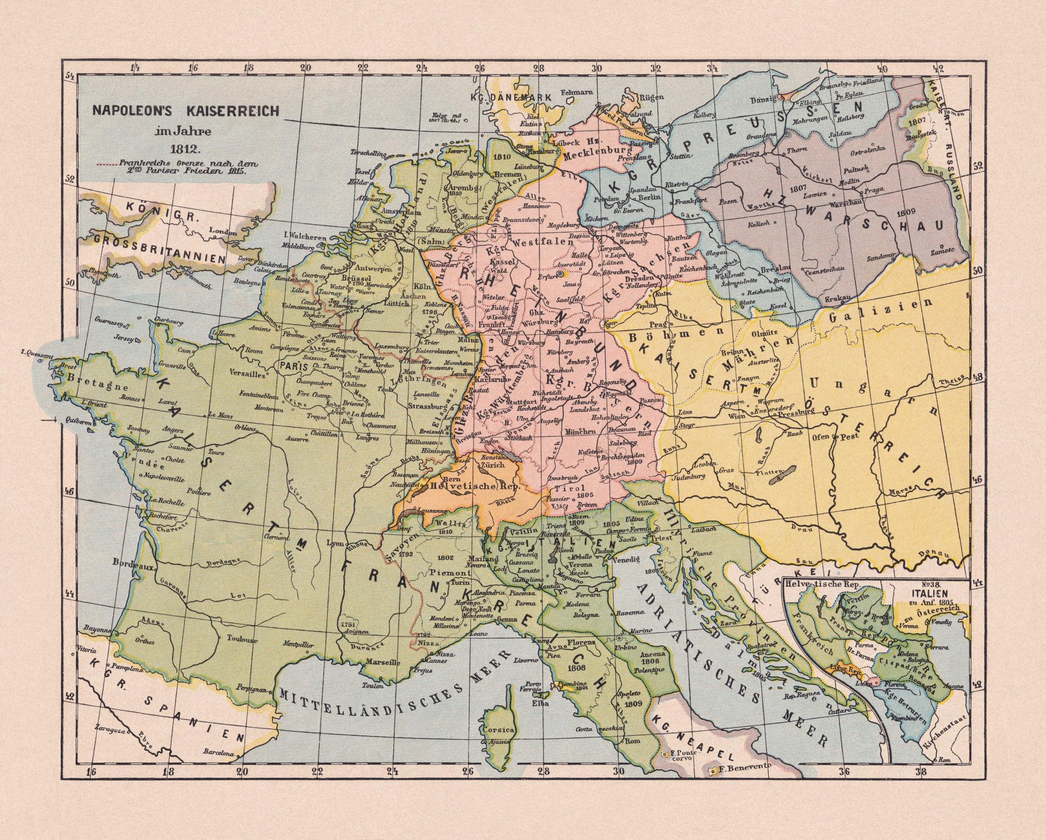
Napoleonic Europe (1812

Slide 17
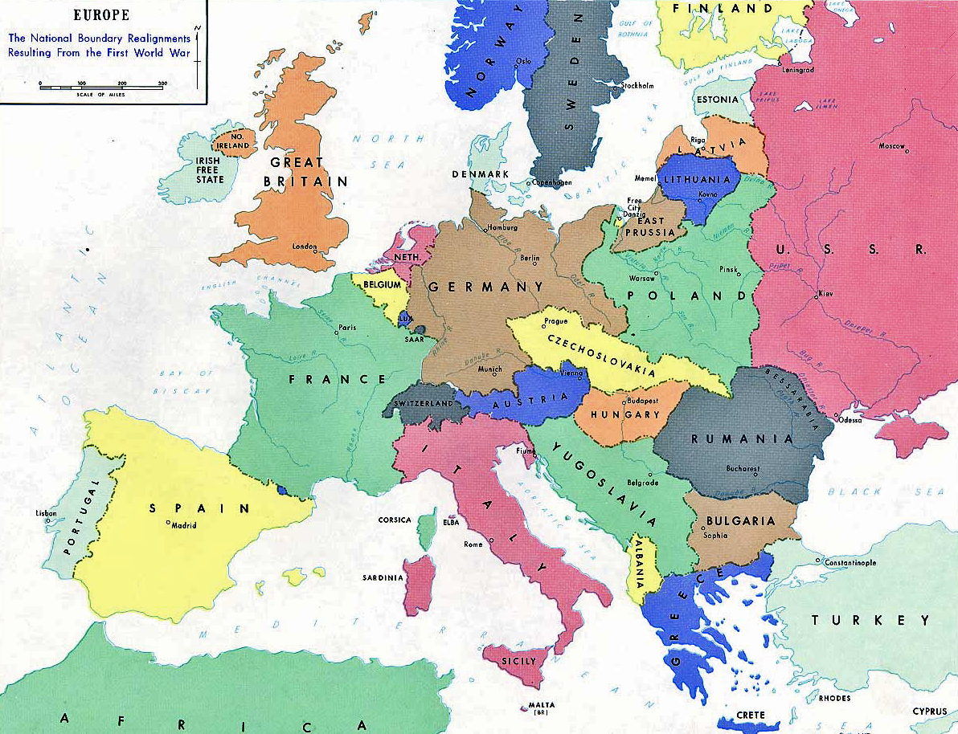
Europe after WWI

Slide 18
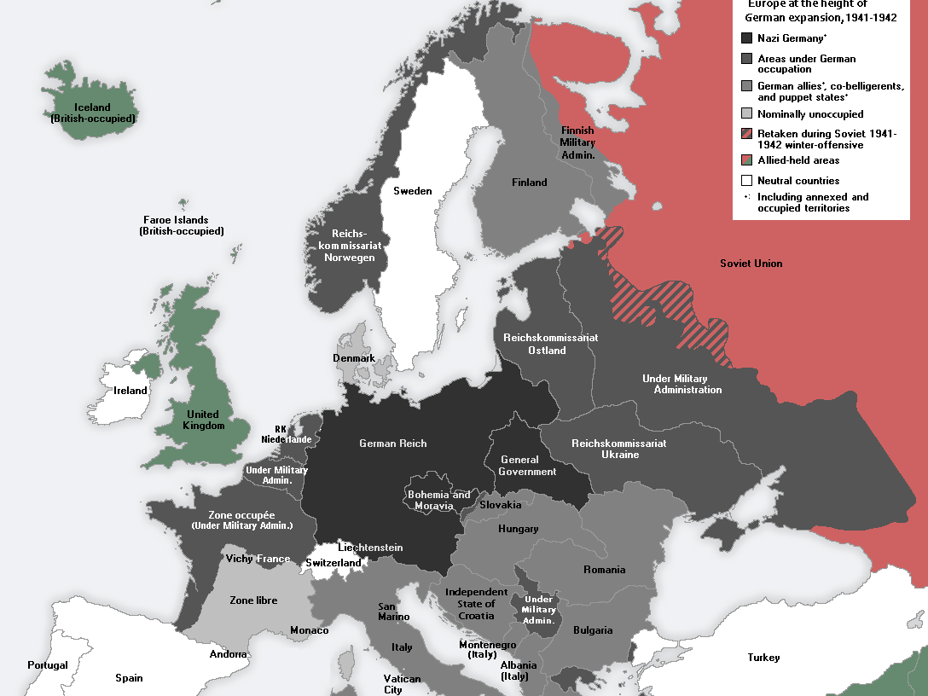
Nazi Europe

Slide 19
Ad Hoc Cooperation
European states historically cooperated only temporarily
Alliances were driven by immediate interests
Long‑term institutions were rare before the 20th century

Slide 20
Sovereignty as the Basis of Cooperation
European states remained sovereign
Integration developed through voluntary cooperation
Shared institutions emerged gradually

Slide 21
War and Peace Cycles
European history marked by repeated wars
Major conflicts reshaped the political order
Peace settlements often unstable

Slide 22
Attempts to Unify Europe by Force
Napoleon attempted continental domination
Hitler attempted violent unification during WWII
Military domination proved unsustainable

Slide 23
Treaty of Versailles (1919)
Ended World War I
Imposed heavy reparations on Germany
Created instability in Europe

Slide 24
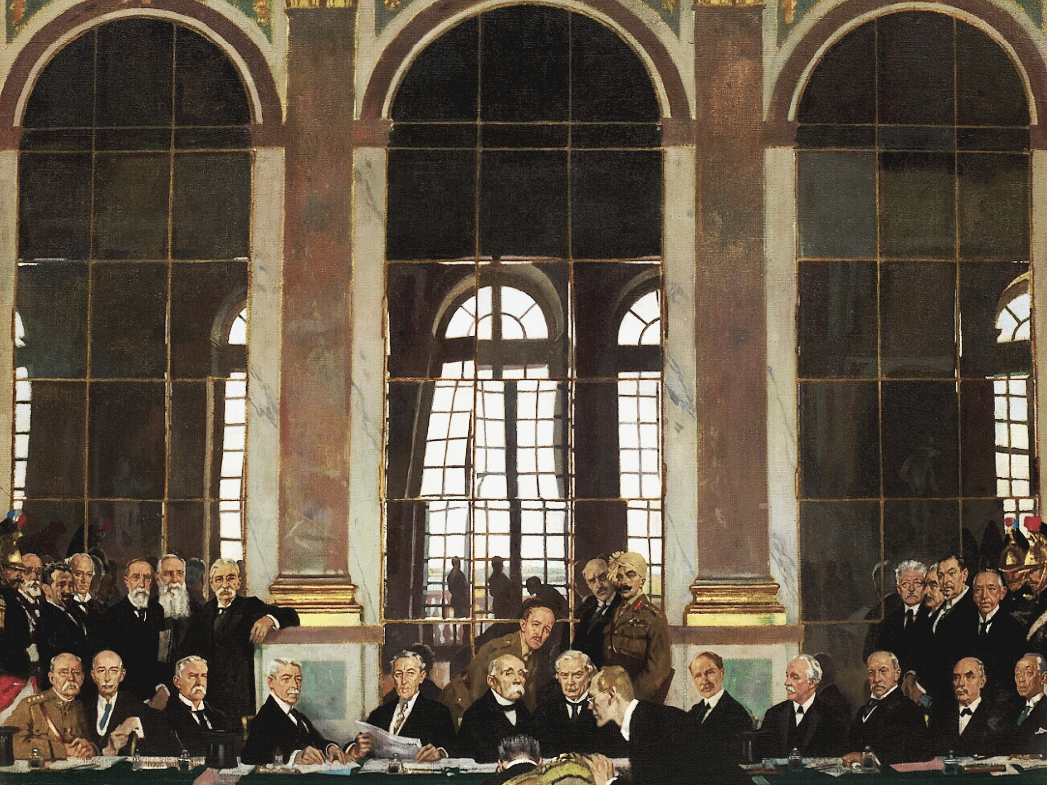
Treaty of Versailles (1919)

Slide 25
League of Nations
First international organization for collective security
Lacked enforcement mechanisms
Failed to prevent World War II

Slide 26
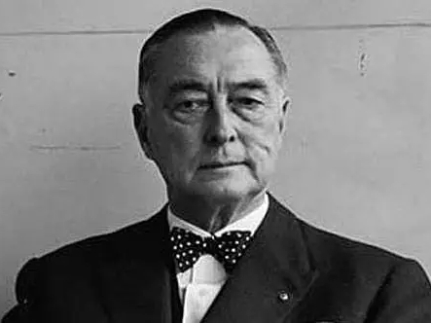
Richard Coudenhove‑Kalergi

Slide 27
Paneuropean Idea
Richard Coudenhove‑Kalergi proposed European unity
Pan‑European movement founded in 1923
Inspired later integration projects

Slide 28
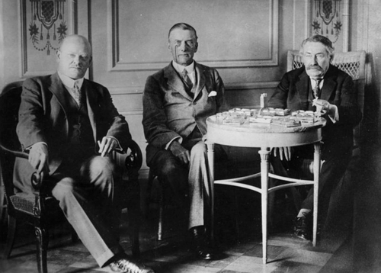
Locarno Treaties

Slide 29
Locarno Treaties (1925)
Attempt to stabilize post‑war Europe
Germany accepted western borders
Failed to prevent later conflict

Slide 30
19th Century Europe
Rise of nationalism
Industrial transformation
Notes:
Speaker notes: Explain the significance of '19th Century Europe' in the broader history of European attempts at unity. Connect the topic to the transition from imperial domination to institutional integration.

Slide 31
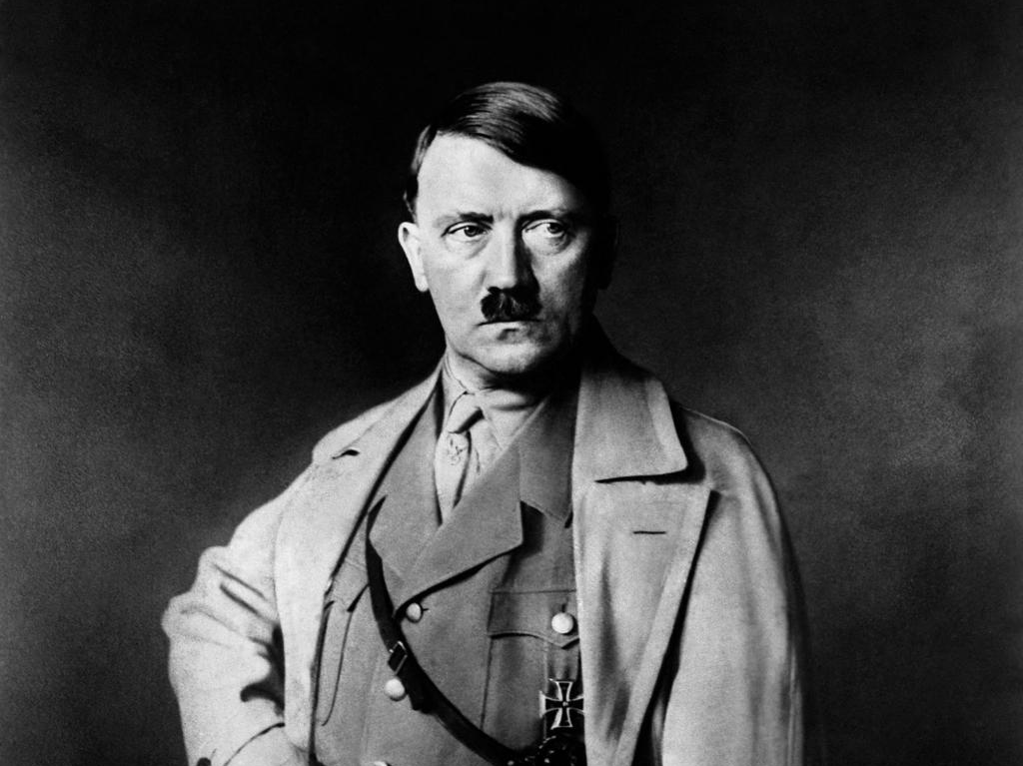
Adolf Hitler

Slide 32
Rise of Nazism
Economic crisis and political radicalization
Hitler came to power in 1933
Led to expansion and war

Slide 33
Nazi Vision of Europe
Neuordnung Europas
Totalitarian domination
Notes:
Speaker notes: Explain the significance of 'Nazi Vision of Europe' in the broader history of European attempts at unity. Connect the topic to the transition from imperial domination to institutional integration.

Slide 34
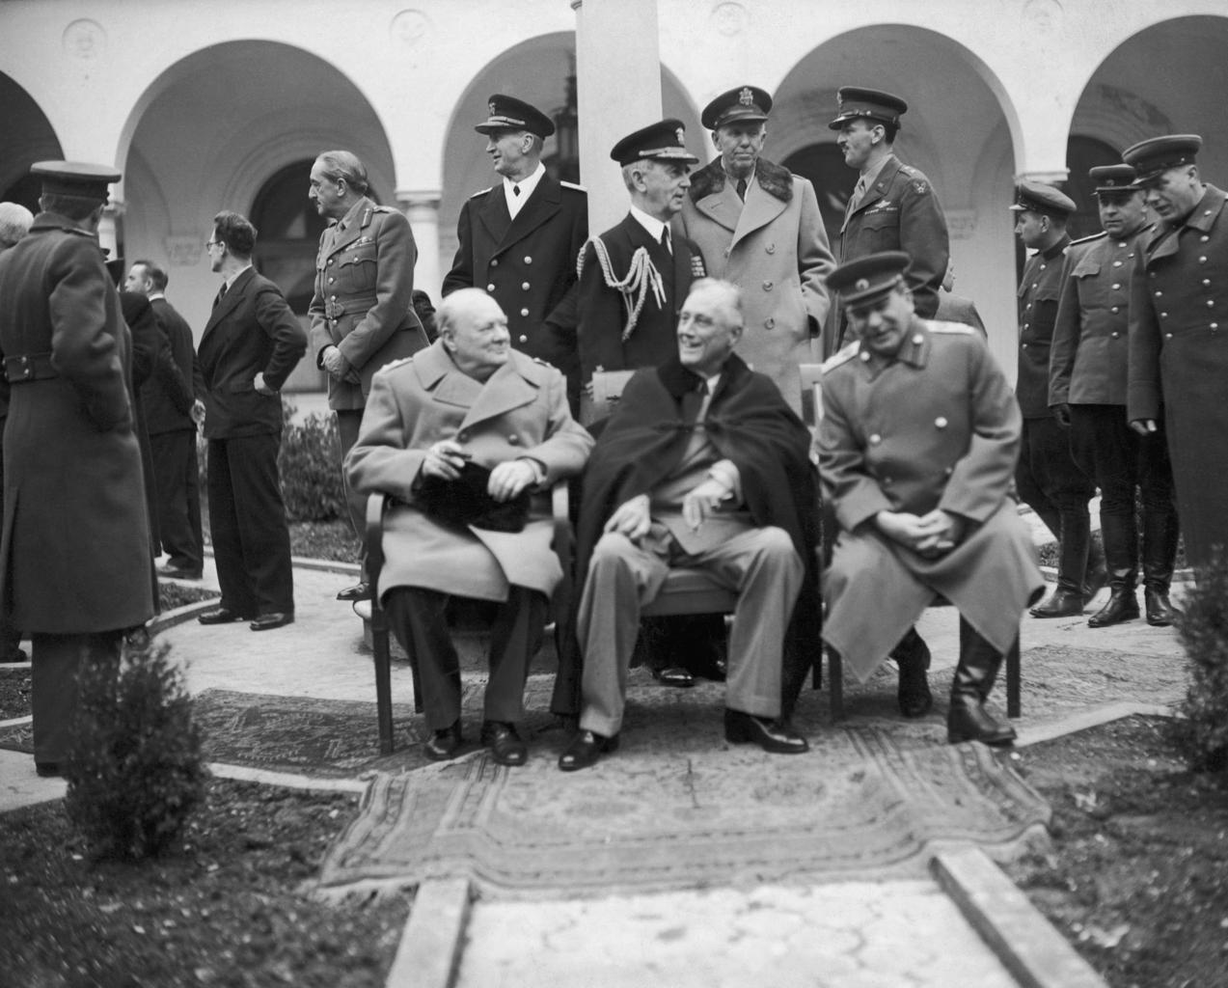
Yalta Conference

Slide 35
Yalta Conference (1945)
Allied leaders discussed post‑war order
Division of influence in Europe
Beginning of Cold War structure

Slide 36
Winston Churchill

Slide 37
Potsdam Conference (1945)
Defined post‑war policy toward Germany
Demilitarization and denazification
Confirmed division of Europe

Slide 38
Creation of the United Nations
Founded in 1945
Goal: maintain international peace
Central institution of global governance

Slide 39
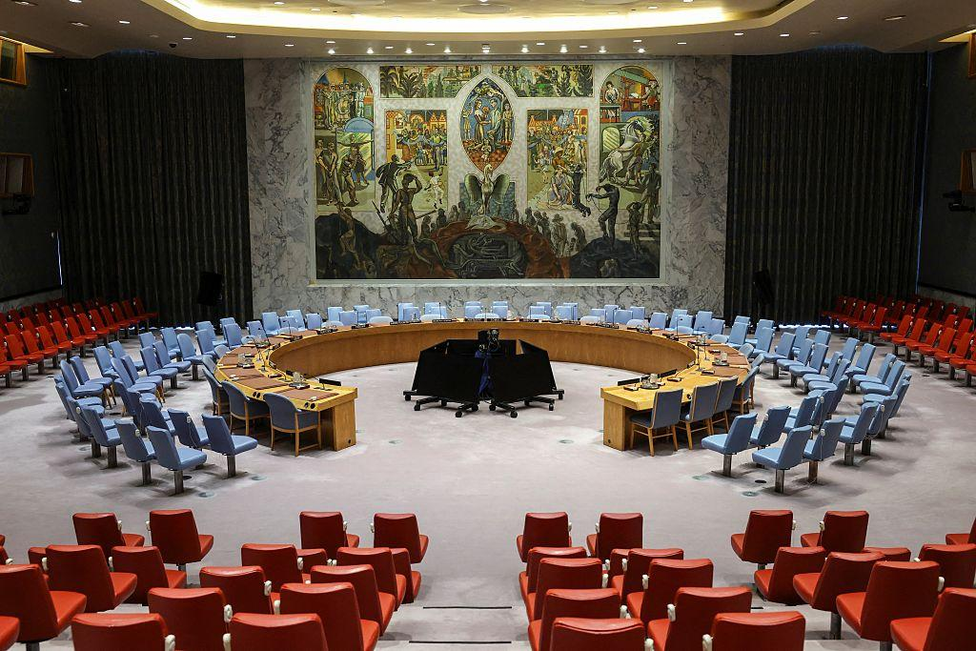
UN Security Council

Slide 40
UN Security Council
Responsible for international peace
Five permanent members with veto
Reflects post‑WWII power balance

Slide 41
Post‑War Reconstruction
Political devastation
Need for stable peace
Notes:
Speaker notes: Explain the significance of 'Post‑War Reconstruction' in the broader history of European attempts at unity. Connect the topic to the transition from imperial domination to institutional integration.

Slide 42
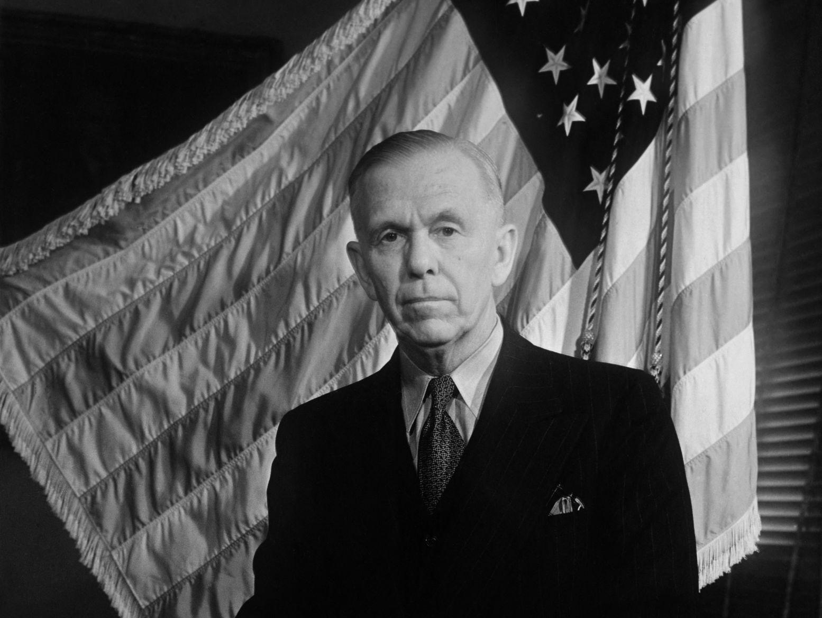
George Marshall

Slide 43
Marshall Plan
US economic assistance
Stimulated European cooperation
Notes:
Speaker notes: Explain the significance of 'Marshall Plan' in the broader history of European attempts at unity. Connect the topic to the transition from imperial domination to institutional integration.

Slide 44
Marshall Plan
US program for European reconstruction
Encouraged economic cooperation
Stabilized Western Europe

Slide 45
Cold War Europe
Division East vs West
Notes:
Speaker notes: Explain the significance of 'Cold War Europe' in the broader history of European attempts at unity. Connect the topic to the transition from imperial domination to institutional integration.

Slide 46
Founders of European Integration
Jean Monnet
Robert Schuman
Notes:
Speaker notes: Explain the significance of 'Founders of European Integration' in the broader history of European attempts at unity. Connect the topic to the transition from imperial domination to institutional integration.

Slide 47
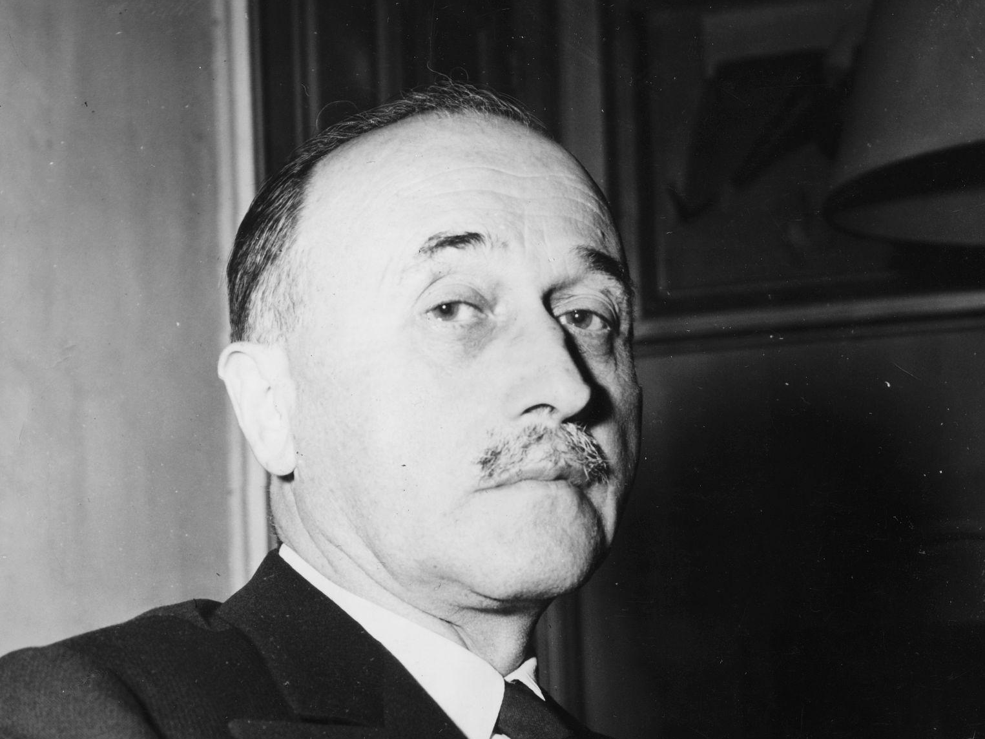
Jean Monet

Slide 48
Jean Monnet
Architect of supranational integration
Promoted economic cooperation
Key strategist of European unity

Slide 49
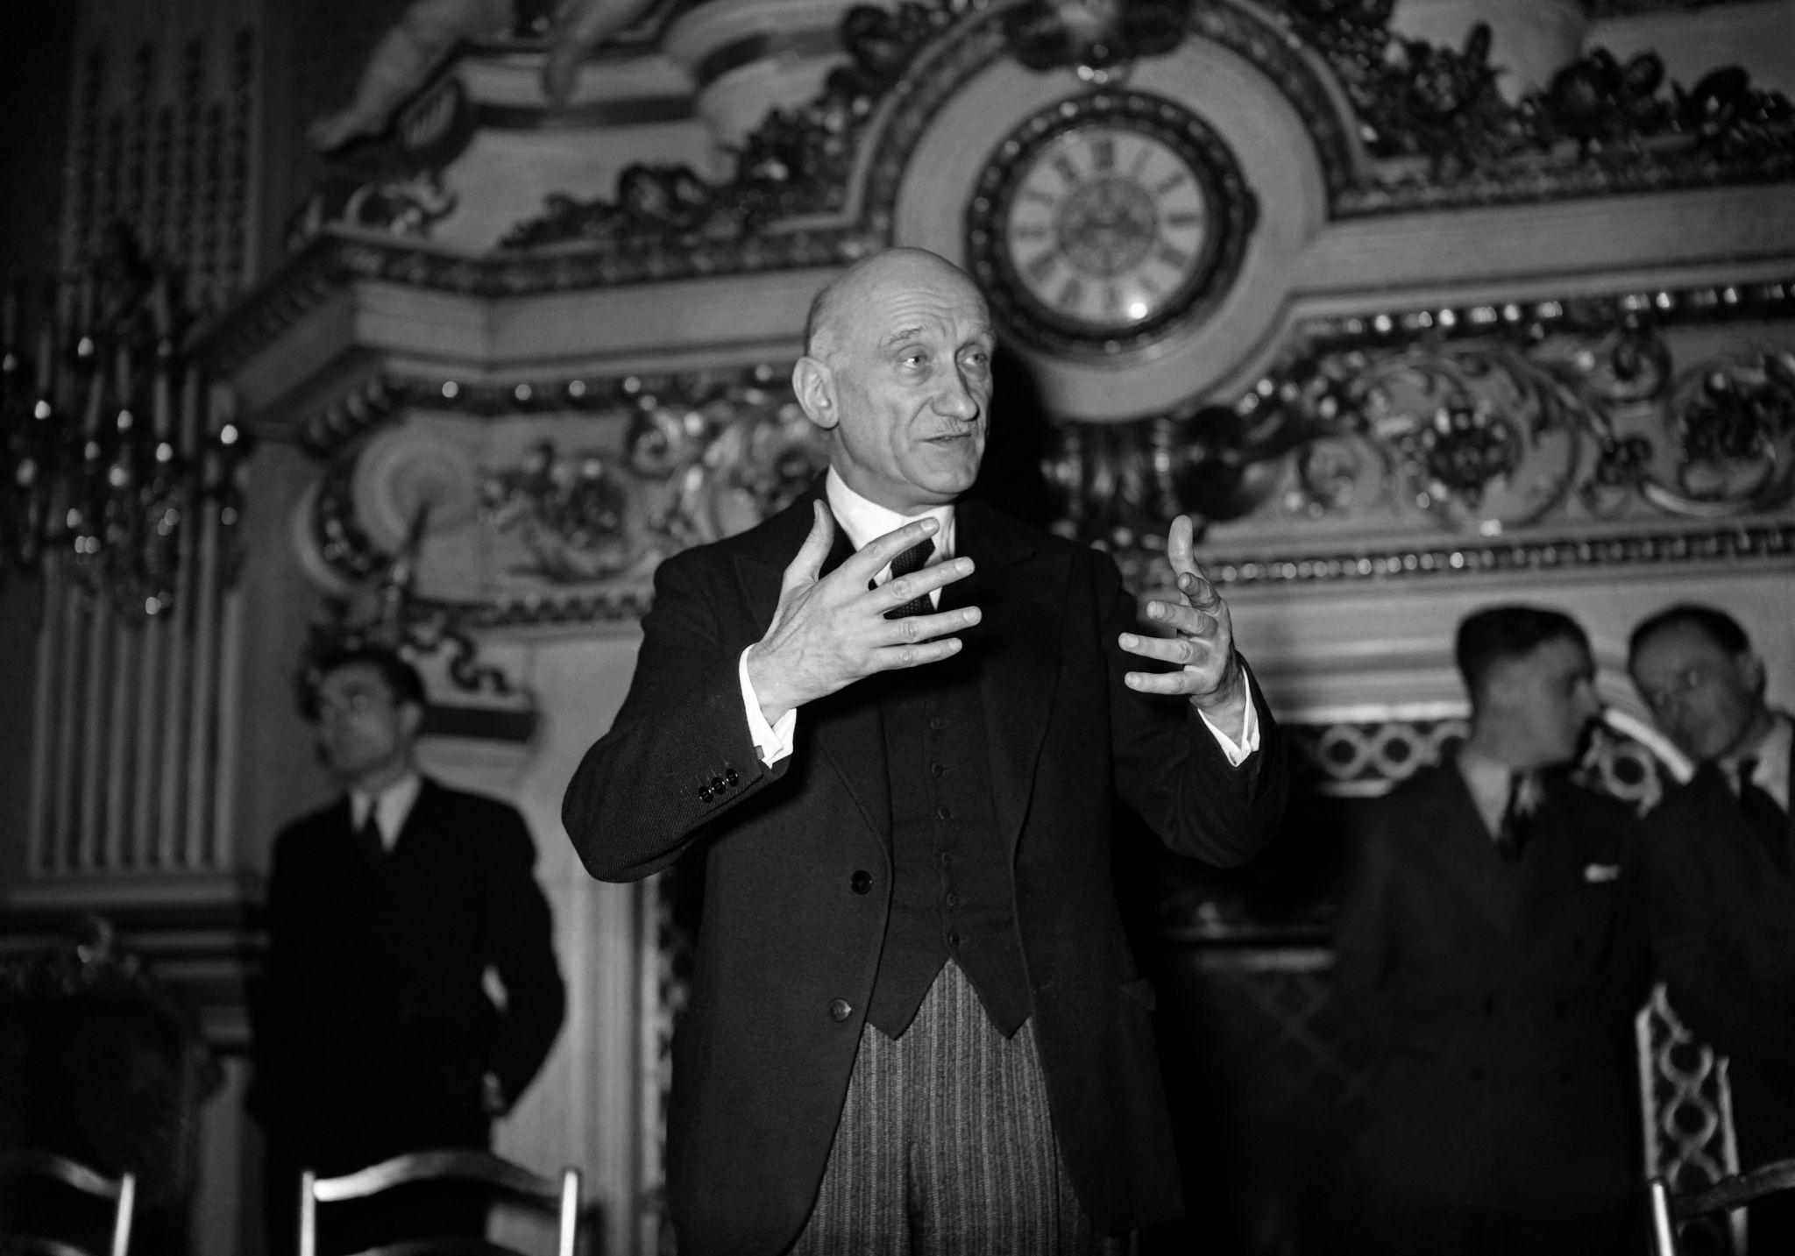
Robert Schuman

Slide 50
Robert Schuman
French foreign minister
Author of the Schuman Declaration
Initiated European integration

Slide 51
Schuman Declaration 1950
Coal and steel integration proposal
Notes:
Speaker notes: Explain the significance of 'Schuman Declaration 1950' in the broader history of European attempts at unity. Connect the topic to the transition from imperial domination to institutional integration.

Slide 52
Schuman Declaration (1950)
Coal and steel integration proposal
Aimed to make war impossible
Foundation of ECSC

Slide 53
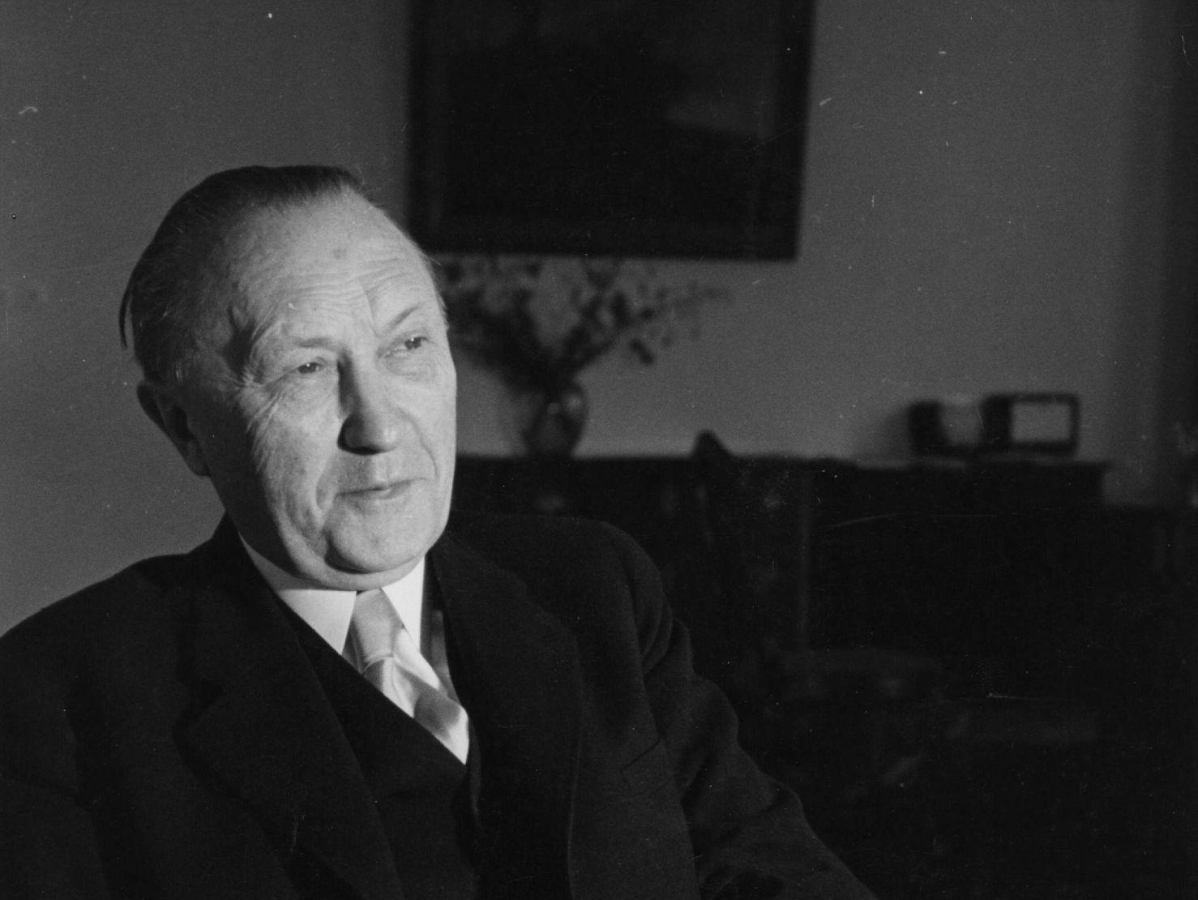
Konrad Adenauer

Slide 54
Konrad Adenauer
German Chancellor
Promoted reconciliation with France
Supported European integration

Slide 55
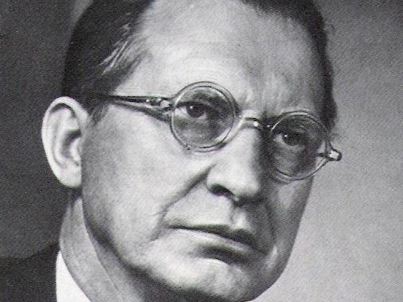
Alcide De Gasperi

Slide 56
Alcide De Gasperi
Italian prime minister
Advocated democratic reconstruction
Founding father of Europe

Slide 57
European Coal and Steel Community
Founded in 1951
Integrated key industries
First supranational European institution

Slide 58
European Coal and Steel Community
First supranational institution
Notes:
Speaker notes: Explain the significance of 'European Coal and Steel Community' in the broader history of European attempts at unity. Connect the topic to the transition from imperial domination to institutional integration.

Slide 59
COMECON
Eastern bloc economic organization
Created by Soviet Union
Counterpart to Western integration

Slide 60
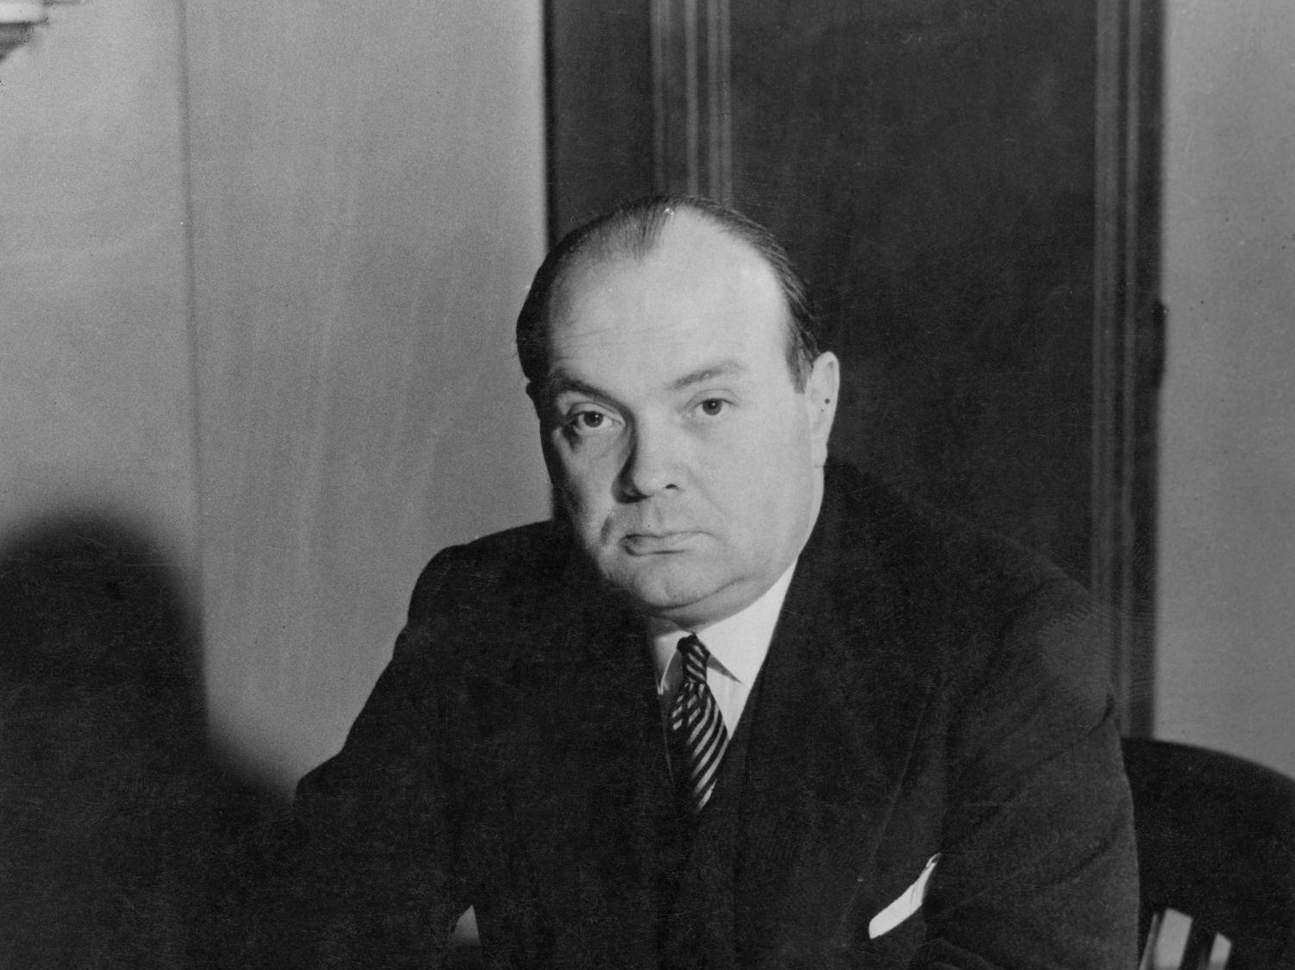
Henri Spaak

Slide 61
Paul‑Henri Spaak
Belgian statesman
Key negotiator of Rome Treaties
Important federalist thinker

Slide 62
Treaties of Rome
European Economic Community
Common market
Notes:
Speaker notes: Explain the significance of 'Treaties of Rome' in the broader history of European attempts at unity. Connect the topic to the transition from imperial domination to institutional integration.

Slide 63
Treaties of Rome (1957)
Created the EEC
Established common market
Major milestone of integration

Slide 64
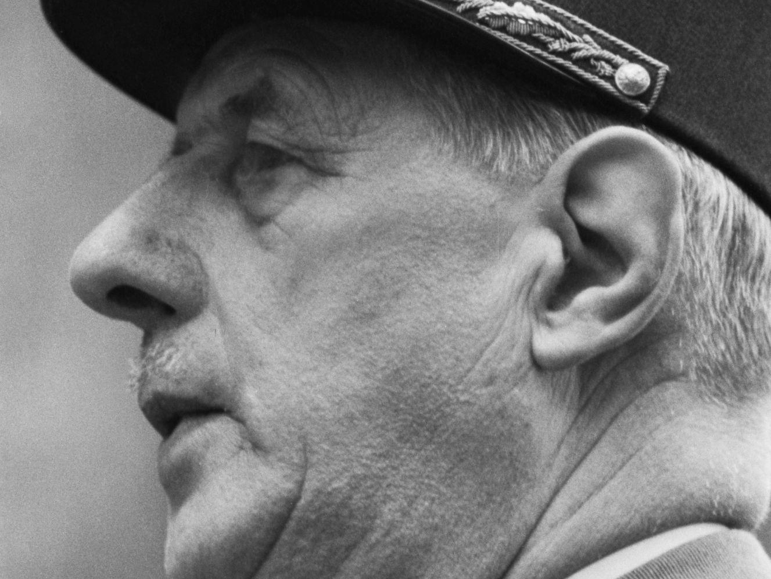
Charles de Gaulle

Slide 65
Charles de Gaulle
Promoted Europe of sovereign states
Strengthened French role
Opposed excessive supranationalism

Slide 66
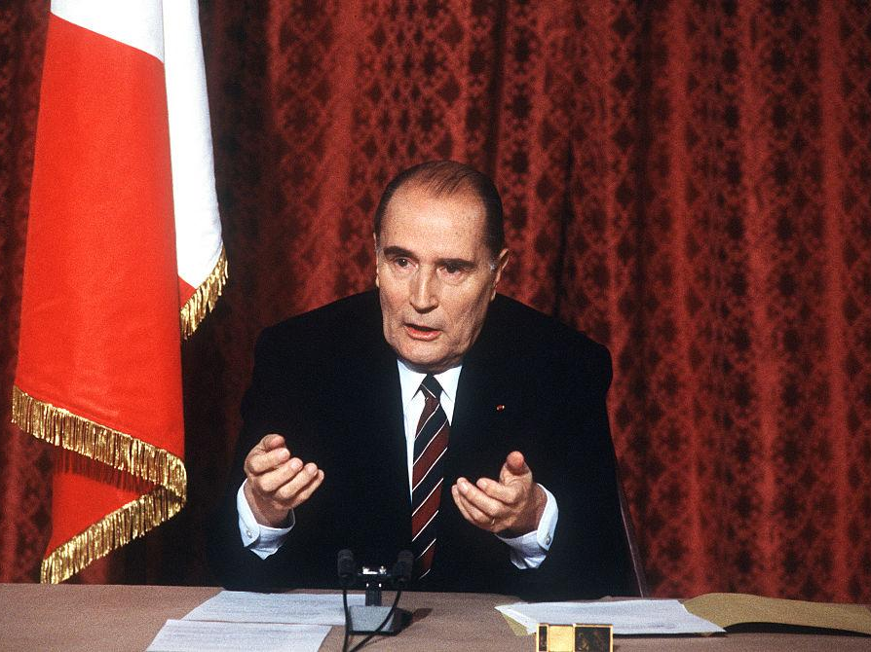
Francois Mitterand

Slide 67
François Mitterrand
Supported European monetary union
Strengthened Franco‑German partnership

Slide 68
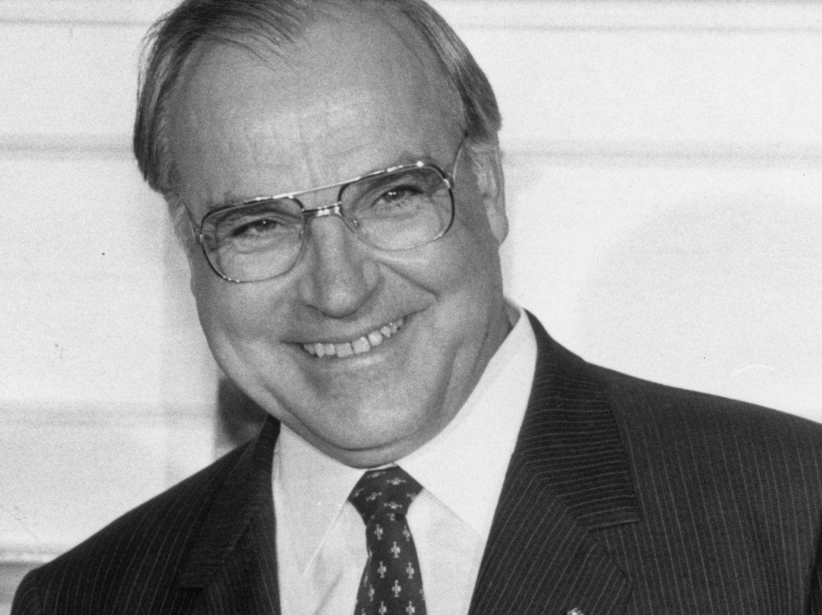
Helmut Kohl

Slide 69
Helmut Kohl
German Chancellor
Supported EU expansion and euro
Architect of German reunification

Slide 70
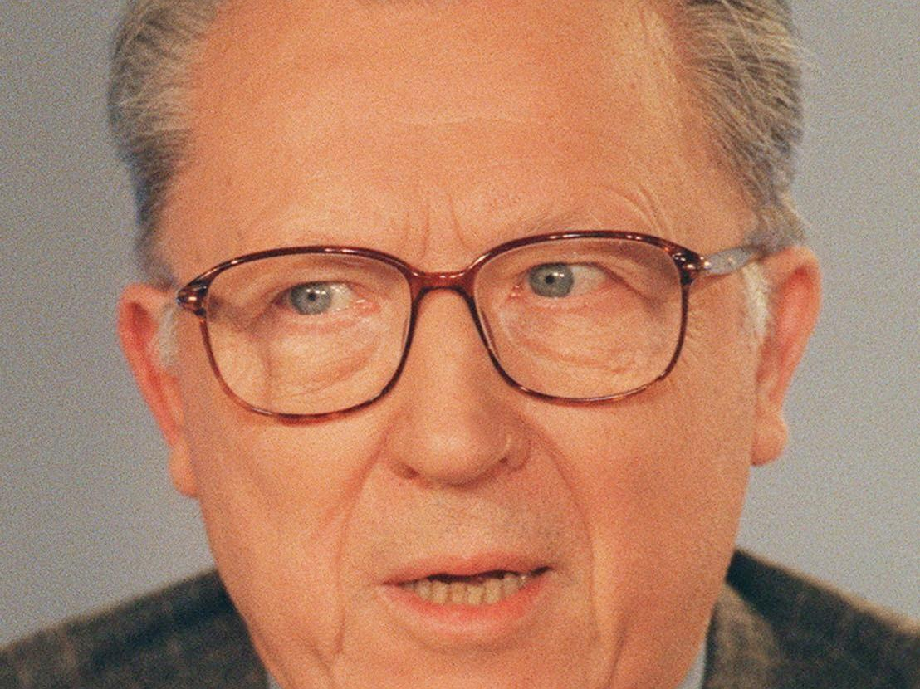
Jaque Delors

Slide 71
Jacques Delors
President of the European Commission
Architect of the Single Market
Prepared foundations of the euro

Slide 72
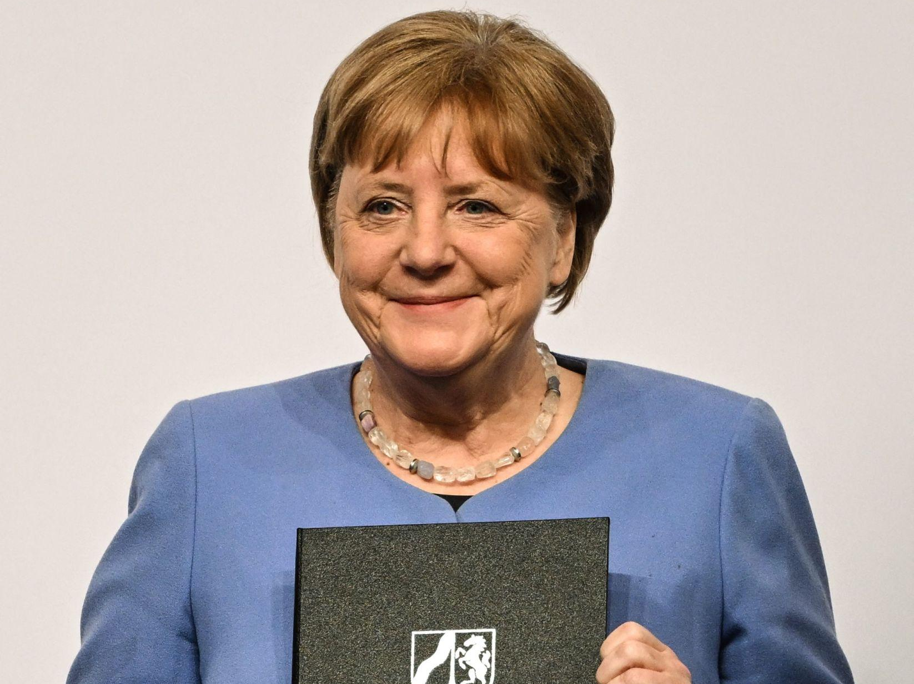
Angela Merkel

Slide 73
Angela Merkel
Central EU leader during crises
Advocated European stability
Promoted EU cohesion

Slide 74
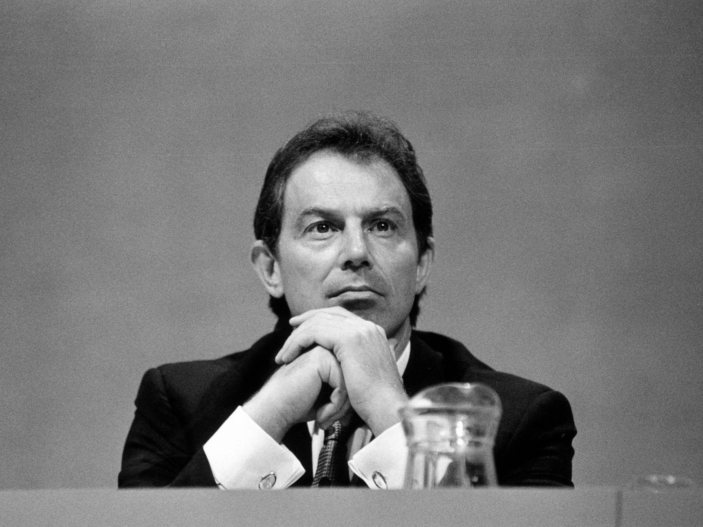
Tony Blair

Slide 75
Tony Blair
Supported EU enlargement
Promoted EU‑US cooperation

Slide 76
European Community Expansion
1973, 1981, 1986 enlargements
Notes:
Speaker notes: Explain the significance of 'European Community Expansion' in the broader history of European attempts at unity. Connect the topic to the transition from imperial domination to institutional integration.

Slide 77
Maastricht Treaty
Creation of European Union
Notes:
Speaker notes: Explain the significance of 'Maastricht Treaty' in the broader history of European attempts at unity. Connect the topic to the transition from imperial domination to institutional integration.

Slide 78
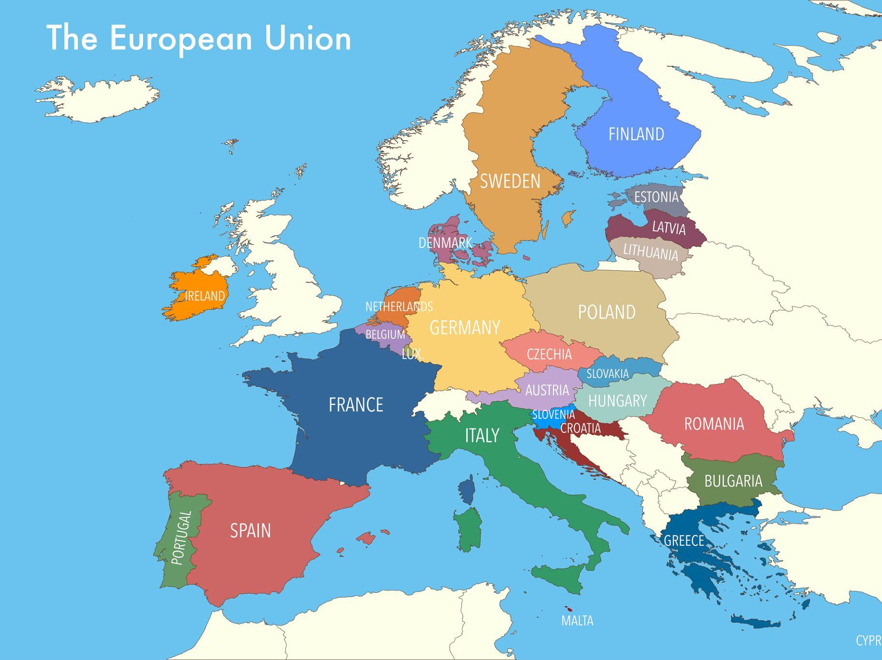
EU Today

