Slide 1
Brexit
CEVRO UNIVERSITY

Slide 2
EU Treaty
Any Member State may decide to withdraw from the Union in accordance with its own constitutional requirements.
A Member State which decides to withdraw shall notify the European Council of its intention. In the light of the guidelines provided by the European Council, the Union shall negotiate and conclude an agreement with that State, setting out the arrangements for its withdrawal, taking account of the framework for its future relationship with the Union. That agreement shall be concluded on behalf of the of the European Union, acting by a qualified majority, after obtaining the consent of the European Parliament.
The Treaties shall cease to apply to the State in question from the date of entry into force of the withdrawal agreement or, failing that, two years after the notification, unless the European Council, in agreement with the Member State concerned, unanimously decides to extend this period.

Slide 3
David Cameron PM 2010 end 2015

Slide 4
Letter David Cameron

Slide 5
PM Letter
In a letter to the President of the European Council Donald Tusk, the Prime Minister has set out the 4 areas where he is seeking reforms as part of negotiations on the UK’s membership of the European Union.
These 4 areas are:
economic governance;
competitiveness;
sovereignty;
immigration.

Slide 6
Economic governance
The EU has more than one currency.
There should be no discrimination and no disadvantage for any business on the basis of the currency of their country.
Any changes the Eurozone decides to make, such as the creation of a banking union, must be voluntary for non-Euro countries, never compulsory.
And any issues that affect all Member States must be discussed and decided by all Member States.

Slide 7
Competitiveness
People across Europe want the European Union to help generate growth and jobs. The United Kingdom has always been a champion of making Europe more competitive.
But with the best will in the world, we would all acknowledge that the EU can go much further.

Slide 8
Sovereignty
As you know, questions of sovereignty have been central to the debate about the European Union in Britain for many years. I have three proposals in this area. First, I want to end Britain's obligation to work towards an "ever closer union" as set out in the Treaty.
It is very important to make clear that this commitment will no longer apply to the United Kingdom. I want to do this in a formal, legally-binding and irreversible way.
As the Dutch have said, the ambition should be "Europe where necessary, national where possible“.

Slide 9
Immigration
The issue is one of scale and speed. Britain's population is already expanding. Our population is set to reach over 70 million in the next decades and we are forecast to become the most populous country in the EU by 2050.
At the same time, our net migration is running at over 300,000 a year. That is not sustainable. We have taken lots of steps to control immigration from outside the EU. But we need to be able to exert greater control on arrivals from inside the EU too.
But we need to go further to reduce the numbers coming here. We can reduce the flow of people coming from within the EU by reducing the draw that our welfare system can exert across Europe. So we have proposed that people coming to Britain from the EU must live here and contribute for four years before they qualify for in-work benefits or social housing. And that we should end the practice of sending child benefit overseas.

Slide 10
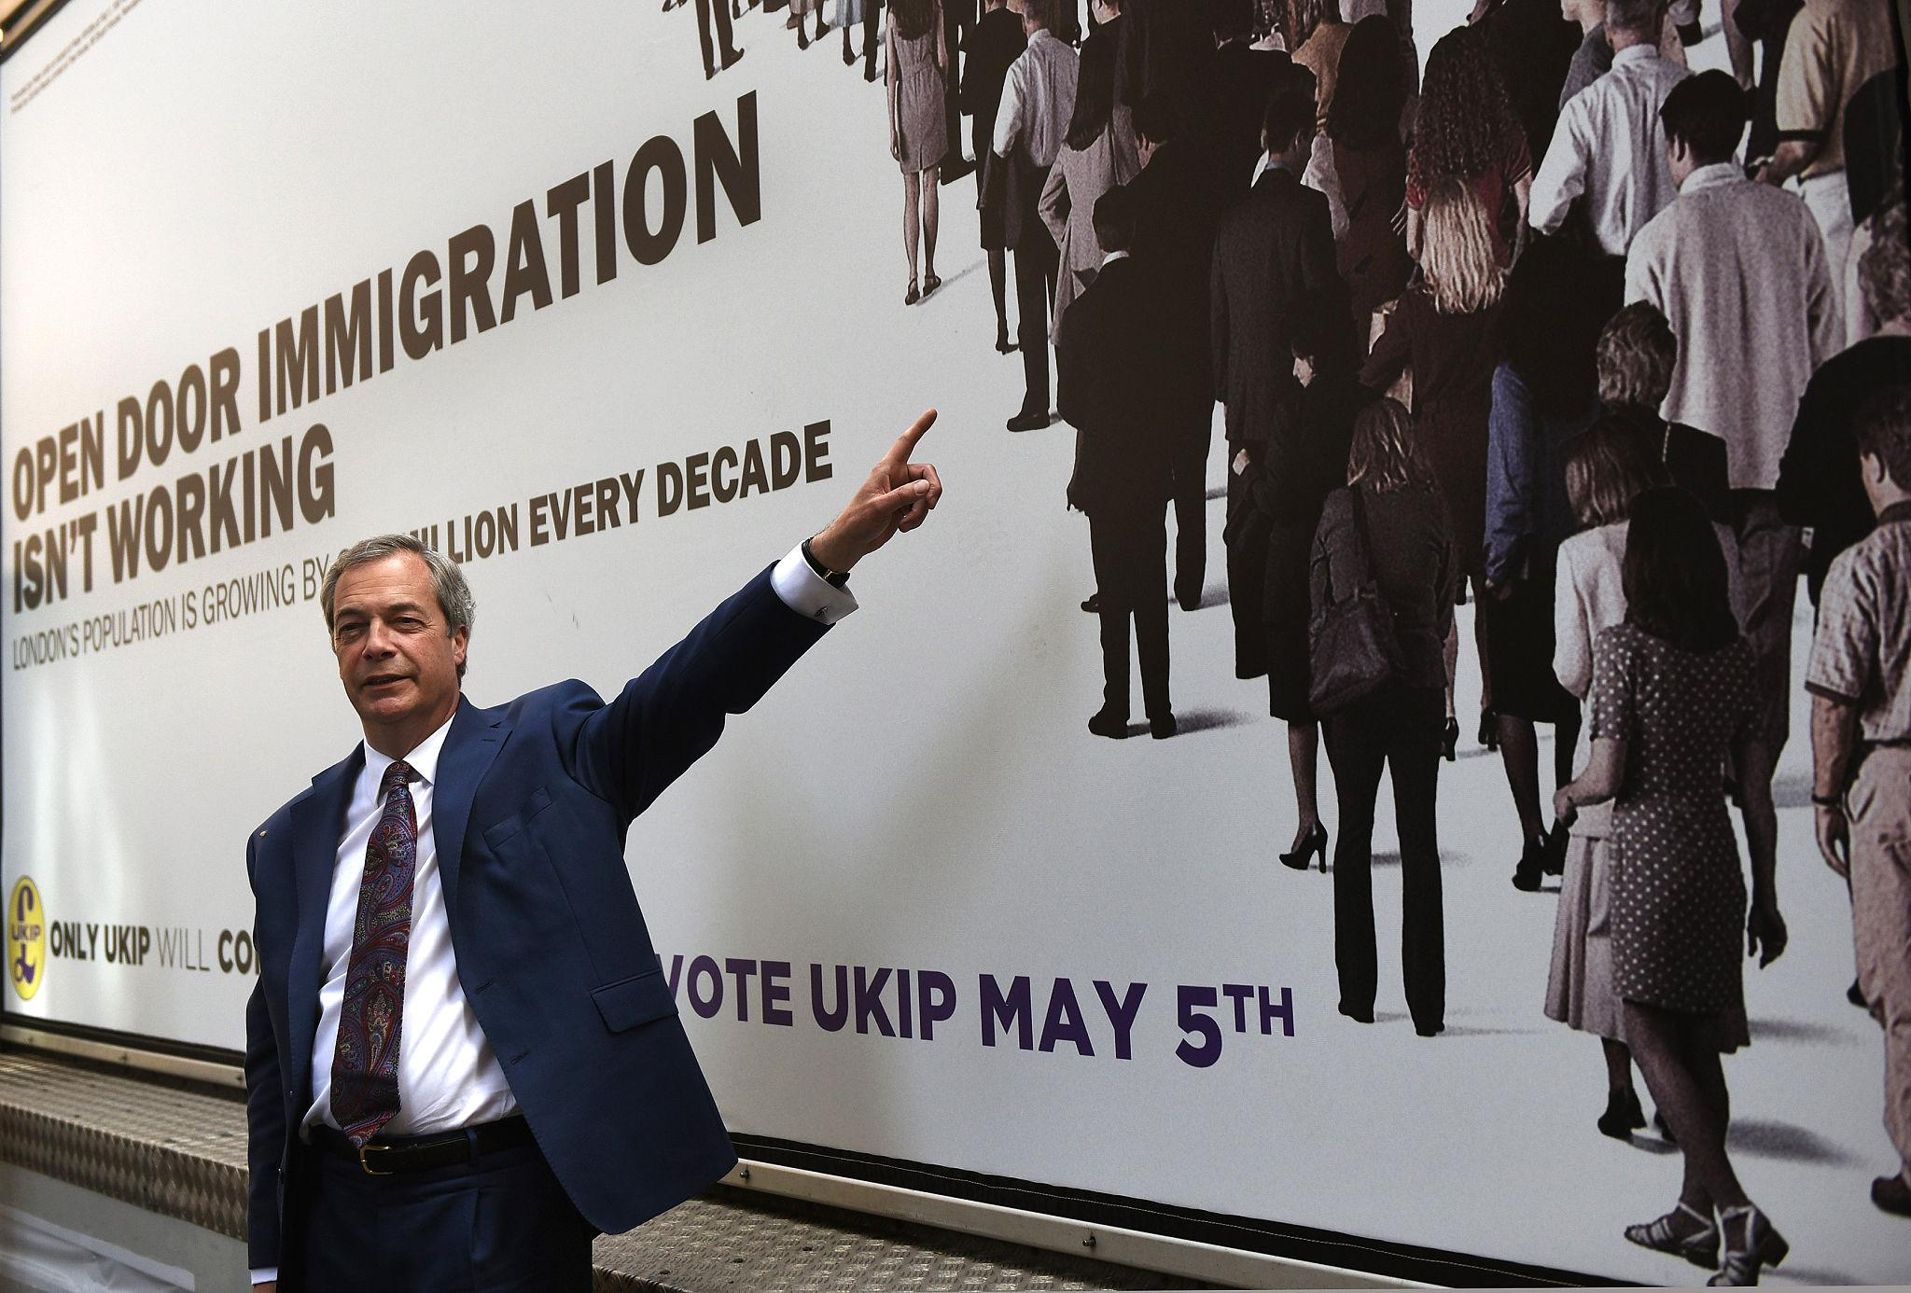
Nigel Farage

Slide 11
David Cameron on the EU referendum
https://www.youtube.com/watch?v=w87GNWJHtFM
Government position

Slide 12
Nigel Farage on referendum
https://www.youtube.com/watch?v=5kD2we8Iiv4

Slide 13
Nigel Farage - Long-Term Architect of Euroscepticism
Farage led:
UK Independence Party (UKIP)
Later the Brexit Party
For years, he reframed EU membership as:
A sovereignty issue
A democratic deficit
A border-control problem
A cultural identity conflict
He normalized exit as a legitimate political objective long before it was mainstream inside the Conservative Party.

Slide 14
Referendum
The referendum on EU membership held on 23 June 2016.
A total of 33,577,342 people voted in the referendum, a turnout of 72.2%. The Leave vote won by a 3.8 percentage point margin.
Laeave votes cast - 17,410,742 % - 51.9%
Reamain Votes cast - 16,141,241 - 48.1%
The highest vote share for Leave (76%) was recorded in Boston (Lincolnshire). The highest vote share for Remain (96%) was recorded in Gibraltar. The dataset accompanying this briefing paper will be published soon.

Slide 15
Theresa May PM 2015 end 2017

Slide 16
EU negotiations

Slide 17

UK officially Invokes Article 50 To Trigger Brexit
https://www.youtube.com/watch?v=XMknKiuVR-0
Term: March 29, 2019
https://www.youtube.com/watch?v=RBMvZRf9Scs
Reaction EU
https://www.youtube.com/watch?v=4okOQrEiRYs

Slide 18
EU red lines
No cherry-picking of the single market.
Financial obligations must be honored.
Citizens’ rights protected.
Irish border must remain open.
EU-27 unity maintained.
Withdrawal first, future later.

Slide 19
Theresa May proposal
May chosed a hybrid model:
Political sovereignty restored
Economic integration partially preserved
Regulatory alignment limited but not eliminated
This satisfied neither:
Sovereigntists (too much EU influence)
Remainers (economic damage)
Soft Brexiteers (not integrated enough)

Slide 20
Repeated Parliamentary Defeats
May’s Withdrawal Agreement with the European Union was rejected three times:
January 2019 – largest defeat in modern British parliamentary history
March 2019 – rejected again
March 29, 2019 – rejected a third time
A Prime Minister who cannot pass the central policy of her government effectively loses governing capacity.
Brexit was not one bill among many — it was the defining constitutional transformation of the UK

Slide 21
Theresa May resignation
https://www.youtube.com/watch?v=7qFBNphjBEg

Slide 22
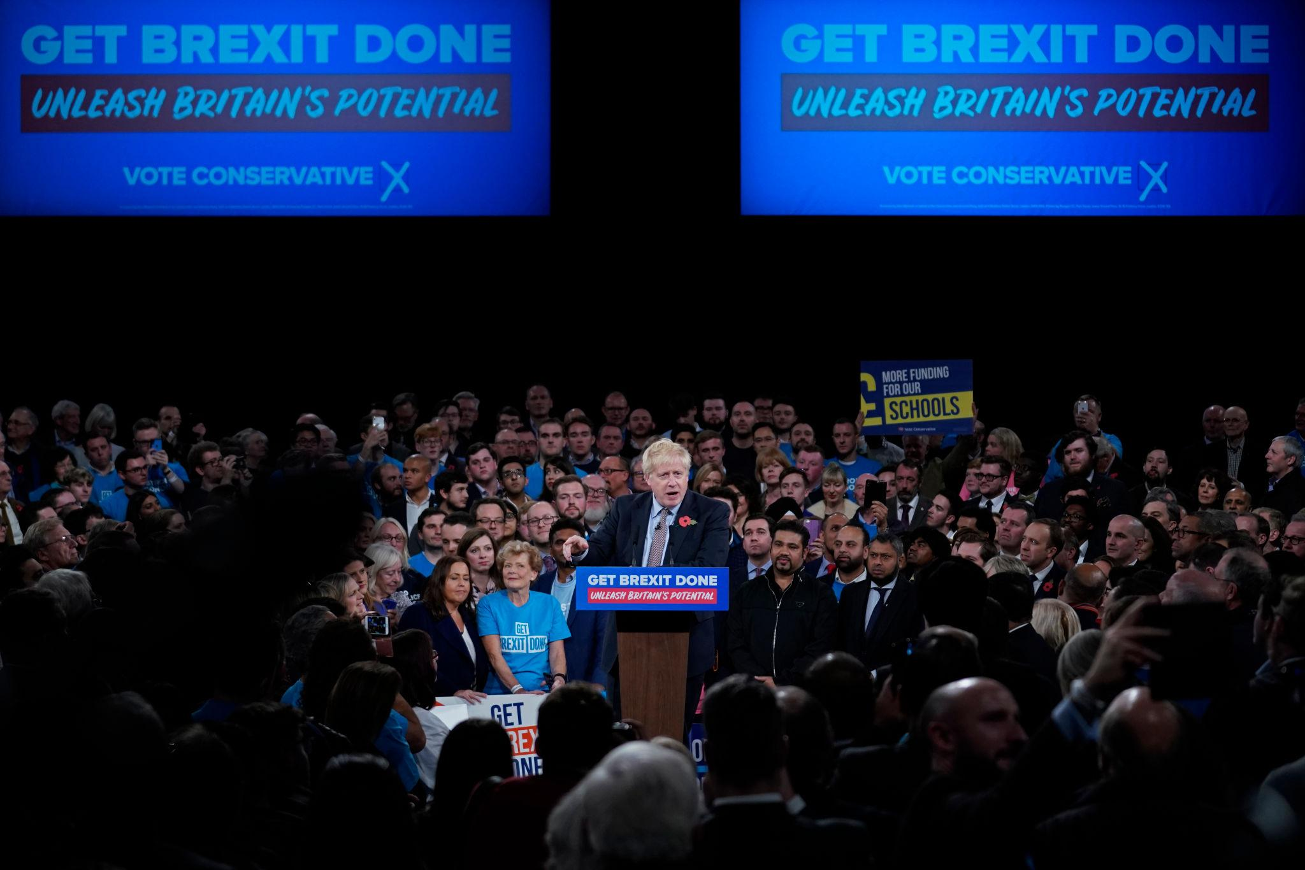
Boris Johnson

Slide 23
Theresa May speech
https://www.youtube.com/watch?v=EIt_qW4ebZQ

Slide 24
General election Boris Johnson
Boris Johnson addresses the nation after historic win
https://www.youtube.com/watch?v=g4OZAdaE5XM

Slide 25
Boris Johnson PM 2017 end 2019

Slide 26
Boris Johnson – elections 2017
Johnson reframed the election as a single-issue referendum on closure.
Clear slogan.
Clear enemy: parliamentary deadlock.
Clear promise: pass the deal quickly.

Slide 27
What happens next
Under the EU treaties, the EC cannot propose a negotiating mandate until after the UK has ceased to be an EU member state.

Slide 28
Brexit Day
January 31st, 2020 - Brexit Day. The UK exits and a transition period begins, which currently runs until December 31st, 2020.
All UK citizens who do not have dual nationality lose their EU citizenship on this day and will also lose the right to vote or stand for office in EU countries.

Slide 29
Extension
June 30th - the deadline for any extension to the transition period to be agreed between the UK and the EU.
The transition period can only be extended up to a maximum of two years, so until December 31st 2022 at the absolute latest.

Slide 30
The End of Negotiation
November 26th - this is the date that EU experts say a trade deal will need to be actually agreed by, in order to leave time for it to be formally presented to the European Parliament and ratified in time for the December 31st deadline.

Slide 31
Withdrawal Agreement
The Withdrawal Agreement sets out the terms of the UK’s withdrawal from the EU and provides for a deal on citizens’ rights.
It sets out a transition period which lasts until 31 December 2020. During this time you can continue to live, work and study in the EU broadly as you did before 31 January 2020.
If you are resident in the EU member state at the end of the transition period, you will be covered by the Withdrawal Agreement, and citizen’s rights will be protected for as long as you remain resident in the member state.
Any rights that are not covered by the Withdrawal Agreement will be the subject of future negotiations. Read this guidance page for more information.

Slide 32
EU mandate the first block
If there is no extension of the transition period the end of 2020 becomes a hard deadline for those parts of a new UK/EU relationship to be in place which will not fall away at the end of the year, either entirely or into other international frameworks, where relevant.
The end of 2020 is also the deadline by which the commission should endeavour to adopt a decision on the adequacy of the UK’s data protection standards.

Slide 33
The second block
There is no definitive deadline for the second block – with political will, ratification time can be squeezed – but the process of agreement for a multinational, multi-institutional, multilingual bloc cannot be completed in a couple of weeks.

Slide 34
UK-EU land border
The potential impact on the border between Northern Ireland and the Republic of Ireland has been a contentious issue.
Since 2005, the border has been essentially invisible. After Brexit, it will be the only UK–EU land border.
All involved parties agree a hard border should be avoided, as it might compromise the Good Friday Agreement that ended the Northern Ireland conflict. To forestall this, the EU proposed a "backstop agreement" (the Northern Ireland Protocol) that would have kept the UK in the Customs Union and kept Northern Ireland in some aspects of the Single Market also, until a lasting solution was found. The backstop was part of the withdrawal agreement, but was replaced in the revised agreement

Slide 35
The Belfast Agreement, also known as the Good Friday Agreement
The Belfast Agreement, also known as the Good Friday Agreement, was reached in multi-party negotiations and signed on 10 April 1998.
On the constitutional question of whether Northern Ireland should remain in the UK or become part of a united Ireland, it was agreed that there would be no change without the consent of the majority. This is called the 'principle of consent’.
Agreement recognises the legitimacy of whatever choice is freely exercised by a majority of the people of Northern Ireland with regard to its status, whether they prefer to continue to support the Union with Great Britain or a sovereign united Ireland.
Majority opinion in the future could be tested by referendum.

Slide 36
Border controls
UK has confirmed plans to introduce import controls on EU goods at the border after the transition period ends on 31 December 2020.
UK reasons for implementing import controls:
to keep our borders safe and secure so we know who’s coming in and how often, what they are bringing in, and why
to ensure we treat all partners equally as we begin to negotiate our own trading arrangements with countries around the world
to collect the right customs, VAT and excise duties
the EU has said it will enforce checks on our goods entering the Eurozone. We will likewise enforce our own rules for goods entering the UK

