Slide 1
Exchange Rates and Open Economy Macroeconomics
Ondrej Bednar

Slide 2
This lesson should teach you:
What is ER
Types of ER
How it is determined
How its movements affect economies

Slide 3
What is an Exchange Rate?
Value of one currency expressed in terms of another
It is customary to use foreign currency in terms of the domestic currency. i.e.: 1EUR = 25.24CZK
  When speaking about the movement of the Exchange Rates, it is necessary to be careful about increases and declines because the meaning will be opposite depending on from what country one looks at it

Slide 4
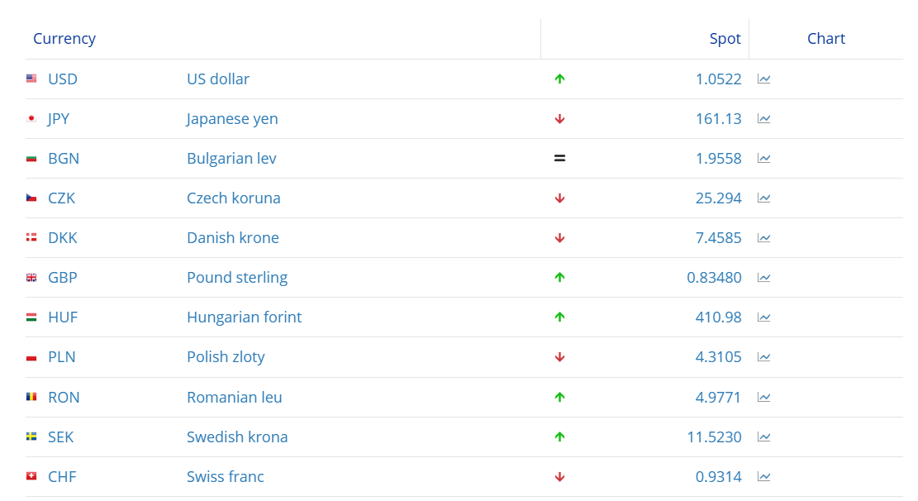
Exchange Rate Chart

Slide 5
Foreign eXchange (FX) Market
Worldwide
The most traded currency is USD
  Also functions as intermediary currency
Retail clients, commercial banks, FX Brokers and central banks
FX arbitrage: financial centers/cross currency arbitrage
The spot vs forward

Slide 6
Types of ER
Nominal
  The value displayed in exchange rate charts
Real
  Adjusted for inflation
Effective
  An index that describes the strength of a currency relative to a basket of other currencies.

Slide 7
Types of ER regimes
Peg
Currency Basket Peg
Managed Float
Currency Board
Crawling Peg
Band
Free Float
Fixed
Float
Singapore
Botswana
Danish Krona
Czech Koruna
Bulgarian Leva
United States Dollar
Hong Kong Dollar
Euro
Chinese Yuan
Russian Ruble

Slide 8
Determination of the spot ER
Many theories
The most simple model is here:
  Demand for domestic currency is derived from demand for the Export
  Supply domestic currency is derived from demand for the Import
EUR/CZK
S_{czk}
D_{czk}
Quantity of CZK

Slide 9
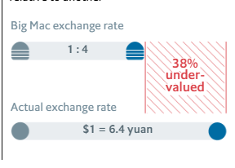

Power Purchasing Parity
Absolute
  Prices ratio of the same baskets of goods in two countries
  E_{CZK/EUR} =$\frac{Pczk}{Peur}$
Relative
  ΔE_{CZK} =π_{czk} - π_{eur}

Slide 10

Interest Rate Parity
Parity in price of money
F₀ =S₀* $\frac{1+IRczk}{1+IReur}$ ; F₀ –forward rate, S₀ - spot rate

Slide 11
Determination of forward ER
The exchange rate at which a bank agrees to exchange one currency for another at a future date when it enters into a forward contract with an investor.
Parity relationship among the spot exchange rate
Differences in interest rates between two countries

Slide 12
Central Banking

Slide 13
What to expect in this lesson
Brief history od central banks
Goals of central banks
Main theories underlying the central banks’ policies
Their operational regimes
Monetary policy implementation

Slide 14
Central Banking
Prior to Central Banking
Coin sorting and storing
Banknote Issuance
Banker to the government
Banker to the banks
Lender of last resort
Banks supervisor
Monetary policy conductor

Slide 15
Central Banks goals
Monetary and price stability
Financial Stability
Full employment

Slide 16
Central Banks - Theory
The Quantity Theory of Money
M × V = P × Q

Slide 17
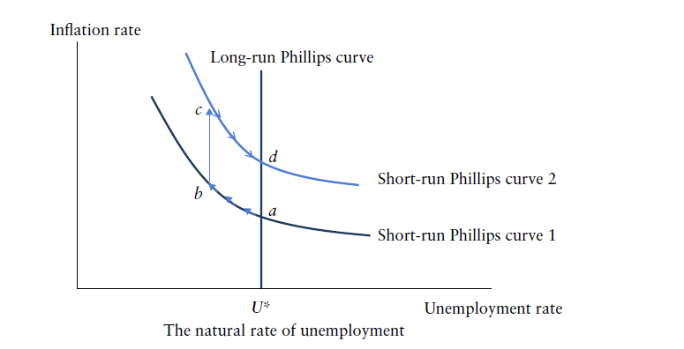
The Phillips Curve and NAIRU

Slide 18
The Rational Expectation Theory
It assumes that individuals' actions are based on the best available economic theory and information.
Departure from Adaptive Expectation Theory
  Under adaptive expectations, expectations of the future value of an economic variable are based on past values

Slide 19
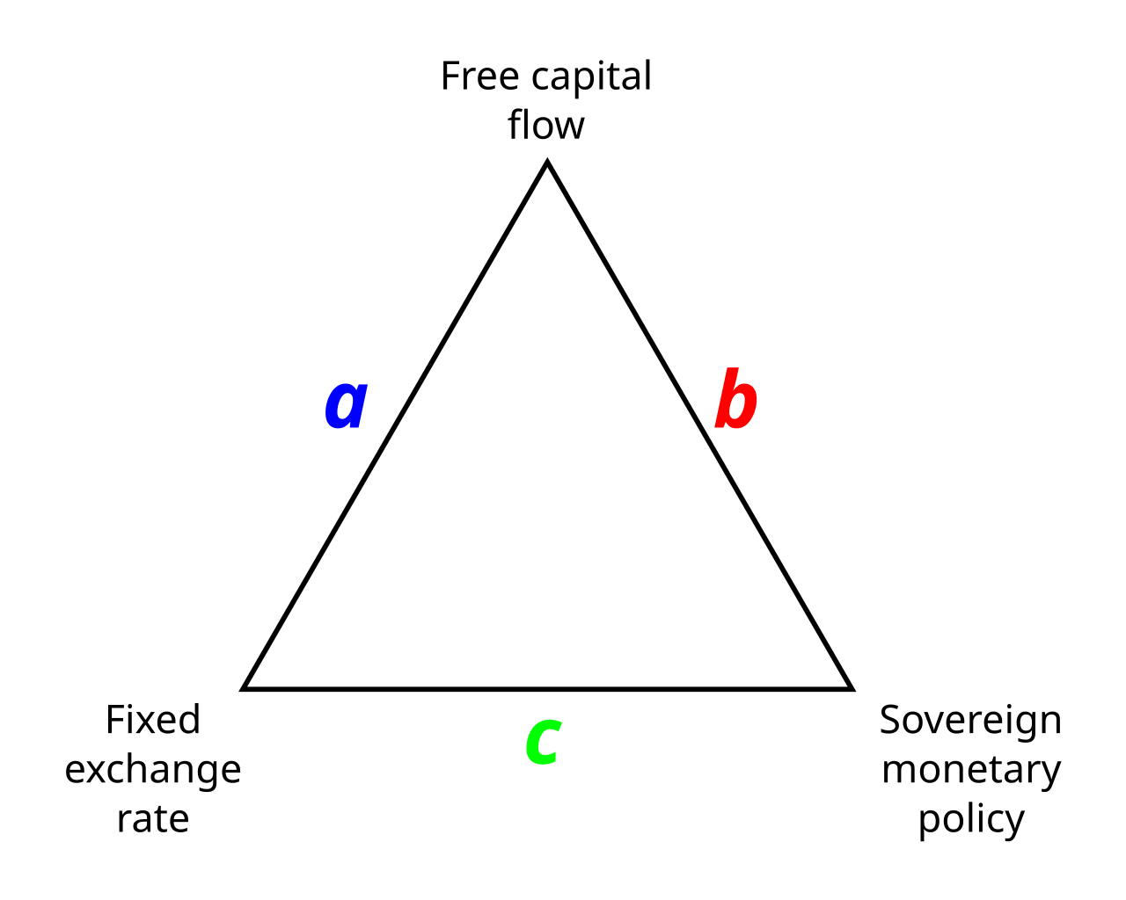
The impossibility trinity aka Trilemma
Why:
a?
b?
c?
Oxelheim, L. (1990)

Slide 20
Monetary policy regimes

Slide 21
Monetary policy regimes
To follow a particular monetary policy rule is to adopt a monetary policy regime
Since the demise of Bretton-Wood system (1971), these monetary rules were pursued:
  Exchange Rate Targeting
  Money Supply Growth Targeting
  Risk Management Approach
  Inflation Targeting
  Unconventional Monetary Policy

Slide 22
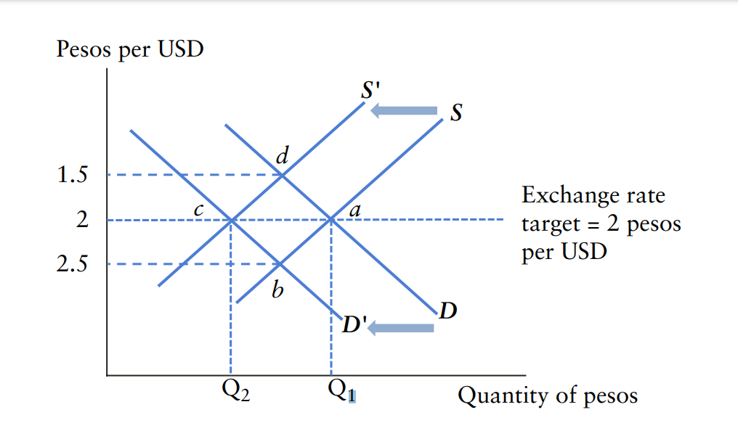
Exchange Rate Targeting
CBs influence the supply curve at FX market to adjust for changes in the demand
Thus influencing also supply of the currency at the domestic market
In small open economy, international capital movements may easily overwhelm the CB’ s ability to keep the ER target

Slide 23
Money supply growth targeting
Coming from quantitative theory of money
M × V = P × Q
The relationship does not always hold as V happens to be unstable (1980’s FED experience)

Slide 24

Risk Management Approach
no announced specific targets for money supply growth or the inflation rate
Taylor’ s rule:
I_{t}…. Policy interest rate at time t
π_{t}… Inflation at time t
π_{t}*… Desired inflation at time t
r_{t}*… Equilibrium interest rate at time t
y_{t} … The actual GDP growth rate at time t
y_{t}*… GDP growth rate at full potential at time t
a_{y} , a_{π} … Relative weights given to GDP growth and inflation growth rate

Slide 25
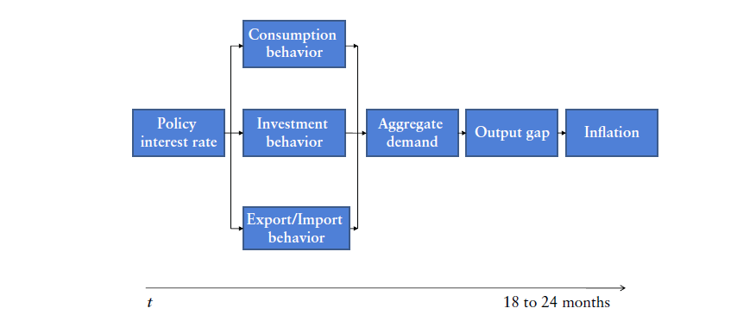
Inflation Targeting

Slide 26
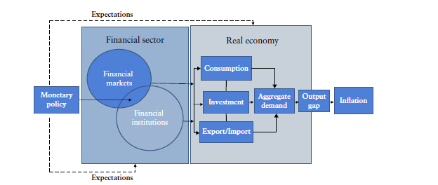
Monetary Policy Implementation

Slide 27
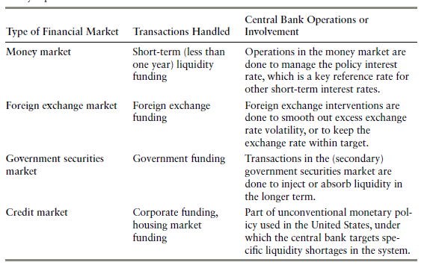
Types of Financial markets

Slide 28
Monetary policy through money market 1
Borrowing and lending funds with short maturity (<1 year)
At the core is interbank lending
  Commercial banks lend and borrow among themselves
  CBs affect the accessibility of the funds by changing the interest rates
  Commercial banks wat to hold as little cash as possible since it does not yield interest, unlike loans. Although they need to hold minimum reserves.
  Commercial banks demand the funds for example if unexpectedly high settlement occurs. Also government, and other financial institution might demand funds on this market
  On the other hand, if commercial banks find out, that they have too much cash, they supply it to the market
  EURIBOR, LIBOR, SOFR, PRIBOR….

Slide 29
Monetary policy through money market 2
Policy Interest Rates
Open market operations
Reserve requirements

Slide 30
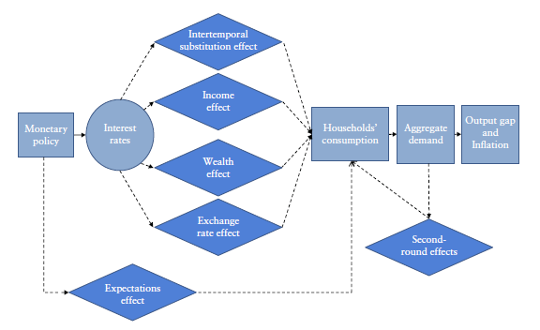
Monetary Policy Transmission - Households

Slide 31
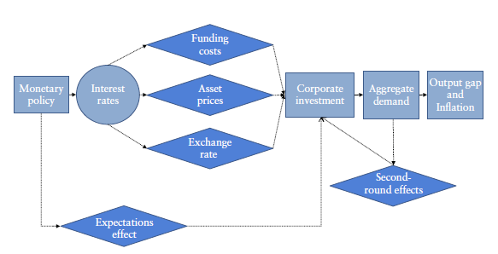
Monetary Policy Transmission- Firms

Slide 32
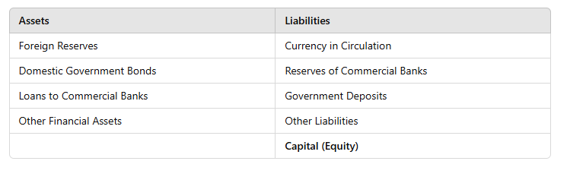
Central Bank’ s Balance Sheet

Slide 33

Balance of Payments
One of the most important macroeconomics indicator
Difference between all money flowing into the country in a particular period of time and the outflow of money to the rest of the world.

Slide 34
Current Account
Trade Balance
Income from abroad

Slide 35
Capital Account
Direct Investments
Portfolio Investments
Loans

Slide 36
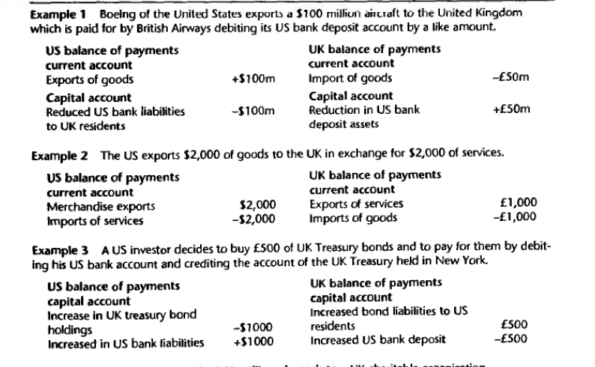
BoP examples… assuming ER 2USD/1GBP

Slide 37

Current Account Imbalances…Do they matter?
Obviously it does to

Slide 38
Some Macroeconomics Identities with CA

Slide 39
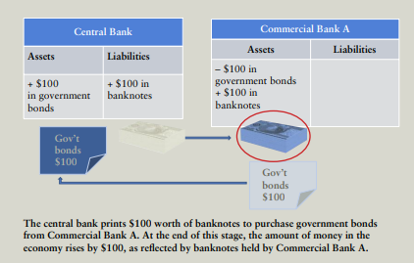
Money Creation 1

Slide 40
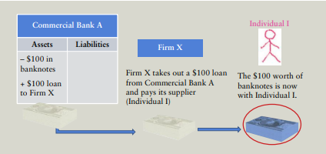
Money Creation 2

Slide 41
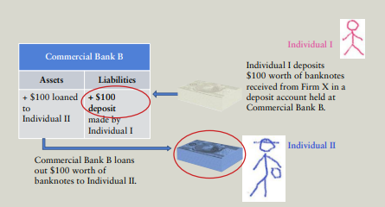
Money Creation 3

Slide 42
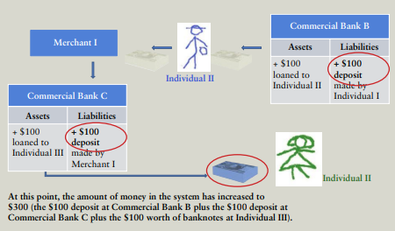
Money Creation 4

Slide 43
However, this is not how it is done in real world…
CBs mostly do not set targets on money supply, but rather on inflation
Reserve requirements(RR) are mostly not used to affect the economy
  For example: In case of hike in RR, it would be very costly for banks and economy to call in the loans from the banks customers
Therefore the CBs prefer to impact conditions on money market by changing interest rates and direct market operations

Slide 44
Oxelheim, L. (1990), International Financial Integration, Heidelberg: Springer Verlag. ISBN 3-540-52629-3

Slide 45
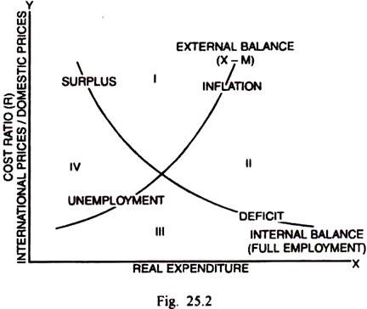
The Swan Diagram
Zone 1: BoP surplus and inflationary pressures
Zone 2: BoP deficit and inflationary pressures
Zone 3: BoP deficit and unemployment
Zone 4: BoP surplus and unemployment
Jan Tinbergen:
We need (at least) as many tools as targets

Slide 46
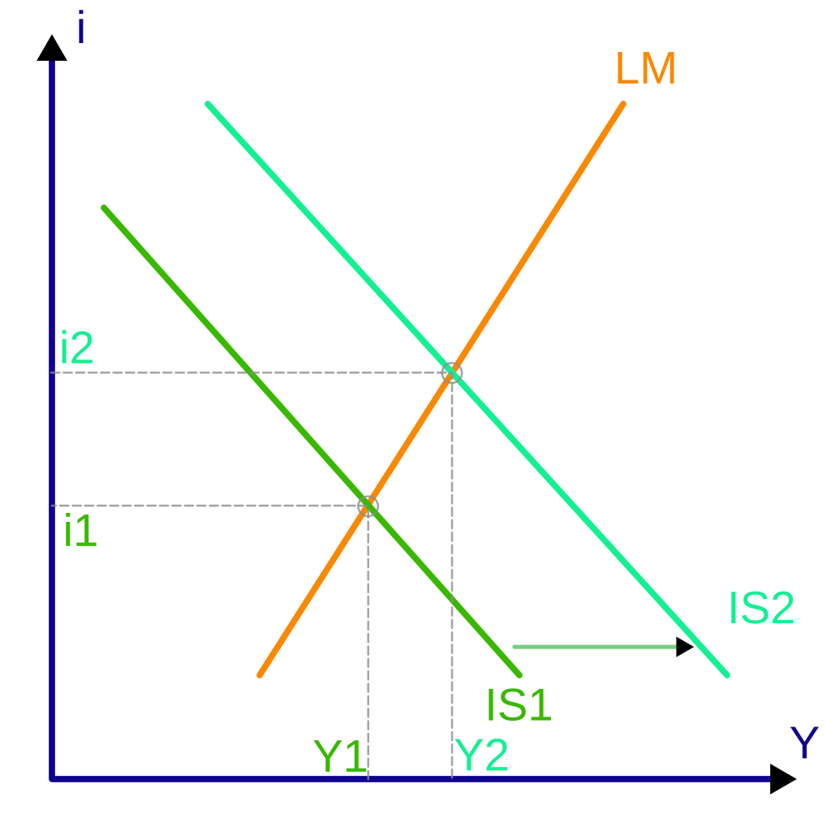
IS-LM model
IS: Investment-Saving: goods market
Y = C+I+G+X-M
Since Y = C+S => S+M = I+G+X
- for simplicity assuming linear function of the identities : S = Sa +sY and M= Ma +mY
Also: i I Y and Y S i
LM: Liquidity preference- money supply
Money market
The higher the income the higher demand for money

Slide 47
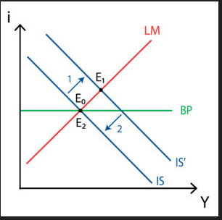
Mundell – Fleming Model aka IS-LM-BP

Slide 48
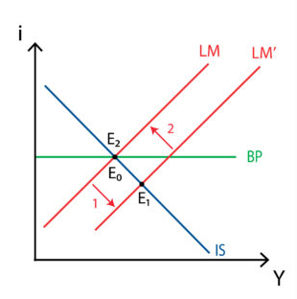
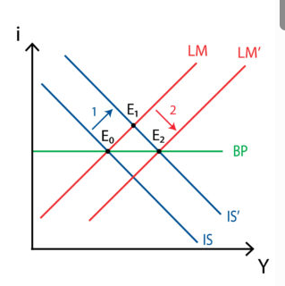
IS-LM-BP fixed ER
Monetary policy case
Fiscal policy case

Slide 49
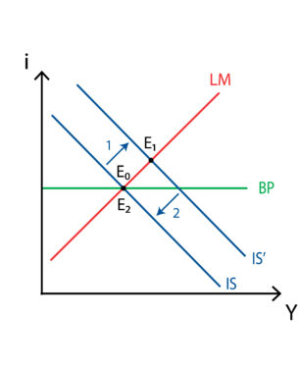
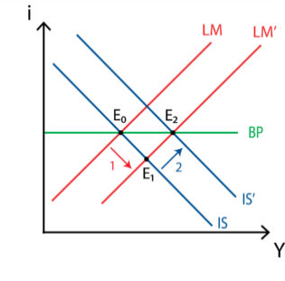
IS-LM-BP under floating Exchange rate

Slide 50
Selected topics in finance
Concept of present value & compound interest
Company finances –Balance sheet
Methods of company valuations
Multiples

Slide 51
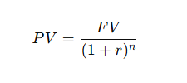
Present value
Time value of money: Rational investor always prefers MORE money SOONER, therefore: money obtained later has to be discounted
OK, but how do I get the discount rate (r)?
  CAPM
  WACC
  Or a rule of thump for rough quick calculation

Slide 52
Company’ s statements
Statement | What It Shows | Key Components
Income Statement | Profitability over a period | Revenue, Expenses, Net Income
Balance Sheet | Financial position at a specific date | Assets = Liabilities + Equity
Cash Flow Statement | Cash inflows/outflows | Operating, Investing, Financing Activities

Slide 53
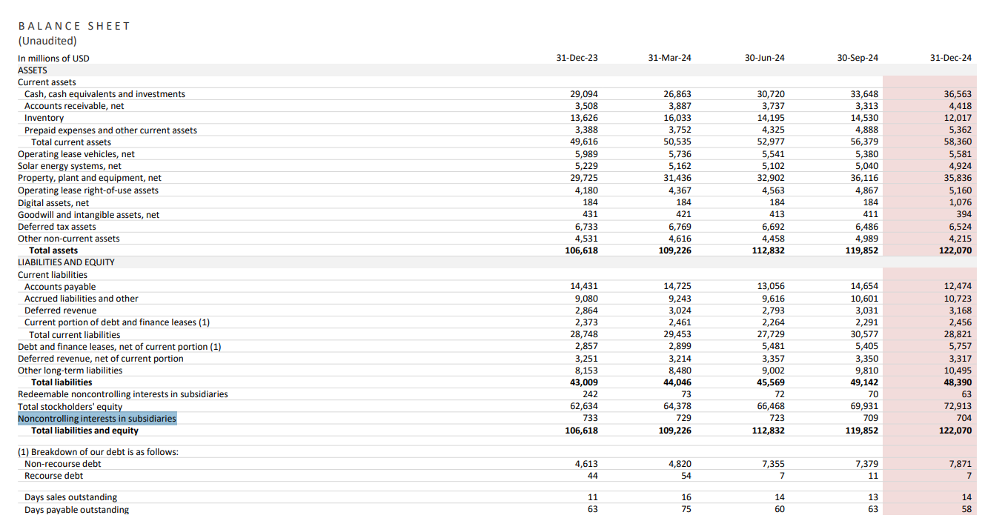

Slide 54
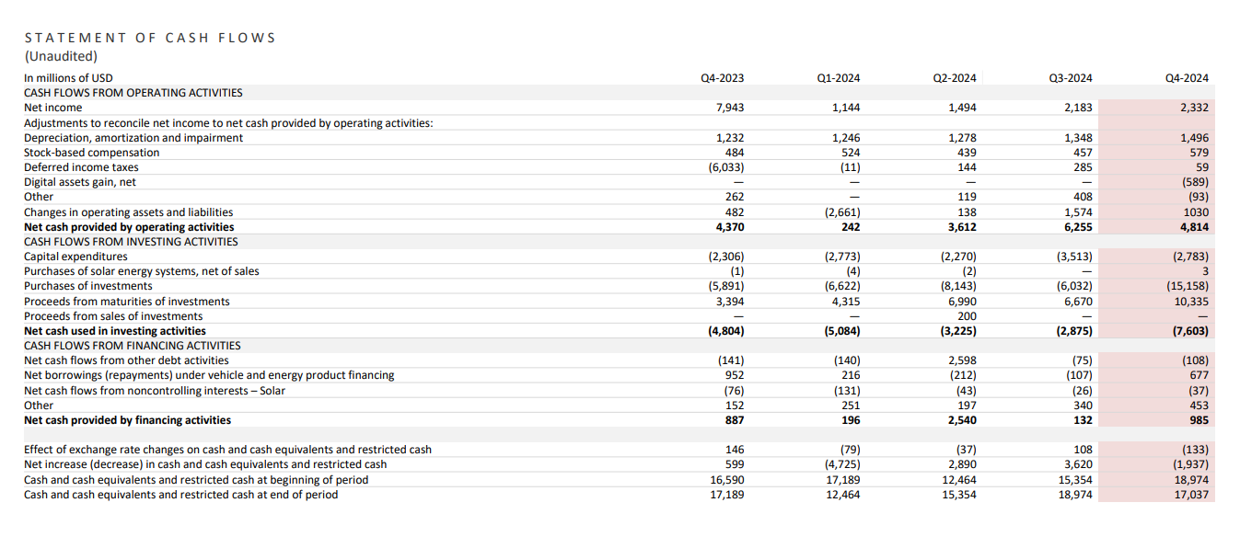

Slide 55
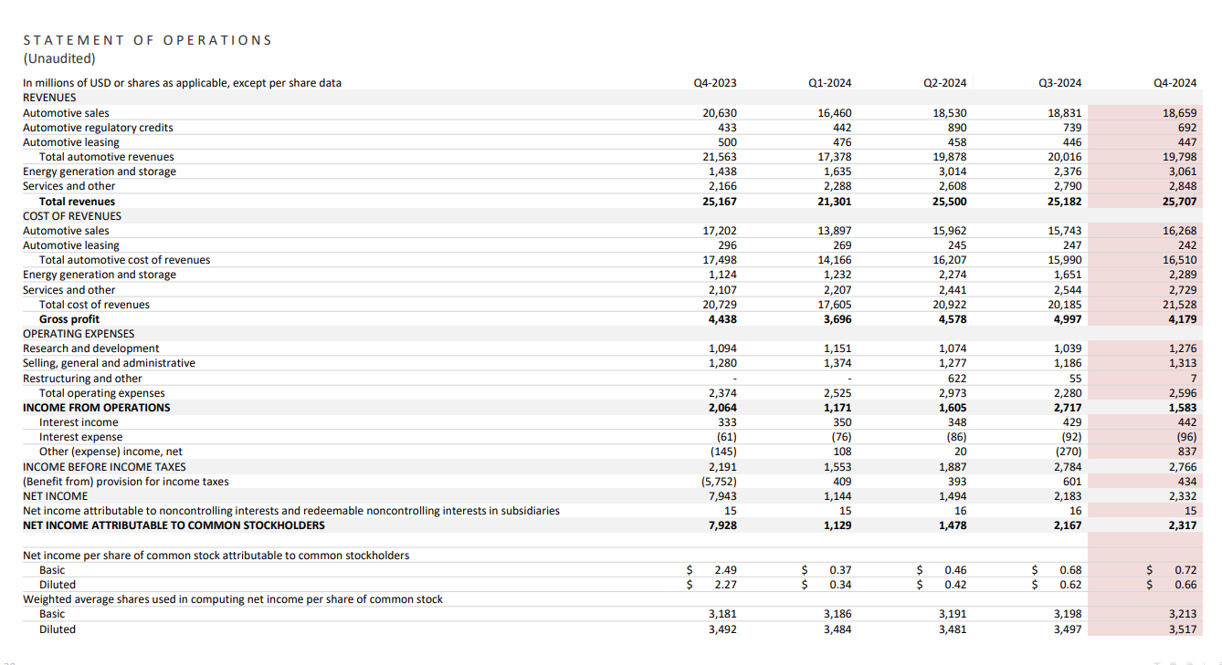

Slide 56
Financial metrics and multiples
EV/EBITDA
P/E
P/B
Enterprise value vs Market Cap
EBITDA vs Earnings
ROI, ROE

