Slide 1
Instruments of trade policy - tariffs
Tariffs - source of government income
  aimed to protect domestic sectors from competition
    Corn law
    19th century tariff on manufactured goods, Germany
  Specific tariff - levied as a fixed charge for each unit of goods imported
  Ad valorem tariff - taxes levied as a fraction of the value of IM goods
Tariffs nowadays substituted by nontariff barriers, such as import quotas and export restraints, export subsidies, voluntary exports restraints, local content requirements, import deposits
Tariff rate quota – oilseeds, tuna imports
Tariff escalation
Bound tariff

Slide 2
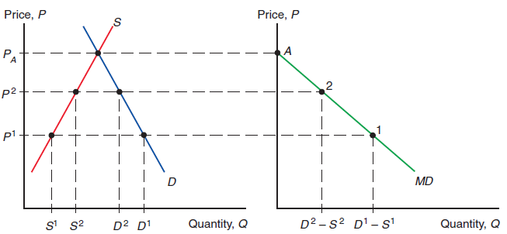
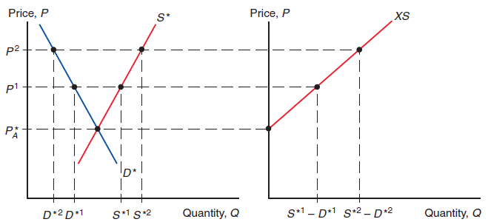
Import demand and export supply
Trade continues until the difference in P has been eliminated.
MD_{H} is the excess of what H consumers demand over H producers supply.
MD_{H} is downward sloping because as P increases, Q of IM demanded declines.
As the S of goods available for X rises as P rises, the XS_{F} curve is upward sloping.

Slide 3
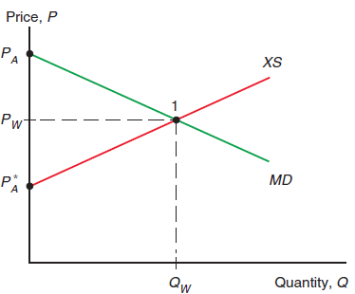
World equilibrium
H demand-H supply = F supply-F demand
A tariff = a cost of transport... If H imposes a tax of $2 on every bushel of wheat imported, shippers will be unwilling to move the wheat unless the P difference between the two markets is at least $2.

Slide 4
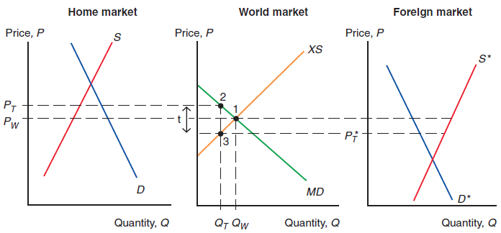
Effects of a Tariff
The T raises the P_{H} and lowers the P_{F} to
P*_{T} = P_{T} – t.
The increase in the P_{H} is less than the amount of the T, because part of the T is reflected in a decline in F export P.
“small country” case -T raises the P of imported good to P_{W} + t.

Slide 5
Effective rate of protection
T may have very different effects on different stages of production
  P_{W} is $8,000, parts sell for $6,000. The country places a 25% T on imported cars. With the T, H assembly takes place if it could be done for $4,000 (instead of $2,000 before T) That is, the 25% T provides assemblers with an effective rate of protection of 100%.
  To encourage H parts industry, the country imposes a 10% T on imported parts. Local assembly takes place only if it can be done for $1,400 . The T on parts provides negative effective protection to car assembly at the rate of -30%.

Slide 6
Effective rate of protection II
g = (t-a*.t*)/(1-a*)
t = T on final commodity
t* = T on the imported input
a* = ratio of cost of imported input to the final commodity in absence of tariffs

Slide 7
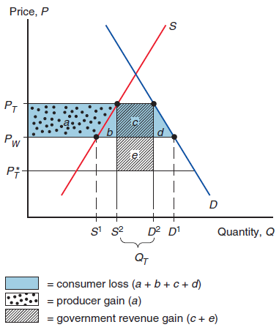
Costs and Benefits of a Tariff – „big“ country
T raises the P in the IM country and lowers it in the EX country.
b+d - efficiency loss
e - terms of trade gain that arise because T lowers EX P_{F}.
b - production distortion loss
d - consumption distortion loss
The gain depends on the ability of the T-imposing country to drive down EX P_{F}. In the „small country“ case T reduces welfare.

Slide 8
Indirect costs of Tariff
Reciprocal tariffs - difficult to remove
Large tariffs can induce producers to behave in creative—though ultimately wasteful—ways in order to avoid them
  Ford – commercial trucks vs passenger vehicles

Slide 9
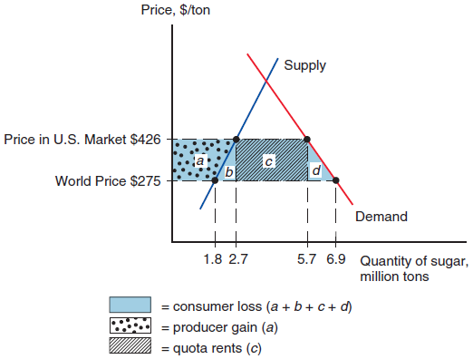
Import quotas
IQ - direct restriction on the quantity imported, usually enforced by issuing licenses.
IQ raise P_{H} by the same amount as a T that limits IM to the same level, but rent is collected by whoever receives the IM licence.
US - sugar, EU CAP…
Net loss (b+c+d) - consumers -little effective opposition x producers are very efectively mobilized.
IQ costs may be magnified by rent seeking (eg. Indian companies overinvested)

Slide 10
Problems and questions
1. Home’s demand curve for wheat is D = 100 - 20P. Its supply curve is S = 20 + 20P.
Derive and graph Home’s import demand schedule.
What would the price of wheat be in the absence of trade?
2. Now add Foreign, which has a demand curve D* = 80 - 20P and a supply curve S* = 40 + 20P.
Derive and graph Foreign’s export supply curve and find the price of wheat that would prevail in Foreign in the absence of trade.
Now allow Foreign and Home to trade with each other, at zero transportation cost. Find and graph the equilibrium under free trade. What is the world price? What is the volume of trade?
3. Home imposes a specific tariff of 0.5 on wheat imports.
Determine and graph the effects of the tariff on the following:
  the price of wheat in each country;
  the quantity of wheat supplied and demanded in each country;
  the volume of trade.
b. Determine the effect of the tariff on the welfare of each of the following groups:
(1) Home import-competing producers;
(2) Home consumers;
(3) the Home government.
c. Show graphically and calculate the terms of trade gain, the efficiency loss, and the total effect on welfare of the tariff.

Slide 11
Problem continued
4) Suppose that Foreign had been a much larger country, with domestic demand: D*=800-200P and supply S*=400+200P.
(Notice that this implies that Pf in absence of IT would be the same as in problem 2).
Recalculate the free trade equilibrium and the effects of a 0,5 specific T by Home.
Relate the difference in results to the discussion of the small country case.

Slide 12
Problems and questions
The nation of Acirema is “small” and unable to affect world prices. It imports peanuts at the price of $10 per bag. The demand curve is D = 400 - 10P.
The supply curve is S = 50 + 5P.
Determine the zero trade and free trade equilibrium. Then calculate and graph the following effects of an import quota that limits imports to 50 bags.
a. The increase in the domestic price.
b. The quota rents.
c. The consumption distortion loss.
d. The production distortion loss.

Slide 13
Problems and questions
The argument of „terms of trade change“ results ………………. (in favor/against) free trade. Tariffs, in fact, …………. (worsen/improve) terms of trade.
A tariff which results in complete elimination of trade is called:…………….
A tariff will ……………… (increase/decrease) the CS and …………….. producers´ surplus
In case of IM quota, the H government receives ………………. (positive/negative/zero) rent.

Slide 14
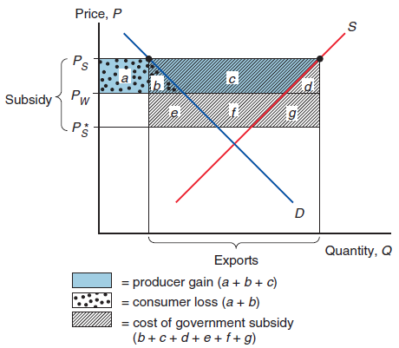
Export subsidy
EX subsidy = payment to a firm or individual that ships a good abroad.
    specific
    ad valorem.
P in the EX country rises from P_{W} to P_{S}, but because the P in the IM country falls from P_{W} to P_{S}*, the P increase is less than the subsidy.
EX subsidy worsens the terms of trade, terms of trade loss is e+f+g
In EX country, consumers are hurt, producers gain, and the G must expend money on the subsidy. Net welfare loss is b+d+e+f+g.

Slide 15
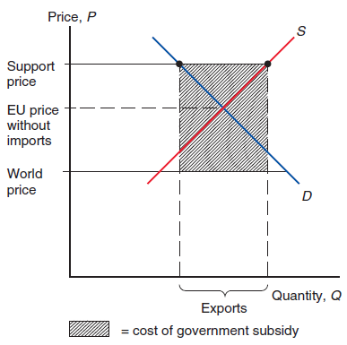
Europe´s Common Agricultural Policy
CAP - effort to guarantee high P to EU farmers , initially backed by tariffs that offset the difference between EU and world agricultural prices.
Support prices have turned out to be so high that EU—was producing more than consumers were willing to buy. To avoid unlimited growth in stockpiles, the EU turned to a policy of subsidizing EX to dispose of surplus production.
The subsidized exports themselves tend to depress the P_{W}, increasing the required subsidy.
Recent effort -reduce the distortion of incentives caused by P support, direct payments that aren’t tied to how much they produce.

Slide 16
Problem
5) Use equations of problem 2 (demand curve D* = 80 - 20P and a supply curve S* = 40 + 20P).
Starting from free trade, assume that Foreign offers exporters a subsidy ad valorem of 50%. Calculate the effects on the price in each country and on welfare in borh countries.

Slide 17
Voluntary Export Restraints = Voluntary Restraint Agreement (VRA)
is a quota on trade imposed from the EX country’s side instead of the importer’s.
generally imposed at the request of the importer and are agreed to by the exporter to forestall other trade restrictions.
  limitation on auto exports to the US enforced by Jap. after 1981.
VRA impact on welfare is exactly like the IQ, always more costly that T. Total costs related to VRA consist primarily in transfers to EX rather than efficiency losses.

Slide 18
Local content requirements
A regulation that requires some specified fraction of a final good to be produced domestically.
May be specified in physical units or in value terms
Does not place a strict limit on imports. Instead, it allows firms to import more, provided that they also buy more domestically
Does not produce either government revenue or quota rents. Instead, the difference between the prices of imports and domestic goods in effect gets averaged in the final price and is passed on to consumers.
An interesting innovation in LCR has been to allow firms to satisfy their local content requirement by exporting instead of using parts domestically.
The buy American Act (1933), the Buy Czech movement

Slide 19
Other trade policy instruments
Export credit subsidies: like an EX subsidy except that it takes the form of a subsidized loan to the buyer (Export-Import Bank, insurance of EX –EGAP)
National procurement: purchases by the G or strongly regulated firms can be directed toward domestically produced goods (e.g. European telecommunication industry).
Red-tape barriers: G restrict IM without doing so formally (health regulations, safety and customs procedures in order to place substantial obstacles in the way of trade).
    French decree in 1982 that all Japanese videocassette recorders had to pass through the tiny customs house at Poitiers—effectively limiting the actual IM
    refineries US x Venezuela

Slide 20
Cases for and against IT
Trade policy is often not based on cost benefit analysis. Political forces often motivate trade policy in practice.
Economists advocate free trade for the following reasons:
      Efficiency
      Economices of scale (Argentina automobile industry – need to deter excessive entry)
      Learning and innovation
      More productive firms engage in export
      Even if, on purely economic grounds, selective set of T and EX subsidies could increase national welfare, governments would probably be captured by interest groups and redistribude income to politically influential sectors.

Slide 21
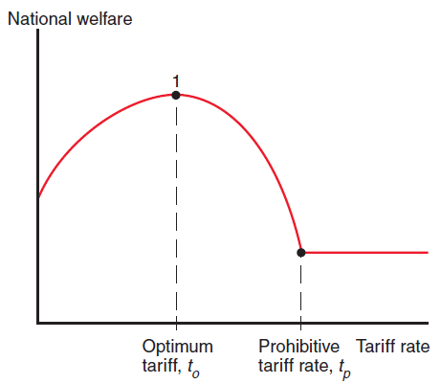
Arguments against free trade
The terms of trade argument
    Large country is able to affect P_{W}, for sufficiently small T, the terms of trade benefits outweigh the costs of T (b+d). As T growths, costs grow more rapidly than benefits – national welfare curve.
    Under optimum T the NW is maximized
    For export sectors the ToT argument would dictate a negative subsidy (tax), because EX subsidy worsend ToT and reduces NW. (Saudi Arabia tax on oil)
    Little practical importance for small countries
    This policy would be done at other countries expense
Domestic market failure argument

Slide 22
Arguments against free trade, cont.
Domestic market failure argument–PS not properly measures benefits of product.
    L used in a sector would otherwise be unemployed
    defects in the K or L markets that prevent resources from being transferred
    technological spillovers (social benefit)
DMF argument is a particular case of theory of the second best
    E.g. subsidizing labor-intensive industries is the second best solution if L market can not be fixed, for some reason, by making wages more flexible.
Any proposed trade policy should always be compared with a purely domestic policy aimed at correcting the same problem,
    A political problem arises with domestic direct policies, as their costs are more visible (even if lower) than T or IQ costs.

Slide 23
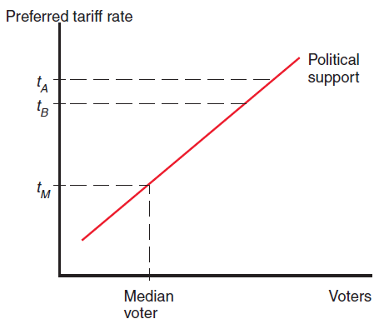
Political competition and trade policy
Desires of individuals get reflected in the objectives of G.
Maximize political success x national welfare.
Political competition drives both parties to propose T close to the T preferred by a median voter.
Problem of collective action
  can be overcome when a group is small and/or well organized. Politicians may be willing to trade off some reduction in the welfare of voters in return for a larger campaign fund.
Case study: Sugar and Diary production

Slide 24
Who gets protected?
Developing countries traditionally protect a wide range of manufacturing (import substituting industrialization).
In advanced economies much protectionism is concentrated in:
    Agriculture: farmers are not many but well organized and politically powerful
      Japan - rice
      EU, US subsidies
    Clothing: low-wage nations have a strong CA, traditionally a well organized sector

Slide 25
Trade creation and trade diversion–preferential trading agreements
Preferential trade agreements: T that nationas apply to eachother are lower than the rates on the same goods coming from other countries. Legal only if the outcome is 0 T (free trade area or customs union)
FTA (NAFTA) – countries implement their own barriers against non members
    Trade distortion – goods are channeled in via the lowest T country and distributed from there in FTA
Customs Union – common external T
    Trade diversion – country is importing from less efficient producer

Slide 26
Trade distortion – welfare analysis
T reduction should raise economic efficiency. Yes, but only if trade is created, not diverted.
    French wheat imports to UK replaces trade with countries outside custom union (US) – trade diversion
Mercosur-new trade among members came at the expense of trade with the rest of the world. (Brazil inefficient auto industry displaced auto imports in Argentina)

Slide 27
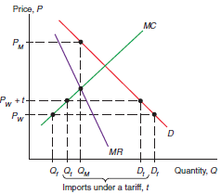
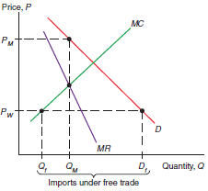
T and IQ in the presence of Monopoly
IT limits monopoly power/impediments to trade increase monopoly power
Under IM competition the monopoly behaves like a perfectly competitive industry.
Monopolist protected by a T will charge Pw+t

Slide 28
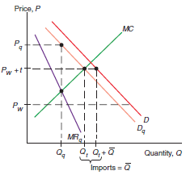
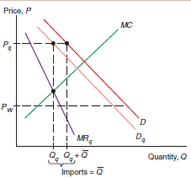
Monopolist protected by IQ
Monopolist is free to raise P – will not lose all its sales
Licence yeald = Pq-Pw
Comparing T and IQ leading to the same level of IM.
IQ leads to higher domestic P and lower Q.

