Slide 1
Population economy - influence of population on economic welfare and business
Lesson 2

Slide 2
Why are population growth theories important?
An integral part of macroeconomic growth models
Population development has a major impact on government budgets in the long term
Technological growth is directly linked to population growth

Slide 3
Marriage
What are economic reasons?
Increase of returns – division of labor
Imperfect credit market – extending credit and coordination of investment activities
Sharing collective goods – nonrival goods (house)
Risk pooling – one works, one is sick

Slide 4
Are children an inferior or a normal good?
Theory and econometrics disagree.
What role does education play?
How much do women have a say in fertility and how much do men?
Do contraception and abortion reduce population growth?

Slide 5
Má pravdu ekonometrie nebo teorie?
A child is an inferior good -> as income increases, the quantity of children decreases.
Child is a normal good -> as income increases, the quantity of children increases more slowly
Vysvětlující proměnná | Level of inome per capita
 | Low income countries | High income countries
Education - woman | -0.17 až -0,06 | -1,1 až -0,19
Education – man | -0.98 až +0,55 | -0,4 až -0,06
Wage - woman | -0,35 až - 0,16 | -0,6 až -0,17
Wage - man | +0,05 | -0,11 až +0,23
Family income | -- | +0,09 až +0,38
Mortality | +0,05 až 0,28 | --

Slide 6
The truth is in the data.
The problem of identification:
Use of inappropriate methods
Insufficient time period
Use of other control variables
Correlation or causality?

Slide 7
More uneducated children or less educated children?
The relationship between education and the number of children is negative.
True, however, for low-income families. High-income families have this relationship neutral. The number of children is affected by sacrificed consumption and leisure opportunities.
Natural experiments on twins confirm these effects.

Slide 8
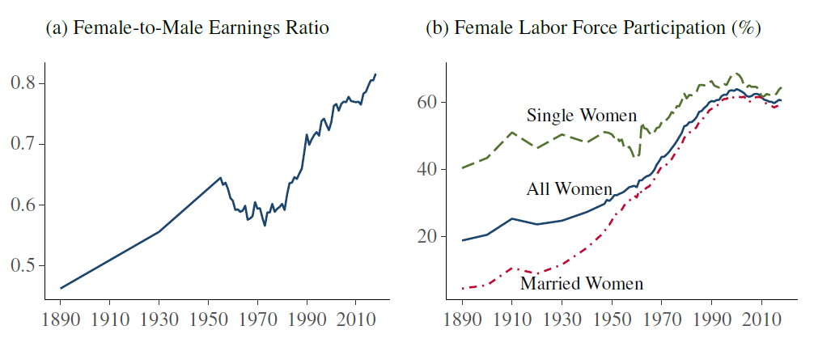
I'm in charge here!
Women decide on the number and quality of children to a greater extent than men.
Before World War II, there was no sacrificed opportunity for women.
After WW2 there is greater participation of women in the labour market -> emergence of the sacrificed opportunity.

Slide 9
Is contraception a scourge on fertility? What about legalized abortion?
Contraception does not cause a drop in fertility, but the timing of pregnancy does.
Insufficient literature on the subject.
Which effect is stronger?
Increasing wages and ensuring financial security leads to an increase in the number of children
or
Greater opportunity cost and therefore a reduction in demand for children.

Slide 10
Legalising abortion may offer the answer
The legalization of abortion has spillover effects on increased female school attendance and subsequent labor supply.
Legalizing abortion leads to increased investment in human capital for the next generation.
Legalizing abortion leads to lower crime rates.
The political economy around abortion is complicated and controversial.
Women in states where abortion is illegal report lower mental well-being, greater risk of insolvency, and increased divorce rates in the early years of a child's life.

Slide 11
What about macroeconomics?
Correlation vs. causation:
Unidirectional relationship -> GDP per capita growth leads to population growth
Unidirectional relationship -> Population growth leads to GDP per capita growth
Bidirectional relationship -> GDP per capita growth leads to population growth and population growth leads to GDP per capita growth
No relationship

Slide 12
A miracle called empirical research? It doesn't look like it.
The authors use different methods and different control variables.
All the first three relationships are found in the country data.
The ambiguity in the relationship...is it positive or negative?
So what are the conclusions?
The direction and relationship is determined by exogenous shocks to technological growth or human capital accumulation and country starting conditions.

Slide 13
And who feeds it all?
Agriculture plays a vital role in population growth. Boserup theory is the most advanced theory to explain this relationship:
Population growth
Increased demand for agricultural products and falling real wages
Urbanisation and decline in available agricultural land
Bringing farmers together in communities
Growth in indirect activities and decline in direct activities related to food production
Transition to more complex technologies
Population growth
Growth in agricultural production

Slide 14
What have you learned so far?
We know we know something, but everyone knows it differently.
Inconsistency in conclusions in both microeconomic research and macroeconomic research.
The mismatch between theory and econometric research.

Slide 15
Fertility
What is the cost of the children? Are costs dependent on family income?
What about revenues?
Demographic transition

Slide 16
Mortality and Health
What is the most frequent reason for mortality in history?
Famine in England and France during 1500 – 1800 were mostly man made.
Technological advance in agriculture leads to 50% increase of consumption of food.
Improvements in nutritional status explains 90% of decline in mortality rate

Slide 17
Migration
Why people want to migrate?
What is the impact of regulations on migration?
What is the effect of migration to the labor markets?
Assimilation of immigrants

Slide 18
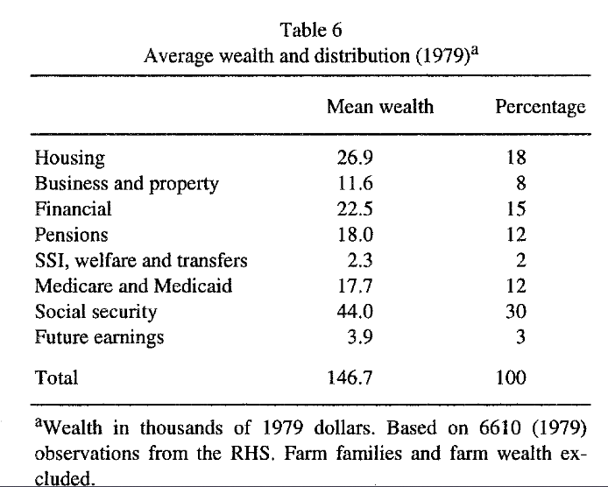
Aging, Demographic Composition, and The Economy
Retirement and social security

Slide 19
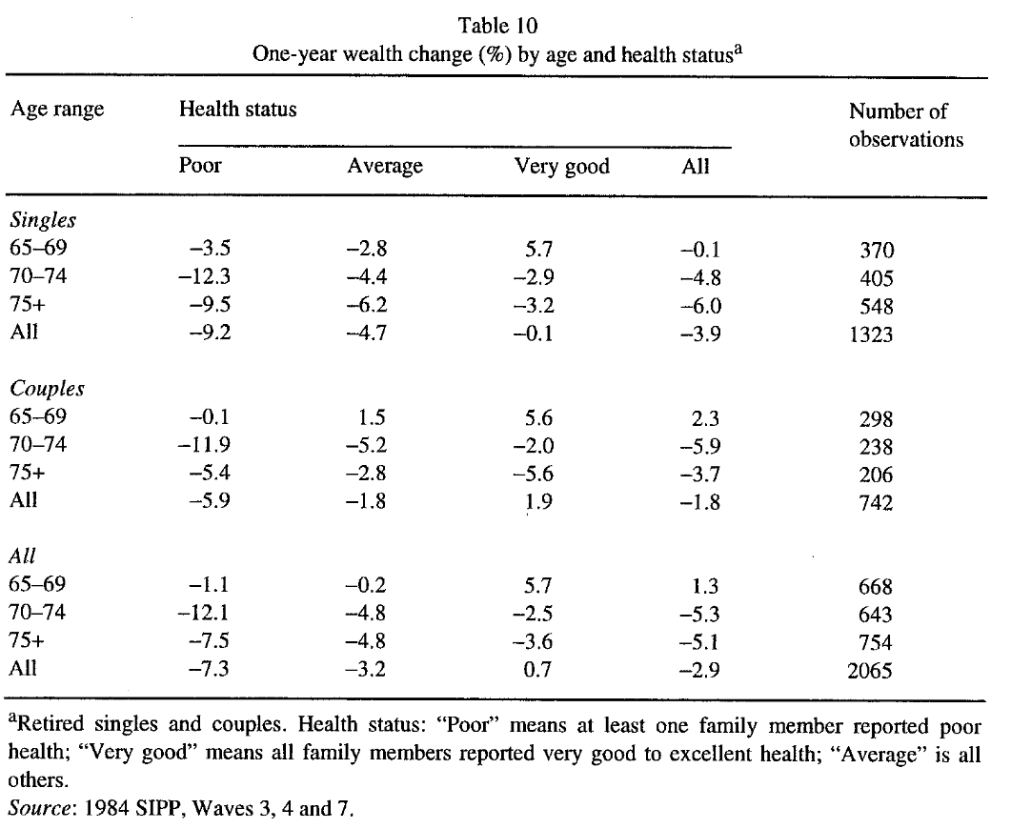
Aging, Demographic Composition, and The Economy
Present versus future consumption and effect of interest rate
Bequest
Dissaving

Slide 20
Aging, Demographic Composition, and The Economy
Aging and labor market
The response of social security system to demographic change

Slide 21
Aggregate Population Change and Economic Growth
Does population growth causes GDP growth or vice versa?
Society and social institutions and effect on population growth
Population growth in the long run and short run
Distribution of intergenerational welfare

