Slide 1
Neurosciences in Economics and Management
Ing. Bc. Jiří Rotschedl, Ph.D.
04/17/2024

Slide 2
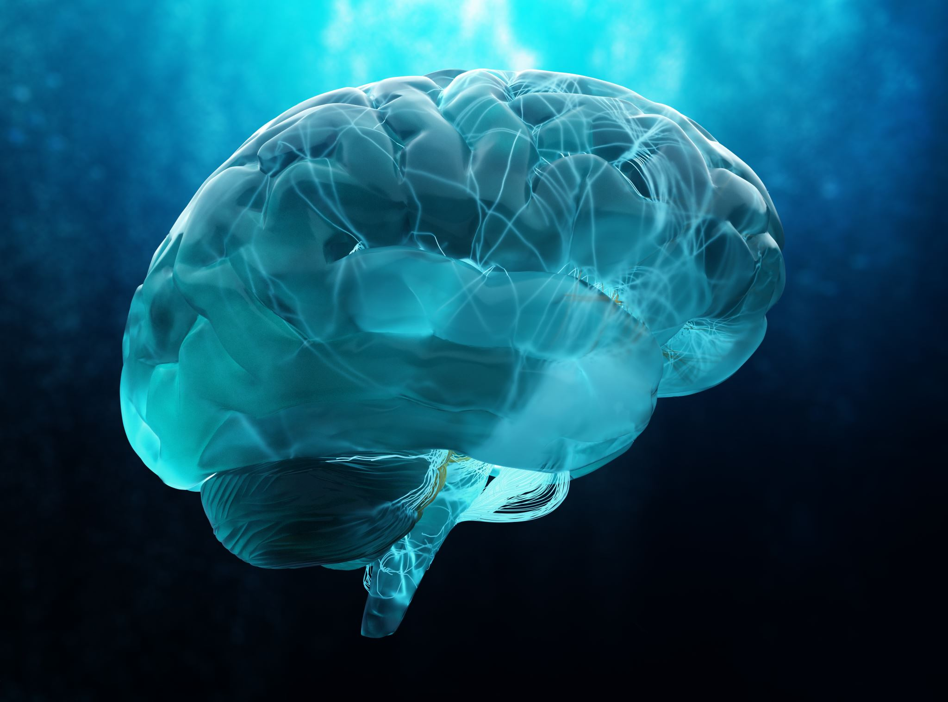
"The basic function of the brain is to convert sensory input into appropriate behaviour".
Human behaviour at the CNS level is dependent on complex interactions between individual neurotransmitters and neurohormones.
The social environment greatly influences these brain substances and their interplay.
(Hess, Sliva, 2021)

Slide 3
Introduction to the human brain - development
What has influenced the development of the human brain:
  7 million years ago: bipedalism
    Narrowing of the birth canal
    Increasing demands on the growth of the human brain
  4 million years ago: the growth of the human brain began
    The beginning of the dilation of the birth canal
  the dilemma of childbirth:
    the female pelvis is a compromise between bipedalism and brain size at birth
    the expansion of the pelvis was slower than the need for a large human brain
    result: human offspring are born about 1 year earlier than other mammals (the size of the adult brain corresponds to a gestation period of at least 2 years in nature, but the child is born after 9 months)

Slide 4
The brain of the child
The brain of a newborn is neurologically immature
The baby's skull is soft to:
  enable brain growth in the first 3 years of life
  to pass through the birth canals, which are very tight in humans
A child:
  needs intensive parental care for the first 2 years
  (mammals are more independent soon after birth, humans are not)
  The brain is born with all the basic neurons not connected by synapses
  by the age of 2, the same number of synapses are formed as in an adult
  doubles by the age of 3 years, maintains until the child is 10 years old and then gradually decreases

Slide 5
Key components of the brain
Brain stem
Brainiac
The Intermediate Brain
The end brain

Slide 6
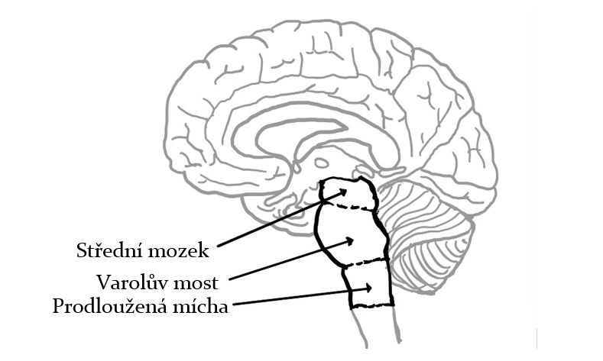
Key areas of the brain - Brain stem
Involved in:
- Balances
- Mimics
- Speeches
- Sucking, swallowing, chewing
Locus Coeruleus = produces noradrenaline and plays an important role in stress.

Slide 7
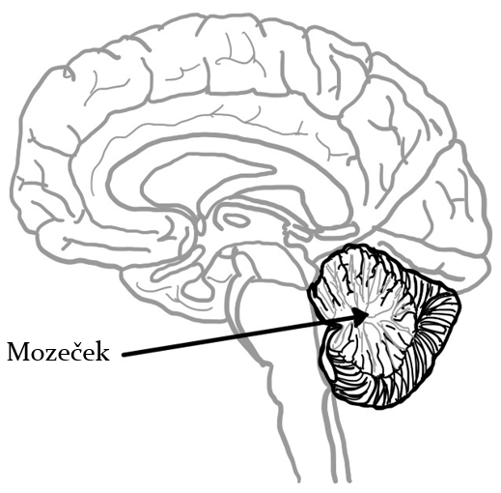
Brainiac
Responsible for:
- attitude
- muscle tone
- coordination of movements (movement experience and skills)
- unconscious learning and procedural memory - automated movements (when speaking, playing a musical instrument or other activities requiring dexterity)
Contains 4 times more neurons than the neocortex
It also appears to be involved in higher cognitive functions

Slide 8
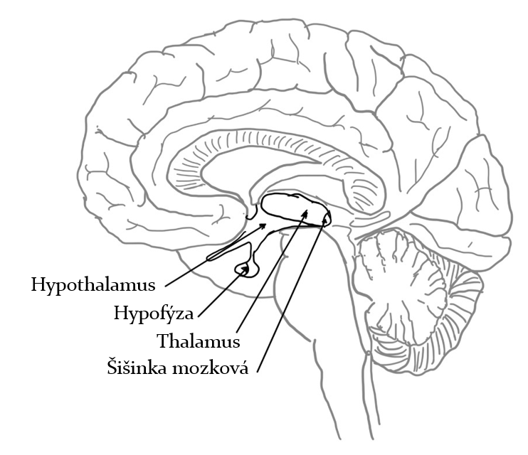
The Intermediate Brain
It is located in the middle of our brain between the hemispheres of the hindbrain
It consists mainly of two key parts: the Thalamus and the Hypothalamus
A very small component is also the pineal gland, which is an unpaired small neuroendocrine gland in the mesenchymal

Slide 9
Pineal gland
Endocrine gland
Plays an important role in setting biorhythms, especially circadian (daily cycle) and circadian (annual cycle)
It contains a lot of norepinephrine and serotonin and from these neurotransmitters it produces melatonin
In terms of biological evolution, the pineal gland evolved from the third inner eye in reptiles - it has elements from the retina and remnants of the lens we have in our eye.
Melatonin is a regulator of hair and eye pigmentation via melanin

Slide 10
Hypothalamus
Involved in the control of homeostasis - a stable internal environment
It is part of the Sympathetic and Parasympathetic nervous systems
The hypothalamus mediates the physical accompaniment of emotions and modulates the experience of emotions, especially feelings of likes and dislikes...
Affects:
  CRH (coticotropin-releasing hormone) - involved in the stress response
  Oxytocin
  Dopamine
  SRH (somatotropin-releasing hormone)
The outer hypothalamic region contains centres that influence attention and arousal

Slide 11
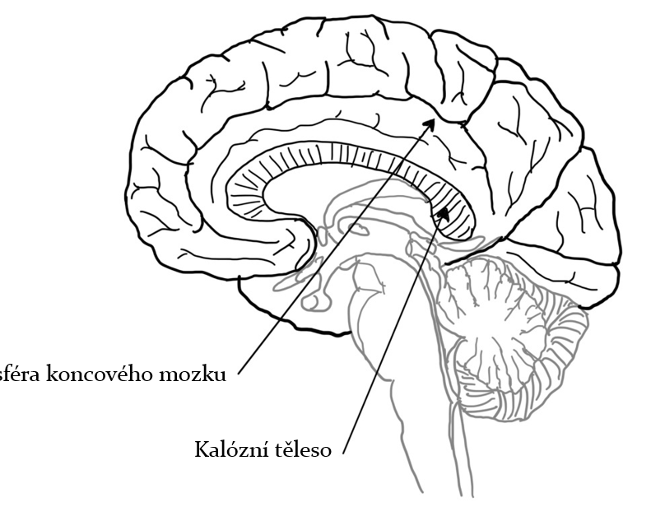
The end brain
It consists of two hemispheres connected by a callose body. The cortex of the terminal cerebrum consists of grey matter 2-5 mm thick.
Connecting the hemispheres through the corpus callosum, does not affect intelligence
The left hemisphere controls the movement of the right part of the body, and the right hemisphere controls the movement of the left part of the body.

Slide 12
The role of the hemispheres
The left part controls the ability to write and express oneself in language, as well as comprehension of text and the spoken word.
The right end brain processes visual and emotional stimuli and is responsible for spatial imagination, geometry and perspective.

Slide 13
The amygdala and motivation
However, a study (Courtin et al., 2022) reveals new insights into the function of the amygdala in relation to the expectation of reward after performing an action without a signal. The mouse learns to perform the action first and receives a reward as a result of performing the action.
The amygdala is responsible for controlling voluntary goal-directed behavior
It is involved in determining the probability of receiving a reward as well as its value. The amygdala sends this information to subregions of the striatum that are known to control goal-directed behavior

Slide 14
Neurons and synapses

Slide 15
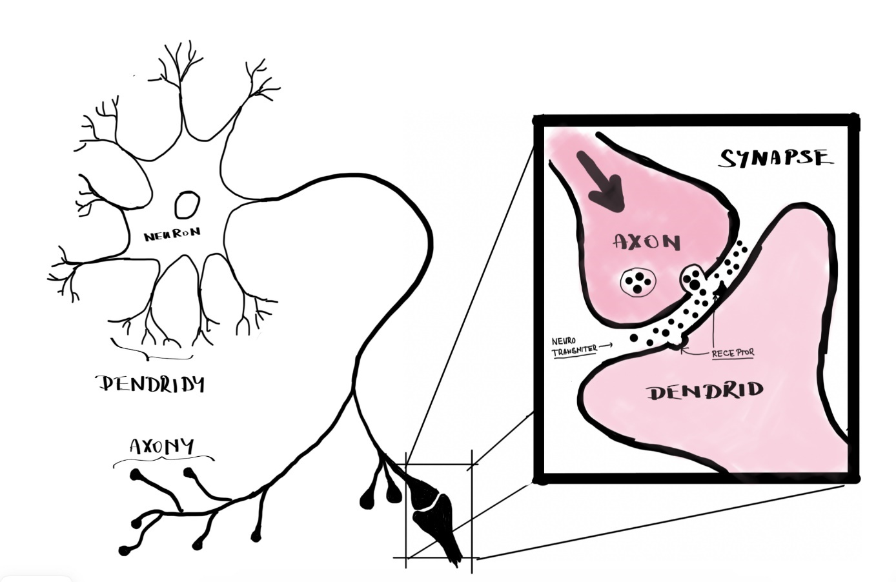
What is a neuron and a synapse
The cornerstone of the nervous system are neurons and their connections - i.e. synapses
Dendrites are projections from the body of the neuron that carry the signal to the center of the neuron
Axon (neurite) is longer and transmits the signal from the neuron to the outside

Slide 16
Neurons and synapses
Dendrites have so-called dendritic spines and signals are transmitted between them and axons via neurotransmitters.
The most famous neurotransmitters:
  dopamine,
  serotonin,
  noradrenaline,
  acetylcholine,
  GABA,
  Adenosine.
For the proper functioning of transmissions between axon and dendrite, receptors through which the signals pass are also necessary.

Slide 17
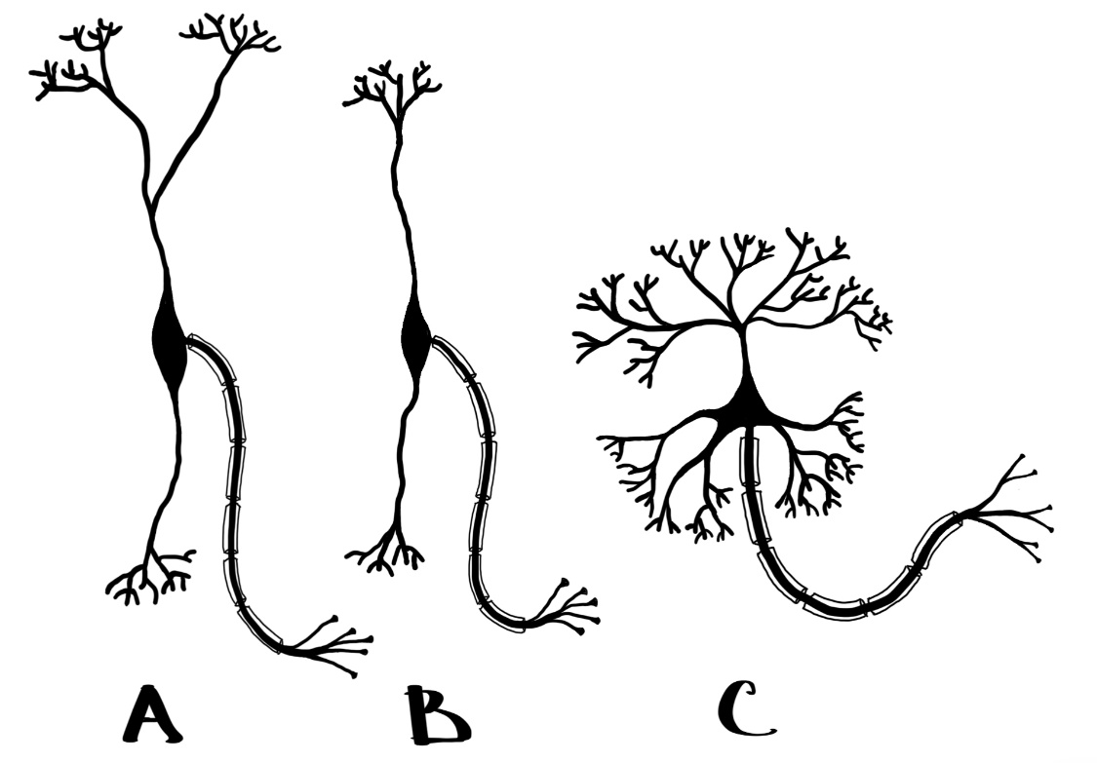
Specific neurons - VEN
In 1925, Constantin von Economo (Economo, 1926) first described a long, thin neuron about 4 times larger than the previously known pyramidal neurons.
Unlike pyramidal neurons, VEN has only one dendrite in the upper (apical) and one in the lower (basal) part of the spindle-shaped cell body - so it has bipolar dendrites with minimal branching. The axon emanating from the side of the VEN cell body is very long.

Slide 18
VEN neurons
These neurons have only been described in:
  humans, see e.g. (Allman et al., 2011)
  great apes, see (Allman et al., 2010) or (Stimpson et al., 2011),
  elephants (Hakeem et al., 2009)
  dolphins and cetaceans, see (Raghanti et al., 2019) or (Butti et al., 2009)
Man is the only one of the above creatures with a large brain that has the most of these neurons in both absolute and relative terms.
Neuroscientists believe that VEN is involved in rapid and intuitive action on social issues (Gazzaniga, 2013)

Slide 19
Forked neurons
Very similar are the so-called fork neurons, which differ from VEN only in that the apical dendrite (coming from the upper part of the neuron) branches into a fork shape.
VEN functions together with fork neurons play an important role in human behaviour and action. It is responsible for:
  social-emotional function,
  empathy,
  intuition.
Example: in frontotemporal dementia, the loss of these neurons causes social changes in the behaviour of the affected person: socially inappropriate behaviour, loss of social tact, impulsivity, reckless or careless behaviour. It also includes apathy, listlessness, indifference to other people's needs, decreased social interest, relationship impairment or loss of warmth (Rusina et al., 2021)

Slide 20
VEN + forked neurons & behaviour
VEN and fork genes play a neurobiological basis in human economic behavior.
People with lower levels of these neurons may exhibit impulsive behaviour - unthinking buying behaviour.
The lack of these neurons will also play a role in the reckless, almost selfish behaviour that forms the basis of the economic principle of maximising utility or profit

Slide 21

Experiment

Slide 22
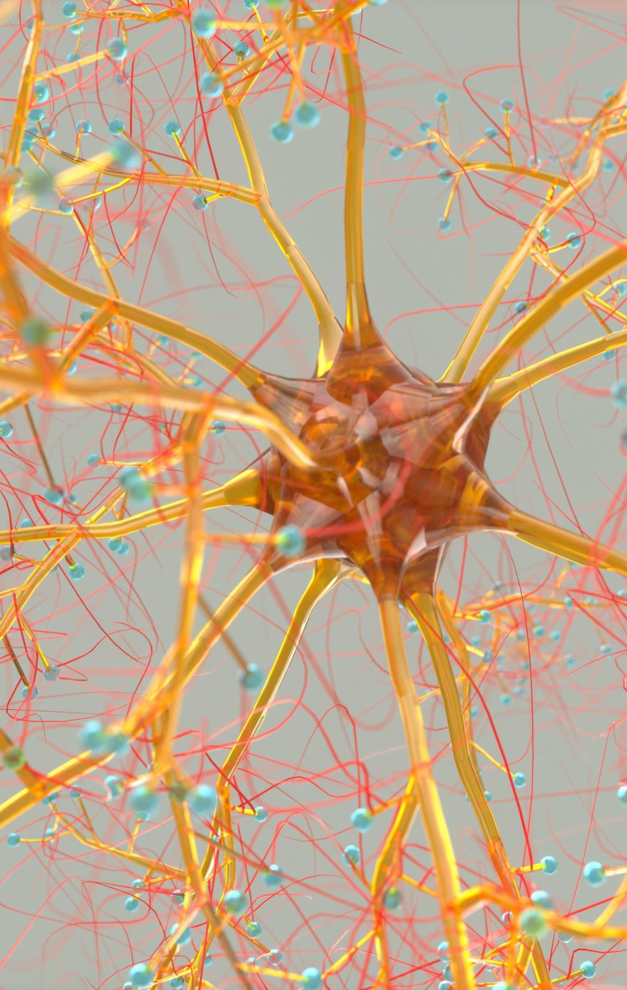
Mirror neurons
What is it? Neurons that are activated in two situations:
  I'm doing an activity
  I see someone doing some activity
  I imagine I'm doing a certain activity
WHEN were they discovered?
  In monkeys, early 1990s
  For people in the second half of the 1990s
Neuroscience shows that mirror neurons influence our ability to learn new skills, acquire knowledge, and form deep emotional connections with those around us, and even help us understand why people do what they do (Cook et al., 2014)

Slide 23
What activities are mirror neurons involved in?
Initiation, planning and coordination of movements and storage of motor programs for learned activities.
Processing sensory information related to touch, pressure and proprioception (perception of body position) from different parts of the body.
Sensorimotor integration, spatial awareness and perception of objects in relation to oneself.
Emotion processing and regulation of emotional reactions
(Penagos-Corzo et al., 2022; Eysenck & Keane, 2015)
Notes:
They have been found in multiple brain regions, including the premotor cortex, supplementary motor area, primary somatosensory cortex, amygdala, thalamus, and inferior parietal cortex. As such, they are potentially involved in these activities

Slide 24
What contributes to our behaviour?
In addition to the brain

Slide 25
Microbiome = colonies of microorganisms
We also have microbiomes in our mouths, on our skin and in/on other parts of body.
The largest colonies of microorganisms are found in the gut = gut microbiome.
It is involved in the expression of our emotions and communicates with our brain through the vagus nerve (Forsythe, Bienenstock and Kunze, 2014).

Slide 26
The importance of the microbiome in general
The quality of the microbiome is very important
It can have a direct effect on the formation of:
  depression,
  anxiety,
  autism,
  Parkinson's disease and other diseases
(Quigley, 2017), (Cenit, Sanz and Codoñer-Franch, 2017)

Slide 27
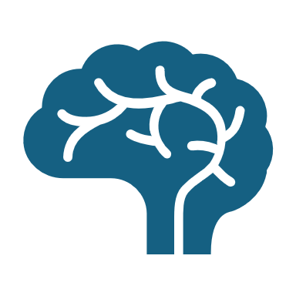
How does our microbiome communicate with the brain?
So the microbiome communicates with our brain through the vagus nerve, and
  from the brain to the organs 20% of fibres
  80% of the fibres run from the organs to the brain
(Bonaz, Bazin and Pellissier, 2018)
The microbiome therefore represents our second "brain" that influences our actions.

Slide 28
What is the Nervus vagus (vagus nerve)
The vagus nerve is:
  longest
  the most complex of the so-called cranial nerves
  10th cranial nerves.
It runs through:
  Face,
  chest, including the heart,
  in the abdomen.
It connects the larynx, pharynx, vocal cords, heart, lungs and most of the digestive tract to the brain.

Slide 29
What do we have Nervus vagus for?
It distinguishes between pathogenic and non-pathogenic bacteria and stimulates the brain to an anti-inflammatory response.
It can produce anxiety or anti-anxiety effects.
It can be activated through nutritional stimuli

Slide 30
Sympathetic and parasympathetic

Slide 31
Sympathetic and parasympathetic nervous system
It belongs to the "autonomic" nervous system - it is activated autonomously
Peripheral system acting against itself
  Sympathetic - activating, works by wiring:
    Dopamine
    Adrenaline
    Noradrenaline
    Glucocorticoids etc.
  Parasympathetic - dampening, works by wiring e.g.
    Oxytocin etc.

Slide 32
Sympathetic - why do we have it?
It activates our organism at a time when:
  we are at risk
    escape x fight x retreat
  when we want to hunt prey
  we have sex
  when we are stressed for reasons other than physical combat or physical exercise
The present time is full of Sympathetically dominant (lots of tasks, lots of stressful situations on a psychological basis, everything is fast.
Notes:
Evolutionarily Sympathetic:
It was created so that we could survive in the event of an attack. He chooses three strategies:
- escape
- fight
- give way
Currently, these predators do not exist. The Sympathetic response is triggered by e.g. stress at work - lots of work, rapidly changing environment, lots of information in the environment, busy and artificially induced stimuli in the mind that stress us out. So we don't have the associated physical activity that should be the response

Slide 33
Sympathetic - what is activated?
The sympathetic is activated as a whole, so it manifests itself in all parts of the body at once:
  increase in heart rate
  increase in breath
  deactivation of the immune system
  upset the homeostasis of the body
  blood clotting is increased
  stress hormones are produced in the adrenal glands

Slide 34
Sympatikus - Side Effects
Managers and workers with long-activated sympathetic:
  are more likely to be sick
  eat more (manager = min. 1 kg extra weight per year)
Food is primarily supposed to activate the parasympathetic, but if we are in sympathetic permanently/long term, it doesn't work
  That's why we have to take our time to eat, not eat on the way - it doesn't work as a parasympathetic activator.

Slide 35
Parasympathetic - when does it work?
A system that calms the body and helps bring it into homeostasis
Parasympathetic is active:
  at the time of rest
  in digestion, etc.
  in a safe environment
It helps to relax the brain and it starts to connect more - it gives creativity or flow.

Slide 36
Parasympathetic - what is it good for?
Manager/Leader
  if he needs to think about strategy
  if he needs to come up with new ideas (new products, etc.)
Creatives
  if they need to come up with an idea
Engineers
  if they need to find unique innovative designs
Must have Sympathetic deactivated and Parasympathetic activated

Slide 37
How to activate parasympathetic?
Being in a safe environment - being in the company of more people (listening)
Touching (victims) = related to Oxytocin production
Meditation
Singing and making deep vowel sounds - oooh, ooooh

Slide 38
Breath
Activation by long exhalation with deep sound
  there are different techniques - breathing into a square
  short inhalations and long exhalations
Improving cognitive function - breathing in through the nose, into the abdomen
  Flushes out nitric oxide - improves blood flow, improves blood pressure, expands airways and improves oxygenation of the body and brain
  breath is more effective
Relax the shoulders (trapezius muscle) when exhaling
Control mechanisms of breath:
  autonomic (originating from the brain stem - locus coreuleus)
  conscious (coming from the motor centres of the brain)

Slide 39
Eye
Peripheral looking = activates parasympathetic (calms the body)
  sunrise and sunset
  looking into the distance
  looking sideways left-right (reduces amygdala activity)
The Eye Pupils:
  parasympathetic reaction: they contract
  sympathetic reaction: they stretch

Slide 40
Smile
Smiling = leads to activation of the parasympathetic system
The brain knows that smiling is associated with pleasure, in which certain parts of the brain and neuromuscular connections (e.g., facial muscles) are active. The brain associates smiling with a safe environment
Artificially induced smile activates the same areas of the brain = it improves mood, increases the feeling of joy
An artificially induced smile is ideal when you can't fall asleep - it activates the parasympathetic system and the body quickly settles down and falls asleep.

Slide 41
Listening
The parasympathetic is activated by listening
  listening to music
  podcasts etc.
Effective is:
  Increase the tone of voice
  Slower talking

Slide 42
Acetylcholine
One of the main mediators of Parasympathetic
Example:
You have the task of leading a discussion, presenting a new product and you have to be alert - to be able to focus on the audience, be creative, have an active mind, you have to activate the Parasympatheticus (see previous slides) - e.g. by supplementing with Acetylcholine or another nootropic.

Slide 43
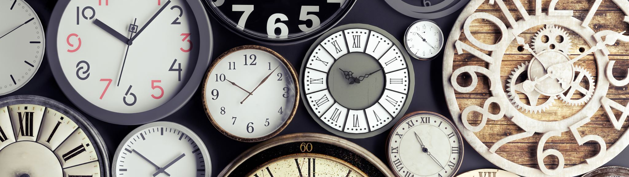
Circadian rhythms of the body
Biological clock

Slide 44
Inner clock (chronobiology)
Ultradial rhythms = 90 min. cycles
Circadian rhythms = diurnal cycle
Circalunar rhythms = lunar cycle
Circaannual rhythms = annual cycle (dark hormone = melatonin)

Slide 45
Main synchronization signals
Photoperiodic change in nature:
Sunrise
Sunset

Slide 46
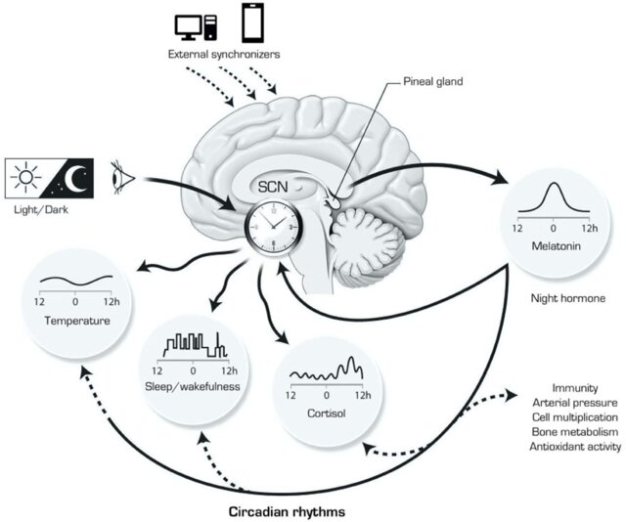
Circadian clock system in the body
Regulating processes inside cells to make circadian rhythm work
The main synchronizer of the cells are the suprachiasmatic nuclei of the Thalamus
Melatonin in paediatric insomnia | NSS (dovepress.com)

Slide 47
Key organ - eyesight
Photoreceptors on the retina
Ganglion cells in the eye that signal what time of day it is
  time signals (light, temperature, food)
Cells in the eye distinguish the angle at which a light source strikes the retina
  in the morning and during the day the source of the world from above = daylight
  in the evening the light source is from below - sunset + fireplace = red light
Notes:
Ganglion cells are in the lower half of the eye -
Ganglion cells have a low sensitivity to light in the morning, so we need a lot of light
In the evening the ganglion cells are very sensitive and therefore in the evening rather not to shine and only red light
The more light we have in the morning and morning (daylight, including blue light), the better.

Slide 48
Suprachiasmatic nuclei
They perceive light - they are connected to the retina of the eye
They're constantly watching whether it's day or night
Functions of suprachiasmatic nuclei:
Synchronizes bio rhythms in cells according to light intensity
Regulate feeding behaviour
They regulate the metabolic organs
Regulates body temperature - changes enzymes in the body
It regulates hormones:
  Melatonin - "the hands of our biological clock"
  Cortisol - has a peak at the beginning of activity (informs the organs that it is daytime)

Slide 49
Chronotypes
owls, extreme owls
Undefined
lark, extreme lark
Causes of different chronotypes:
Gene mutation (owls have a slower clock, larks have a faster clock) Different gene mutations affect regulatory processes in the body

Slide 50
Differences between owls and larks
Larks:
They have a harder time tolerating eastbound flights (it goes against their clock)
They have problems adapting
The lark has one peak of activity (in the morning until 15:00 and then tapers off)
Owls:
More prone to chronic dysregulation
Sleep deprivation results from a longer cycle than
The owl has two peaks of activity (10:00 - 14:00 and the other is 20:00 - 00:00)
Notes:
Evening activity

Slide 51
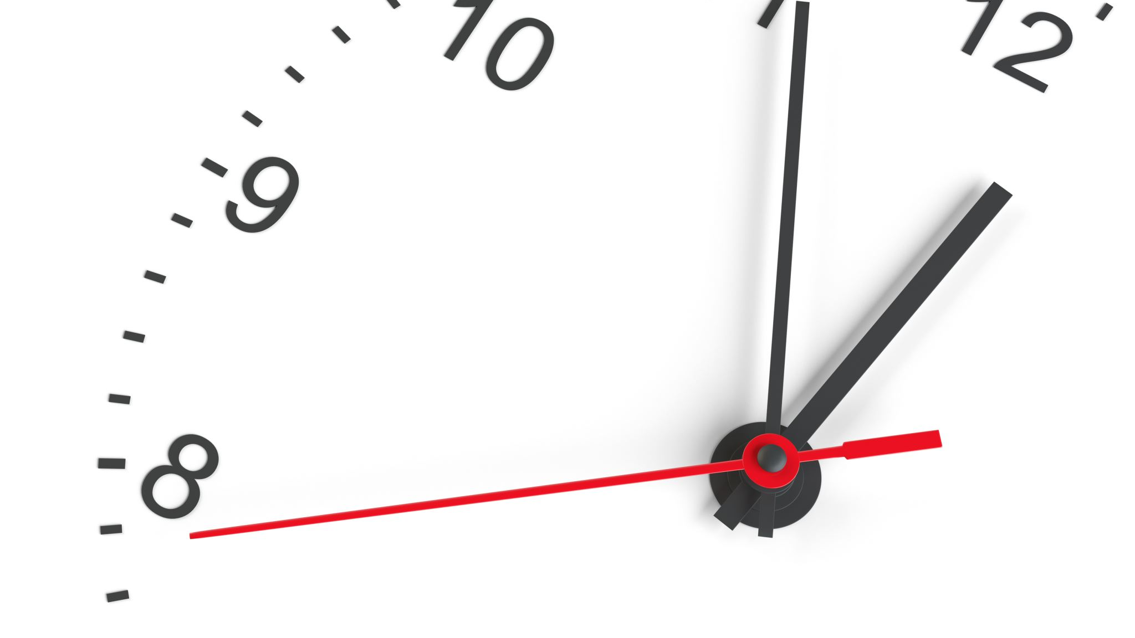
How do suprachiasmatic nuclei synchronize the cell clock?

Slide 52
Body temperature level - bio clock regulation
The temperature has its minimum about 2 hours before we wake up. The maximum is 4-5 hours after the minimum and at this maximum one should be doing temperature raising activities (exercise, cold shower). then it starts to drop. The next maximum is at about 16:00 - 17:00 - when it is best to exercise, to burn fat. The subsequent decrease in temperature leads to preparing the body for sleep.
Shortening the day:
  Ice shower in the morning at a time when the temperature is rising, shifting the peak to earlier in the day
  Sauna in the evening leads to the activation of cooling of the body and faster cooling and shortening of the day
Extending the day:
  ice shower, cold therapy in the evening
When it's hot, don't take a hot shower; rather, a lukewarm shower is a good idea to help cool the body down.

Slide 53
Cortisol level
Increases naturally upon waking and peaks 1 hour after waking
Peak cortisol levels are earlier than temperature, but there is a correlation between the two
Cortisol then decreases from the morning peak and slightly increases or stagnates before the second temperature peak and then decreases again
Individuals with depression, mood disorders - have a flatter trend in cortisol levels throughout the day

Slide 54
Melatonin levels
Melatonin is related to cortisol - negative correlation between them
When cortisol levels are high, melatonin levels are low and vice versa
Plays a key role in sleep (reducing inflammation, cleansing the body, regenerating tissues, remembering things we've learned)
Ganglion cells are very sensitive in the evening - inhibits (suppresses) melatonin production
What does that imply?
If we are burdened with stress we fall asleep harder and have less quality sleep

Slide 55
Related substances with circadian rhythms
Vitamin D - may suppress melatonin secretion
  supplementation of vit. D in the morning improves sleep
  supplementation of vit. D in the evening worsens sleep
Caffeine - coffee drinking should be related to the circadian rhythm
  Adenosines from ATP sit on receptors, thus signaling to the brain that the body is tired
  Adenosines are free and wait for receptors to be released = then comes rapid fatigue
  Not ideal for the first hour after waking up - coffee supplements cortisol and a decaffeinated start to the day is even worse
Protein: are suitable in the morning
Carbohydrates: in the evening they are associated with better quality sleep
Alcohol: raises our temperature, impairs sleep quality

Slide 56
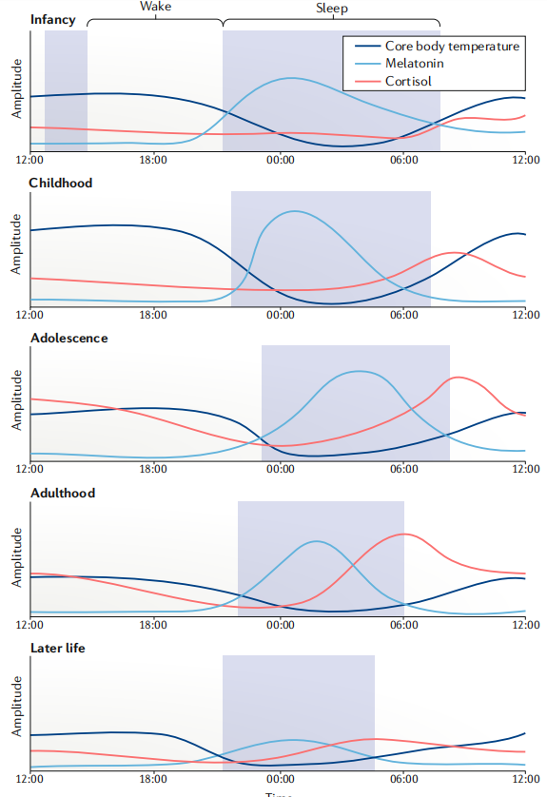
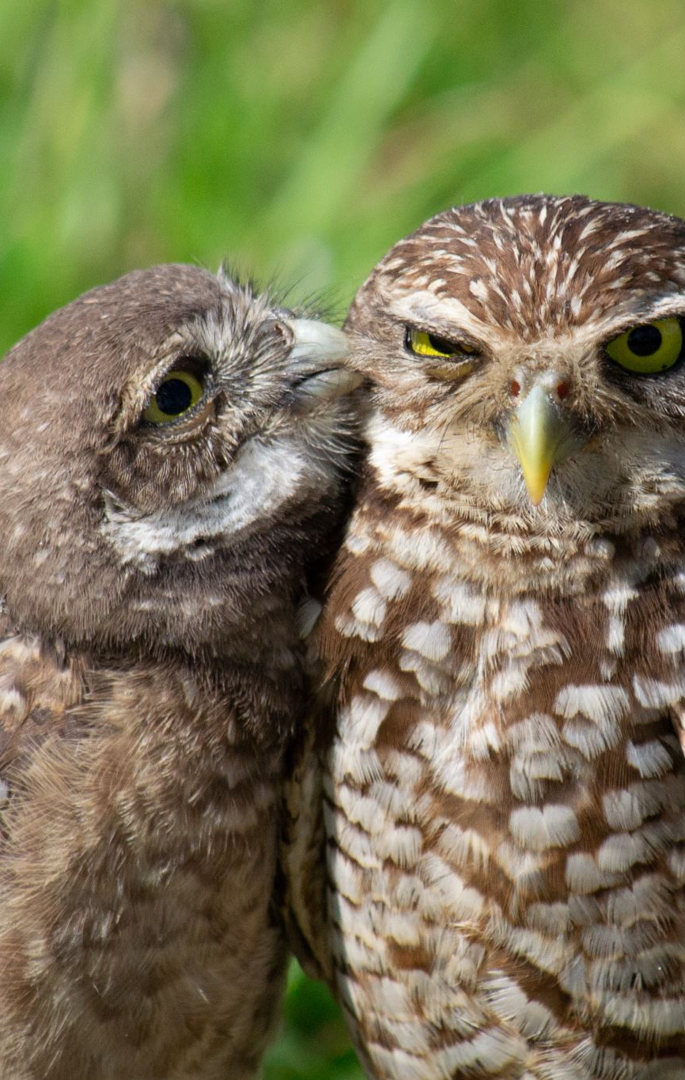
Biological clock of the chronotype during life
Children - mostly larks
Puberty - mostly owls
Maturity - different types - owls, barn owls, larks according to the Gaussian curve
Seniors - mostly larks

Slide 57
Circaannual rhythm - winter/summer
With autumn, the production of melatonin, which affects the immune system, is prolonged
Comply with the seasonal changes of lengthening and shortening the day has a health benefit
in spring and summer we have more cortisol, dopamine, testosterone, estrogen = we have more desire to have relationships, have sex more often, we are more horny (animals mate more often with the arrival of spring as the day starts to lengthen)
The arrival of spring 03-04 is one of the two times of the year when most human relationships break down
Daylight even in winter has a health benefit - at least 1 hour a day in daylight improves
Morning - we need a lot of intense light
Evening - only yellow/red light in winter

Slide 58
Circadian rhythms and manager/economist
Increase the efficiency and performance of the work team:
  approach people individually according to their chronotype
  avoid shift work that is irregular on a daily basis
  Introduce afternoon rest breaks
Proper setting of the team's biological clock:
  reduction of team sickness
  increase in human performance and use of all active phases (one phase in larks, both phases in owls)

Slide 59
Shift work
Permanent changes in the working regime lead to dysregulation of circadian rhythms and cause:
  metabolic syndrome
  depression
  Hypertension
  diabetes
  various types of cancer (breast cancer is associated with shift work, and cancers related to hormonal imbalances)

Slide 60
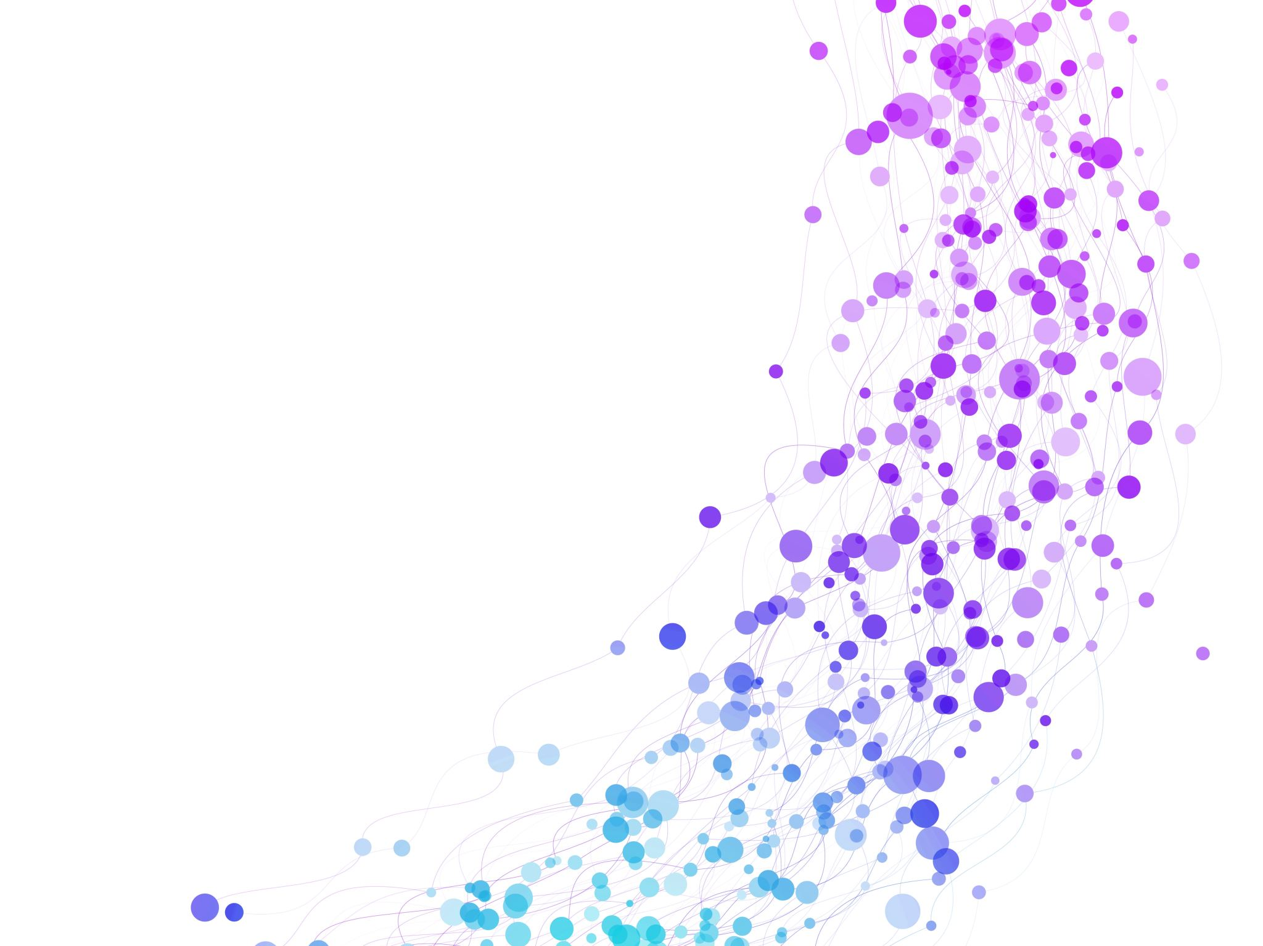
Endrophins

Slide 61
Endorphin - Motivation for further performance
Feeling great after a hard day of hunting game was the main goal of going hunting the next day.
Endorphins therefore encourage us to repeat the activity. That is, to make us feel great again.

Slide 62
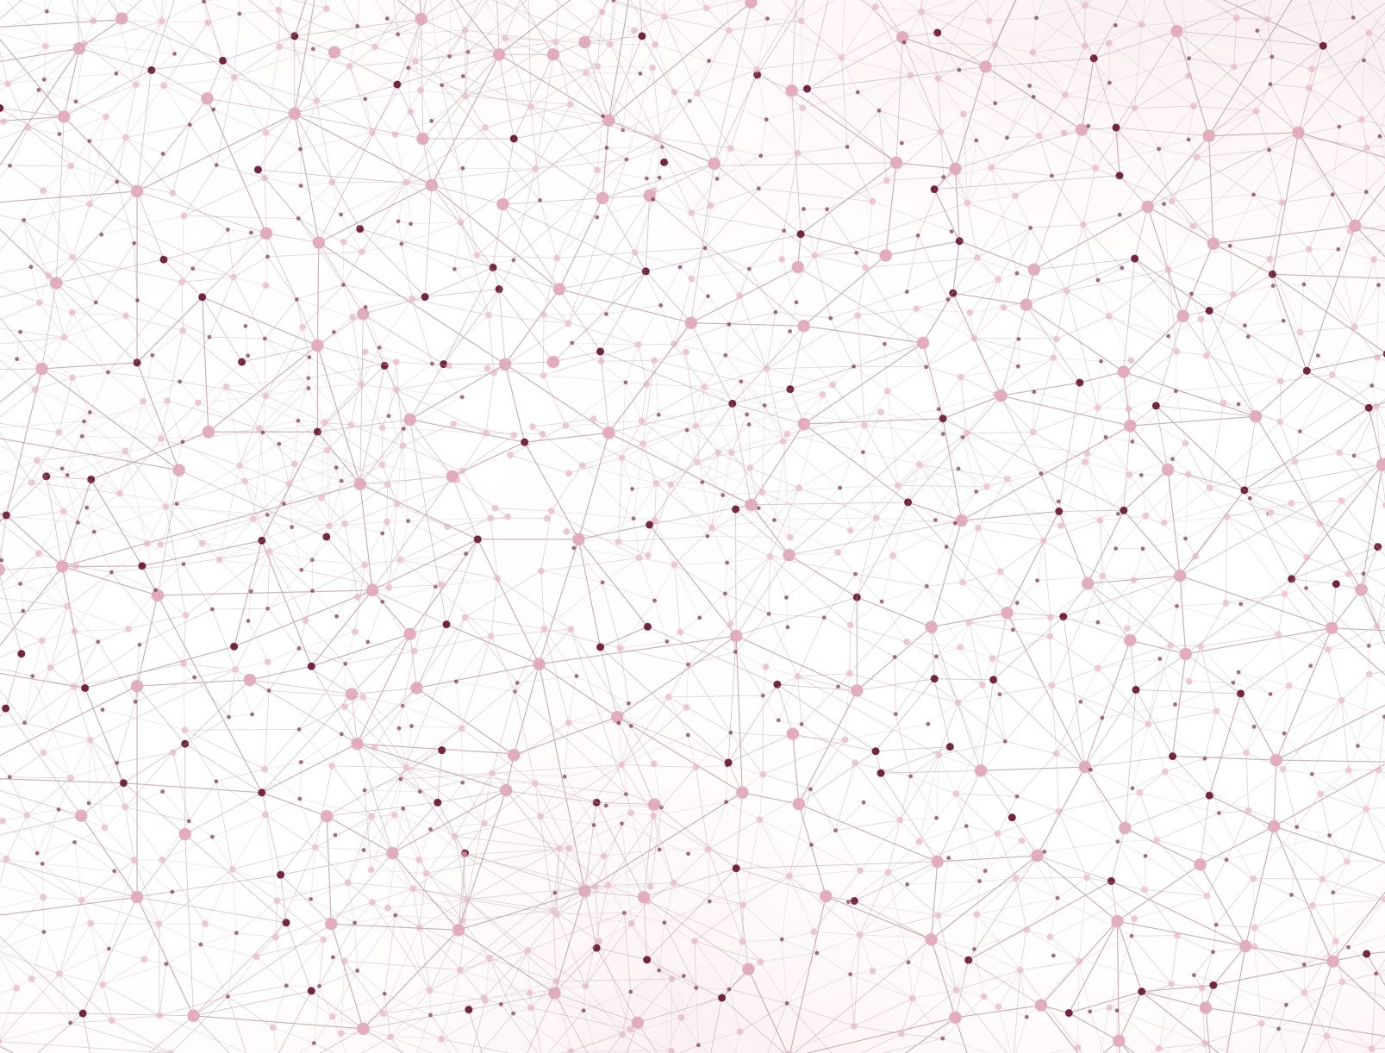
Dopamine

Slide 63
Dopamine - disorders
Genetic and epigenetic basis:
  The D4DR gene, on chromosome 11, has a repetitive sequence in the middle
    Repetition is 2 to 10 times
    Higher repetition decreases dopamine receptor sensitivity
People with a long gene (multiple repeats):
  tend to engage in activities that produce large amounts of dopamine:
    adrenaline sports
    change sexual partners more often
    seek sensation and new experiences
    do not tolerate boredom
People with a short gene (fewer repeats):
  opposite

Slide 64
Dopamine
Neurologically and physiologically
Its deficiency leads to motor poverty, reduced facial expressions, uncontrollable trembling at will and slow and monotonous speech.
  Parkinson's disease
It affects the production of estrogen:
  in female athletes or ballerinas, it causes a drop in estrogen, which is associated with cessation of menstruation

Slide 65
Dopamine
Decision-making and economic behaviour
Increased dopamine leads to hyperactivity, which alters buying behavior and leads to:
  impulse buying
  the lack of forethought, in particular with regard to intermediate decisions
What our subjective discount factor is will be affected by the impaired reward dependence syndrome in particular.
Hyperactive people are more likely to be poor, as well as more likely to go into debt or save less
(Rotschedl, 2022)

Slide 66
Dopamine
Motivation and leadership
More dopamine is released when we get an unexpected reward than when we expect a reward
(Mirenowicz and Schultz, 1994)
Dopamine also starts to form when you are done = it is advisable to write a TO DO sheet and check off the completed tasks
The feeling of victory when winning, reaching the goal
  Human is sight oriented = seeing the target is essential
  Companies therefore set their VISION (from seeing) - this contributes to the creation of dopamine and motivation to go after the vision, to fulfill it.
Therefore the VISION must be: tangible

Slide 67
What's the problem with dopamine?
The problem is not changing it, but increasing the "base line"
A person addicted to dopamine has high levels of dopamine
But the brain responds to "changes" in dopamine.
For people with high "base line" dopamine it is difficult to induce a feeling of happiness, a feeling of reward from any activity - over time nothing motivates them to do anything - a classic manifestation of burnout: "they don't enjoy anything"
The problem is with people addicted to drugs - especially meth, cocaine. Drugs change the physiology of the brain (they lose dopaminergic receptors) and even if they go through the withdrawal phase, they are bored for the rest of their lives, ordinary things don't make them happy.

Slide 68

Noradrenaline

Slide 69
Noradrenaline (norepinephrine)
Chemistry of alertness
WHY:
  increases our alertness
  plays an important role in the case of unwitting attention
  Lower level: we feel boredom
  Proper dopamine and norepinephrine levels = leads to flow (Rock, 2010)
  Higher levels = in shy people, in people with fast metabolism (Hess and Sliva, 2021)
WHERE:
  It is produced in the adrenal glands
HOW:
  Noradrenaline is formed from dopamine by dopamine-beta-oxidase, and adrenaline is then formed from noradrenaline

Slide 70
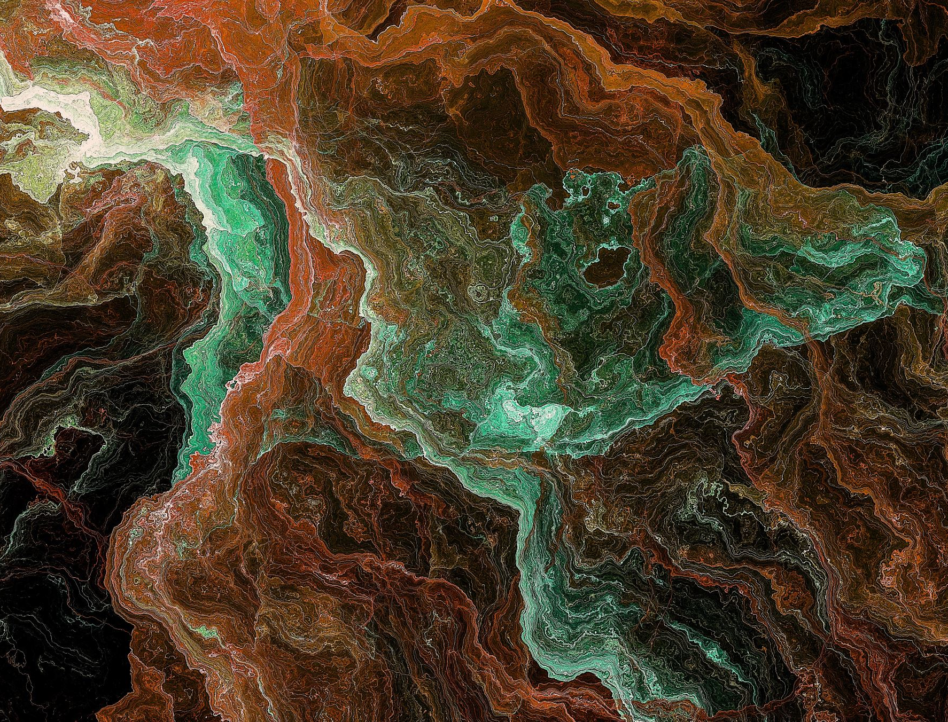
Serotonin

Slide 71
Serotonin
A key hormone for hierarchical division of society and status (not only humans, but also animals)
  Hierarchically, elevated serotonin levels have the highest rank
  Hierarchically, those lower down the hierarchy have lower levels of serotonin, even though they were higher up before and were demoted
When the leading "male" is removed, there is a decrease in the density of serotonergic receptors in the area of the brain involved in social behavior
By supplying the precursor Serotonin = leads to prosocial behaviour and males treated in this way achieved higher status
It is the hormone responsible for a sense of pride and status
gives a feeling of confidence

Slide 72
How to trick the status system?
We live in a material society
Status = expensive car, big house, designer clothes, logo on building or clothes
What's missing?
  it is not the status due to a better relationship between the caregiver and the cared for
  Despite the fact that we accumulate "status enhancing" things, we don't feel successful!

Slide 73
Serotonin
How to influence serotonin levels?
By increasing the intake of Tryptophan and at the same time less of other amino acids
Increase glucose and subsequently insulin uptake = promotes amino acid delivery to muscles
  Chocolate contains a lot of tryptophan = after consumption, plasma serotonin levels increase
  Bananas contain large amounts of serotonin
  After main meal chocolate dessert => tryptophan => serotonin
  Milk and honey before bed => tryptophan => serotonin and melatonin
  Sweets on the pillow at the hotel => for better sleep as a result of higher tryptophan absorption
Note: Melatonin is also produced from tryptophan (produced in the pineal gland and retinal cells = regulates biorhythms).

Slide 74
Serotonin
Management and leadership
As a leader: if you are not willing to give up benefits when needed, you should NEVER be promoted to the position you hold - You have the position, but you are not the leader!
If you promote to leader:
  you have MORE work (not less)
  you are putting other team members at risk
It touches us deeply when people who are supposed to be leaders sacrifice their team for their own benefit when there is a problem.

Slide 75
Serotonin
Management and leadership
If we trust each other in the team, then:
  we will take more risks
  we will innovate
  we're going to do great things
If we don't trust each other in the team, we won't achieve these things

Slide 76

Oxytocin

Slide 77
Oxytocin
Psychologically
It is involved in the formation of emotional attachment:
  of mother and child
  between sexual partners during orgasm and fear
Increases trust and empathy in the group
Suppresses anxiety
Increases confidence and reduces fear
Improves mood and reduces stress response

Slide 78
Oxytocin
What increases it?
Social contacts
Cuddling, orgasm
Doing good deeds without reward.

Slide 79
Oxytocin
Psychiatrically
Oxytocin is used in addiction recovery because:
  reduces withdrawal symptoms
  reduces drug addiction

Slide 80
Oxytocin
Management and leadership
Social contact - e.g. shaking hands of strangers is an important moment for joint negotiations and contracting
Business and business relationships are often not rational, they are much more about a certain belonging, a sense of security.
Refusing to shake hands will lead to
  you'll be nervous or..,
  you'll find the other side untrustworthy,
  you don't have to sign the contract after all.
In management speak, giving your time and energy to someone else without getting anything in return = the basic activity of a Leader

Slide 81
Oxytocin
Management and leadership
Real leaders are those who give us their time and energy, not money - money is not biologically effective
Leader has limited time
A leader's basic decision: who to give time+energy to and who not to
Leader realizes an important fact:
Oxytocin also plays an important role in the overall health of the body and improving immunity (happy people and people living in a relationship live longer - they are healthier)

Slide 82
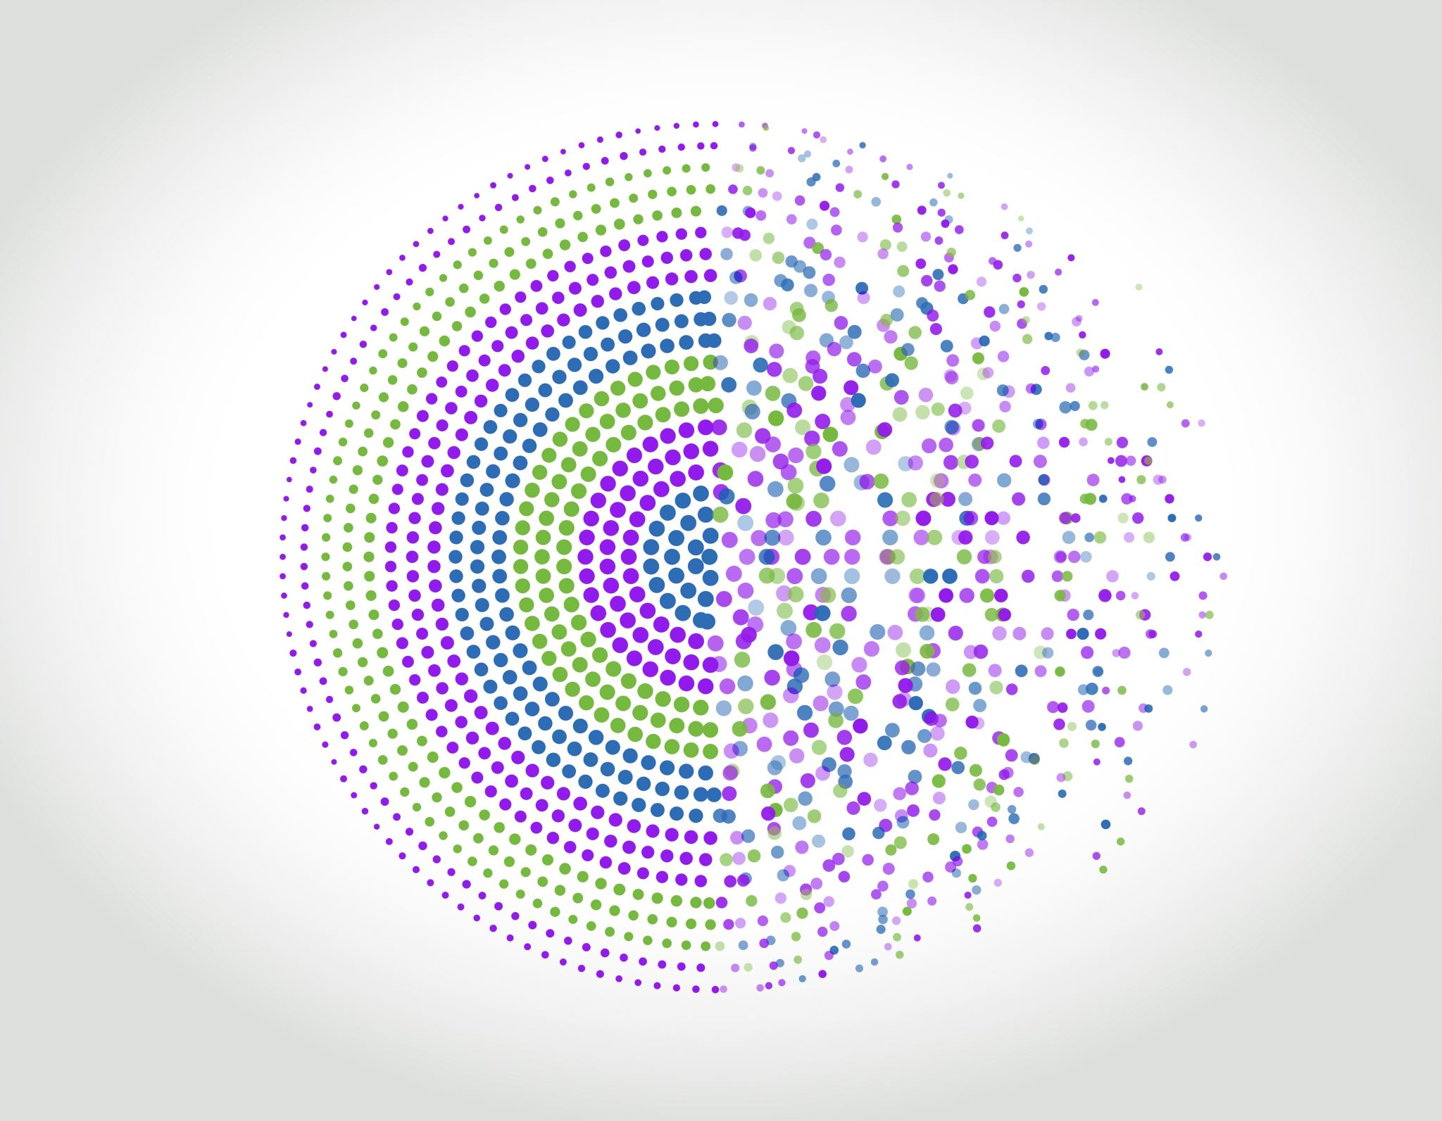
Cortisol

Slide 83
Cortisol chemistry of stress
WHY:
  main role is the regulation of nutrient metabolism - carbohydrates, proteins and fats
HOW:
  Stress => signal to Amygdala => Locus coreuleus => activation of stress axis: hypothalamus => pituitary => adrenal => feedback via hippocampus to hypothalamus
WHERE:
  produced by the adrenal cortex from
  the starting substance for the formation is cholesterol
CO:
  Cortisol is one of the main steroid hormones
  It is a stress hormone

Slide 84
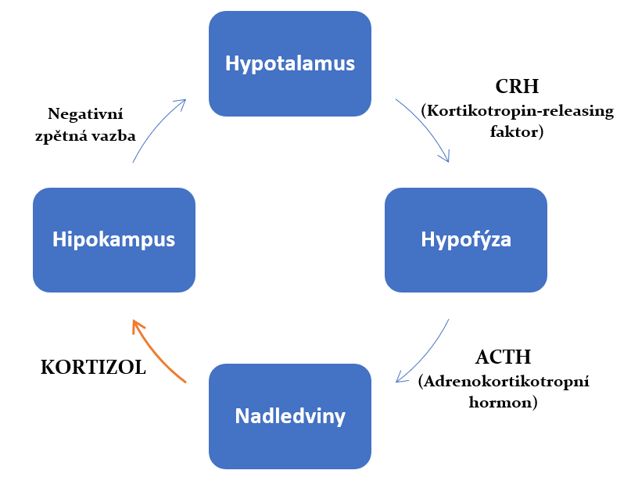

Slide 85
Cortisol
Physiologically and anthropologically
Responsible for the initial reaction type: running, attack, retreat
It prepares the body for this type of stress:
  Induces a paranoid state: makes one nervous, makes others nervous
  Sharpens our senses
  Responsible for pumping glucose into the blood
  Regulates blood clotting
  Shuts down the immune system
  Suppresses hair and nail growth
Short term - OK, but long term it causes more frequent sickness,

Slide 86
Cortisol
Psychologically
Cortisol increases selfishness and suppresses oxytocin release
biologically, our character is changed by long-term exposure to cortisol
  less compassionate
  less noble
  we stop caring about others
  we focus on protecting ourselves
In the event of danger (an attack on a group of people), it is natural that a person will start to choose a side

Slide 87
Cortisol
Health
Toxic environment, i.e. toxic company culture, enormous stress, etc. is killing us
  This kind of work is killing us, and the people working in these companies should leave as soon as possible because they are sacrificing the most valuable thing they have - their health

Slide 88

Stress

Slide 89
Stress
In terms of risk, stress can be divided into two forms:
  A) EUSTRES
  B) DISTRESS
Eustress is a kind of stress that has a beneficial effect on our organism. This is, for example, sports. This type of stress is characterised by one basic characteristic: stress in which we have an influence on the events that cause it. In other words, we can stop this stress.
Distress is one of the dangerous stresses that cause phenomena that we cannot control by our own actions. The worst situation is when our organism is exposed to such stress for a long time.

Slide 90
Stressors
repeated threat
bossing and bossy behaviour, generally bullying
frustration (e.g. due to extensive responsibility and low authority = I cannot influence the phenomena)
conflicts and disputes

Slide 91
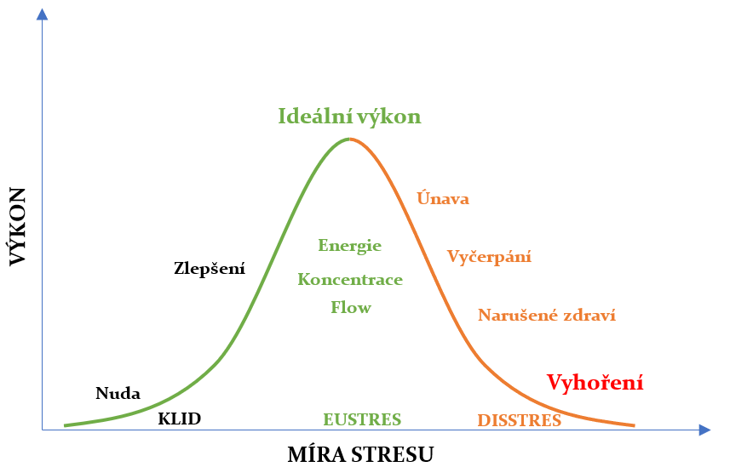
The Yerkes-Dodson curve of human performance

Slide 92
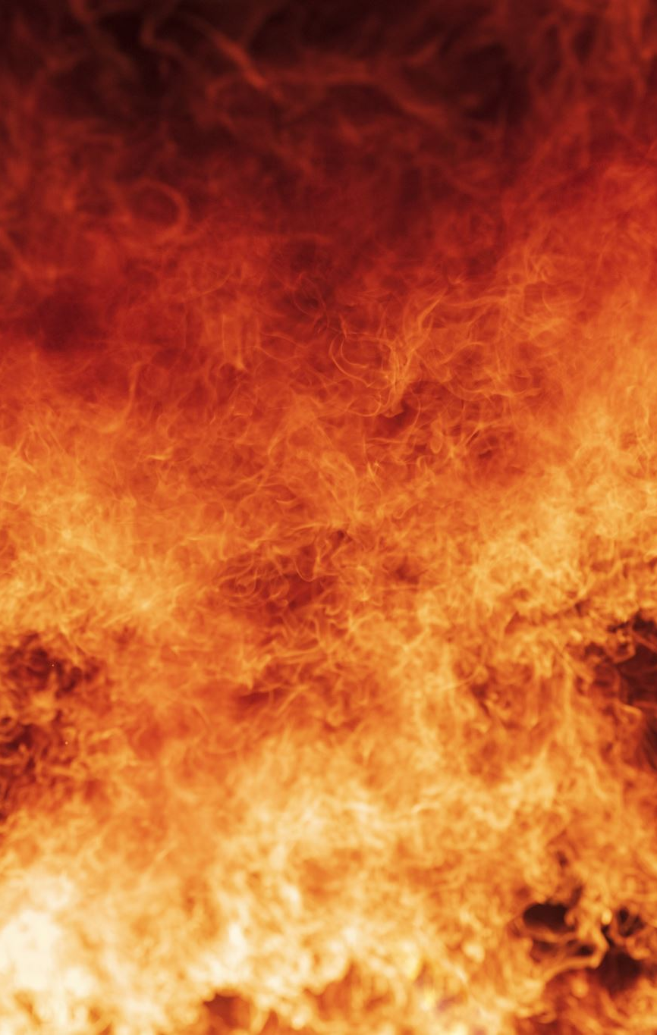
Burnout Syndrome
H. Freudenberger 1975 - state of exhaustion, fatigue and permanent stress
Stages:
  Zero: High performance but insufficient reward
  First: The feeling of not keeping up
  Second: anxious chaotic and overworked
  Third: loss of interest, irritability, disappointment, dullness

Slide 93
Burnout syndrome - symptoms
Fatigue
Depression and anxiety
Memory disorders
Attention deficit disorder
Sleep disorders
Somatic disorders
Crankiness, feeling of pressure
Alcohol, smoking
Disruption of interpersonal relations
What it leads to:
  decrease in enjoyment of work
  decline in the capacity for empathy
It manifests itself further :
  unwillingness to serve clients
  cynicism
  with impatience
  irritability towards colleagues and clients
  fantasies of testimony

Slide 94
Measuring burnout syndrome
Maslach Burnout Inventory (MBI)
3 spatial model, evaluated from three perspectives:
  Exhaust
  Cynicism
  Underperformance
Exhaust
Cynicism
Underperformance

Slide 95
How to prevent burnout?
Time management - setting priorities and urgency
Functioning at least two pillars of life out of three:
  Thesis
  Relations
  Hobbies
Self-teaching and self-improvement
Having an impact on events - supervising your own life
To have my own sanctuary where I can be alone
Know how to give but also receive praise
We shouldn't aspire to do everything perfectly
Doing things differently - prevention to stereotypes
Create
Don't always talk about work
Plan - work and leisure,
Know how to say yes and no - especially at work
Humour (affects how we read the present
Sport

Slide 96
Maslow's pyramid of needs a little differently
When I have it, I want more of it.
If I don't have it, I don't mind
Growth motifs
Need
Self-realization
5.5 miles - 0.75%
The need for recognition
and status
30 million - 4.11 %
If I got it, I got it.
If I don't have it, I want to have it.
Social needs
538 million - 73.77 %
Deficit motives
Needs for safety and security
126 million - 17.28 %
Physiological needs 29.8 million - 4.00 %
Source. Orlita, 2014 TED Kroměříž

Slide 97
Need
Self-realization
Serotonin, dopamine, noradrenaline
The need for recognition
and status
Serotonin, oxytocin and dopamine
Social needs
Oxytocin, dopamine, noradrenaline
Needs for safety and security
Oxytocin, dopamine, noradrenaline and cortisol
Physiological needs (food, sex, sleep)
Endorphin, dopamine, noradrenaline and cortisol

Slide 98
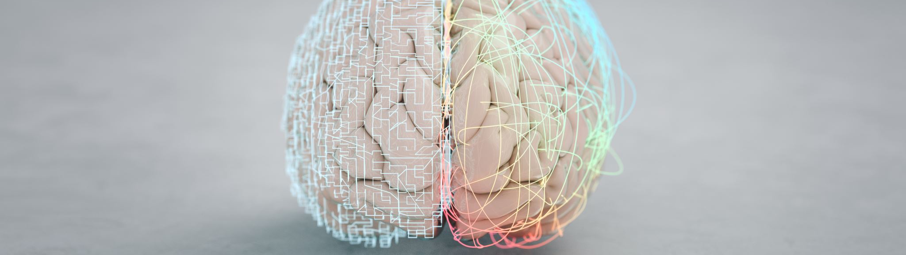
Intelligence and rationality

Slide 99
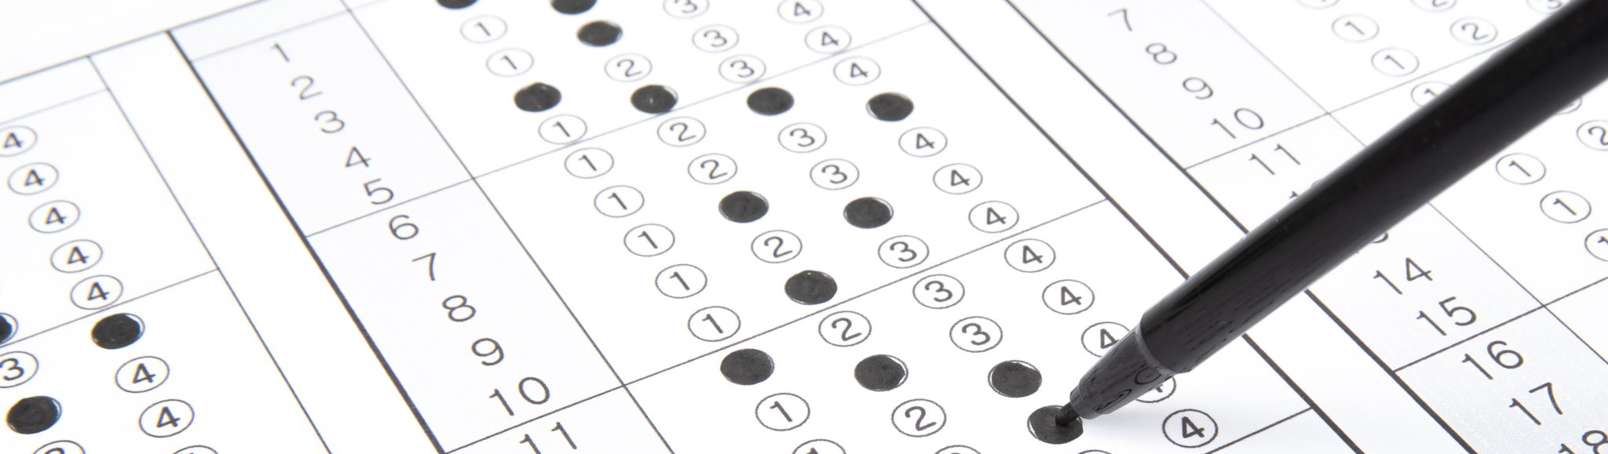
TEST

Slide 100
Test
The bat and ball cost a total of $1.10. The bat costs $1.00 more than the ball. How much is the ball? _____ cents,
If it takes 5 machines 5 minutes to make 5 products, how long would it take 100 machines to make 100 products? _____
There is a cluster of water lilies in the lake. Every day the clump doubles in size. If it takes 48 days for a clump to cover the whole lake, how long would it take for the clump to cover half the lake? _____ days.

Slide 101
This was the Congitive Reflection Test
by Shane Frederick (2005)
CRT was conducted on 3428 students from different universities.
  33% of those tested could not identify the correct answer to any of the questions.
  Only 39% of students answered two or all three questions correctly.
  61% percent of respondents in the CRT test succumbed to the System 1 result and did not engage the controls available in System 2 at all.
How did we do?

Slide 102
Why?
Keith Stanovich (Stanovich, 2010) concludes that high intelligence does not make people immune to biases in judgment
Intelligence is not the same as rationality.
Stanovich concludes that CRT test-type tasks are superior to traditional IQ tests.

Slide 103
Why?
Failure in cognitive tests is due to "lack of motivation" (one does not try hard enough to verify the correctness of the answer generated by System 1)
Those who have avoided intellectual laziness are more alert, more intellectually active, less willing to be satisfied with superficially plausible answers, and more skeptical of their intuition - what might be called "engaged"
  are more "rational" (Stanovich, 2010) and (Kahneman, 2012).

