Slide 1

Party for Freedom
Alexander Vanderaa

Slide 2
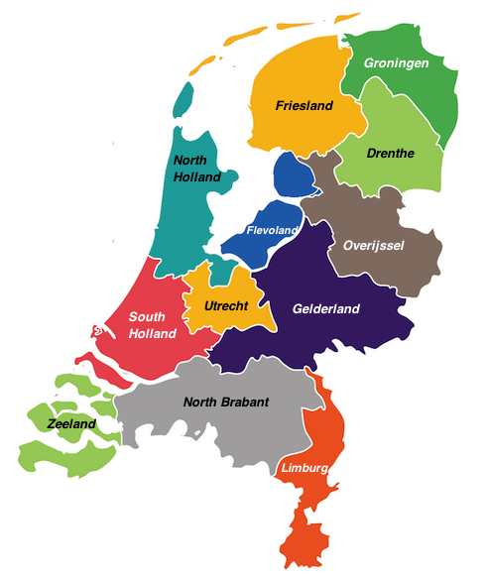
How the Dutch Political System Works
Based on a Constitutional Monarchy
Governed by the Prime Minister and the Ministry of General Affairs
Arranged as a Parliamentary Democracy
States General consists of the House of Representatives and the Senate
Made up of twelve provinces
The Parliament has 18 Majority Parties

Slide 3
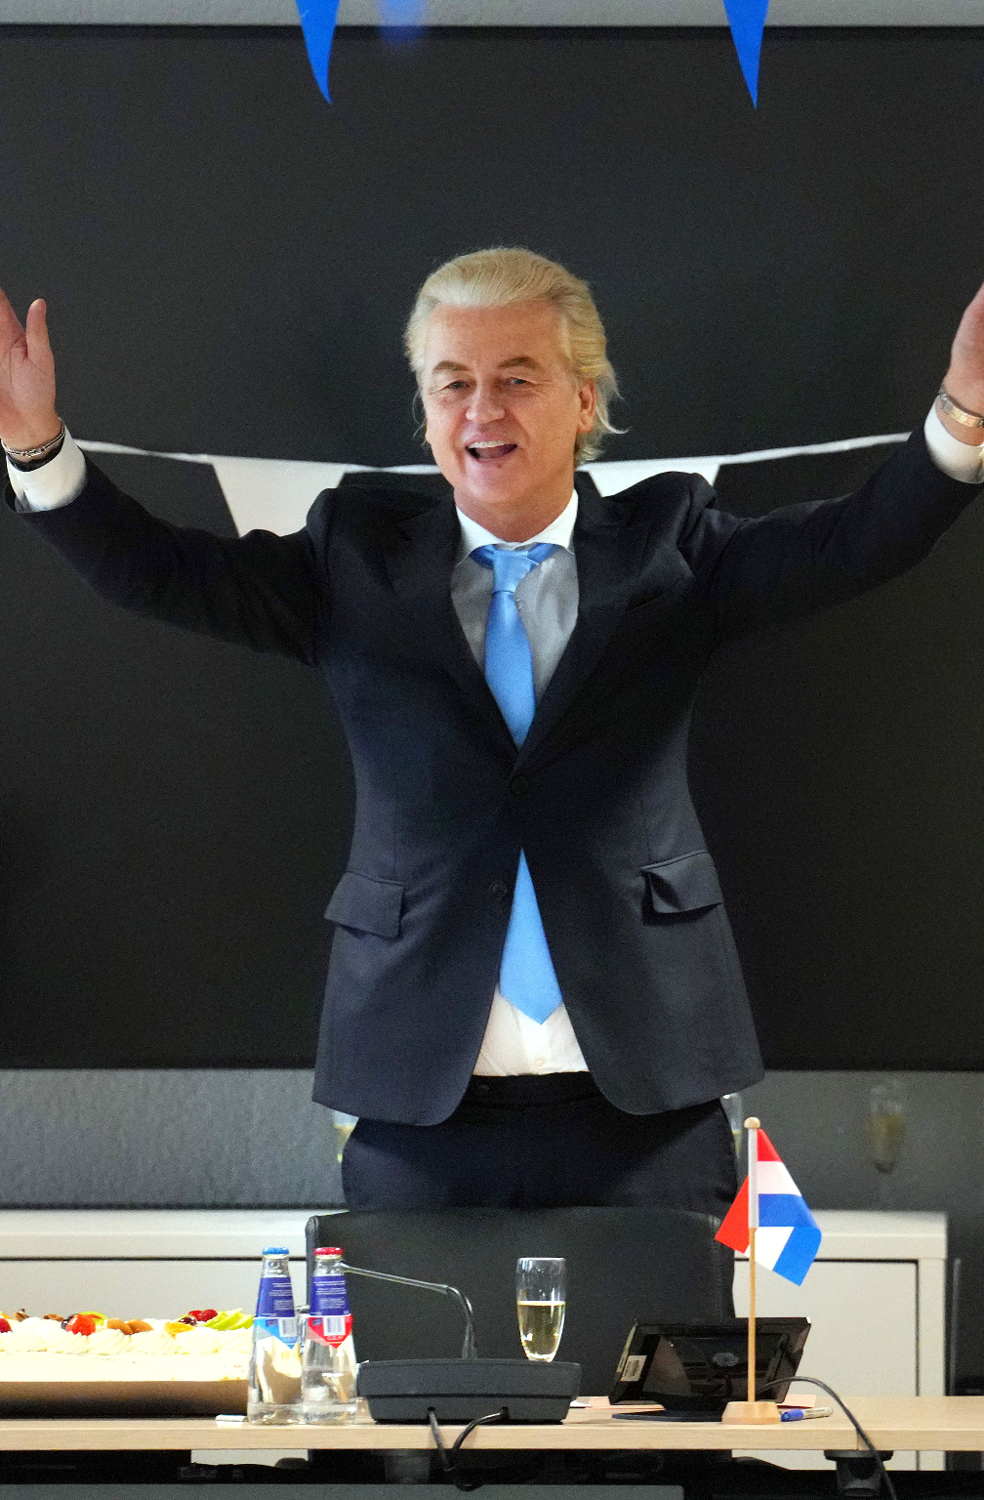
Who is Geert Wilder?
Big Forehead + Stringy White Hair
= Right Wing Extremist (like Trump)
Founder of the Party in 2006
Was part of the People’s Party for Freedom and Democracy from 1997
Began as a Speechwriter for Bolstein
Travelled a lot within and around the middle-east and has always pondered the question of Islamic values versus Christian values
Vehement about ‘Netherlands First’ and banning the Koran and the practice of Islam

Slide 4

What is the Party for Freedom?
Far-Right Party
Anti…
EU
Immigration
Climate Action
Globalist
Profoundly Netherlands First

Slide 5
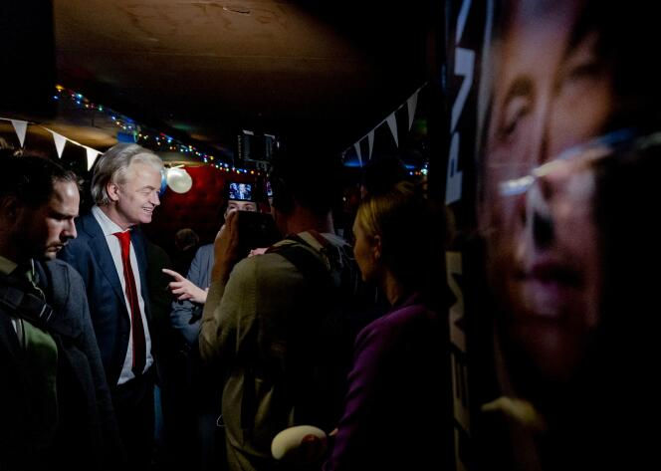
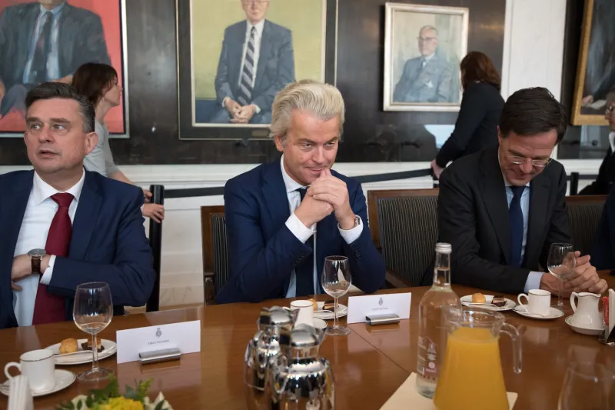
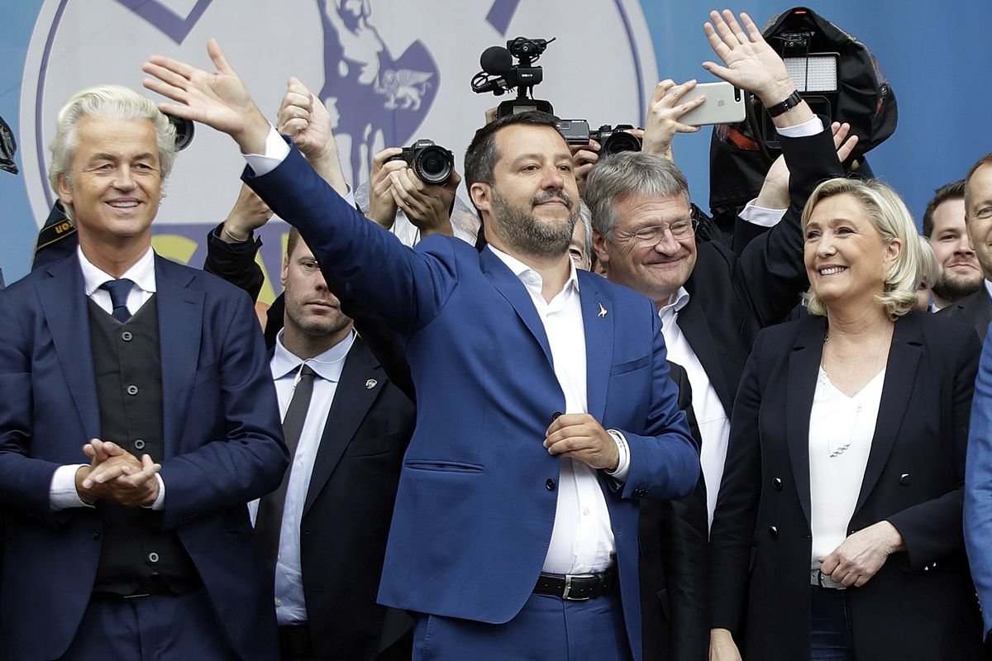
Agenda of the Party for Freedom
Proposes to ban the Koran, the building of Mosques, and head coverings
Is against Asylum from Eastern Countries
(that of Islamic countries)
Very against the European Union, and wishes to have a more ‘sovereign’ Netherlands
Claims that because of the Netherlands “best water engineers” handling the rising sea level won’t be an issue

Slide 6
Sources
https://www.government.nl/government/about-the-government
https://www.spiegel.de/international/europe/islam-critic-wilders-a-missionary-with-dark-visions-a-543627.html
https://www.newarab.com/opinion/geert-wilders-left-needs-be-real-opposition

