Slide 1
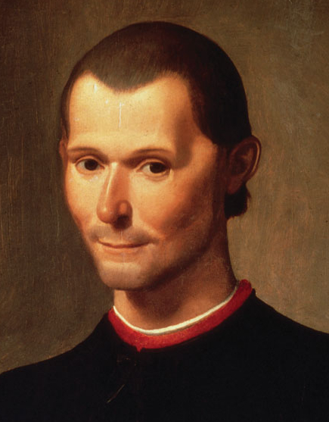
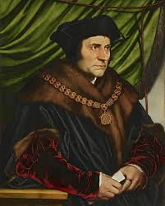
Renaissance and Humanism
Political Realism (1513/1532)
Political Utopism (1516)

Slide 2
Thomas More
1478 – 1535
Lawyer
1504 (Parliamentarian)
1516 (Utopia), limited reception
Inspired by Geographical Discoveries
1529 – 1532 (Chancellor)
Henry the VIII.
1535 (executed for disavow of Act of Succession)
1935 Canonized

Slide 3
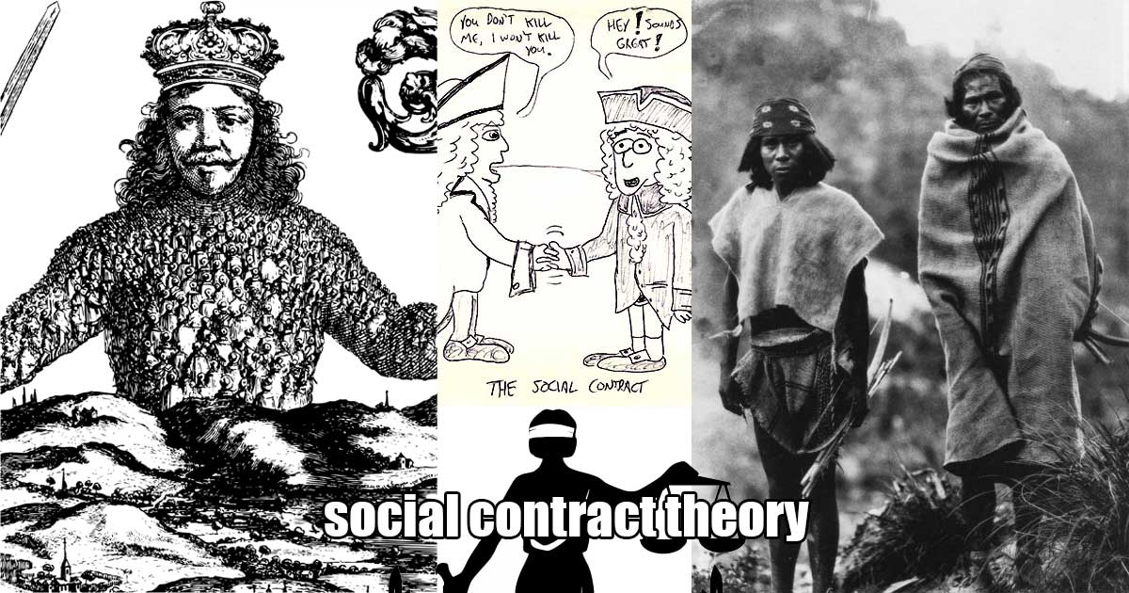

Slide 4
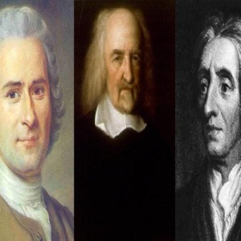
Soc
What is Human Being?
What is Society?
What is Rule, Politics, Freedom?

Slide 5
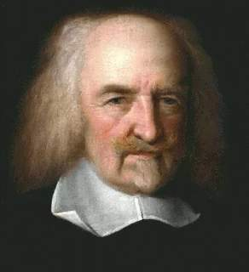
Thomas Hobbes
1588 – 1679

Slide 6
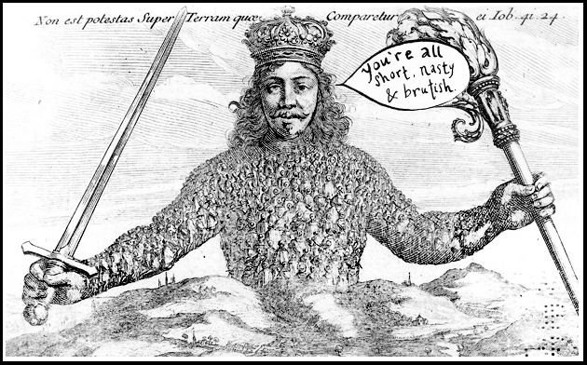
Leviathan 1651

Slide 7
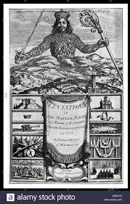

Slide 8
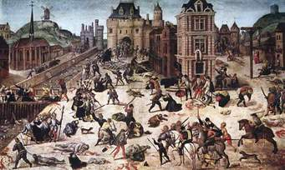
St. Bartholomew's
Night massacre
1572
Thousands killed

Slide 9
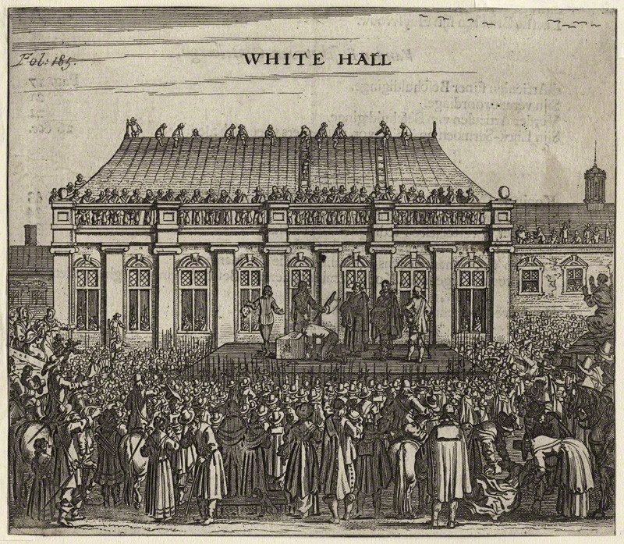
English Civil War
1642 – 1660
1649

Slide 10
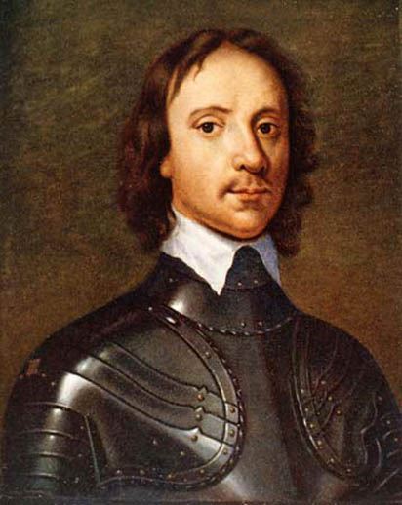
England is Republic
1649 – 1660
General, signatory of Charles I. execution
Oliver Cromwell, Lord protector 1653 – 1958
Dictatorship
Radical puritan
Massacre of Catholics (Ireland, Scotland)

Slide 11
Thomas Hobbes (1588 – 1679)
What is man? What is society? What is the state?
„Liberating“ man, society, politics from …
Negative anthropology (homo homini lupus + bellum omnium contra omnes)
State of nature – no society, culture, development …
Natural state/human condition: rights, free, equal, autonomous (delegated to KING, no resistance)
Security state (non-violence, peace, progress)
Negative freedom – free of external obstacles
Concertation of power, state/monarch absolutistism
Political power/state man made
Modern legitimacy of Power/State

Slide 12
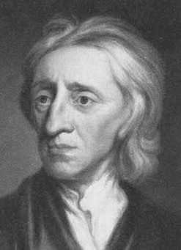
John Locke
1632 – 1704

Slide 13
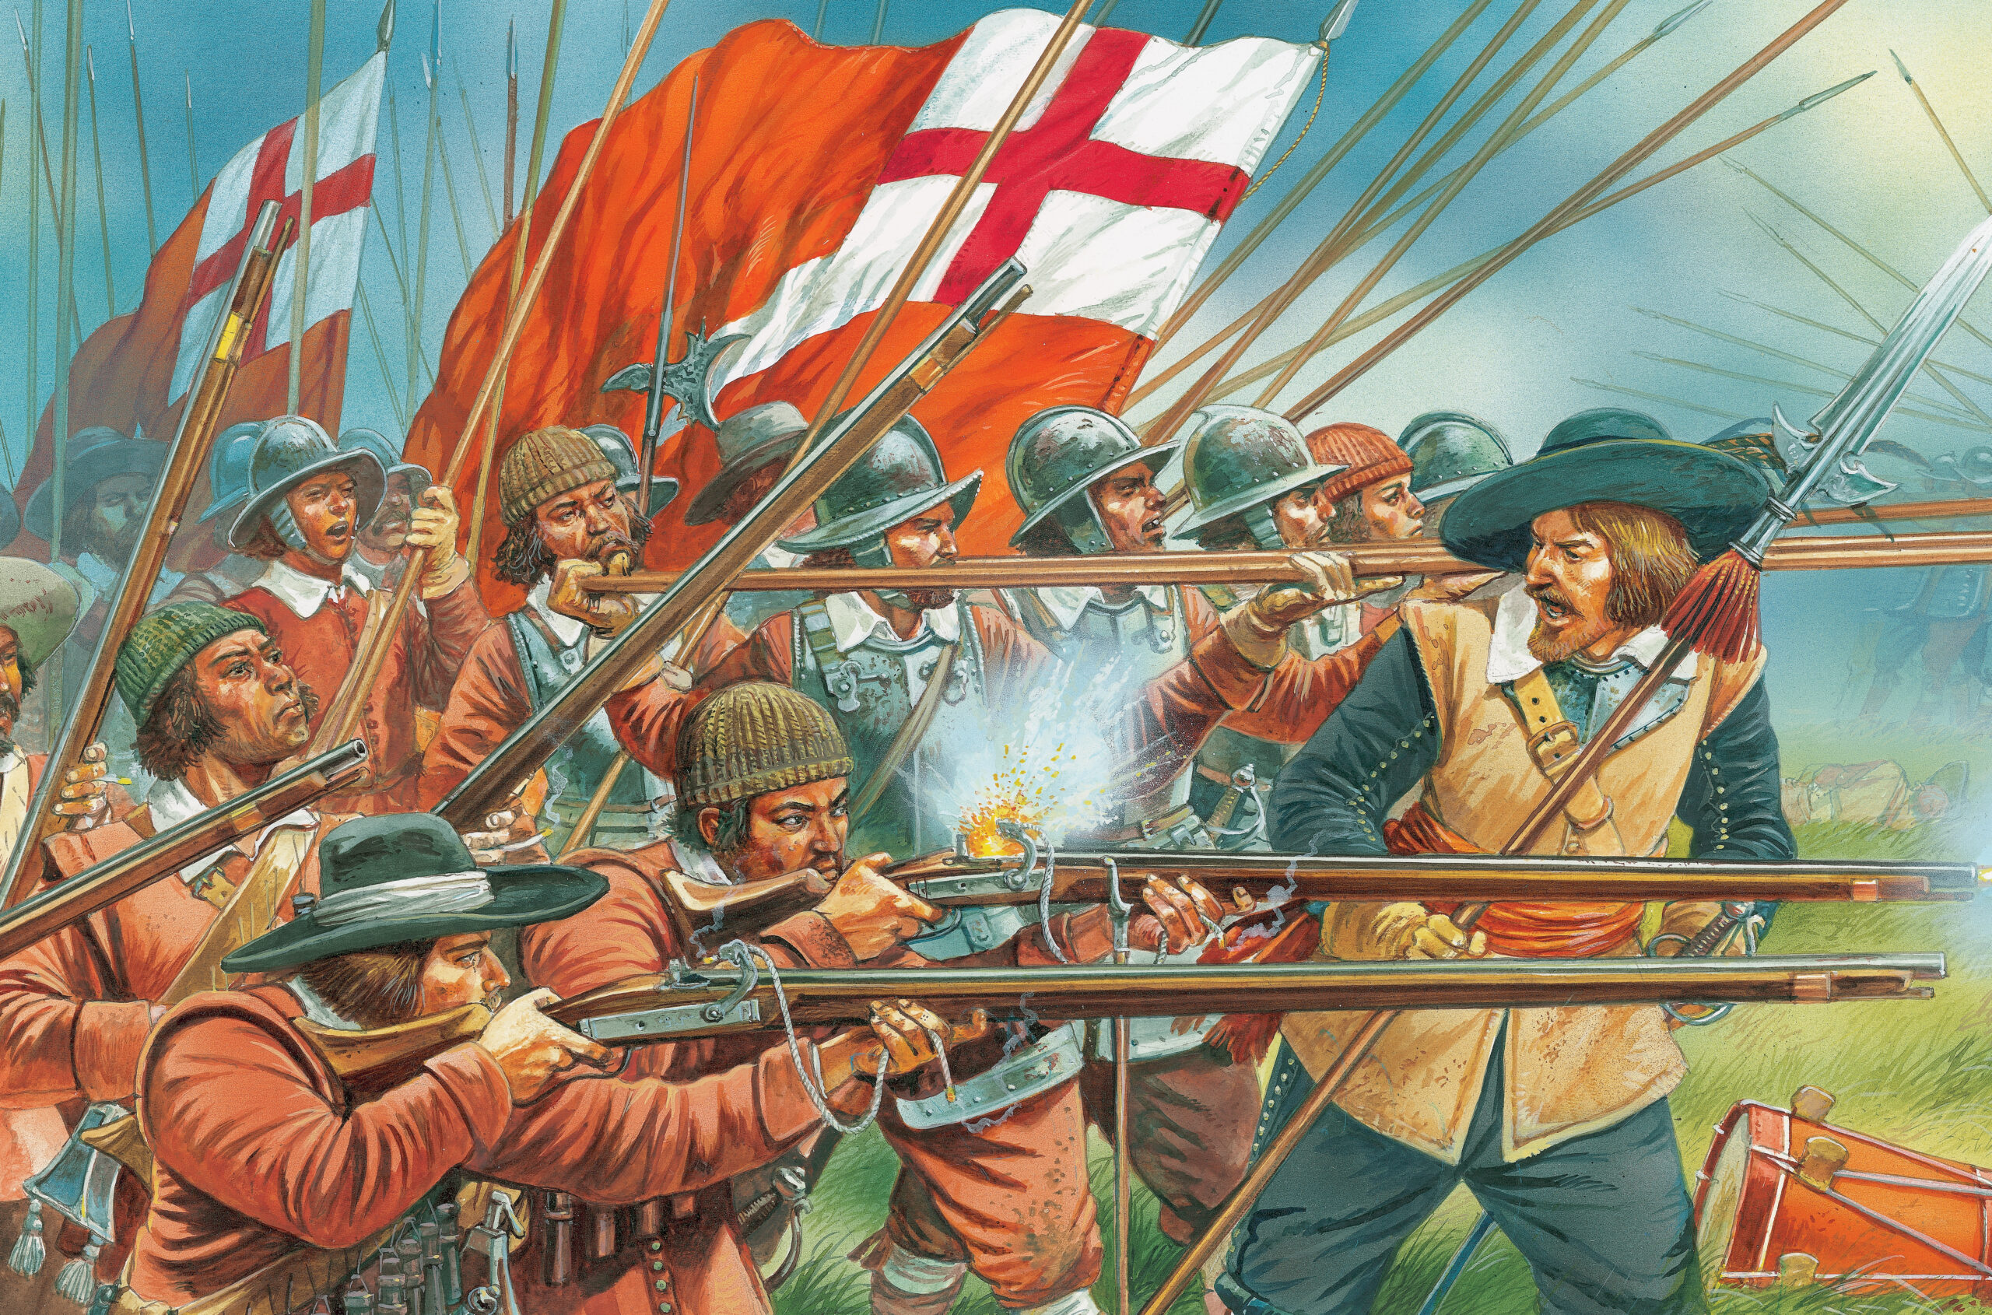

Slide 14
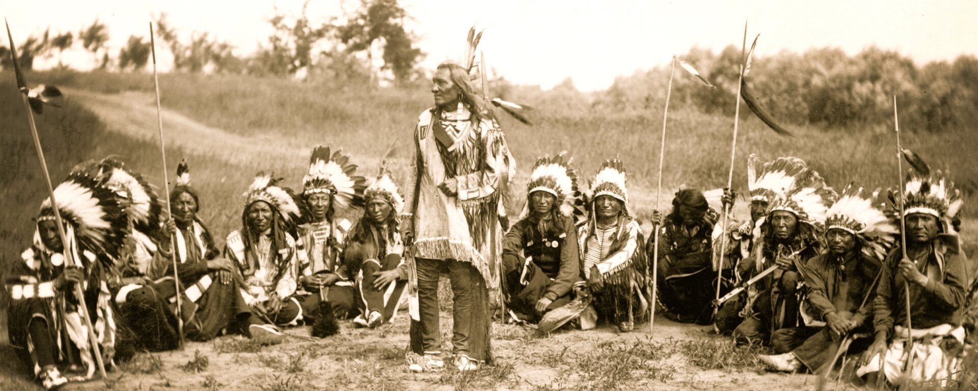

Slide 15
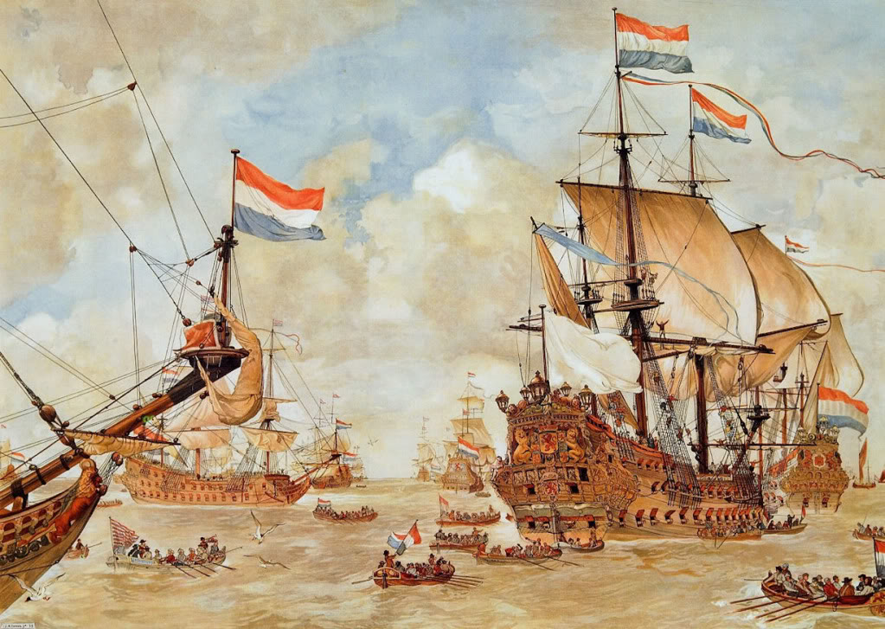
William of Orange
1688

Slide 16
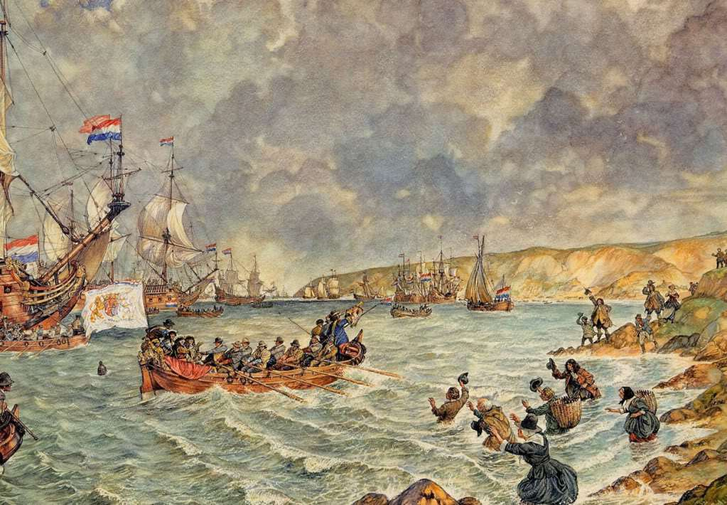

Slide 17
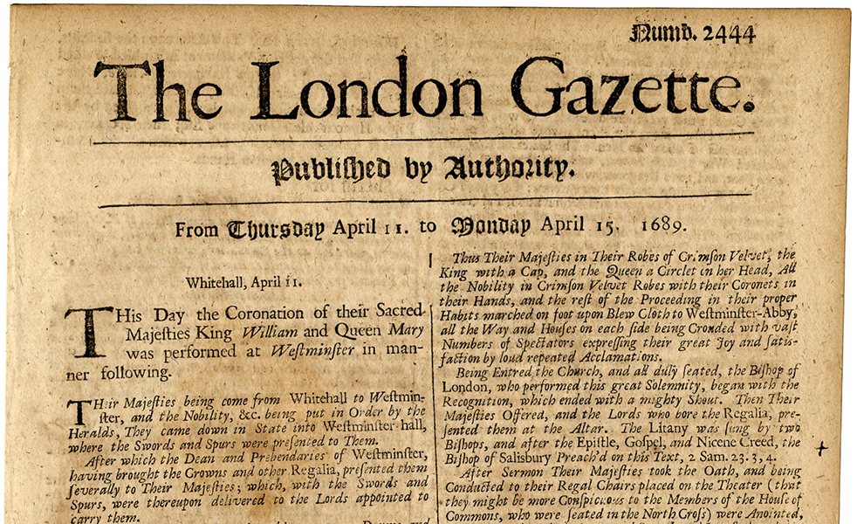

Slide 18
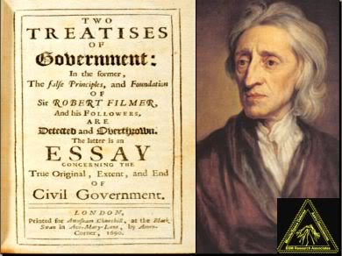

Slide 19
John Locke (1632 – 1704)
Two Treatises of Government (1689), A letter Concerning Toleration
Complex gnozeological system (innate ideas)
State of Nature – perfect freedom, but insecure
Greed, conflicts, uncertainty (Hobbes x Locke – less pessimistic)
Who to blame? Inequality, money … humans
Civil Society (x war states) – civil/natural rights to life, liberty, property
Freedom under the Rule of Law, constituted freedom – liberty, „Freedom must be limited in order to preserve it“
Political mechanisms to protect freedom, equality, human rights
State is an officer of the law, division of power, rule of law, representative government
Social contact in 3 steps: society/community, governance, taxes
Right to remove unlawful or unjust government (civil disobedience)
Positive freedom: ability, opportunity, might
1776, 1789 – liberalism, constitutionalism, democracy

Slide 20
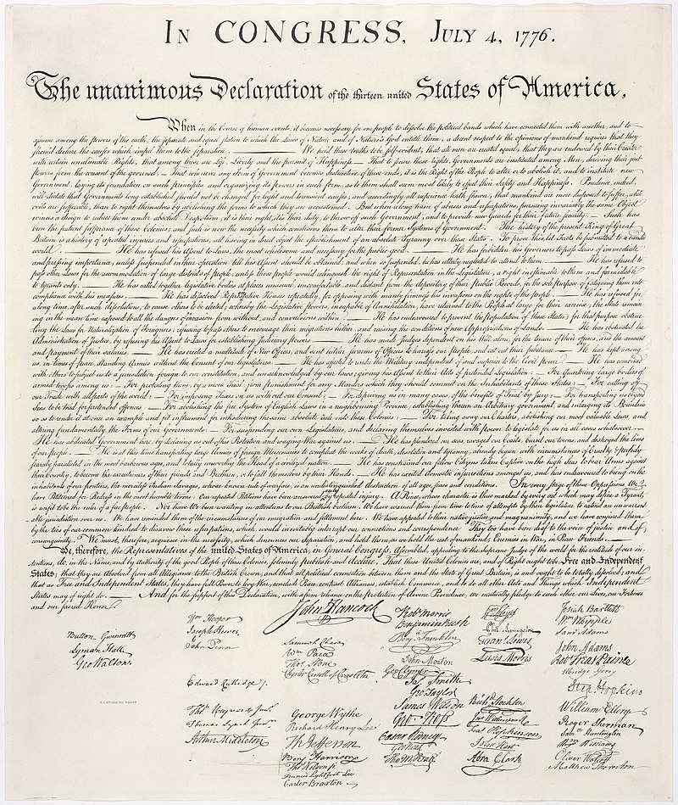

Slide 21
Political Ideas x Political Reality
Giovanni Sartori/Theory of democracy
„Bad ideas hurt more than bad intentions“
Bad idealism, bad realism
Ideas are ideals/idols – routes rather than goals, things, or even rights/claims
Optimize not maximize our ideals
First and intermediary principles (Benjamin Constant 1767 – 1830, critic of GFR)
Utopic realisms – Epistemological Reflexivity (Anthony Giddens)

