Slide 1
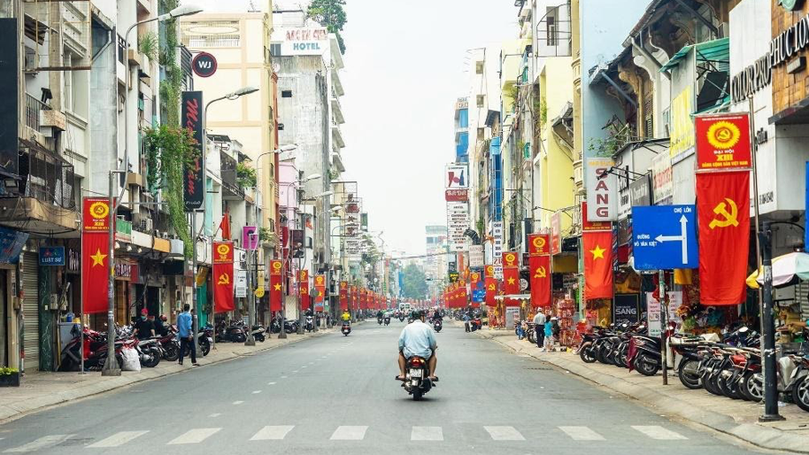
Civil society and socio-political change in Vietnam through Tocquevillian and Gramscian theoretical lenses
Dan Nguyen
CEVRO 04-09-2022

Slide 2
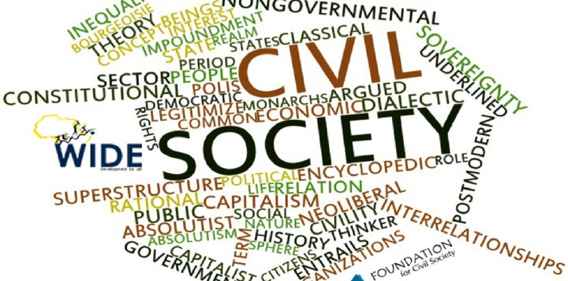
Civil society as concept/(s) and theory/(ies)
Concepts and theories – “to think by/with”
Elusive concept
  Different spatial and temporal contexts
    Greeks, Hegel, Marx, Gramsci, Habermas, Putnam…
  Scholars not clear about what they mean
  Used in multiple arenas – intellectual, political rhetoric, policy intervention
Empirical mis-recognition – “NGO”
Policy (mis)-focus

Slide 3
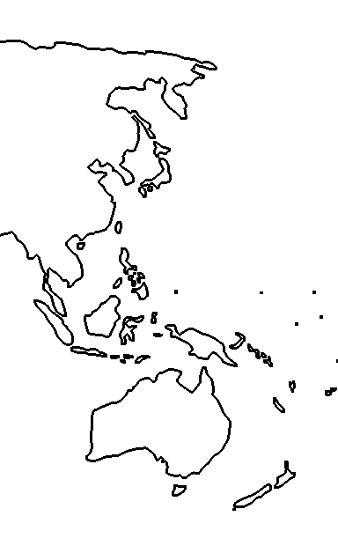
Vietnam – why should one care?
Complexity deserving careful examination - Knowledge and inspirations for practitioners
An illustrative case study
Knowledge of Vietnam beyond the advertising
Reflections on your own society and politics
“
Gramsci’s distinctive approach to the analysis of civil society […] should animate a new series of inquiries into the present condition of civil society in different parts of the globe. The results of such enquiries are likely to be disconcerting; […] the prison notebooks raise difficult and unsettling questions and are an antidote to complacency – the sort of political and intellectual complacency that has taken hold of civil society since 1989.
Joseph Buttigieg, 1995
”

Slide 4
Structure of the content
Civil society and socio-political change in Vietnam through Tocquevillian and Gramscian theoretical lenses
Vietnam’s general context: political, economic, socio-cultural
The puzzle of Vietnam’s civil society
Unravelling the puzzle with Tocqueville and Gramsci
Prospects of progressive socio-political change

Slide 5
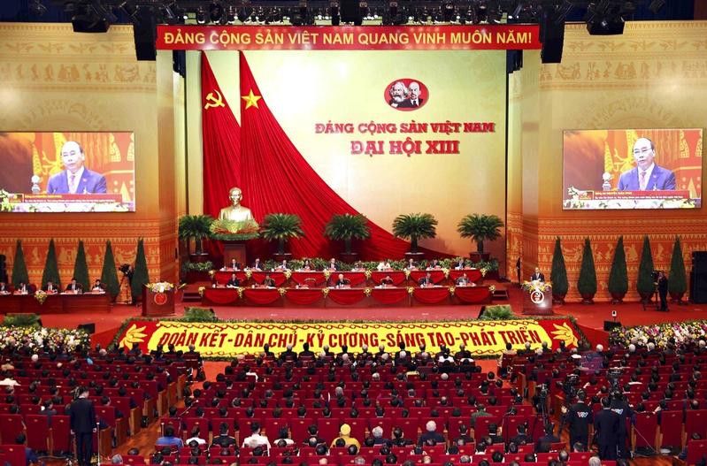
Vietnam – political context
French colony from the late 1800s to the 1940s-early 1950s
Monarchy officially ended in 1945 and Communists in formal power
Split of North and South Vietnams
1945 – 1975: Communist rule in the North vs “semi-democratic” rule in the South
Since 1975: one-party rule and limited civil-political rights
No free and fair election
“Propaganda against the state”, “organising activities to topple the government”, “abusing democratic freedoms to infringe on the interest of the state”…
Crackdown on street protest, plainclothes police, harassments…

Slide 6
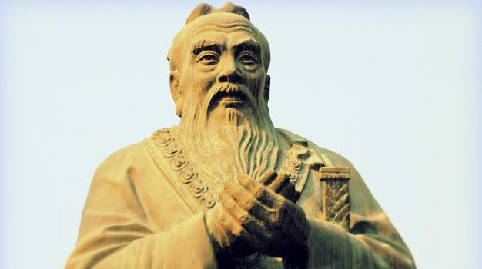
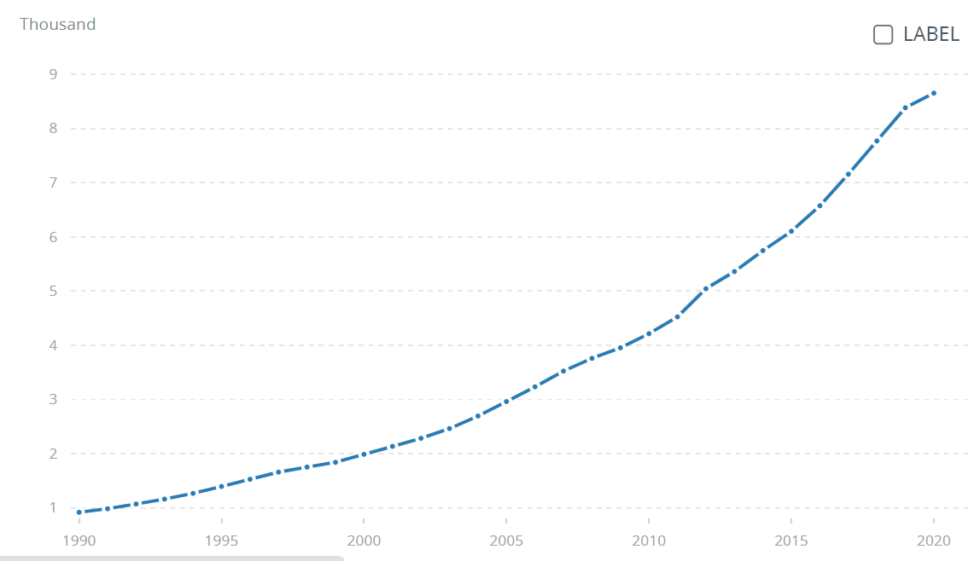
Vietnam – economic and socio-cultural context
Economy and living standards: ‘the other Asian dragon’
Before 1975, relied on Soviet Union and the US
1986-1989 ‘Open Door’ Reform
2000s: Lower-middle income country
GDP per capita PPP 2020: $8,650 (2x Nepal/Pakistan, a bit higher than India/Philippines, 1/5 Japan/CZ)
Culture: ‘chronic quiescence’
Confucianism: obedience, deference, loyalty
Era of political reprisal and ‘reactionary’/’hostile forces’ purging
Normalisation of corruption
Developmental state-society consensus
Economic appeasement

Slide 7
2. The puzzle of Vietnam’s civil society
Minimalist definition: a public sphere and actors that exist relatively separately from state apparatuses, the family, and the market
Self-help community groups
Religious bodies
Citizens collectives
VNGOs
Pro-democracy activists
Mass organisations (e.g., Women’s Union, Farmer’s Union…)
Too broad and vague to be meaningful or of any use
Anti-corruption journalists
How to make sense of the vast difference amongst these actors? – formation, purposes, functions, relations towards the state/ruling class…
Who are the likely actors to drive progressive socio-political change?
Schools
Street protesters

Slide 8
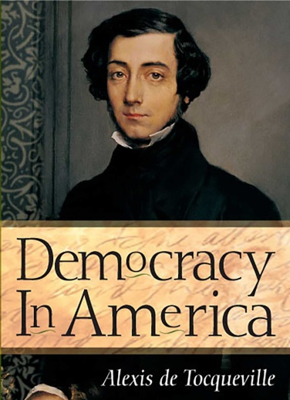
3a. Unraveling the puzzle with Tocqueville
Enlightenment, 17th-18th century
Aftermath of American Revolution (1785-1791)
civil society vital for democracy
1
Civil society representing diverse interests of the people
2
People learn the norms of democracy through associational life
3
Civil society balancing state power/keeping government in check

Slide 9
VNGOs = typical (failed) Tocquevillian story of Western aid
Historical context of the 1990s:
  Collapse of the Soviet Union and unrivalled rise of liberal-democratic West, blossoming of the Tocquevillian style of civil society
  Western donors rushed into Vietnam now free from Soviet influence
  Post-war Vietnam being a highly ‘legit’ recipient of Western aid
  VN transitioned to market economy in 1986-1989
  Normalisation of US-VN relations
  Aid requirement: domestic recipients must be “civil society” organisations – not government-”owned/controlled”, formally registered, focusing on socio-economic development and political representation
  => Oscar Salemink (2006) – ‘Translating, interpreting and practicing civil society in Vietnam: A tale of calculated misunderstandings’
Self-help community groups
Religious bodies
VNGOs
Citizens collectives
Pro-democracy activists
Mass organisations (e.g., Women’s Union, Farmer’s Union…)
Anti-corruption journalists
Schools
Street protesters

Slide 10
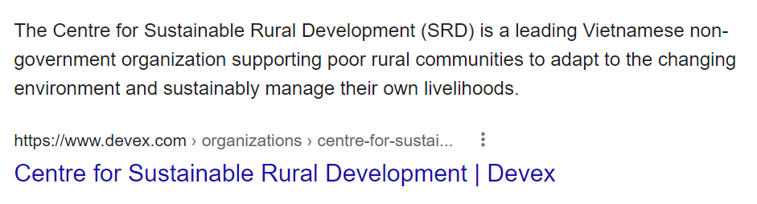
VNGOs = typical (failed) Tocquevillian story of Western aid
Reality of VNGOs:
  E.g., Center for Creative Initiatives in Health and Population (1999), Center for the Studies and Applied Sciences for Gender, Family, and Adolescents (2001), Center for Sustainable Rural Development (2006), Center for Social Initiatives Promotion (2006)…
  VNGOs’ differing legal statuses vis-a-vis Vietnam having never allowed the freedom of association nor establishing law towards that end
  VNGOs born out of common interests in socio-economic development of the West and VN’s govt
  VNGOs failing in political representation/counter-balance state power
    Legal status can be revoked at the whim of the government
    Weren’t intended to become a political actor
    VNGO people do not perceive themselves in political role
    Non-membership-based, hence absence of social base
Self-help community groups
Religious bodies
VNGOs
Citizens collectives
Pro-democracy activists
Mass organisations (e.g., Women’s Union, Farmer’s Union…)
Anti-corruption journalists
Schools
Street protesters

Slide 11
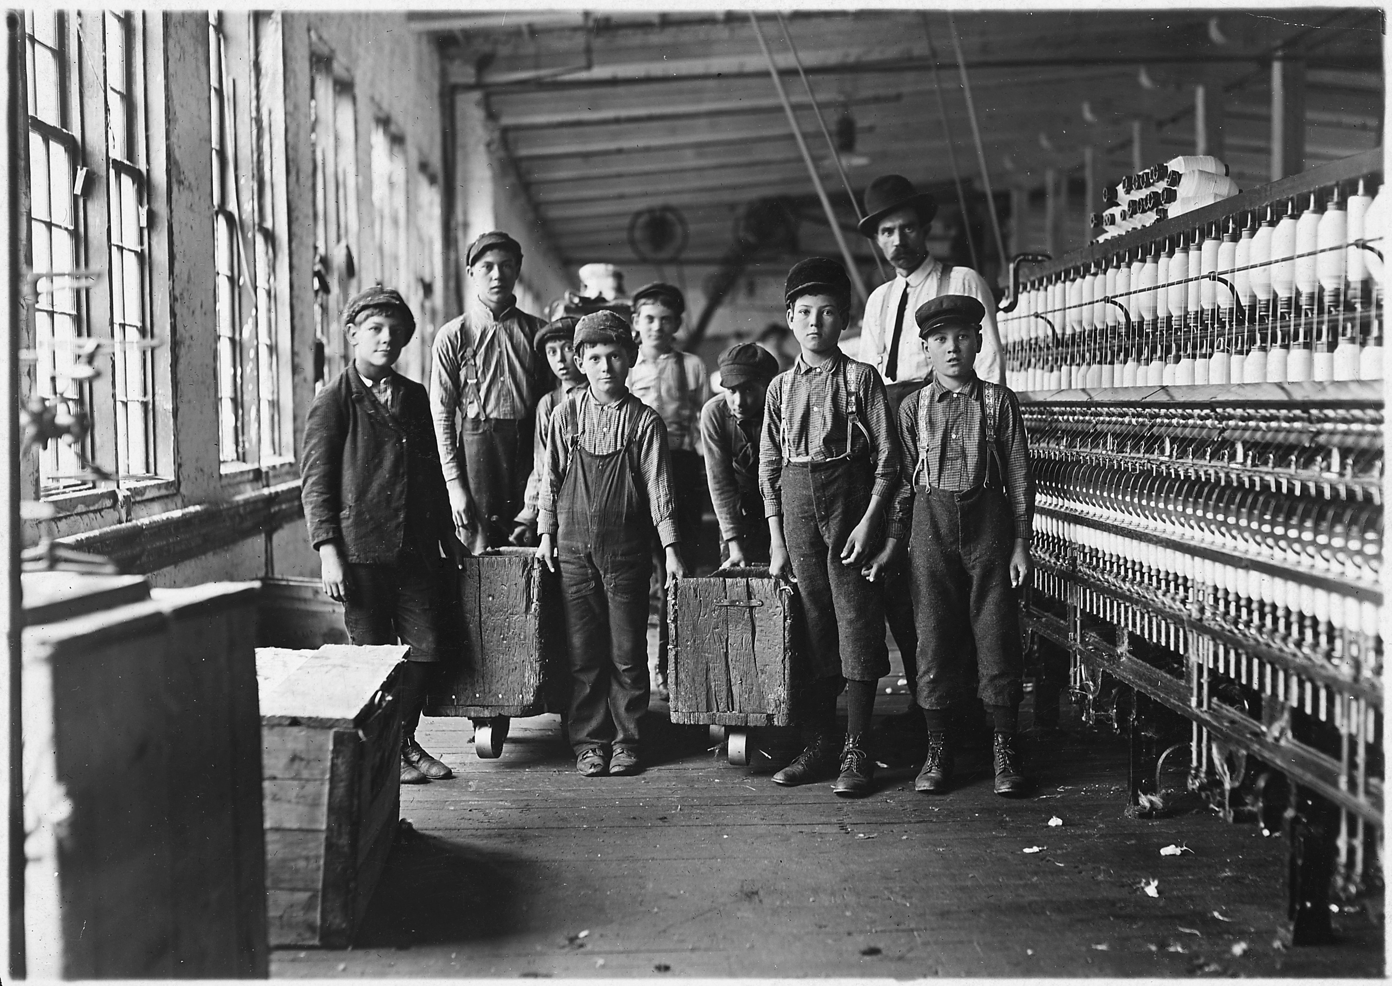
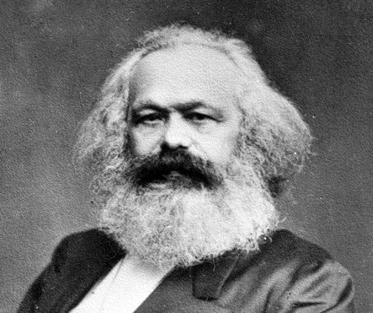
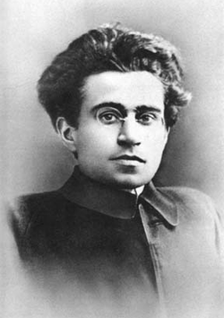
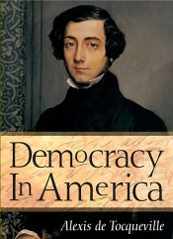
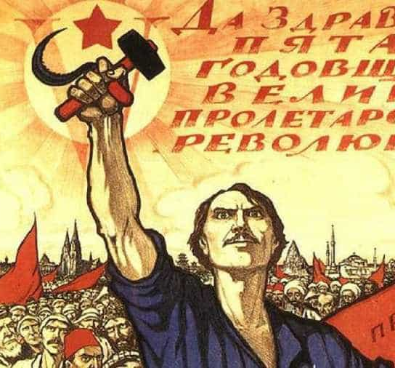
3b. Unraveling the puzzle with Gramsci
Activist for workers and peasants
“Bourgeois democracy”
  Capitalist + aristocrat ruling class
  Violent siege of power
Russian Revolution failing to spread to Italy + own observation of Italian society
Civil society -> consent & political society -> coercion
Consent = norms, ideas, beliefs…
Consent + coercion = hegemony , i.e., the power of commonsense
Site of struggle: civil society
Alexis de Tocqueville
1805-1859
Antonio Gramsci
1891-1937

Slide 12
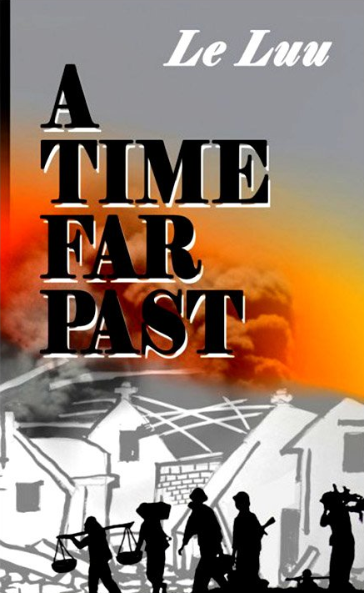
Mass organisations = typical Gramscian story of manufacturing consent
Historical context of war and post-war Vietnam:
  Vietnam War 1950s-1975
  Established in the 1950s, top-down process lead by the VCP
  Leninist idea of two-way conduit
  Effective downward war mobilisation and legitimation and upward reporting of dissent
  Communists = ruling class
Self-help community groups
Religious bodies
VNGOs
Citizens collectives
Reality of mass organisations in modern Vietnam:
Continue to be a far-reaching arm of the state, focusing on consent and legitimation
Reporting to ‘Vietnam Fatherland Front’
Wide membership, especially in rural areas
Hardly seen by international donors or VNGOs as ‘civil society’, nonetheless an important partner to work with
Declining influence on urban, educated population, esp. in SVN
Pro-democracy activists
Mass organisations (e.g., Women’s Union, Farmer’s Union…)
Anti-corruption journalists
Schools
Street protesters

Slide 13
4. Prospects of progressive socio-political change
Proliferation since Internet and economic development in 2000s and peak in 2010s
Bottom-up formation, based on common interests
Counter-hegemonic ideas – rule of law, transparency and accountability, voice, freedom of thought/expression/association, social and political equality
Ideas translated into actions
  Horizontal – association and mobilisation
  Vertical – criticism of the VCP and its government
  Political change – towards democracy (free and fair elections, civil-political rights…)
  Social change – towards democratic hearts and minds (active citizenship, respect and tolerance, critical thinking)
Self-help community groups
Catholic church
VNGOs
Citizens collectives
Pro-democracy activists
Mass organisations (e.g., Women’s Union, Farmer’s Union…)
Anti-corruption journalists
Schools
Street protesters
* For brevity…

Slide 14
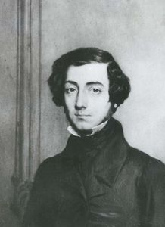
4. Prospects of progressive socio-political change
Proliferation since Internet and economic development in 2000s and peak in 2010s
Bottom-up formation, based on common interests
Counter-hegemonic ideas – rule of law, transparency and accountability, voice, freedom of thought/expression/association, social and political equality
Ideas translated into actions
  Horizontal – association and mobilisation
  Vertical – criticism of the VCP and its government
  Political change – towards democracy (free and fair elections, civil-political rights…)
  Social change – towards democratic hearts and minds (active citizenship, respect and tolerance, critical thinking)

Slide 15
Civil society and socio-political change in Vietnam through Tocquevillian and Gramscian theoretical lenses
Dan Nguyen
CEVRO 04-09-2022

