Slide 1
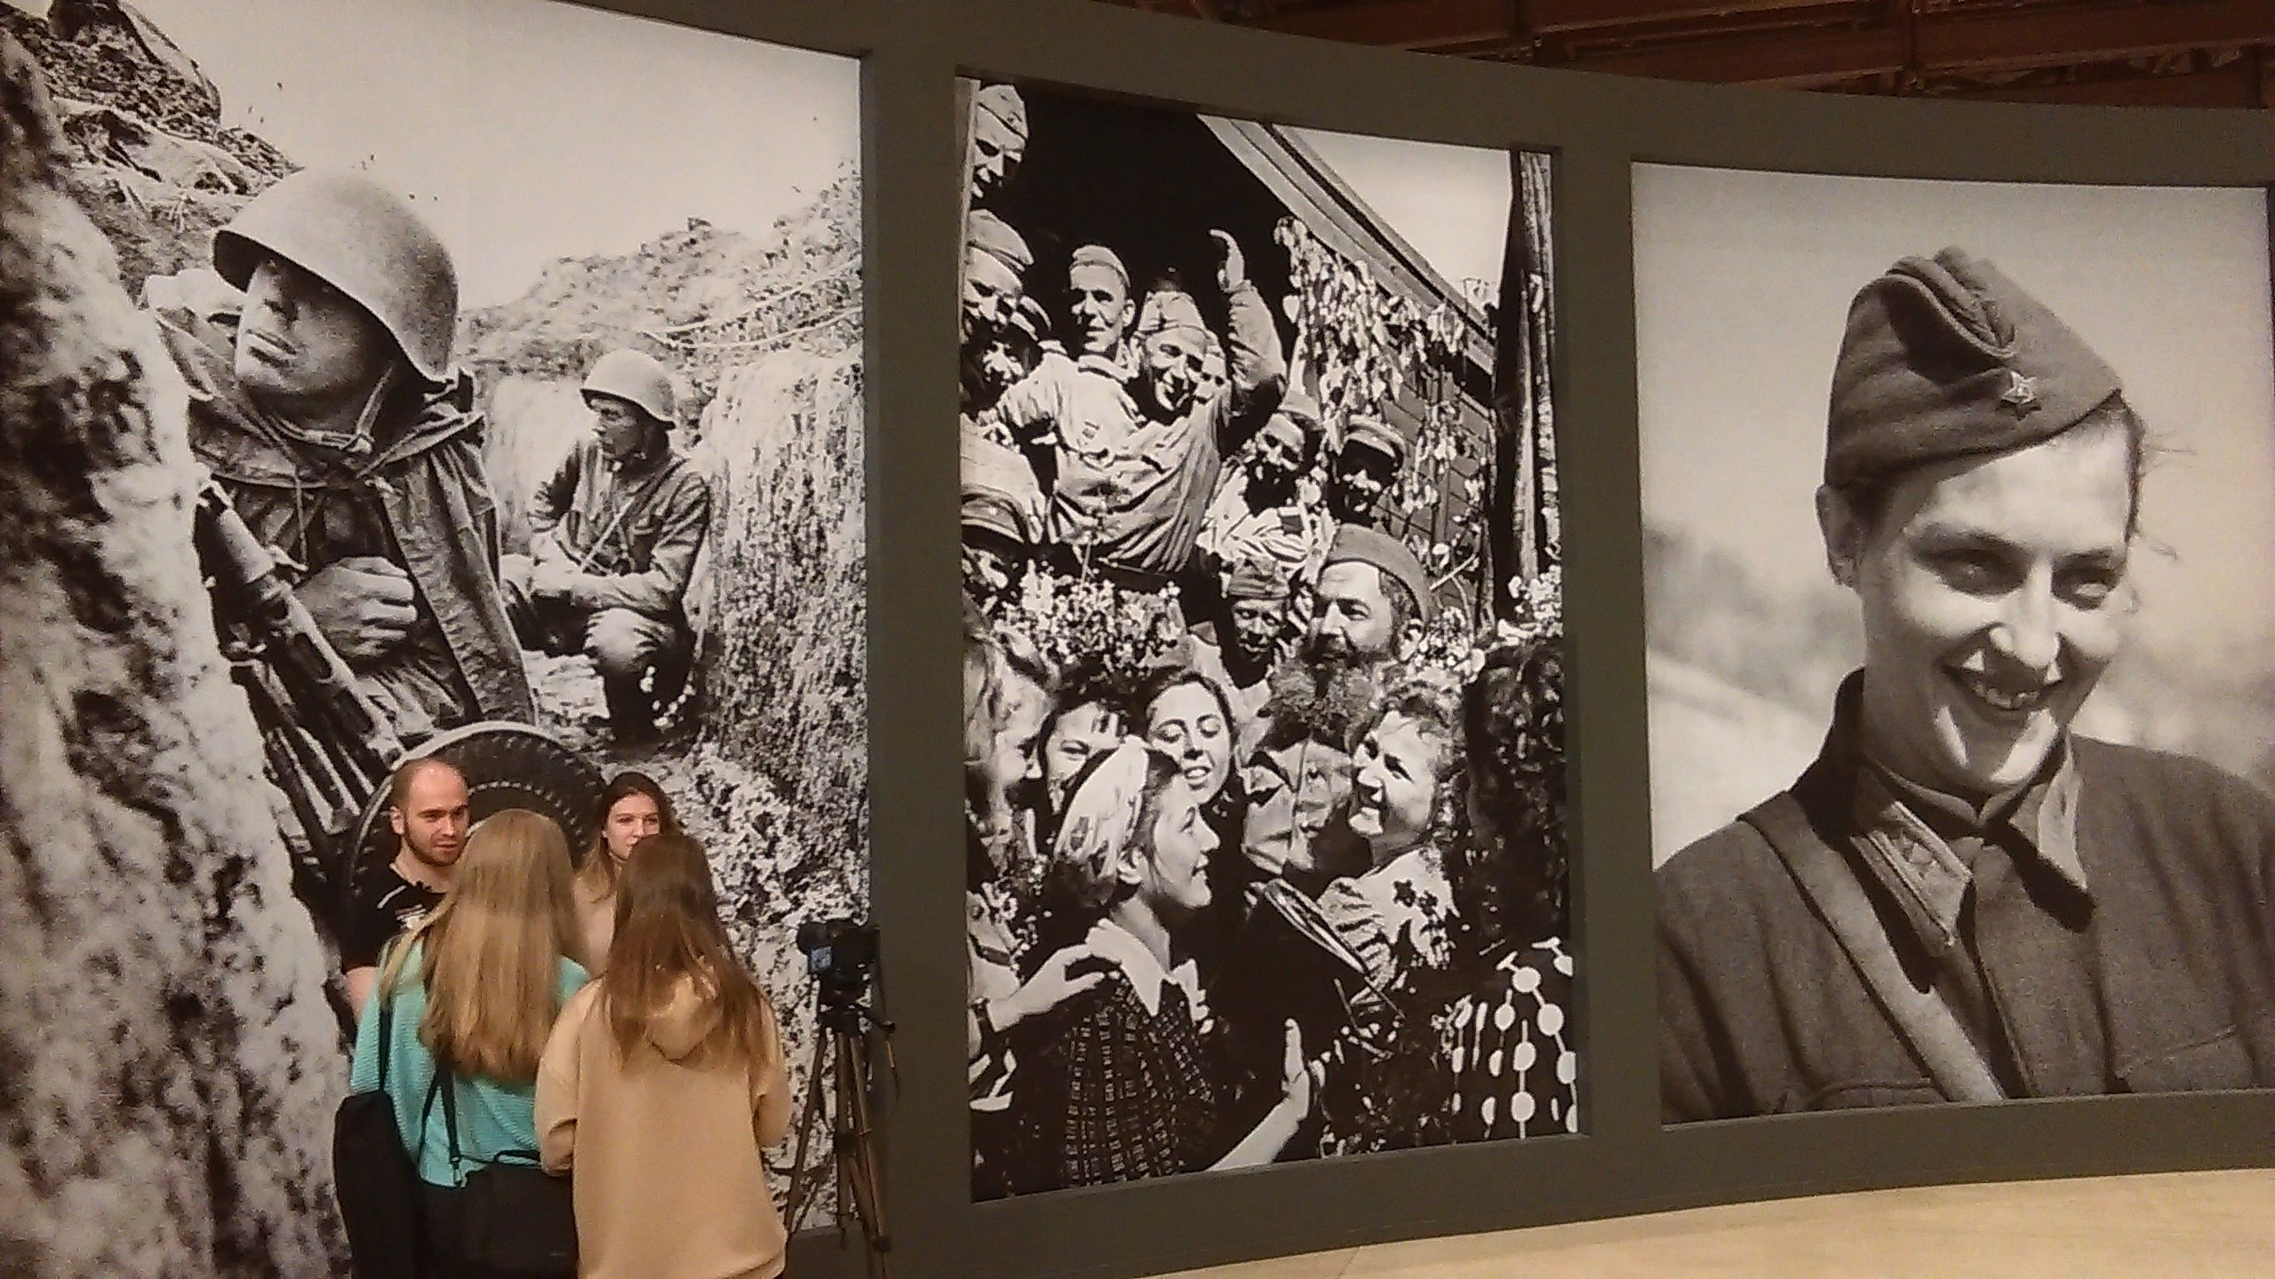
Moscow: Great Patriotic War, December 2019

Slide 2
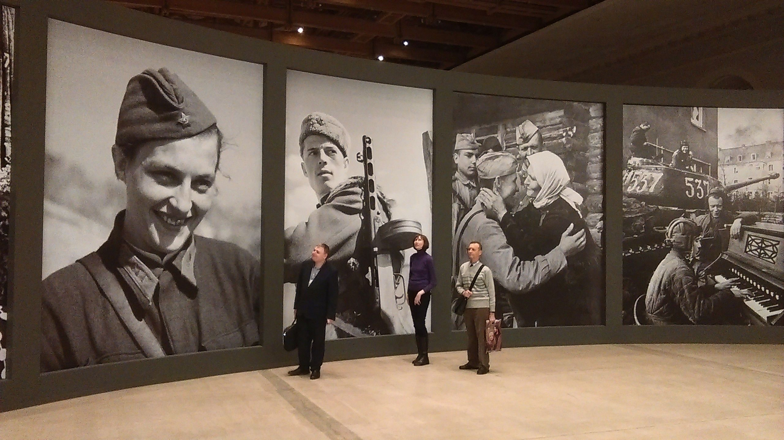

Slide 3
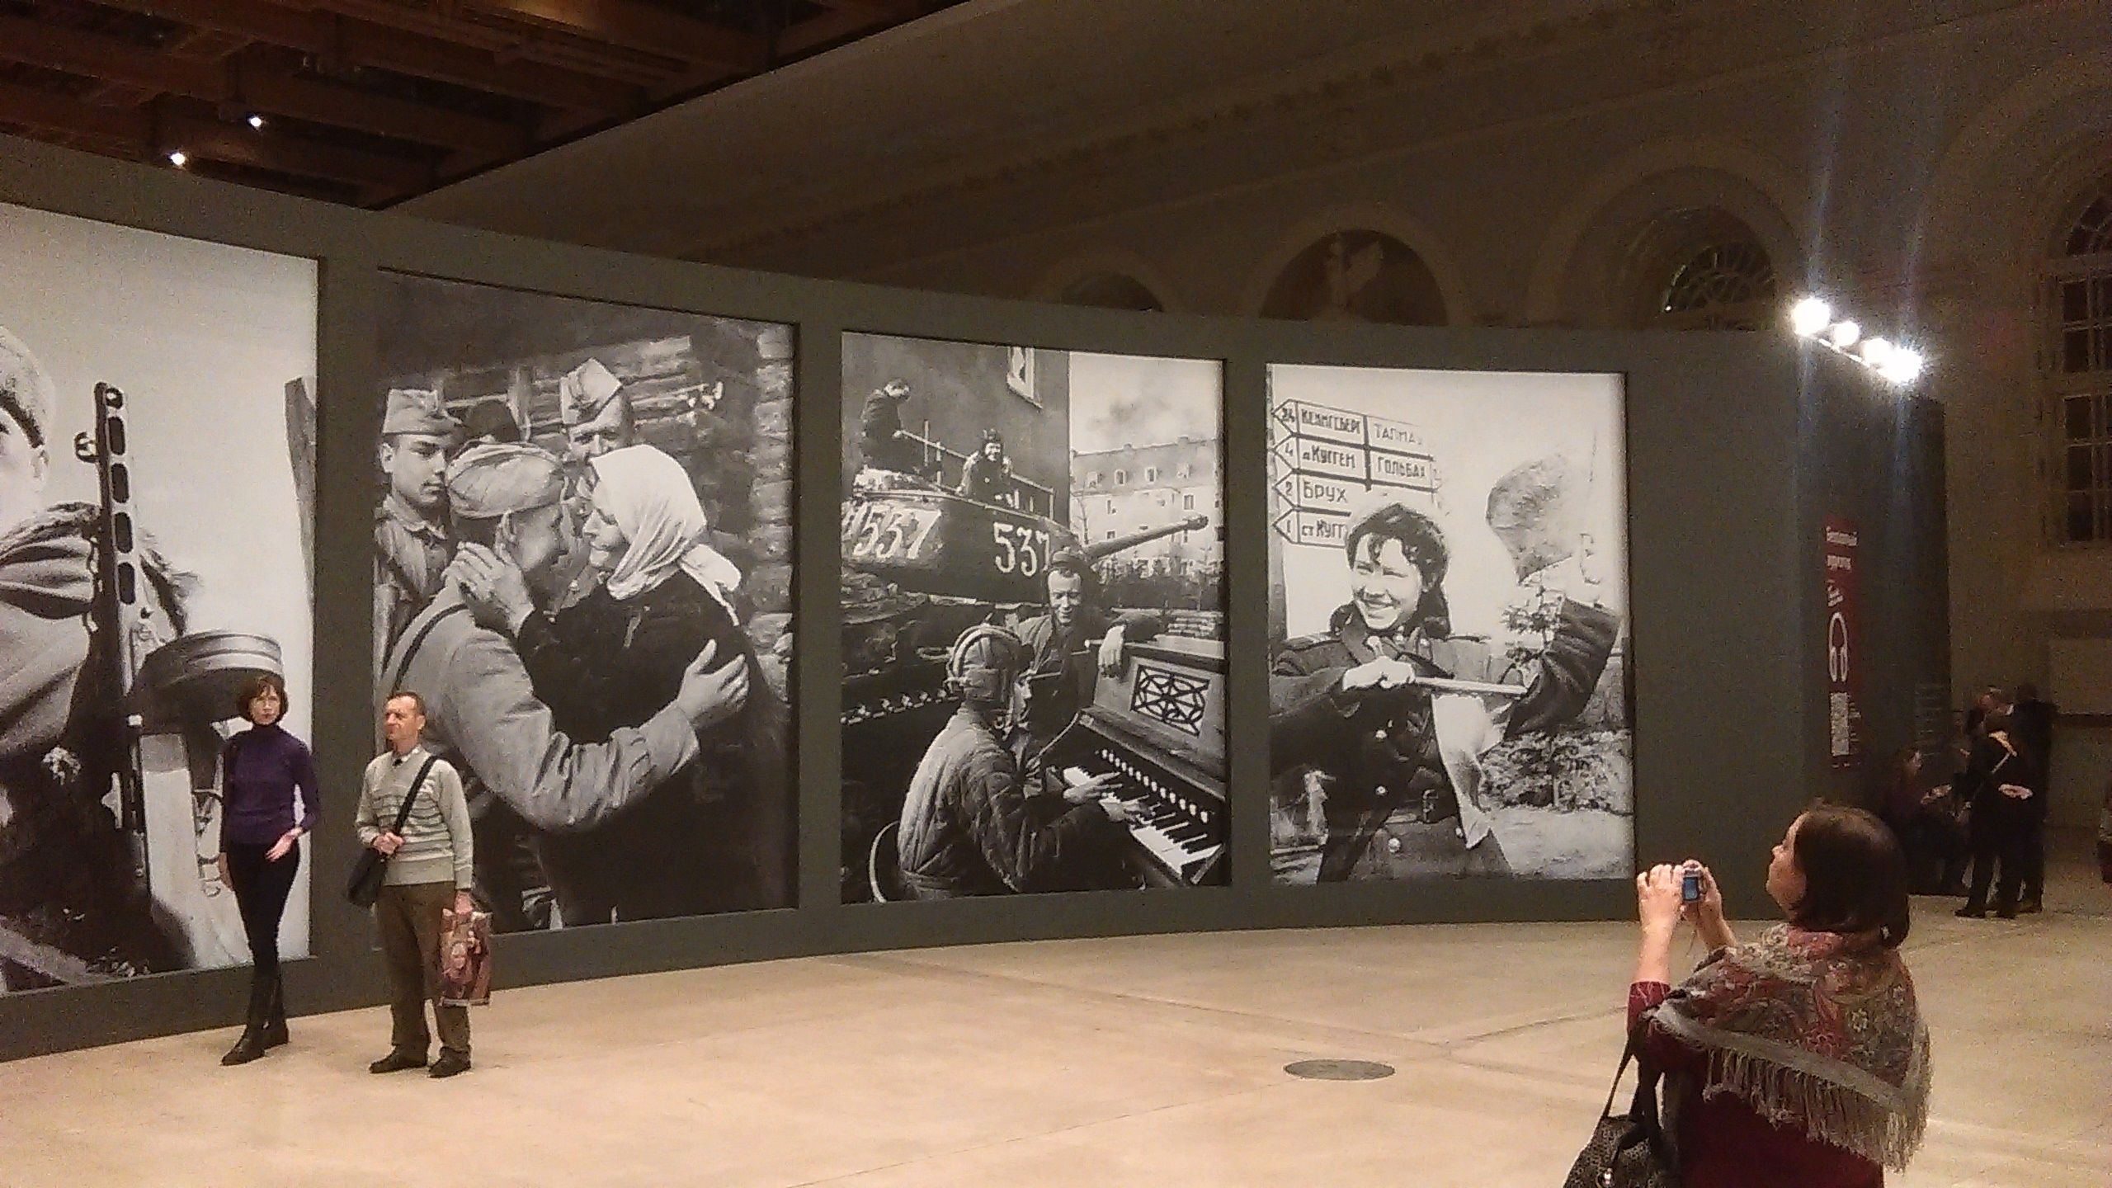

Slide 4
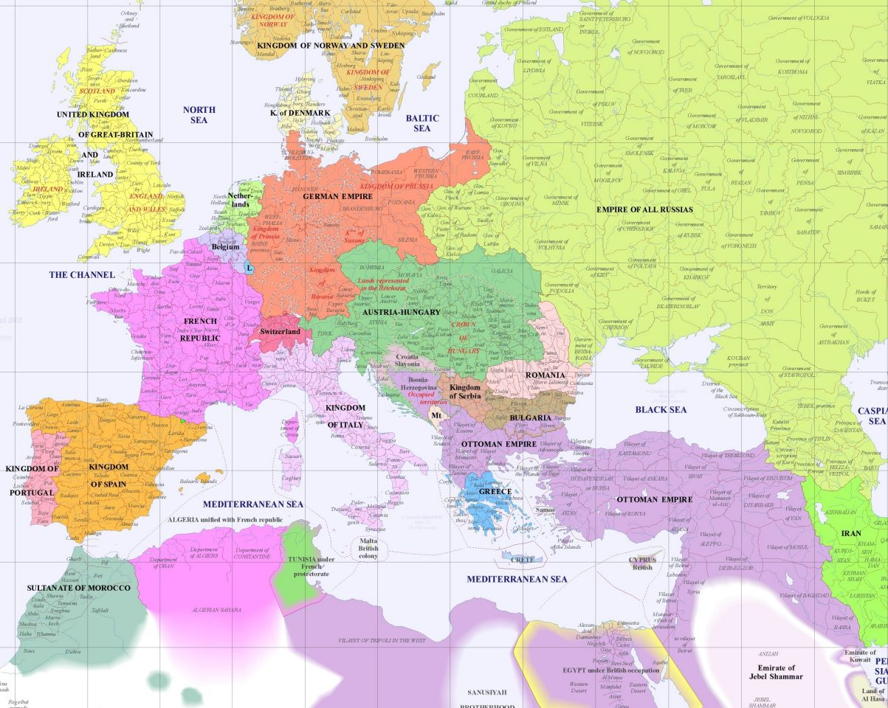

Slide 5
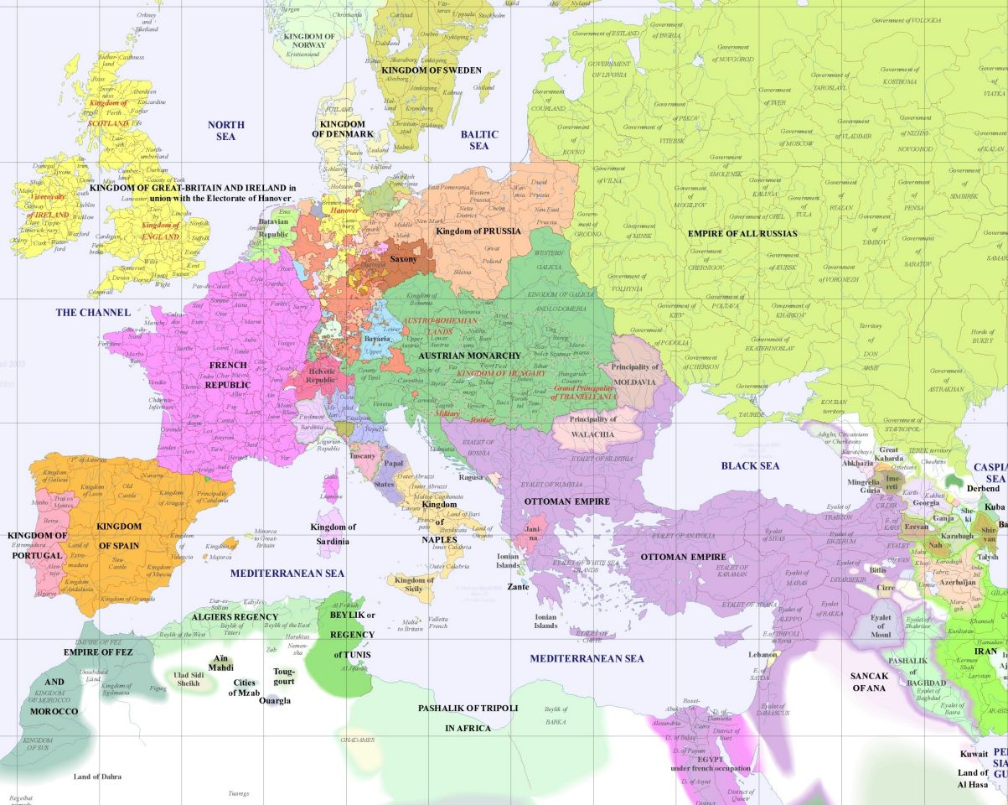

Slide 6
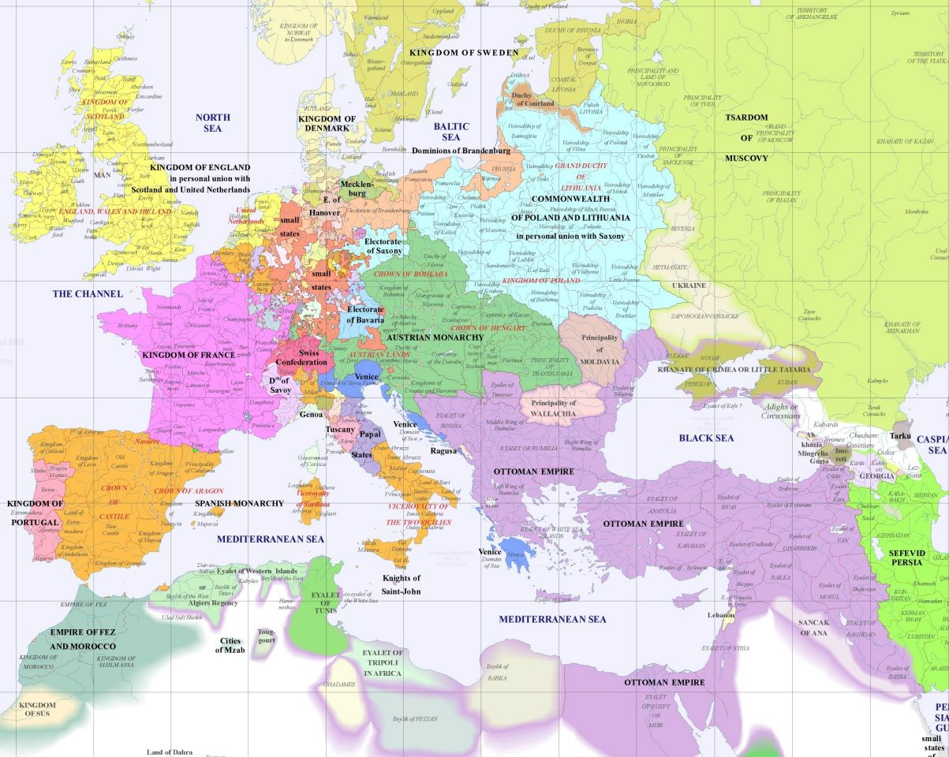

Slide 7
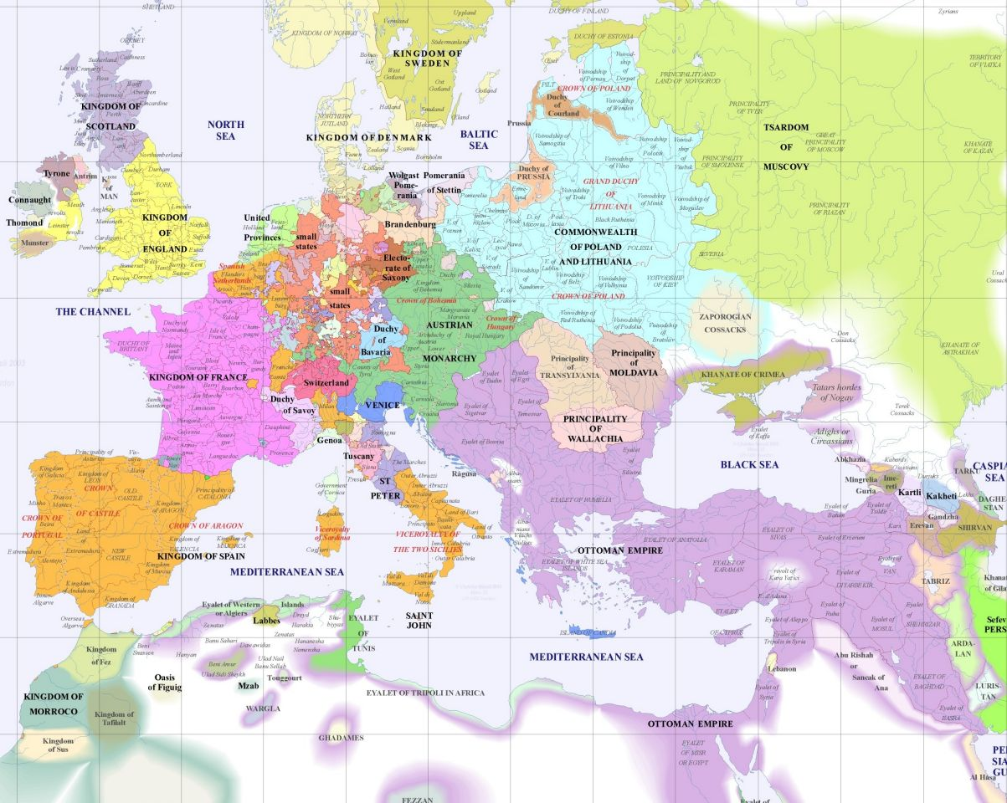

Slide 8
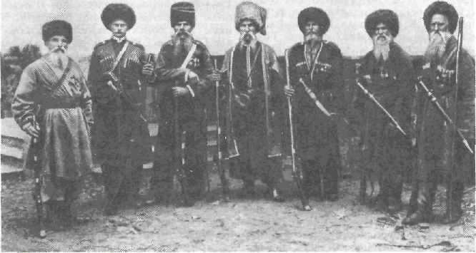

Slide 9
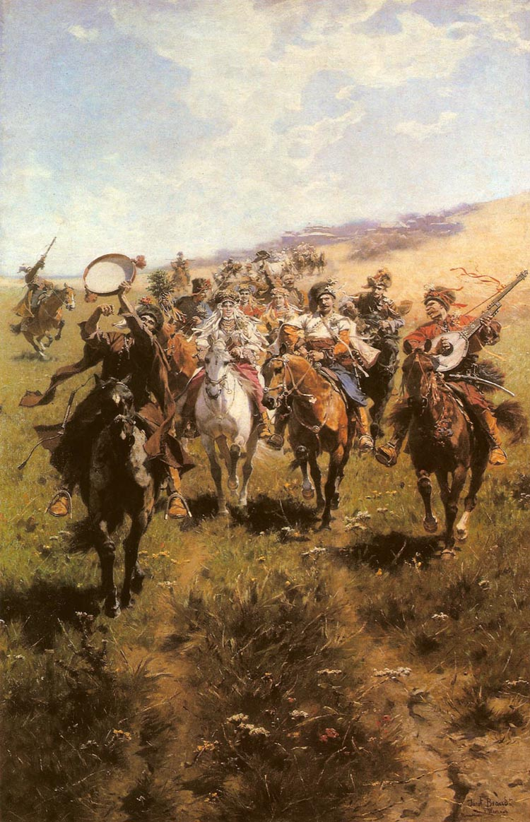
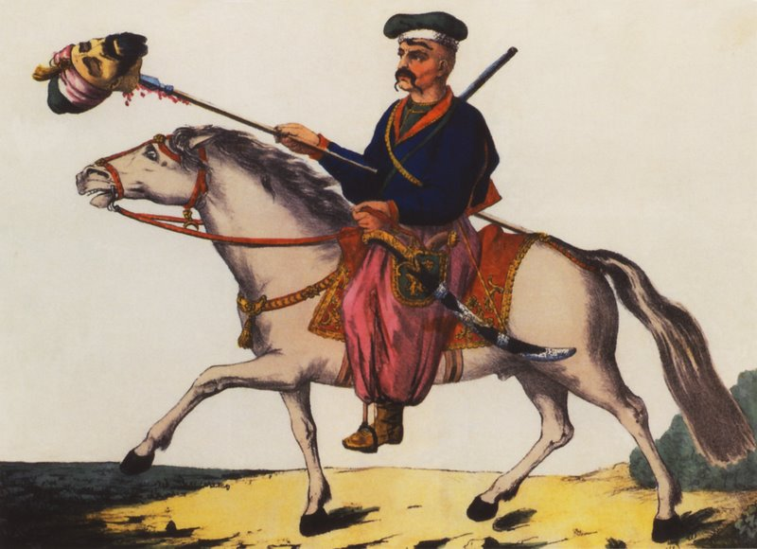
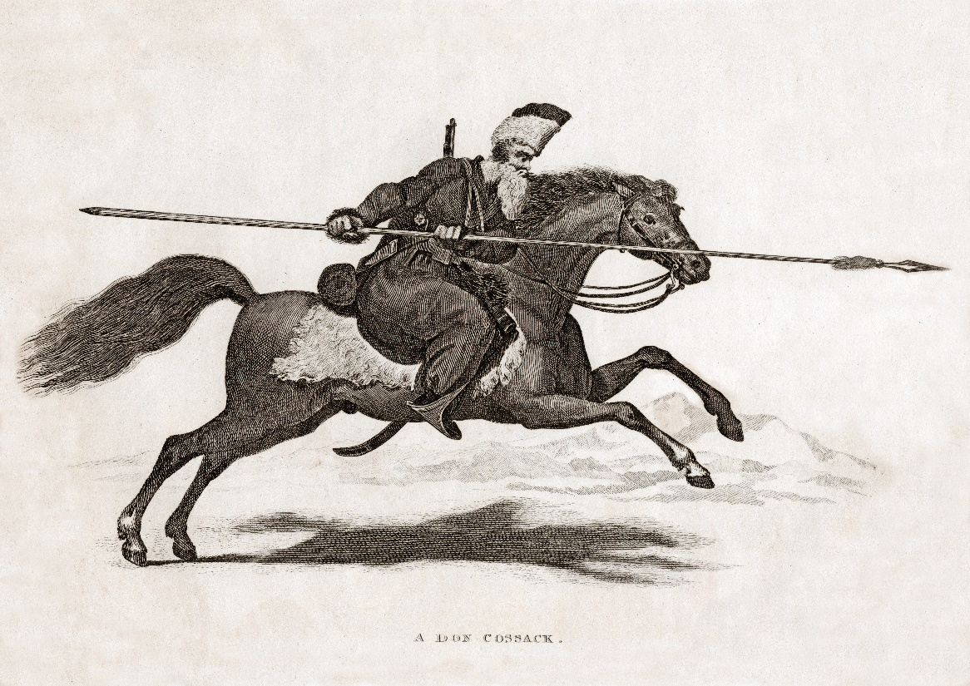

Slide 10
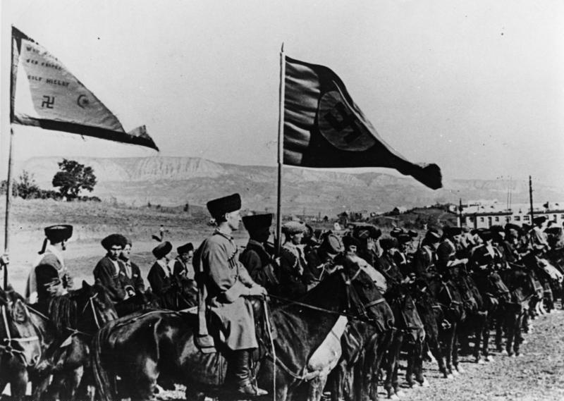

Slide 11
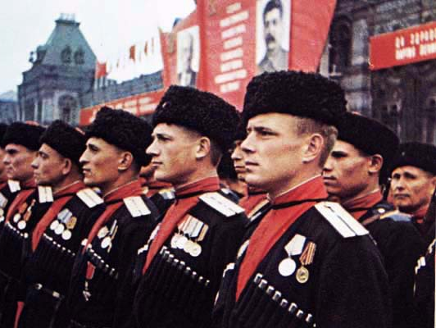

Slide 12
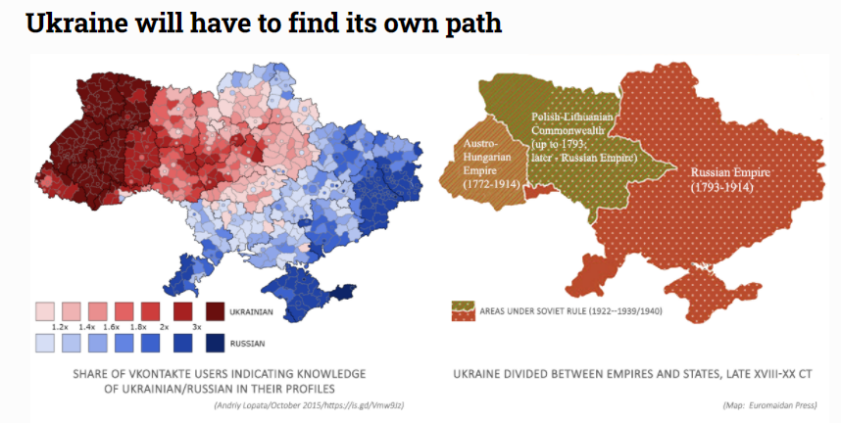

Slide 13
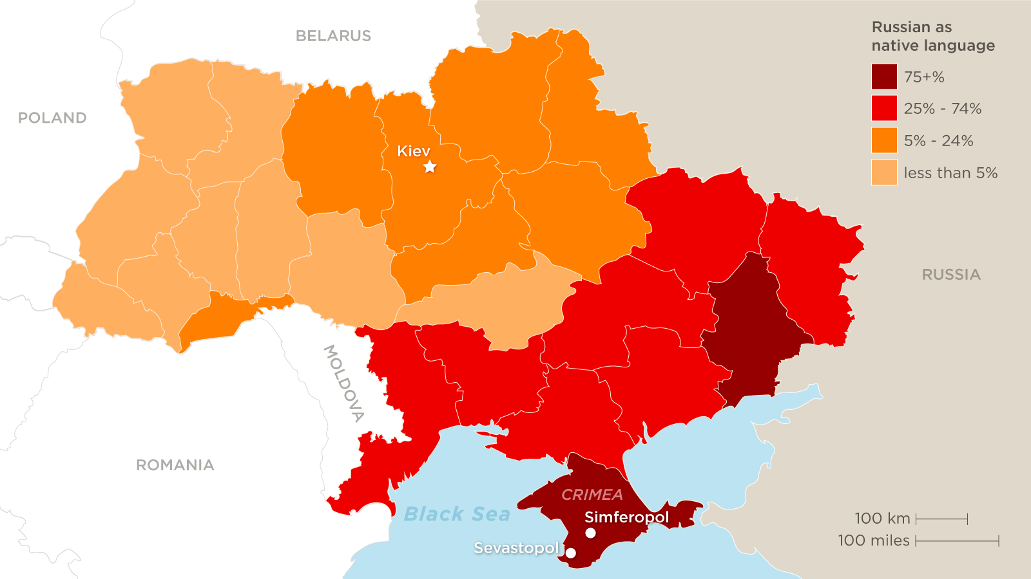
Ukraine Census 2001

Slide 14
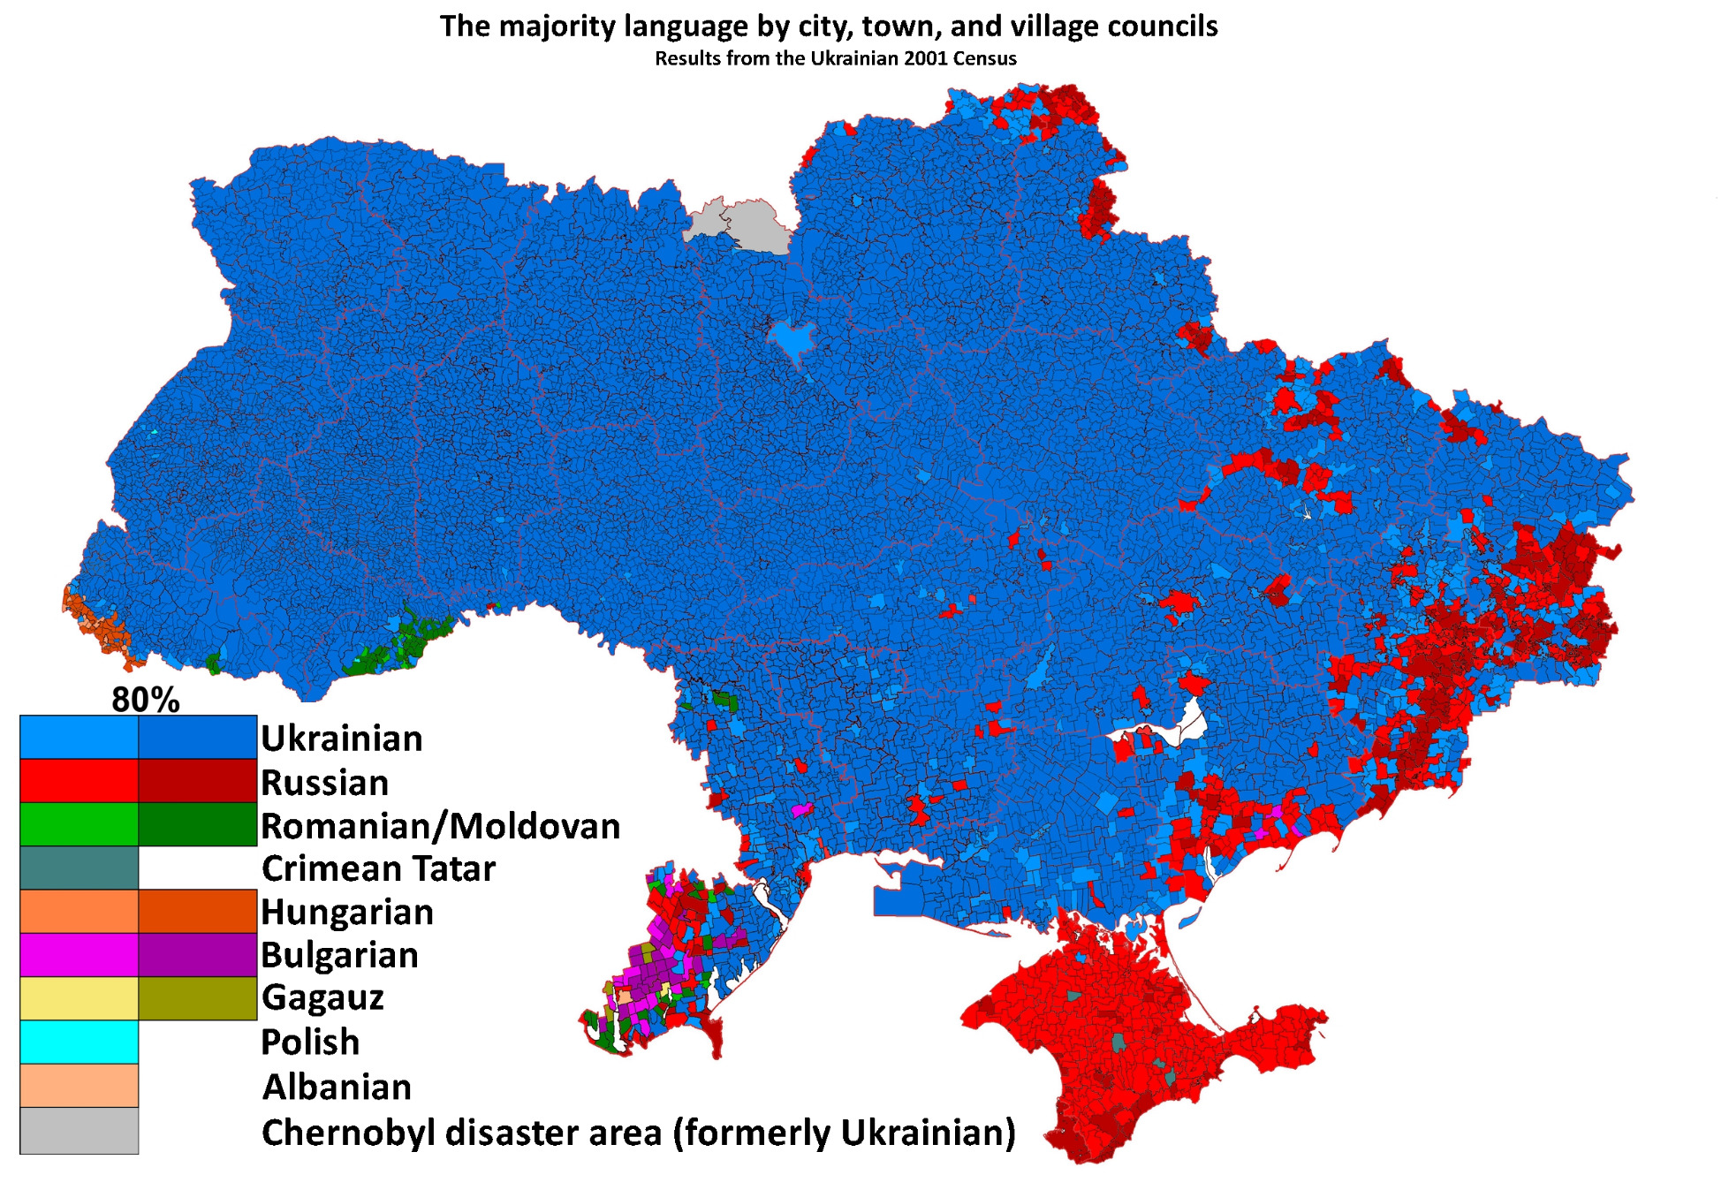

Slide 15
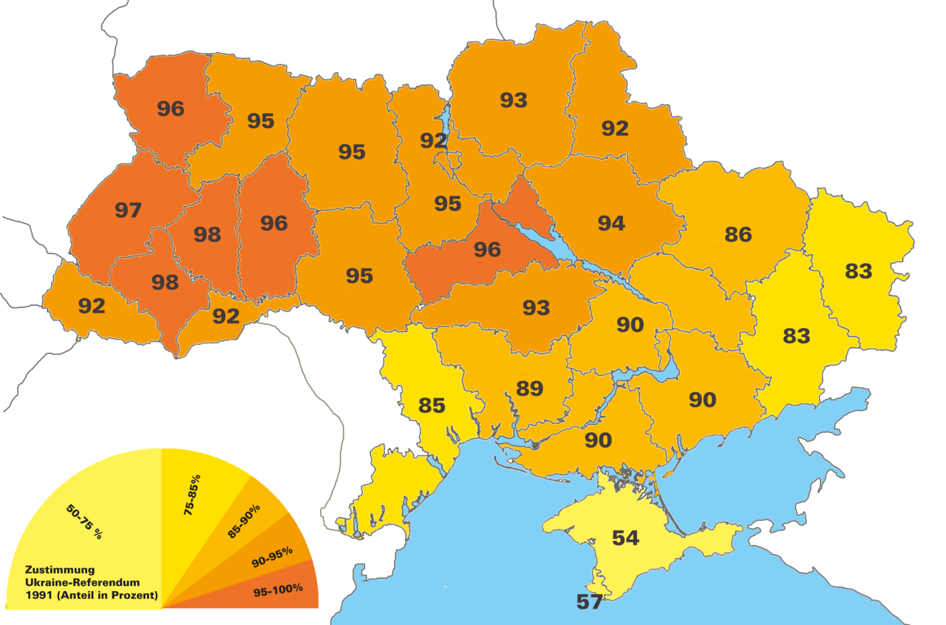
Referendum on Independence 1991

Slide 16
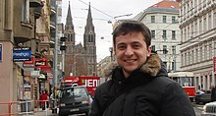
Road to War in Ukraine
Collapse of USSR 1991, Independent Ukraine (24. 8. 1991 – 90%)
10 years of economic crisis, 2004 Orange revolution
Viktor Juščenko (2005–2010, pro European, anti Russian)
Viktor Janukovyč (2010–2014)
  Cancelled summit with the EU, November 2013
  Fled to Russia, February 2014
  Euro & Anti Majdan (39% x 37%, November 2013, Kiev Institute)
  Crimea Crisis, March 2014, referendum + annexation
Russia established EAEU, May 2014 (5 postsoviet countries)
Separatist Insurgency in Doneck, Luhansk, more than ½ ml. refugees for there in Ukraine (UN)
Minsk Agreement, February 2015
Petro Porošenko (2014–2019, pro European)
  Protection of Ukrainian language
Volodymyr Zelenkyj (photo: Prague 2009)

Slide 17
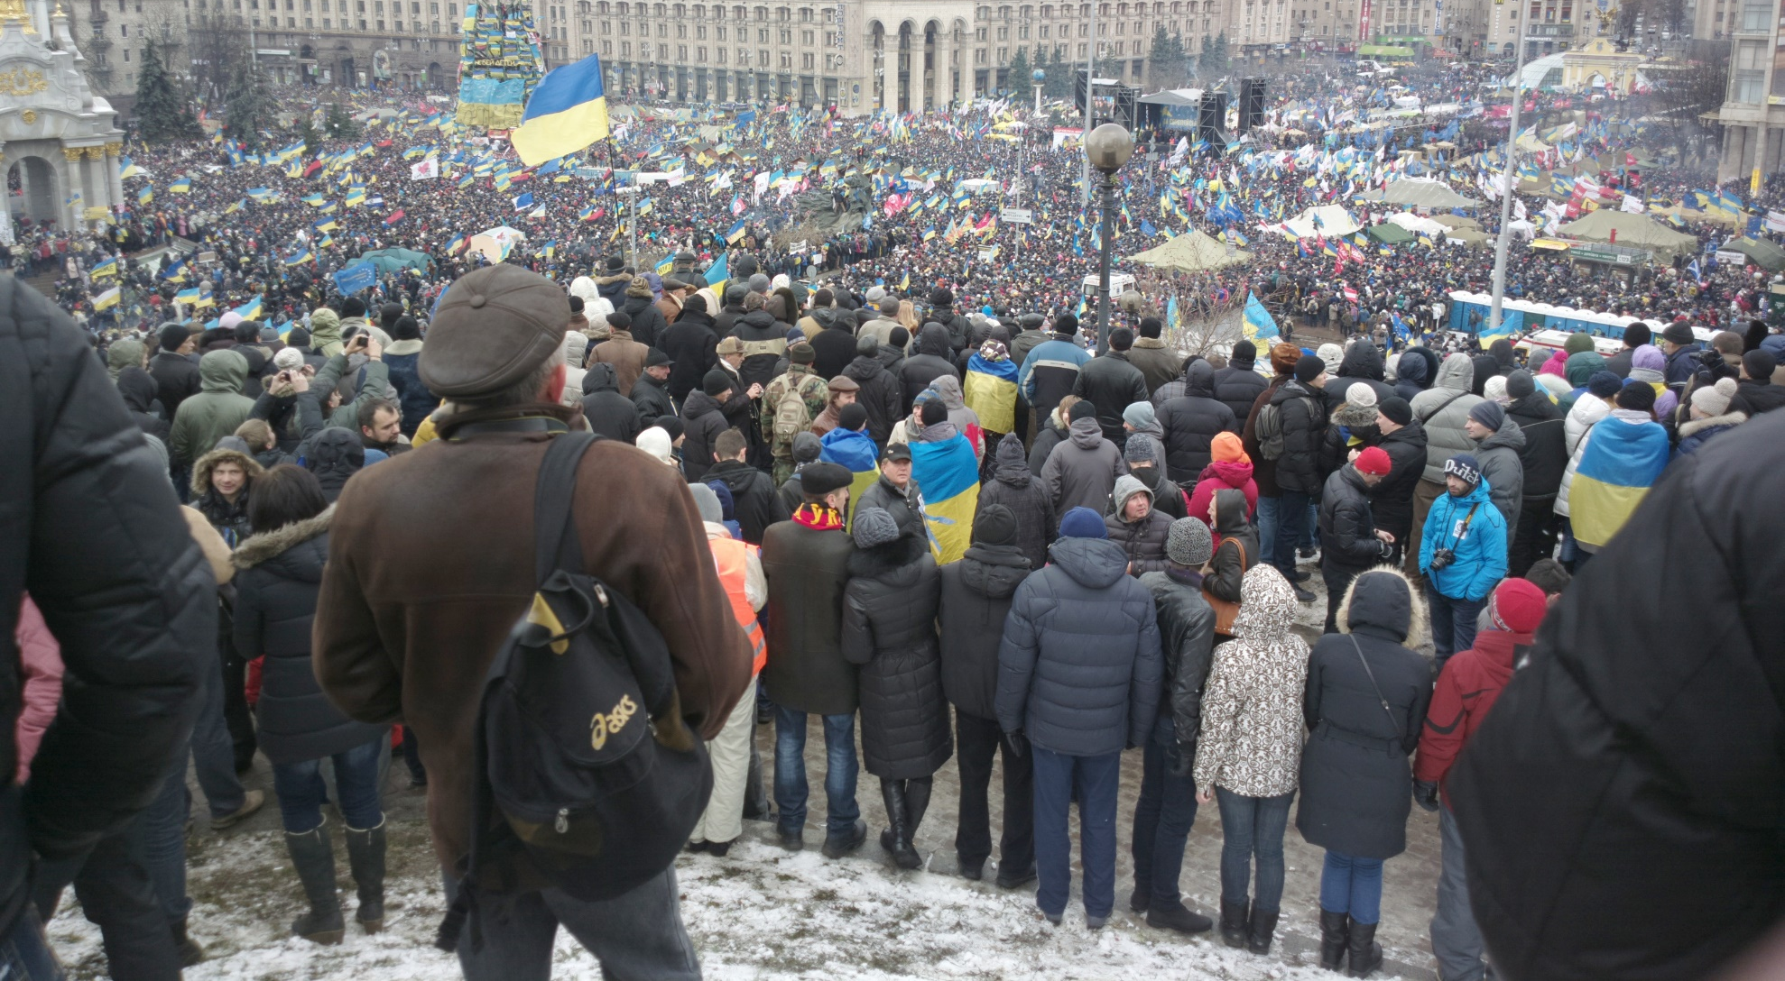
Euromajdan, December the 8th 2013

Slide 18
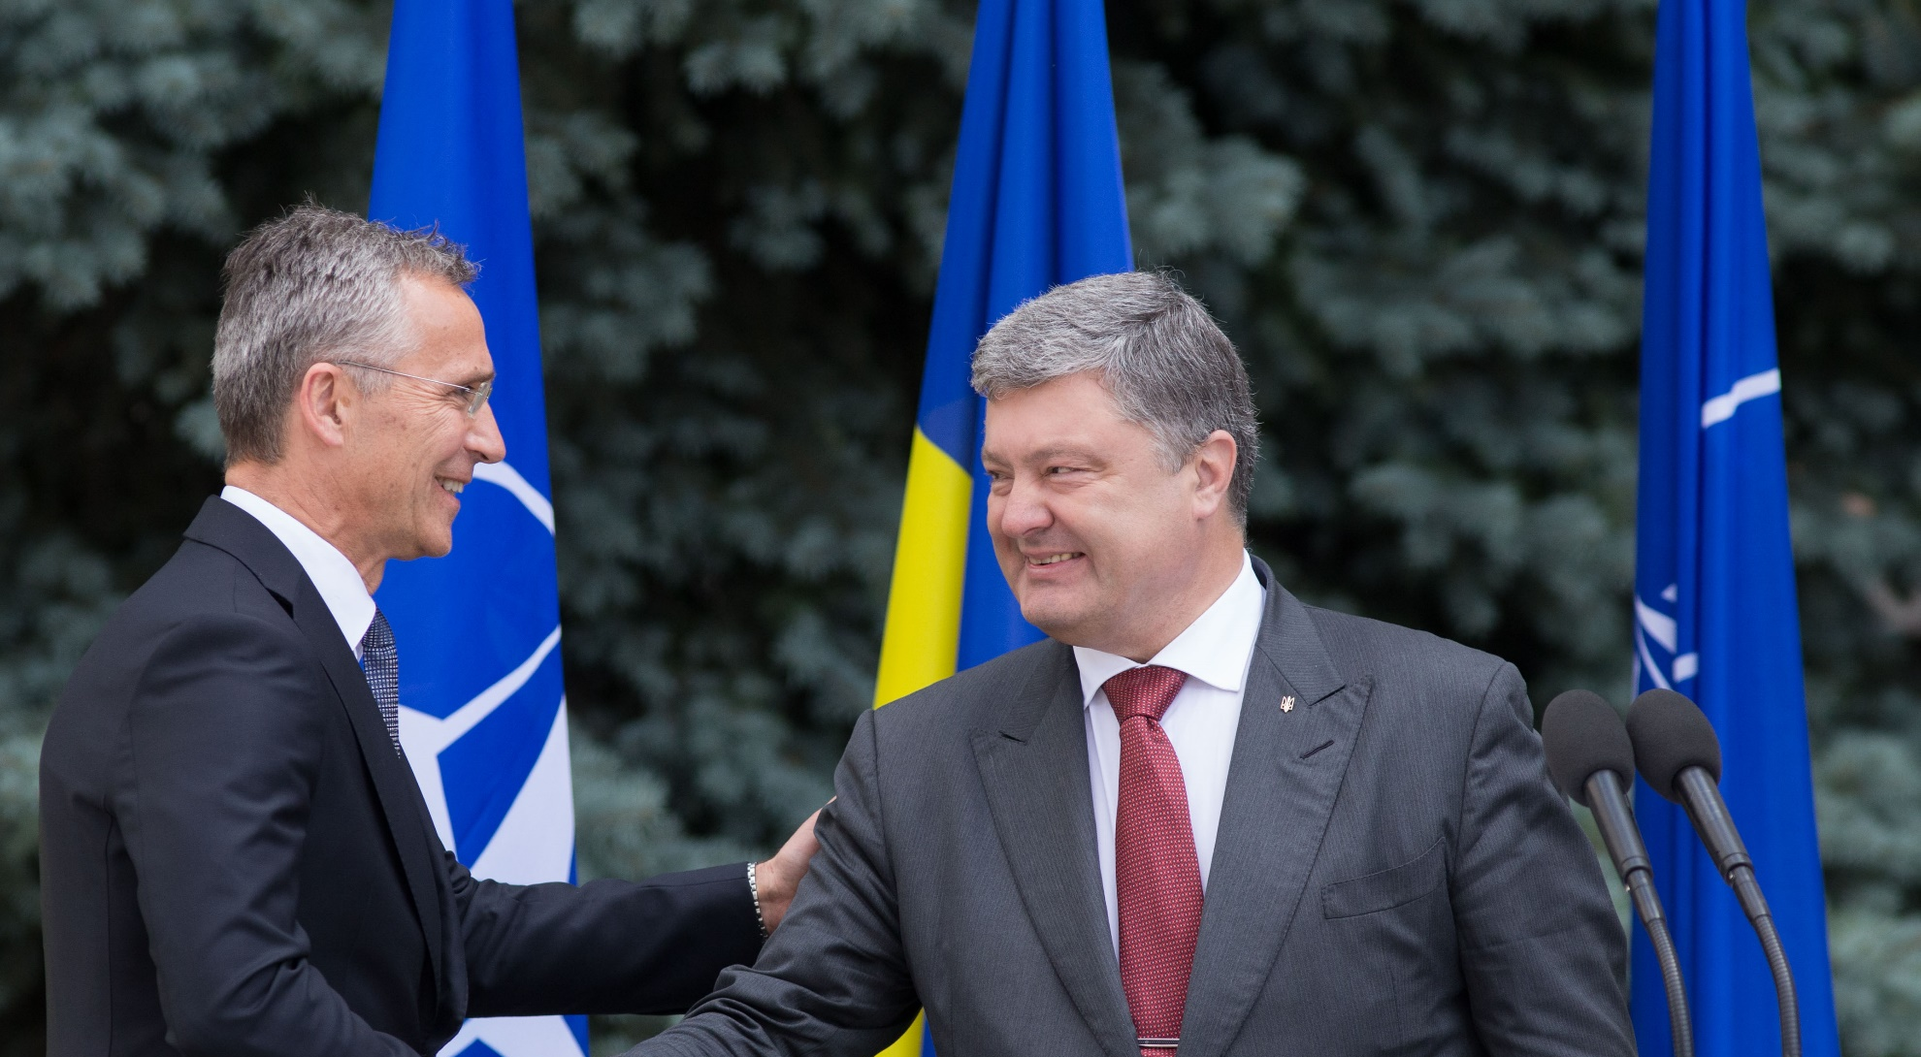
Jens Stoltenberg meets Petro Porošensko

Slide 19
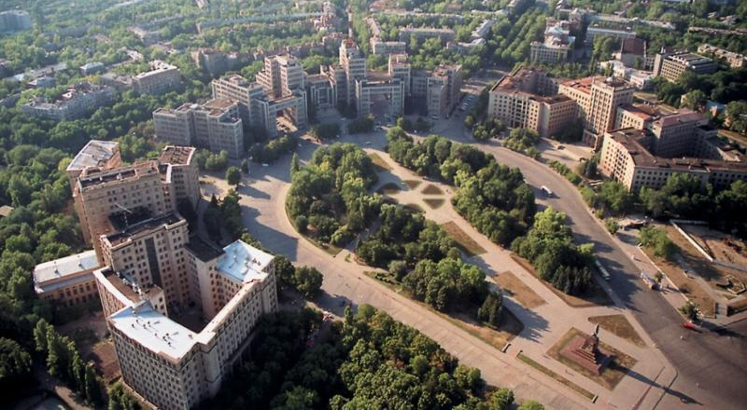
Plošča Svobody, CHARKOV

Slide 20
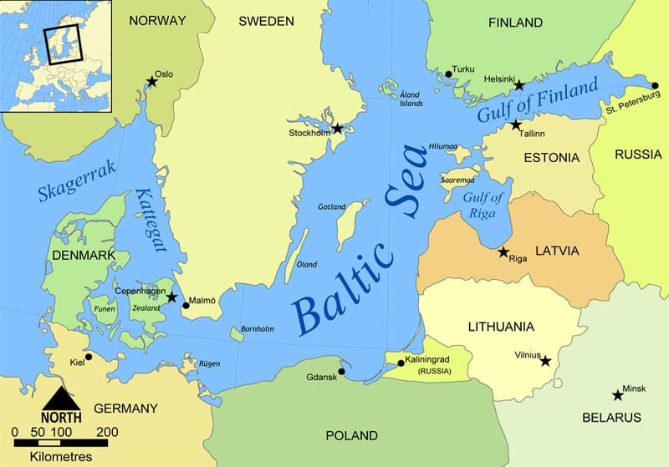

Slide 21
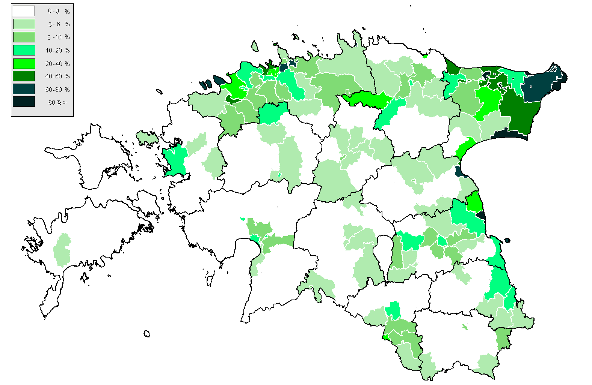
Estonia: 25 per cent Russian

Slide 22
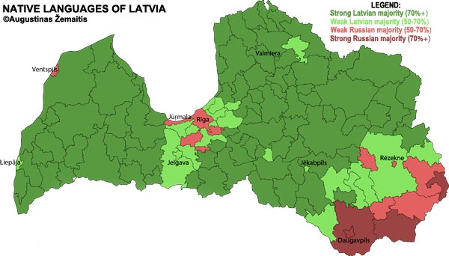
Latvia: 25 per cent Russian

Slide 23
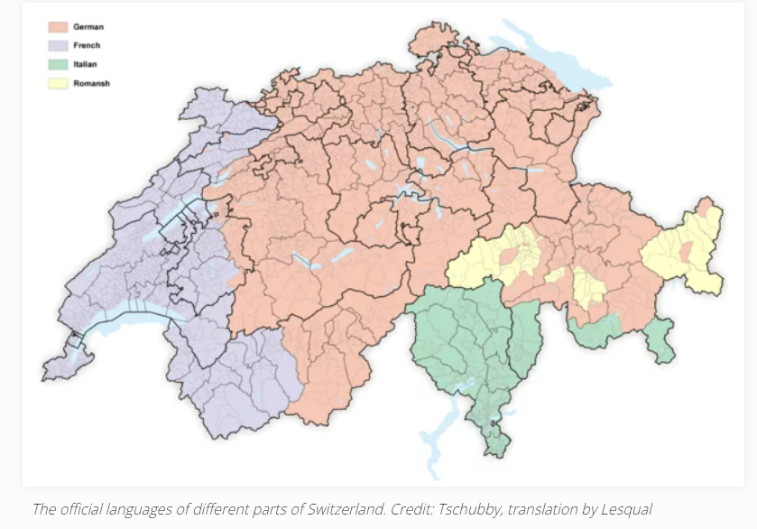

Slide 24
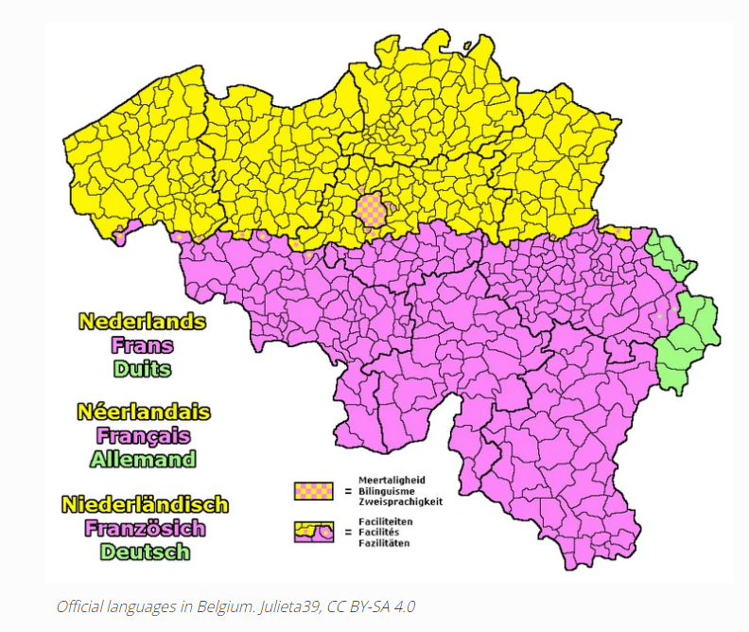

Slide 25
