Slide 1
European identity (DELAnty)
Historical perspective
Europeanness as (Western) Christendom
Constitutive Others/Outside - Role of Islam & Orthodoxy
Significance of Crusades/Crusaders, Constantinople Seized (1453)
1492 (New World) – colonization & the end of Reconquista
Double schism (Roman x Orthodoxy; Catholics x Protestants)
Religious war, Victory of Protestantism,
Peace of Westphalia (1648)
European identity as set of values (cultures)

Slide 2
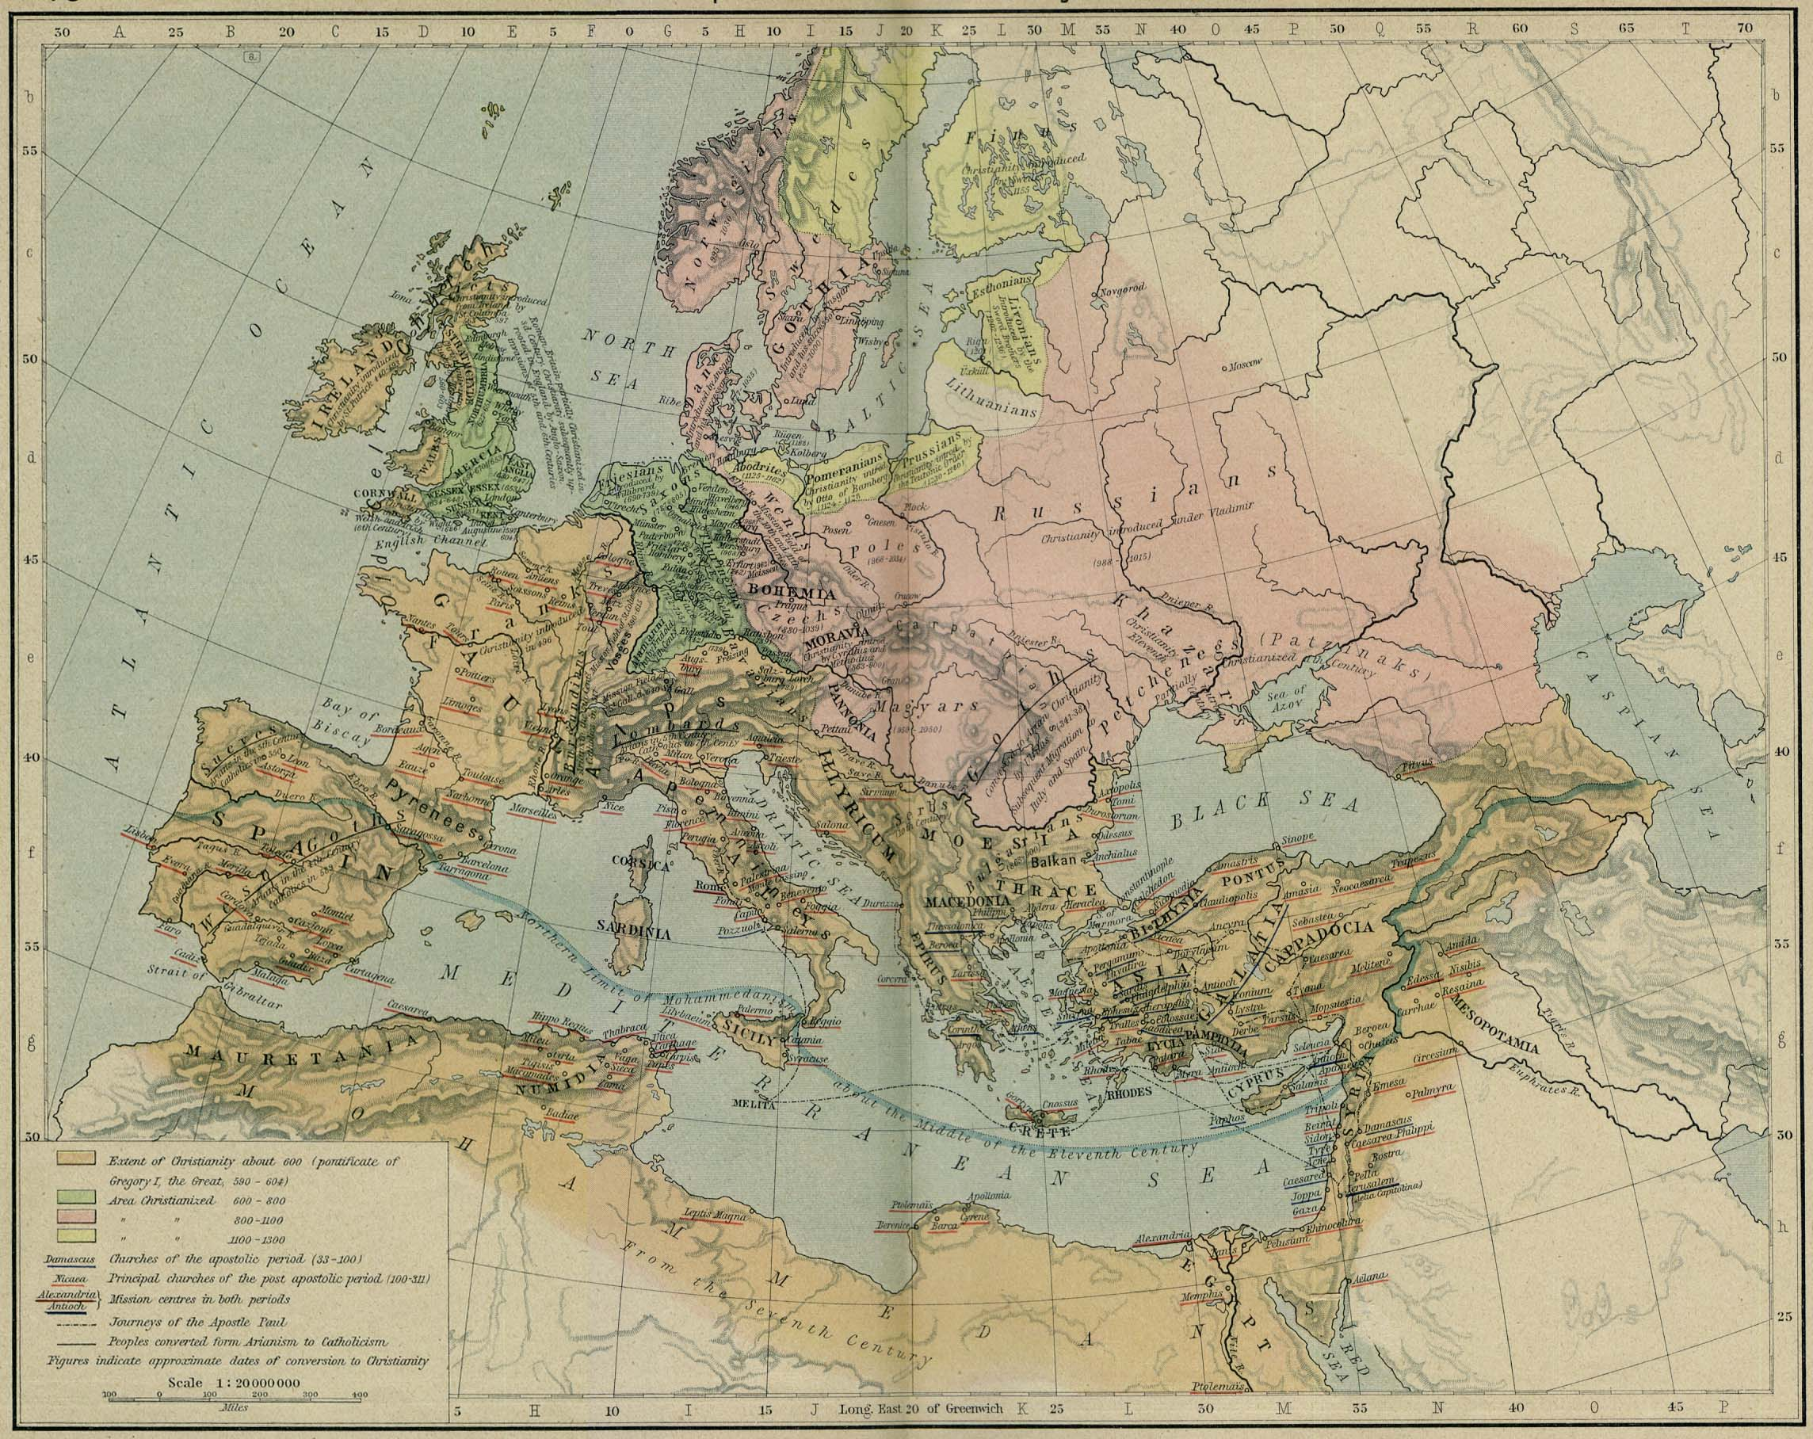
Christianization waves

Slide 3
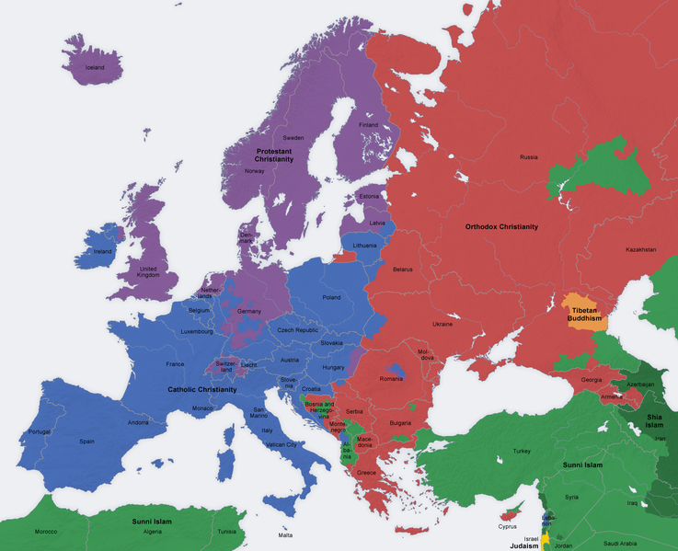
Religions in europe

Slide 4
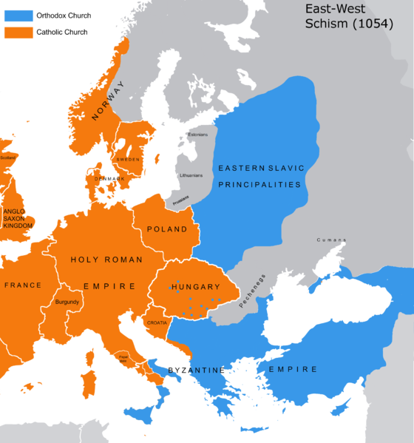

Slide 5
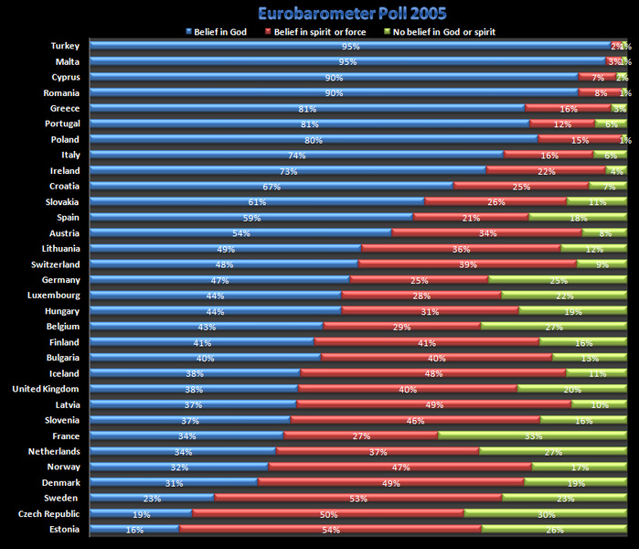

Slide 6
