Slide 1
The Belt and Road Initiative
Natálie Škrabánková
Asia in IR
March 2022

Slide 2
What is BRI?
A global infrastructure development strategy adopted by Chinese government in 2013
Goal is to invest in nearly 70 countries and international organizations
A centerpiece of the Chinese President Xi Jinping`s foreign policy
A central component of Xi`s Major Country Diplomacy = strategy, which calls for China to assume a greater leadership role for global affairs in accordance with its rising power and status
Some estimates list BRI as one of the largest infrastructure and investment projects in history (70 countries, 65% of world`s population and 40% of global GDP) – data from 2017
BRI refers to historic `Silk Road` trade route (used in antiquity)

Slide 3
Belt & Road
At first BRI was announced as `Silk Road Economic Belt `
Belt is referring to the proposed overland routes for road and rail transportation through landlocked Central Asia
Road is short for the `21st Century Maritime Silk Road` = referring to the Indo-Pacific sea routes through Southeast Asia to South Asia, Middle East and Africa
Examples of the invesments are airports, bridges, ports, skyscrapers, railroads, roads, ..
Should be done by the year 2049 = centenary of the founding of China

Slide 4
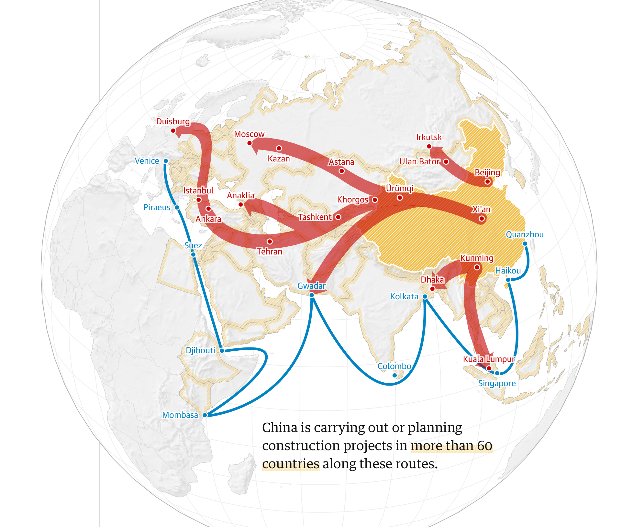
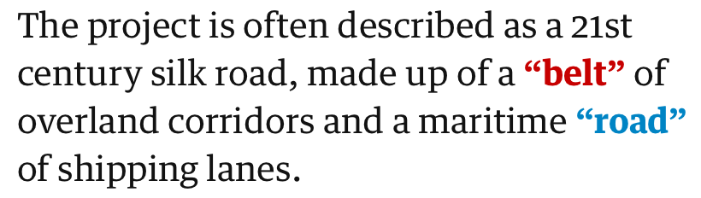

Slide 5
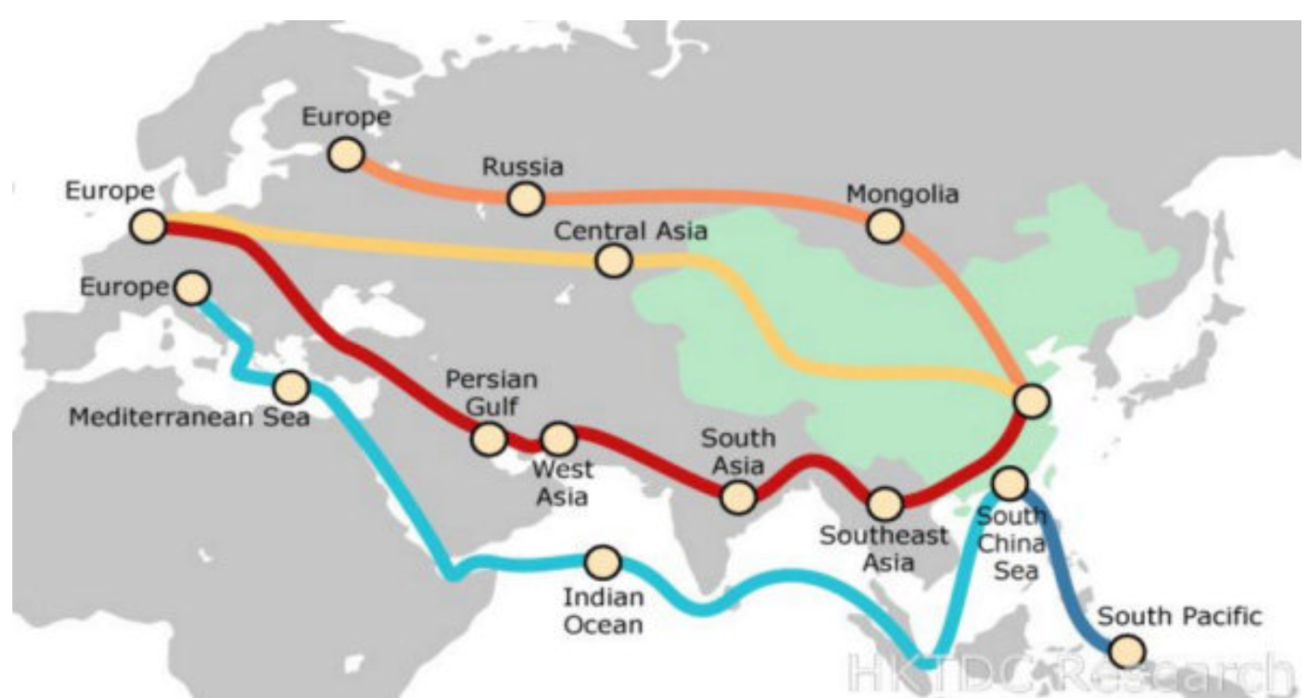
Silk Road Economic Belt
1. The North belt would go through Central Asia and Russia to Europe
2. The Central belt passes through Central Asia and West Asia to the Persian Gulf and the Mediterranean
3. The South belt runs from China through Southeast Asia and South Asia and on to the Indian Ocean through Pakistan

Slide 6
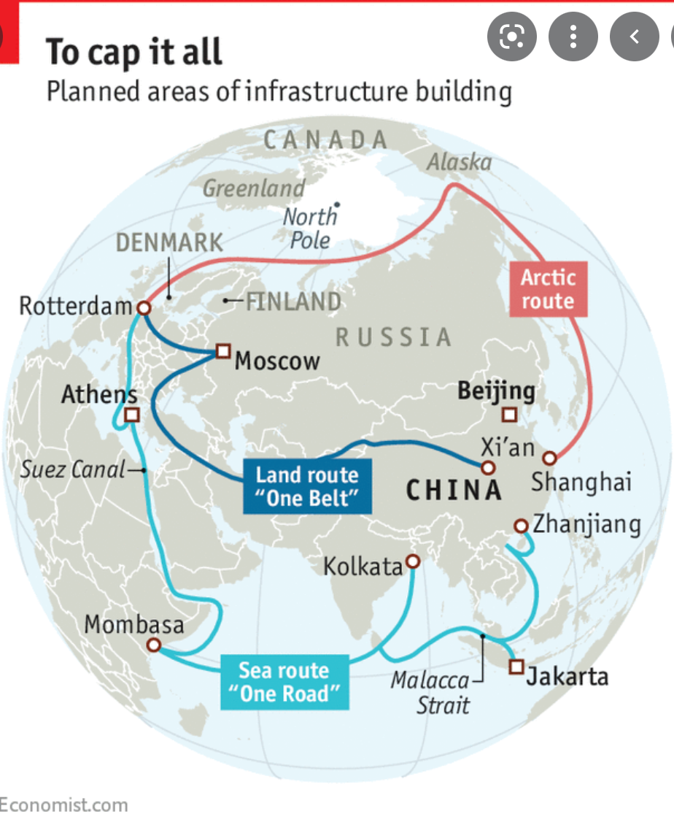
Ice Silk Road
China & Russia project along the Northern Sea Route in the Artic

Slide 7
Objectives of the BRI for China
Development of the infrastructures of Asian countries
Strenghtening dipomatic relations whilst reducing dependency on US
Creating new markets for Chinese products
Integrating commodities-rich countries more closely into the Chinese economy

Slide 8
Risks of the BRI
Involved countries are at risk of not being able to repay their loans
The affected nations – Djibouti, Kyrgyzstan, Laos, the Maldives, Mongolia, Montenegro, Pakistan and Tajikistan – are among the poorest in their regions and will owe more than half of all their foreign debt to China
Critics worry China could use “debt-trap diplomacy” to extract strategic concessions – such as over territorial disputes in the South China Sea or silence on human rights violations
Concerns are also about a form of economic imperialism that gives China too much leverage over other countries, often those that are smaller and poorer
Chinese commercial presence = leading to expanded military presence
Others worry China will export its political model

Slide 9
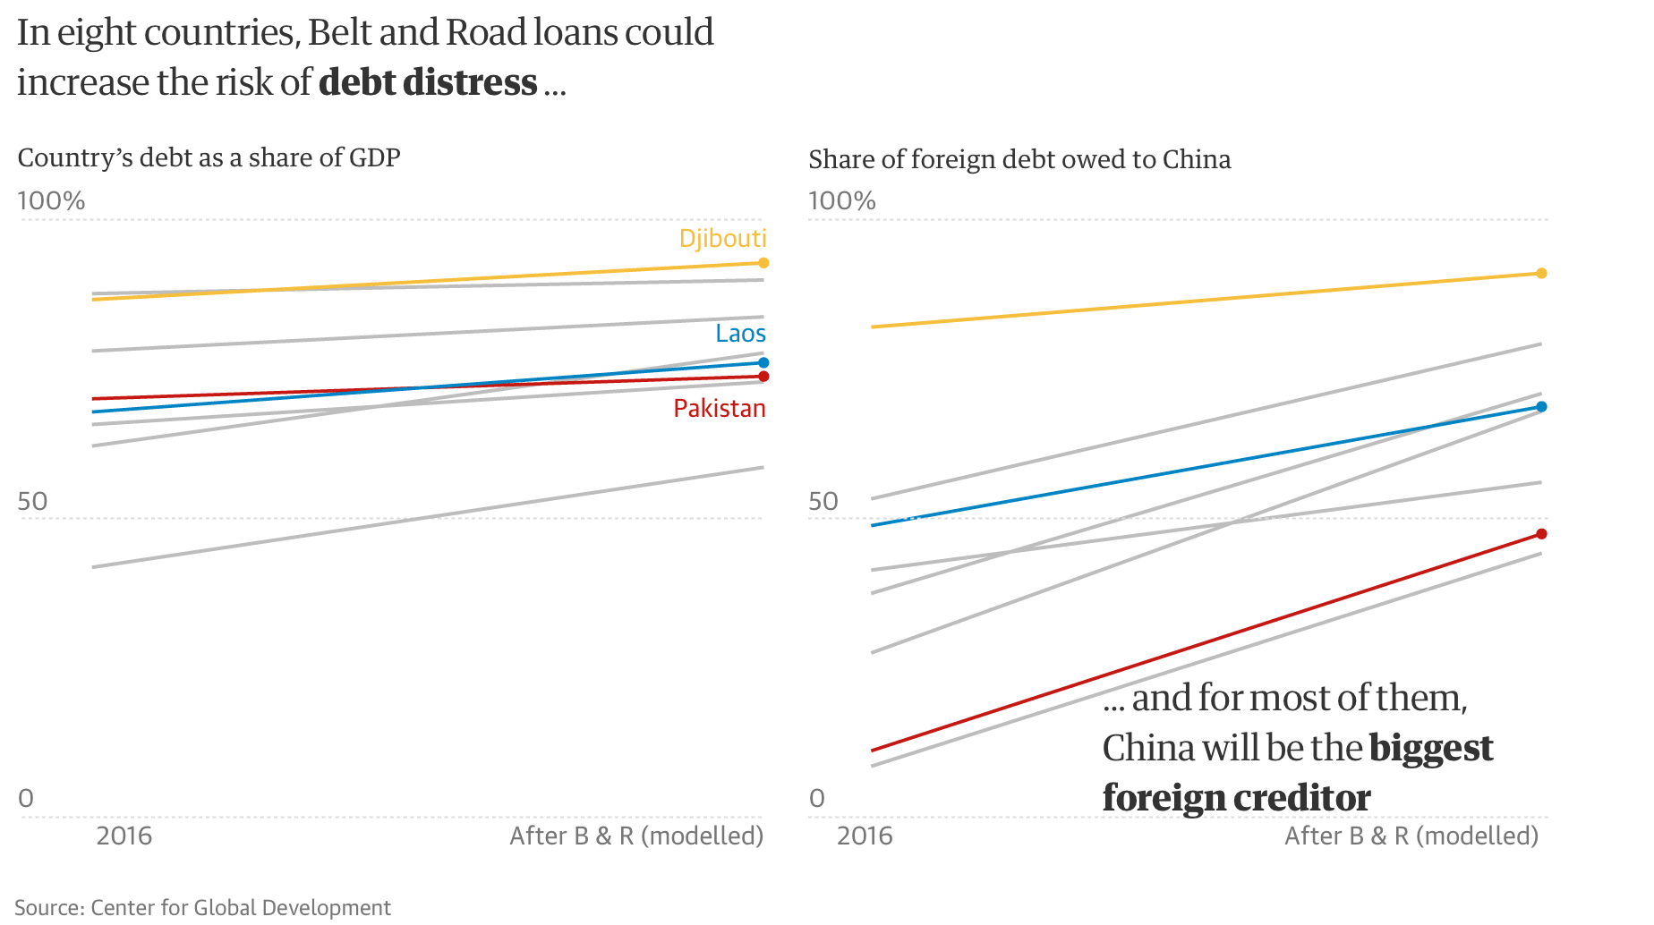

Slide 10
What about ecology?
BRI represents risks and also opportunities for sustainable development
Prioritizing economic development over environmental protections
Risks: overuse of natural resources, emission of pollutants, disruption of ecosystems, water pollution as a result of poorly planned infrastructure projects
The development of port infrastructure could impact sensitive species and marine habitats like coral reefs
Up to 85% of BRI projects can be linked to high levels of greenhouse gas emissions

Slide 11
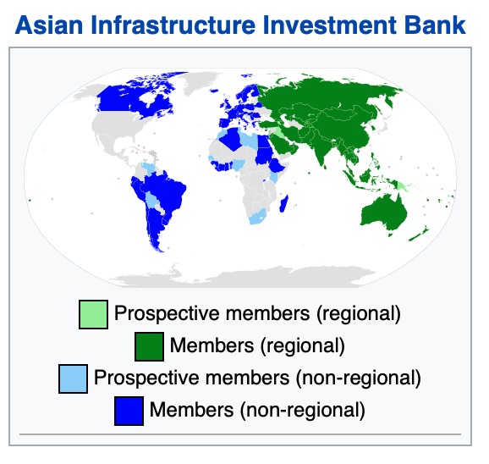
Financing
1. Asian Infrastructure Investment Bank
Goals: enhance regional integration, promote economic development, improve public access to social services
2. Silk Road Fund
3. China Development Bank
4. Bank of China
Others

Slide 12
Infrastructure networks:
Land corridors
1. The New Eurasian Land Bridge, which runs from Western China to Western Russia through Kazakhstan, and includes the Silk Road Railway through China's Xinjiang Autonomous Region, Kazakhstan, Russia, Belarus, Poland and Germany
2. Corridor that will run from Northern China through Mongolia to the Russian Far East. 2012 - Russia-China Investment Fund = bilateral integration
3. The China–Central Asia–West Asia Corridor, which will run from Western China to Turkey
4. The China-Indochina Peninsula economic corridor, which will run from Southern China to Singapore
5. The Trans-Himalayan Multi-dimensional Connectivity Network (Nepal)
6. The China–Pakistan Economic Corridor

Slide 13
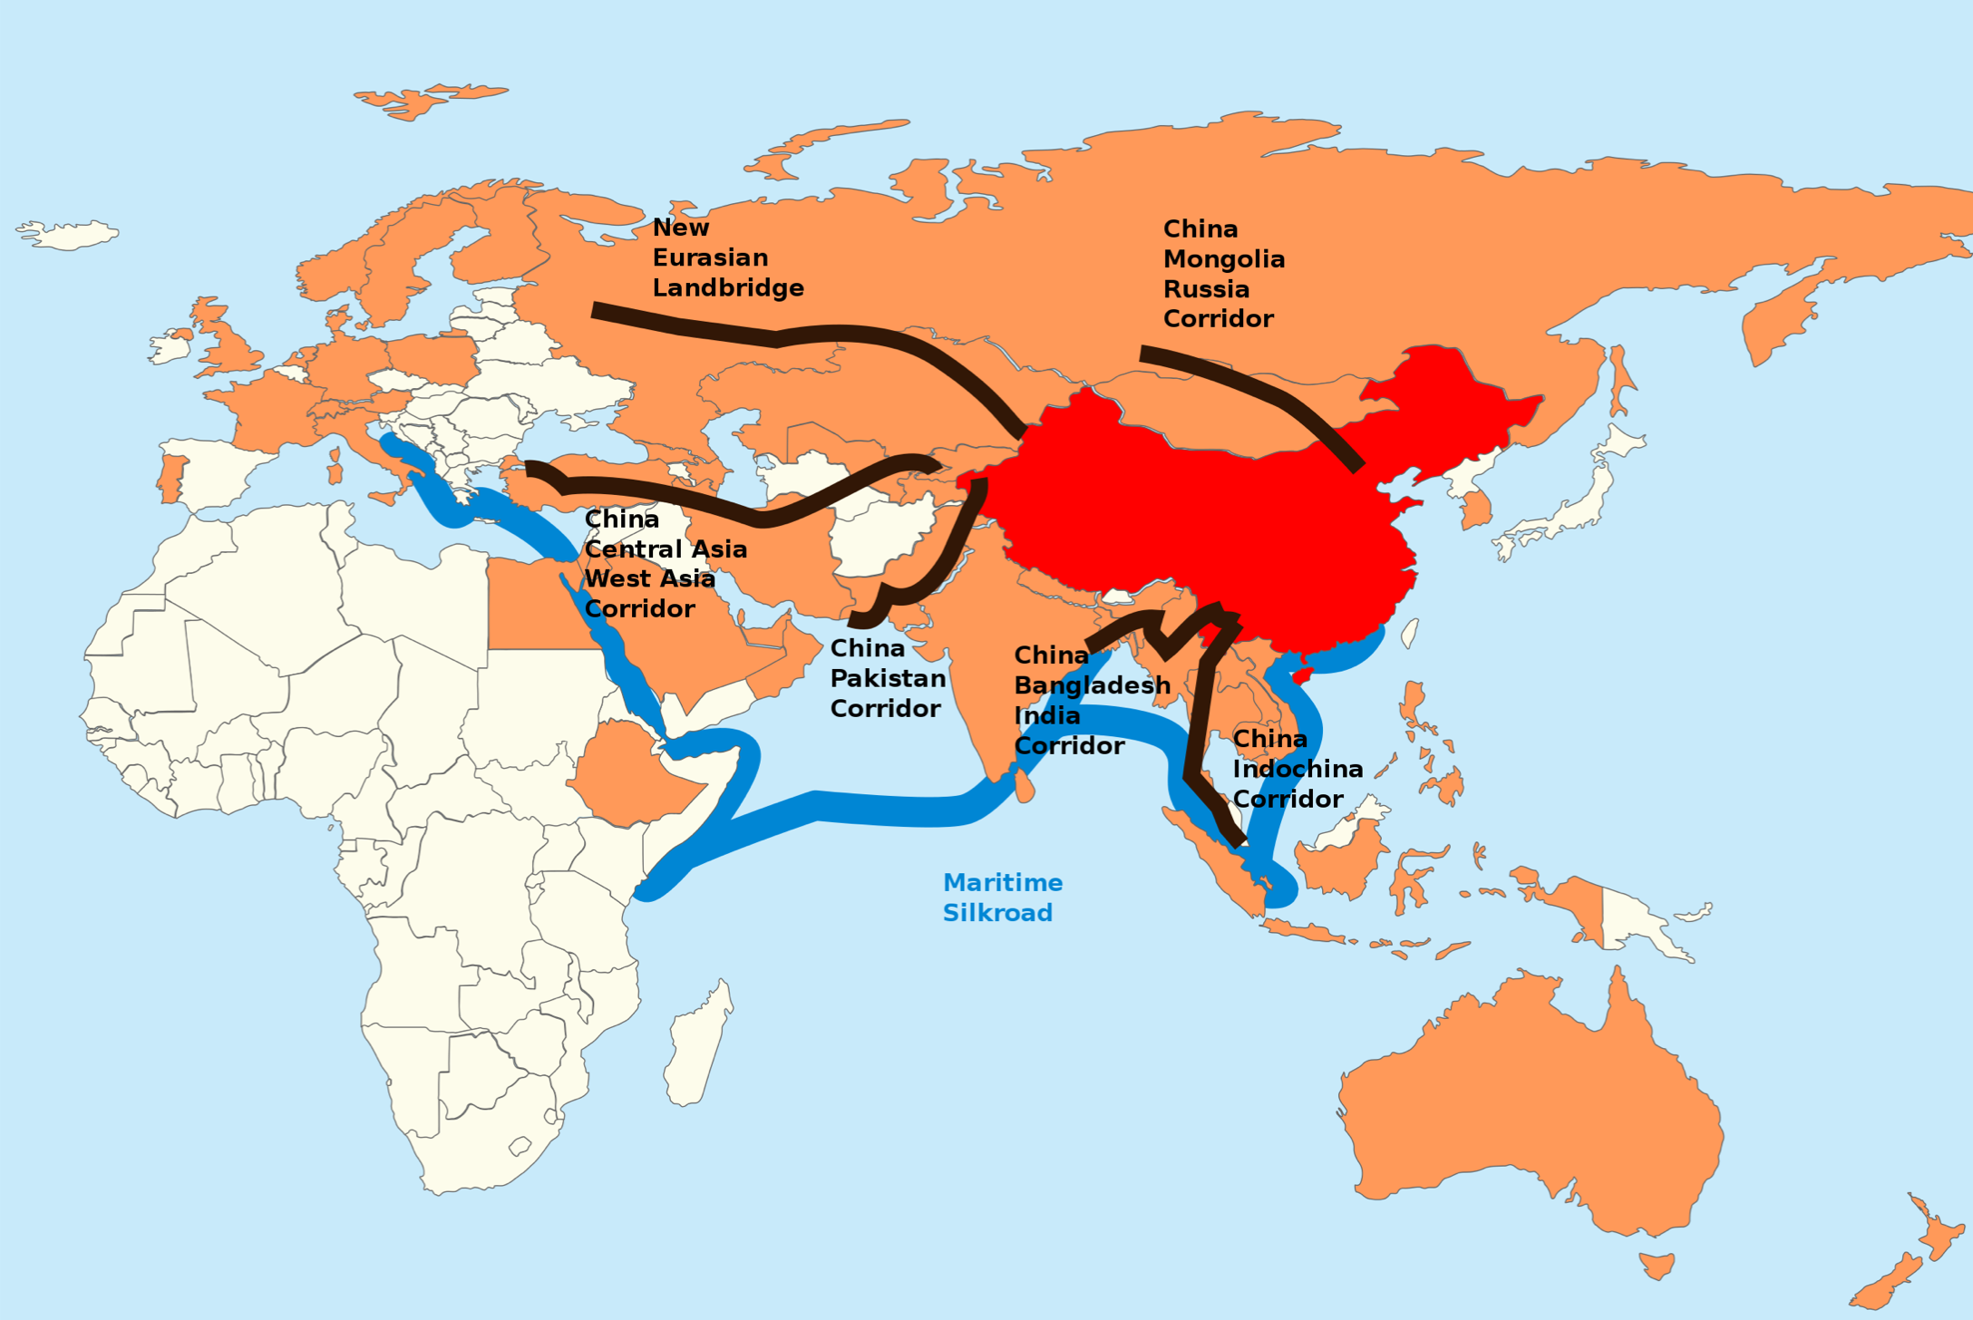

Slide 14
India, Japan & BRI
India - ,,The BRI is a plan to dominate Asia, warning of what some analysts have called a “String of Pearls” geoeconomic strategy whereby China creates unsustainable debt burdens for its Indian Ocean neighbors in order to seize control of regional choke points.``
India is unsetted by China`s decades-long embrace of its traditional rival – Pakistan
India is also spending money on infrastructure plans in Afghanistan
Japan is interested in regional infrastructure develompemt, but also worry about Chinese influence

Slide 15
Europe, Russia & BRI
Italy, Luxembourg, Portugal = signed provisional agreements to cooperate on BRI projects
During 2018 trip to China, Emmanuel Macron said the BRI could make partner countries “vassal states”
Experts claims China is using BRI funds to gain influence in Balkan countries that are on track to become EU members, thereby providing Chinese access to EU market
Russia has become one of the BRI’s most enthusiastic partners

Slide 16
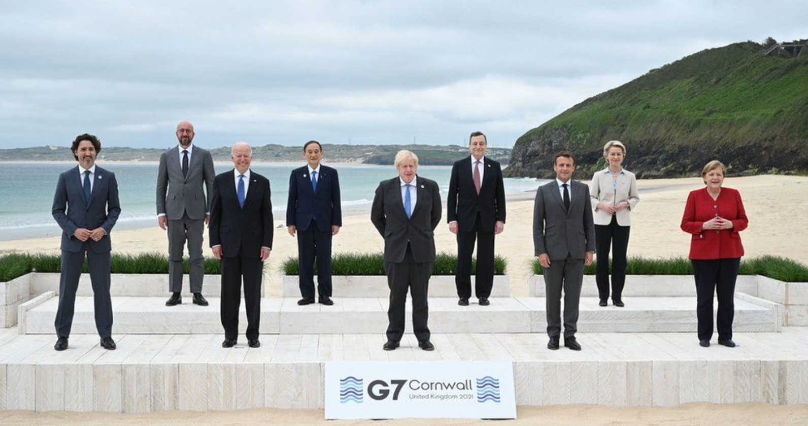
G7 offering an alternative vision
G7 summit in Cornwall 2021 – B3W = Build Back Better World
Infrastructure develompment of low and middle income countries
The initiative aims to catalyze funding for quality infrastructure from the private sector and will encourage private-sector investments that support "climate, health and health security, digital technology, and gender equality“
February 2022 – China is willing to join B3W initiation

Slide 17
Sources
https://www.theguardian.com/cities/ng-interactive/2018/jul/30/what-china-belt-road-initiative-silk-road-explainer
https://www.researchgate.net/figure/The-Belt-and-Road-Initiative-overland-and-maritime-routes_fig1_351955076
https://www.researchgate.net/figure/The-Map-of-the-Belt-and-Silk-Road-and-21-st-Century-Maritime-Silk-Road_fig1_327119928
https://www.economist.com/china/2018/04/14/china-wants-to-be-a-polar-power
https://www.beltroad-initiative.com/belt-and-road/
https://www.jstor.org/stable/26760128?searchText=the+belt+and+road+initiative&searchUri=%2Faction%2FdoBasicSearch%3FQuery%3Dthe%2Bbelt%2Band%2Broad%2Binitiative%26so%3Drel%26efqs%3DeyJjdHkiOlsiYW05MWNtNWhiQT09Il0sImRpc2MiOltdfQ%253D%253D&ab_segments=0%2Fbasic_search_gsv2%2Fcontrol&refreqid=fastly-default%3A7af929e6e32f65756839efd36665741f&seq=1
https://www.jstor.org/stable/26591865?searchText=the%20belt%20and%20road%20initiative&searchUri=%2Faction%2FdoBasicSearch%3FQuery%3Dthe%2Bbelt%2Band%2Broad%2Binitiative%26so%3Drel%26efqs%3DeyJjdHkiOlsiYW05MWNtNWhiQT09Il0sImRpc2MiOltdfQ%253D%253D&ab_segments=0%2Fbasic_search_gsv2%2Fcontrol&refreqid=fastly-default%3A7af929e6e32f65756839efd36665741f
https://www.jstor.org/stable/26642285?searchText=the%20belt%20and%20road%20initiative&searchUri=%2Faction%2FdoBasicSearch%3FQuery%3Dthe%2Bbelt%2Band%2Broad%2Binitiative%26so%3Drel%26efqs%3DeyJjdHkiOlsiYW05MWNtNWhiQT09Il0sImRpc2MiOltdfQ%253D%253D%26groupefq%3DWyJyZXZpZXciLCJyZXNlYXJjaF9yZXBvcnQiLCJjb250cmlidXRlZF90ZXh0Iiwic2VhcmNoX2NoYXB0ZXIiLCJtcF9yZXNlYXJjaF9yZXBvcnRfcGFydCIsImNvbnRyaWJ1dGVkX2NvbnRhaW5lciIsInNlYXJjaF9hcnRpY2xlIl0%253D%26pagemark%3DeyJwYWdlIjoyLCJzdGFydHMiOnsiSlNUT1JCYXNpYyI6MjV9fQ%253D%253D&ab_segments=0%2Fbasic_search_gsv2%2Fcontrol&refreqid=fastly-default%3Ab7e6fcf11d8637c24b37cb368f37f974
https://www.youtube.com/watch?v=j8zzL2aBo2M
https://www.oecd.org/finance/Chinas-Belt-and-Road-Initiative-in-the-global-trade-investment-and-finance-landscape.pdf
https://www.cfr.org/backgrounder/chinas-massive-belt-and-road-initiative
https://www.bbc.com/news/world-us-canada-57452158

