Slide 1
Collective identity (Shils)
Collective (national) X Individual (civil) Identity
What is NATION/VOLK, the people?
Nationalism, National Interests, National Enemies (?)
Variety of meanings, multicultural competence
Primordial, Sacred, Civil – Types of Collective Identity
Border Perspective: Im/Permeability
Various Integrational/Absorption Capacity
Case of Immigrants Quota (?)

Slide 2
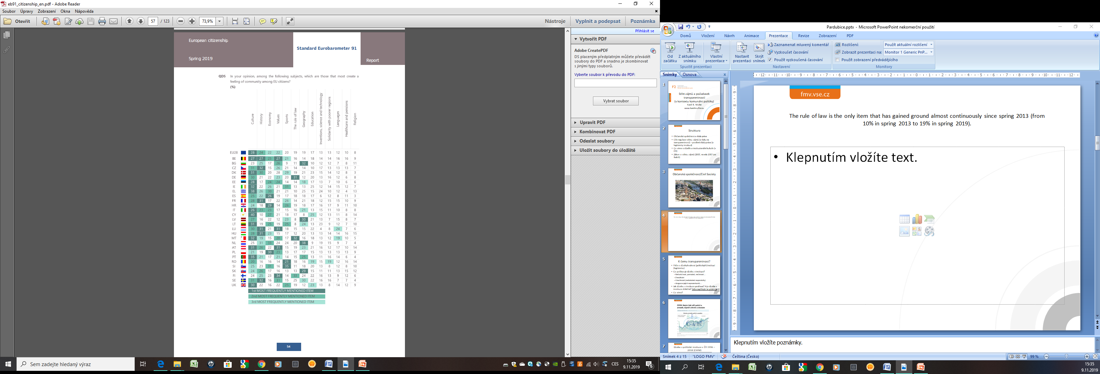
Source: EB, Spring 2019

